Slide 1

RESUME CLASSIFICATION
Team members:
1.) Priya Sanjay Jadhav
2.) S. Ayesha
3.) Mr. Jarajapu Siva Kumar
4.) Mr. Bhargav. M
5.) Nikhil Uttam Labde
6.) Harsha Moulika Nandyala

Slide 2
BUSSINESS OBJECTIVE
1.Reduce manual human effort in resume screening by 80%.
2. Achieve accuracy of 95% or higher in resume classification.
3. Automate resume categorization into relevant job categories.

Slide 3
PROJECT ARCHITECTURE
Collection of Data
Business Understanding
Exploratory Data Analysis(EDA)
Deployment
Model Evaluation
Model Building

Slide 4
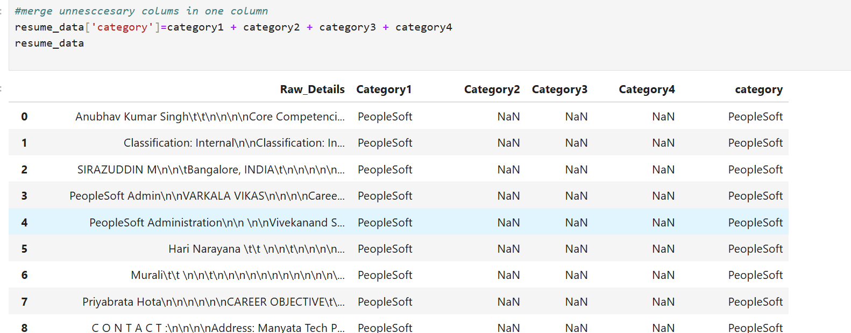
Merging all category files

Slide 5
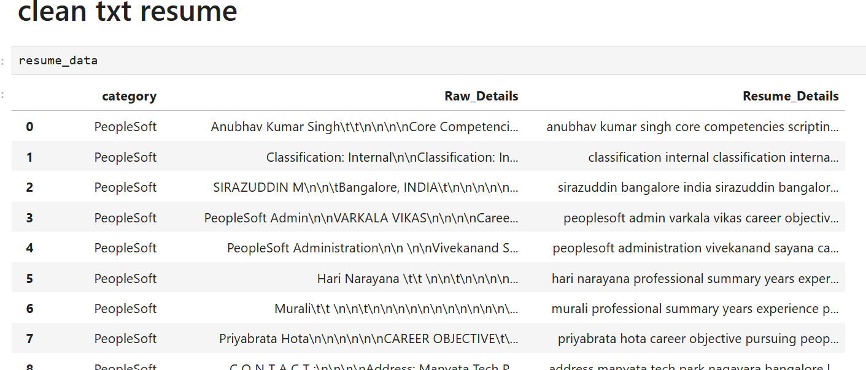
Cleaning Text Resume

Slide 6
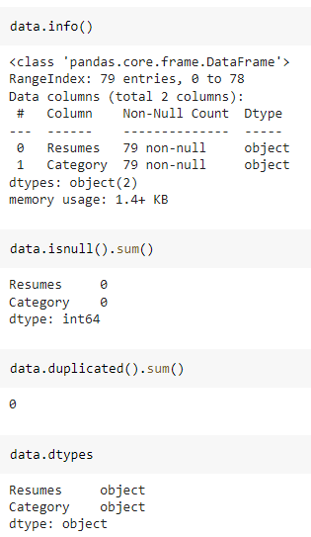
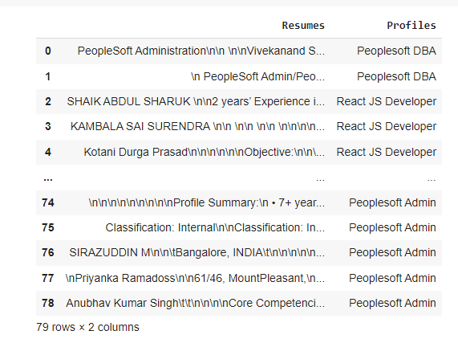
Data Set Details
After Extracting and Modifying the Dataset, given data contains a total of 4 Classes and 79 rows .

Slide 7
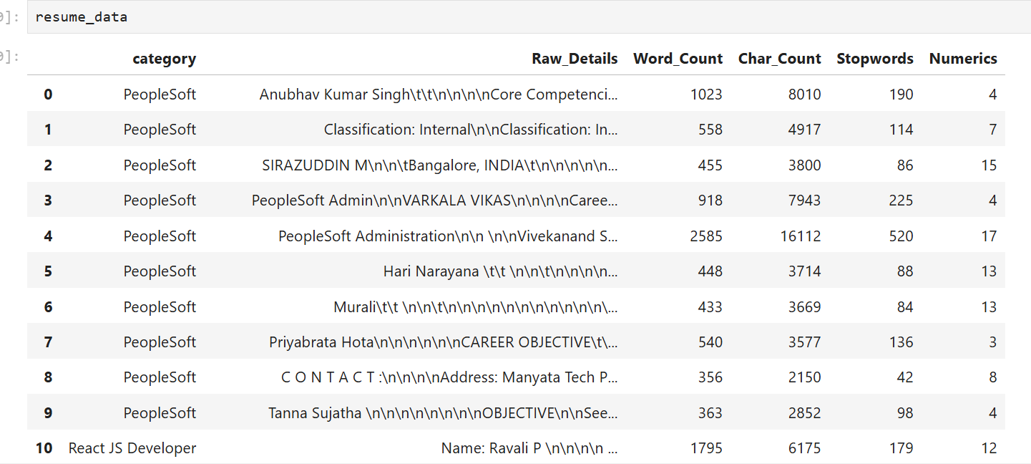
Removing All Unwanted Character’s
Word Tokenization - Tokenization is essentially splitting a phrase, sentence, paragraph, or an entire text document into smaller units, such as individual words or terms. Each of these smaller units are called tokens.
Stop-words - A stop word is a commonly used word (such as “the”, “a”, “an”, “in”) that a search engine has been programmed to ignore, both when indexing entries for searching and when retrieving them as the result of a search query.

Slide 8
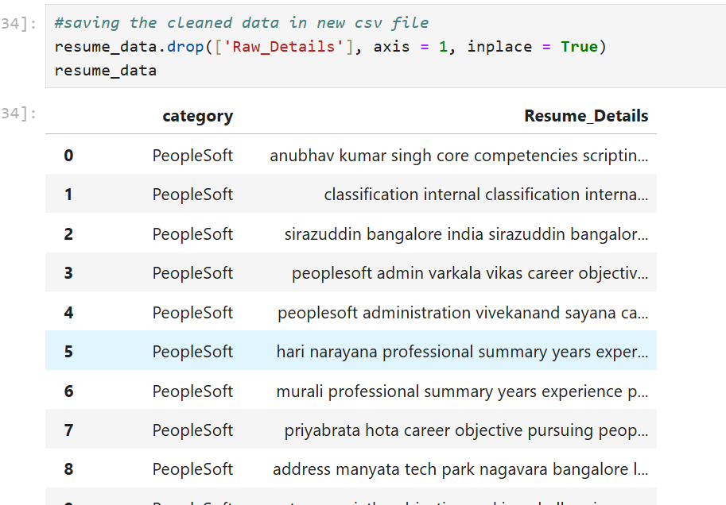
Text – Preprocessing
After Cleaned data in csv
In natural language processing, text preprocessing is the practice of cleaning and preparing text data. NLTK and re are common Python libraries used to handle many text preprocessing tasks.
The Dataset contains 79 rows and 3 Column
There are total four Classes – Peoplesoft, Workday, React JS Developer and SQL Developer.

Slide 9
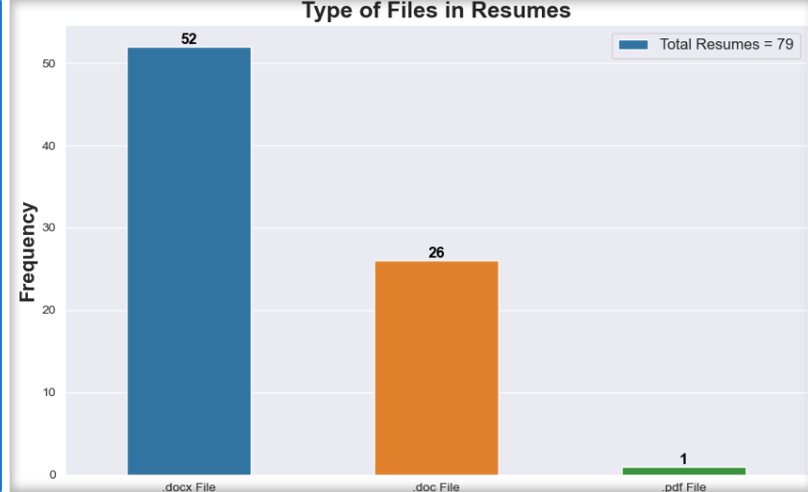
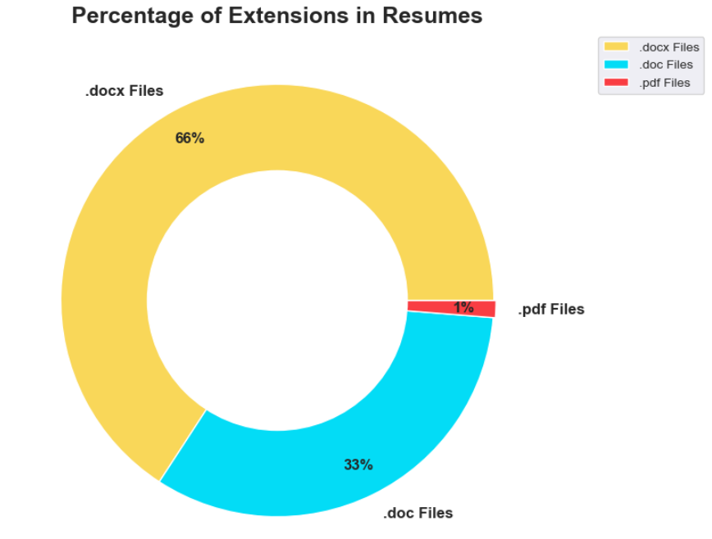
Labels

Slide 10
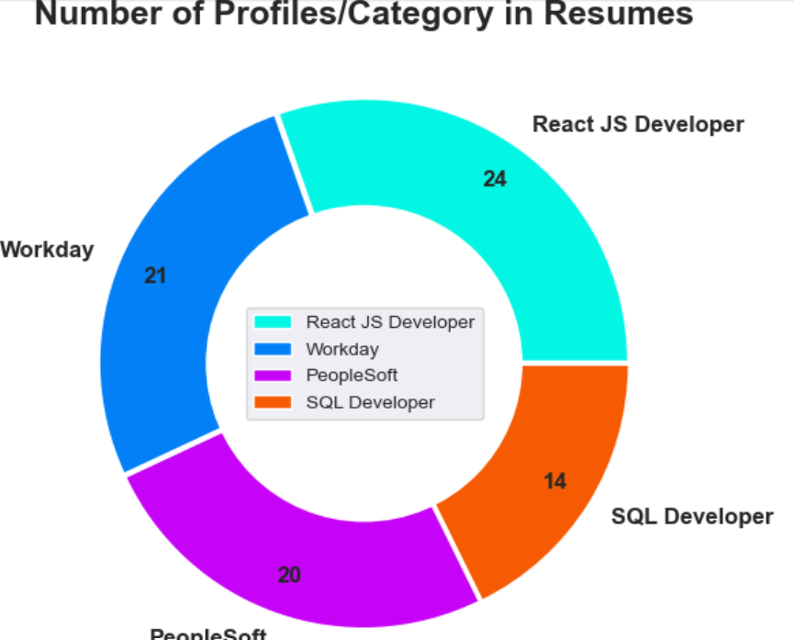
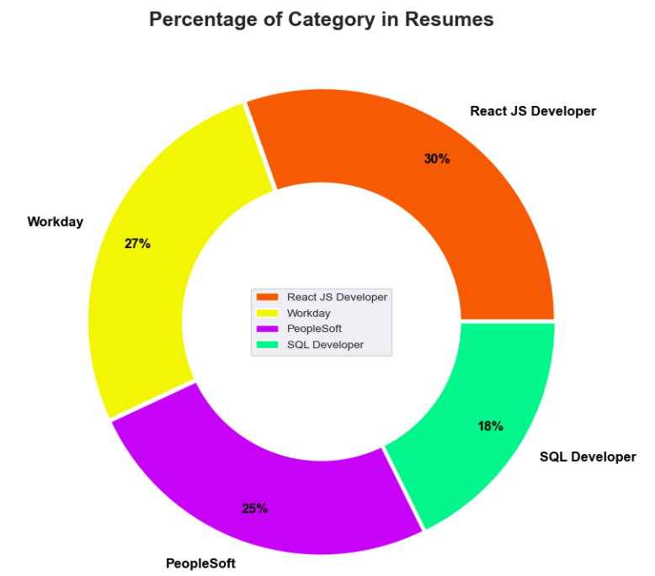
Labels

Slide 11
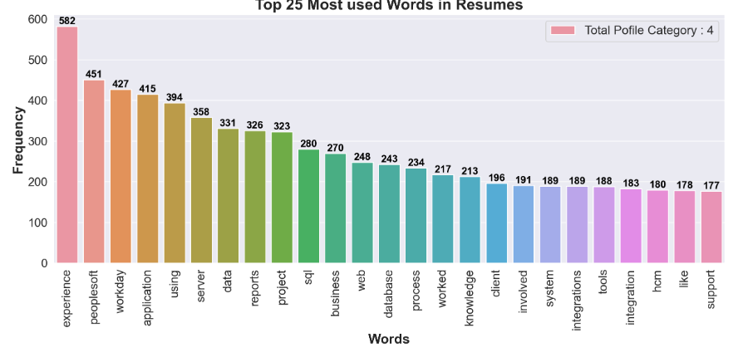
Histogram

Slide 12
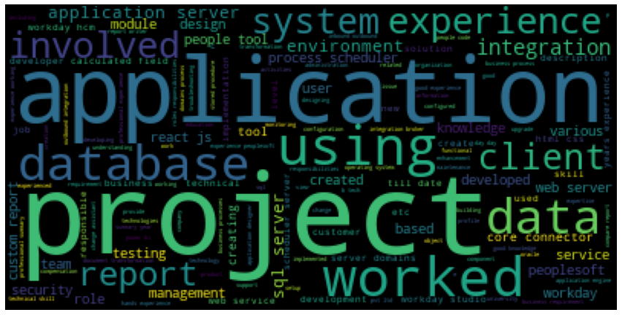
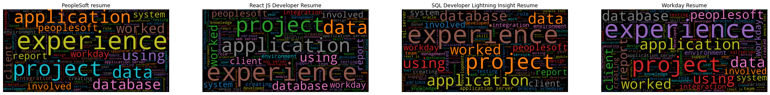
Word cloud

Slide 13
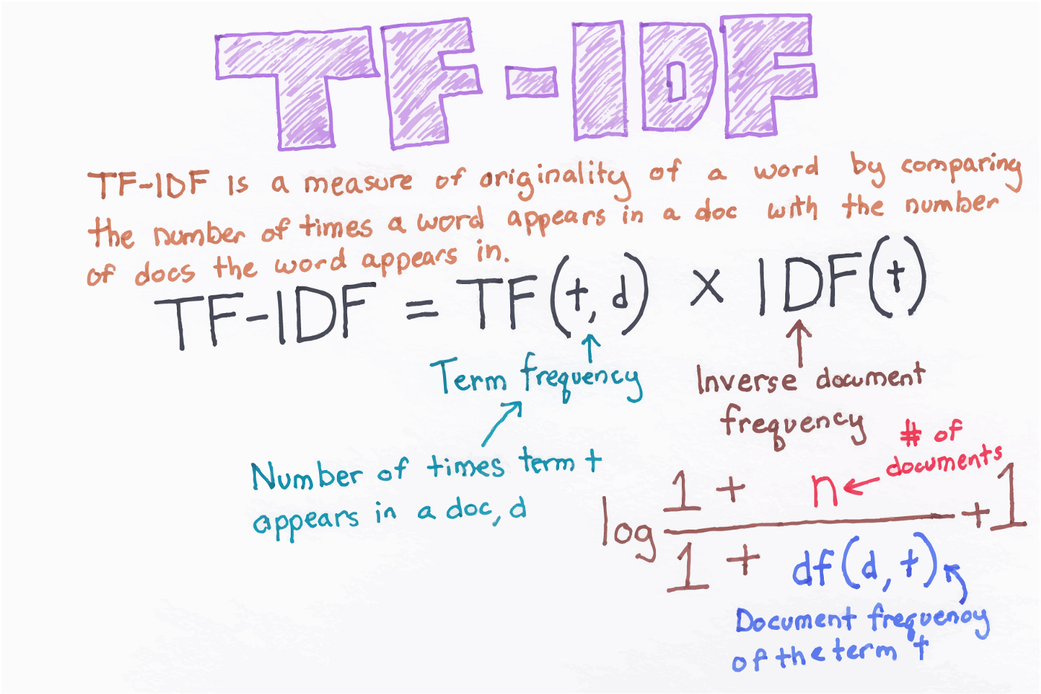
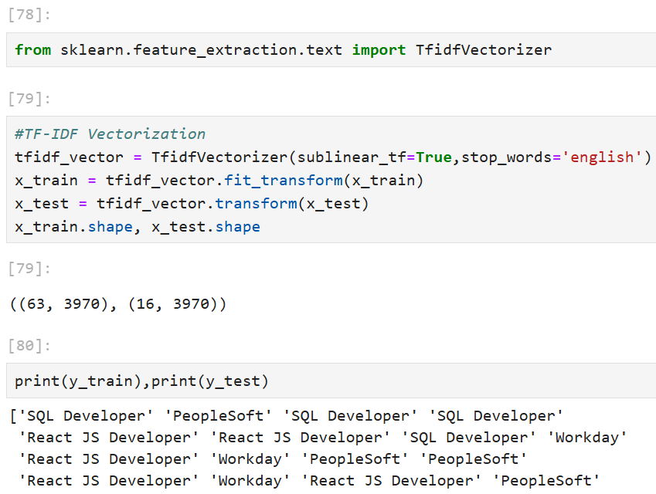
TF-IDF
TF-IDF is better than Count Vectorizers because it not only focuses on the frequency of words present in the corpus but also provides the importance of the words.
We can then remove the words that are less important for analysis, hence making the model building less complex by reducing the input dimensions.

Slide 14
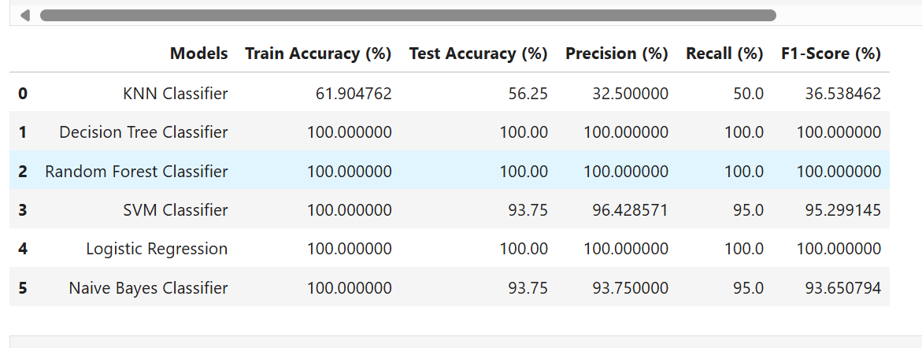
Model- Evaluation
Metrics on Testing Data
Here, we have taken Model building algorithms such as Decision Tree Classifier, Logistic Regression, SVM, Random , Forest, etc.
Among these algorithms, 100% Accuracy, Precision, Recall and F1-score have been achieved.
100% Test accuracy is achieved by using the model Random Forest, Decision Tree and Logistic Regression.

Slide 15

Deployment-Logistic Regression
Accurate resume classification using Logistic Regression
Efficient text extraction and preprocessing
User-friendly Streamlit interface
Scalable and deployable solution

Slide 16
Thank you

