Slide 1
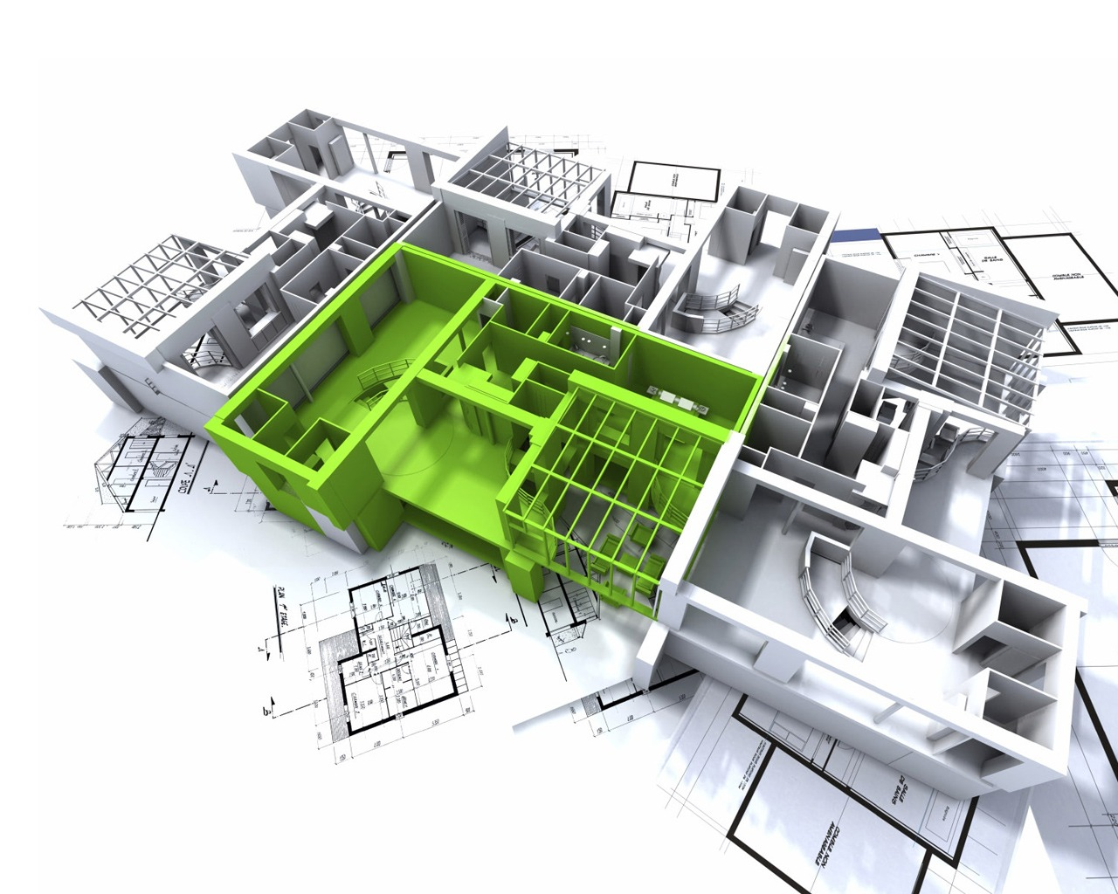
System Architect
ChiVTSE61217
TranDBSE61263
KhoiNTSE61038

Slide 2
This presentation will contains:
Diagram:
Component Diagram.
Schematic.
Concept:
System architect.
Conceptual diagram.
Class Diagram.

Slide 3
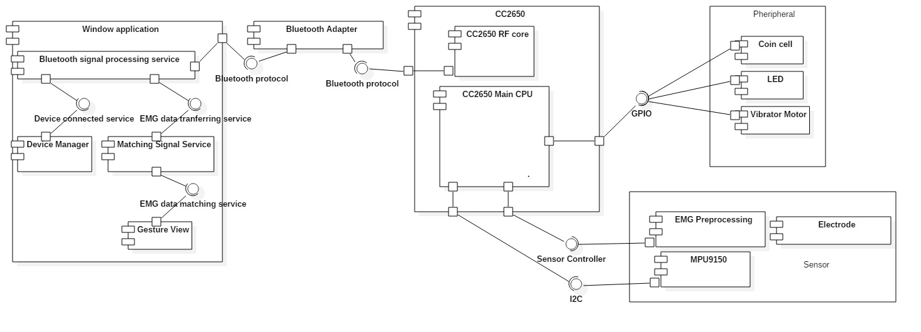
Component diagram
An delegate connector.
An interface is a classifier that declares of a set of coherent public features and obligations.
A component is a class representing a modular part of a system with encapsulated content and whose manifestation is replaceable within its environment.
Assembly connector.
A component has its behavior defined in terms of provided interfaces and required interfaces (potentially exposed via ports).
A port specifies an interaction point through which a classifier can communicate with its environment

Slide 4
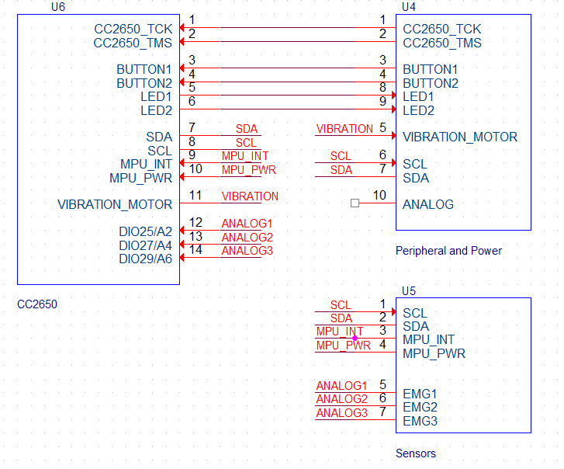

Slide 5
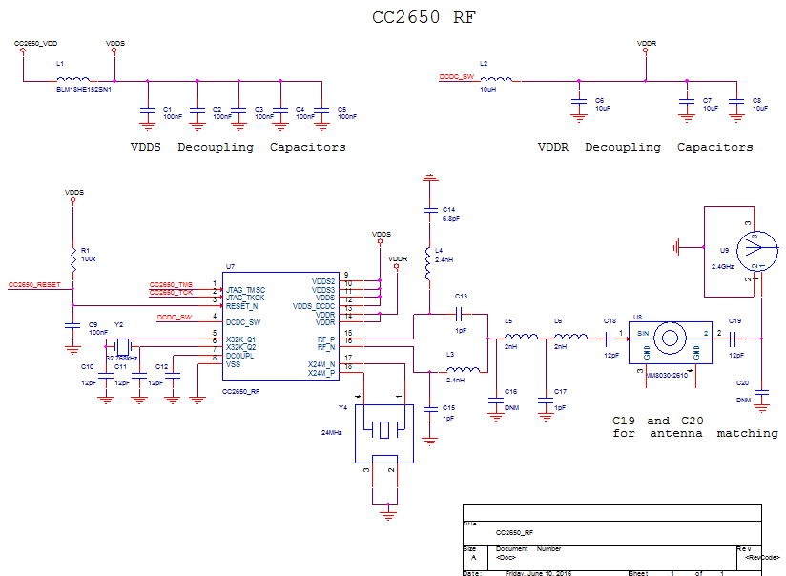

Slide 6
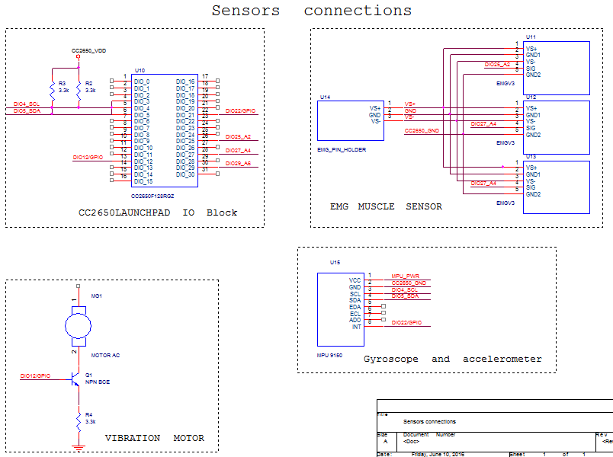

Slide 7
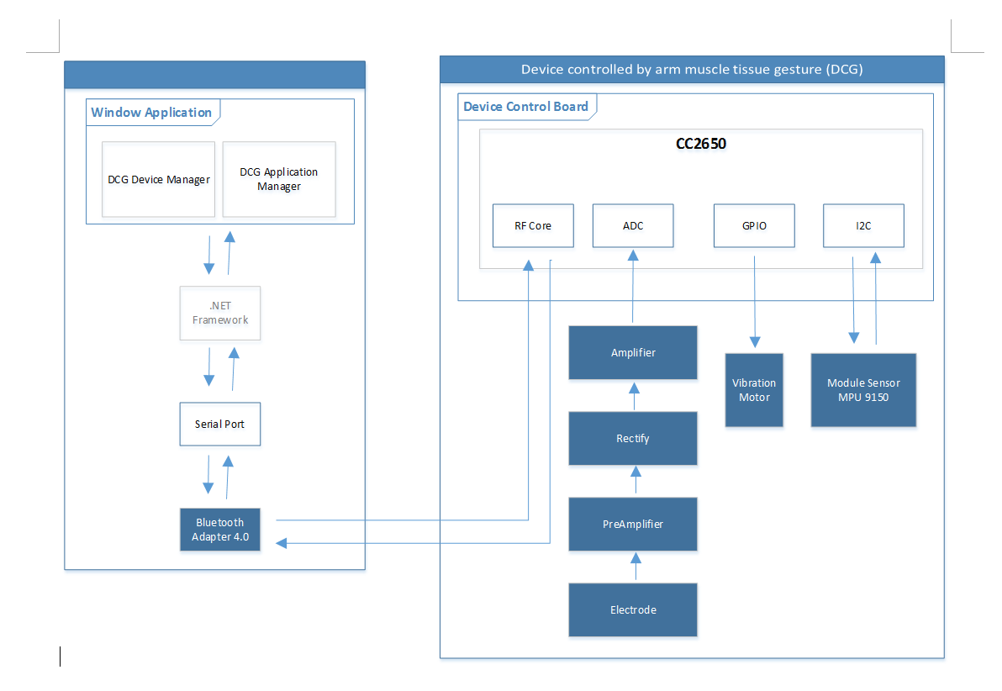
System architect:

Slide 8
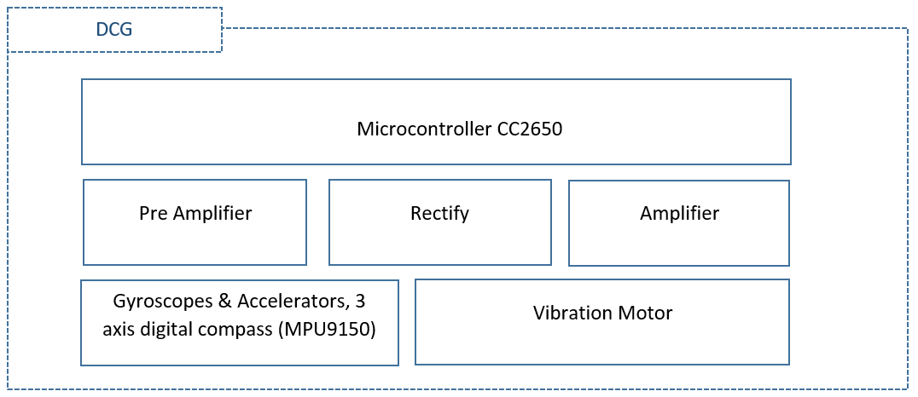

Slide 9
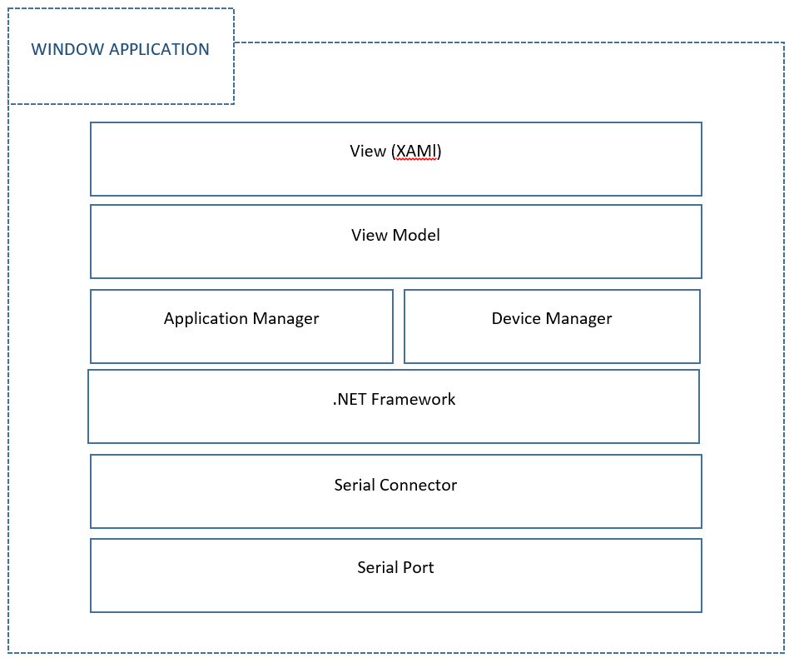

Slide 10
Conceptual Diagram:
1
…
many
1 and only 1
1
…
0 or 1

Slide 11
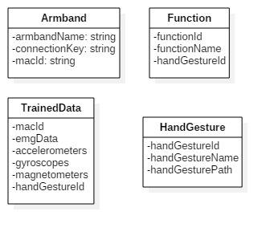
Class Diagram:

