Slide 1
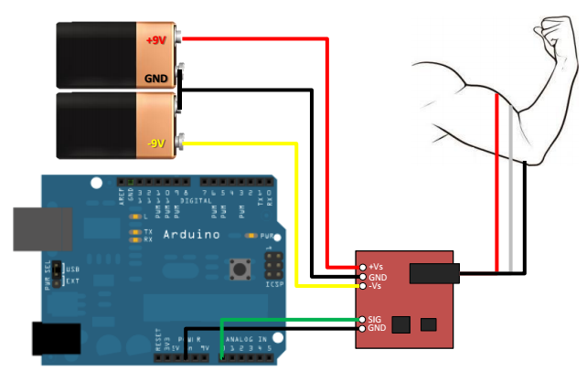
Setting up

Slide 2
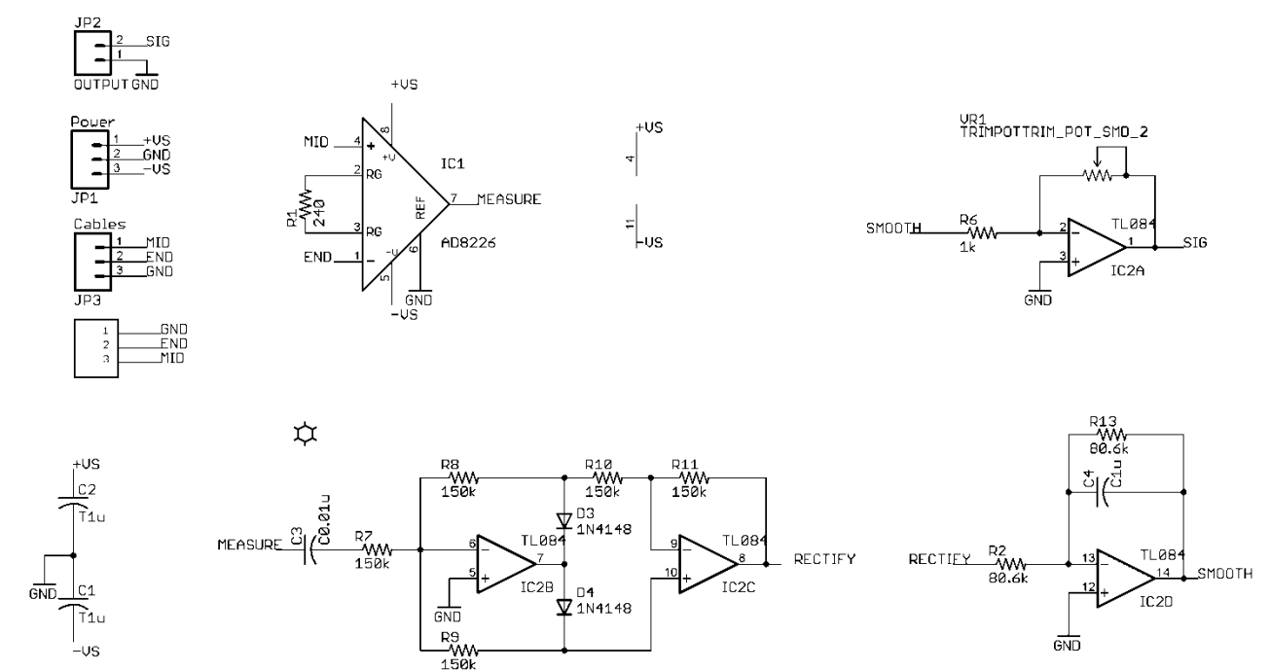

Slide 3
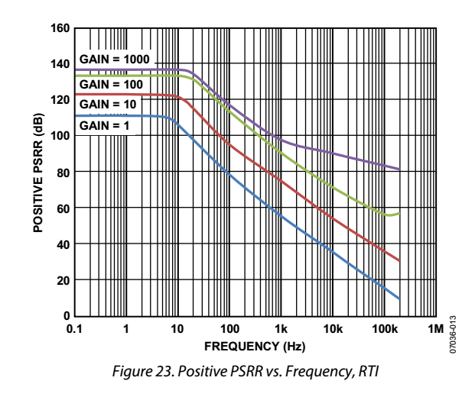
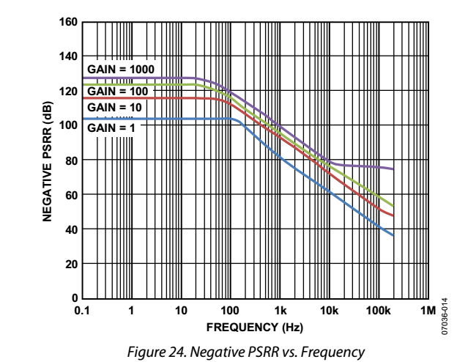
A stable dc voltage should be used to power the instrumentation amplifier. Note that noise on the supply pins can adversely affect performance. For more information, see the PSRR(power supply rejection ratio used to describe the amount of noise from a power supply that a particular device can reject.) performance curves in Figure 23 and Figure 24.
A 0.1 μF capacitor should be placed as close as possible to each
supply pin. As shown in Figure 61, a 10 μF tantalum capacitor
can be used farther away from the part. In most cases, it can be
shared by other precision integrated circuits.

Slide 4
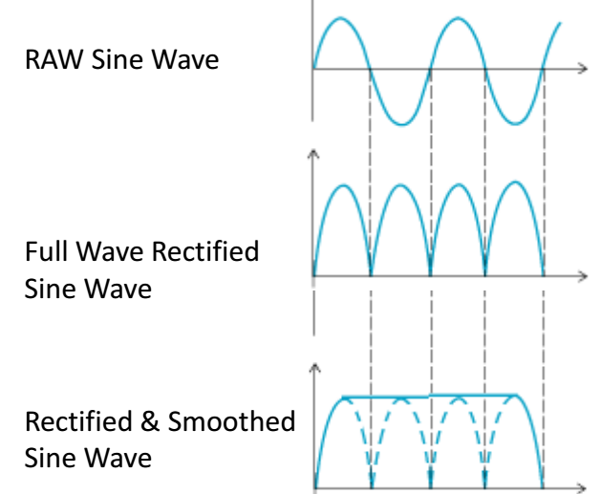
Muscle Sensors are designed to be used directly with a microcontroller. Therefore, the sensors do not output a RAW EMG signal but rather an amplified, rectified, and smoothed signal that will work well with a microcontroller’s analog-to-digital converter (ADC). This difference can be illustrated by using a simple sine wave as an example.

