Slide 1




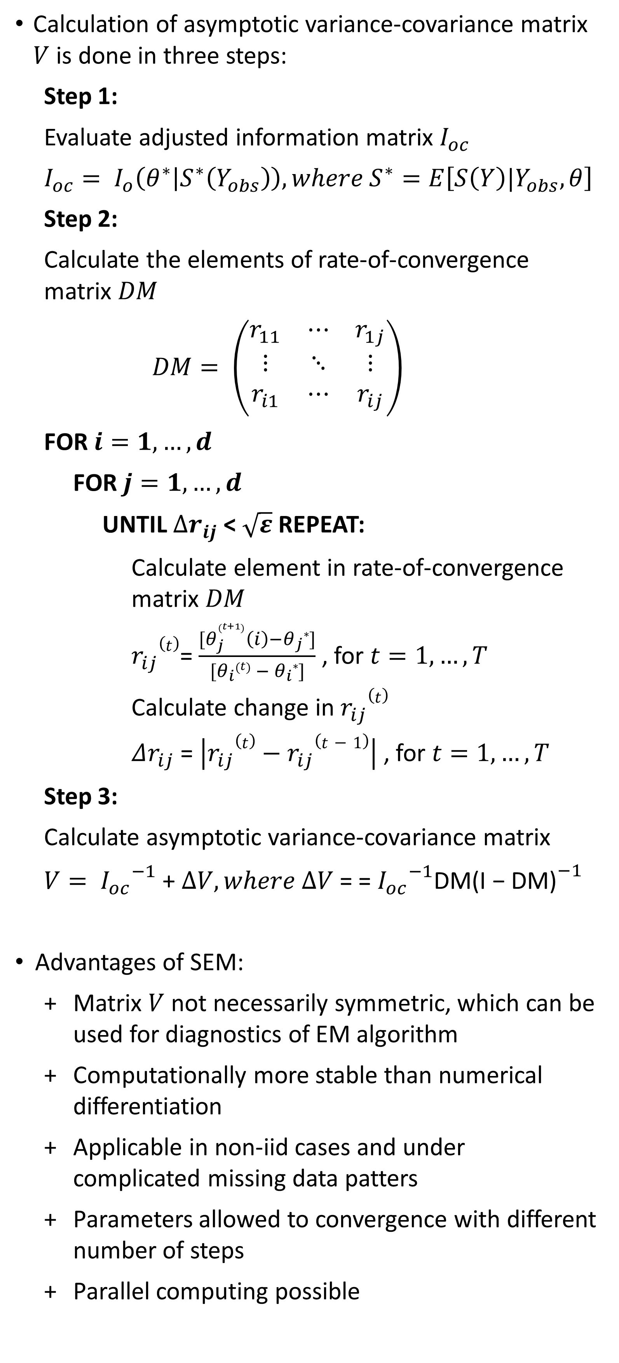


SEM Algorithm
Munch, J., Schreck, F., Höft, N.
Statistics M. Sc. - Joint masters program
Free University Berlin, Berlin, Germany
Humboldt University Berlin, Berlin, Germany
1. Motivation
3. Supplemented EM algorithm
4. Simulation study
6. Conclusion
Expectation-Maximization (EM) is one of the most popular tools to obtain maximum likelihood estimates in incomplete data problems
Problem: EM algorithm does not provide an asymptotic variance-covariance matrix for the parameters
Such matrix is needed for asymptotically valid inference
Existing approaches are computationally problematic and not generically applicable
SEM algorithm provides numerically stable asymptotic variance-covariance matrix for estimates obtained by EM
Calculation of asymptotic variance-covariance matrix $V$ is done in three steps:
Step 1:
Evaluate adjusted information matrix $I_{oc}$
$$I_{oc}= I_{o}\left(θ^{∗} | S^{∗}\left(Y_{obs}\right)\right),where S^{∗}=E\left[S\left(Y\right)|Y_{obs},θ\right]$$
Step 2:
Calculate the elements of rate-of-convergence matrix $DM$
$$DM= \left(\begin{matrix}r_{11} & ⋯ & r_{1j} \\ ⋮ & ⋱ & ⋮ \\ r_{i1} & ⋯ & r_{ij}\end{matrix}\right)$$
FOR $i=1,…,d$
FOR $j=1,…, d$
UNTIL $∆r_{ij}$< $\sqrt{ε}$REPEAT:
Calculate element in rate-of-convergence matrix $DM$
$r_{ij}(t)$= $\frac{[θ_{j}^{\left(t+1\right)}\left(i\right)−θ_{j}∗]}{[θ_{i}\left(t\right) − θ_{i}∗]}$ , for $t=1, …,T$
Calculate change in $r_{ij}(t)$
$Δr_{ij}$ = $\left|r_{ij}(t)−r_{ij}(t−1)\right|$ , for $t=1, …,T$
Step 3:
Calculate asymptotic variance-covariance matrix
$V= {I_{oc}}^{−1}$ + $∆V, where ∆V$ = = ${I_{oc}}^{−1}$DM${\text{(}\text{I}\text{ − }\text{DM}\text{)}}^{−1}$
Advantages of SEM:
Matrix $V$ not necessarily symmetric, which can be used for diagnostics of EM algorithm
Computationally more stable than numerical differentiation
Applicable in non-iid cases and under complicated missing data patters
Parameters allowed to convergence with different number of steps
Parallel computing possible
Data simulation by random draw from bivariate normal distribution:
$$Y= \left({Y1 \atop Y2}\right)\sim 𝒩\left(\left({1 \atop 4}\right),\left({4 \atop 3 } {3 \atop 5}\right)\right)$$
MNAR pattern of missing data in $Y2$
Parameter vector $θ= \left(θ_{1},θ_{2}\right)$, whereby
$$θ_{1}= \left(μ_{1},logσ_{1}^{2}\right), θ_{2}= \left(μ_{2},logσ_{2}^{2}, ρ\right)$$
Simulation is run with nine combinations:
$Vc(θ_{2})−V(θ_{2})$ for each combination as a measure of accuracy.
EM works well in our multi-parameter problems and algorithm converges fast.
Complexity of SEM implementation depends on type of data
In contrast, an asymptotic variance-covariance matrix can relatively easily be obtained from bootstrapping method
Bootstrapping delivers very accurate results, as can be seen by the difference $Vc(θ_{2})−V(θ_{2})$
7. Discussion
5. Results
SEM still in discussion as an alternative to multiple imputation and bootstrapping methods
EM widely established in open-source and commercial statistical programs
Nevertheless, SEM only rarely implemented
Implementations in IRTPRO and R (openmx, coarseDataTools)
SEM mostly used field of item response theory
Refinements of SEM, like agile-SEM for item response problems
Bootstrapping heavily used in many fields, especially when large sample and iid-structure available
2. EM algorithm
FILL IN: EM convergence of parameters:
FILL IN: Bootstrap VCOVplot
In latent variable problems, especially in incomplete data problems, maximum likelihood estimation is analytically not possible
EM algorithm enables convergence to optimum, which could be a local optimum depending on the starting values
EM algorithm consists of two iteratively applied steps:
UNTIL $Δθ$ < $ε$ REPEAT:
E-step:
Find expected complete-data log-likelihood and treat $θ^{(t)}$ as the true parameter $θ$
$$Q\left(θ | θ^{(t)}\right)=E_{Y_{mis}|Y_{obs},θ^{(t)}}[logL(θ;Y_{obs},Y_{mis})]$$
M-step:
Update $θ^{(t)}$ by the value that maximizes the expected log-likelihood from the E-step
$θ^{(t+1)}={\underset{θ}{argmax}{Q\left(θ | θ^{(t)}\right)}}$
Calculate change in estimated parameters
$Δθ$ = $|θ^{(t+1)}−θ^{(t)}|$
References
Dempster, A. P., Laird, N. M., & Rubin, D. B. (1977). Maximum likelihood from incomplete data via the EM algorithm. Journal of the royal statistical society. Series B (methodological), 1-38.
McLachlan, G., & Krishnan, T. (2007). The EM algorithm and extensions (Vol. 382). John Wiley & Sons.
Meng, X. L., & Rubin, D. B. (1991). Using EM to obtain asymptotic variance-covariance matrices: The SEM algorithm. Journal of the American Statistical Association, 86(416), 899-909.
Little, R. J., & Rubin, D. B. (2014). Statistical analysis with missing data (Vol. 333). John Wiley & Sons.
Pritikin, J. N. (2016). A computational note on the application of the Supplemented EM algorithm to item response models. arXiv preprint arXiv:1605.00860.

