Slide 1


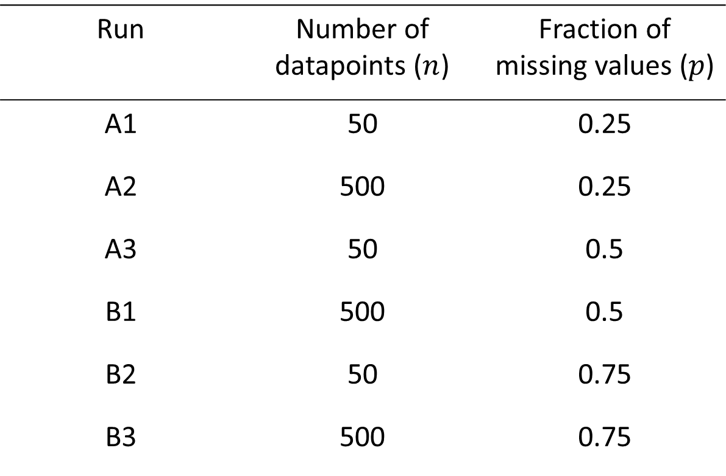



SEM Algorithm
Munch, J., Schreck, F., Höft, N.
Statistics M. Sc. - Joint masters program
Free University Berlin, Berlin, Germany
Humboldt University Berlin, Berlin, Germany
1. Motivation
3. Supplemented EM algorithm (SEM)
5. Results
6. Discussion
Expectation-Maximization (EM) is one of the most popular tools to obtain Maximum Likelihood estimates (ML) in incomplete data problems
Problem: EM algorithm does not provide an asymptotic variance-covariance matrix
Such matrix is needed for asymptotically valid inference
Existing approaches computationally problematic and not generically applicable
Calculates numerically stable asymptotic variance-covariance matrix for ML estimates obtained by EM
Calculation of this matrix $V$ is done in three steps:
Step 1:
Evaluate adjusted information matrix $I_{oc}$
$$I_{oc}= I_{o}\left(θ^{∗} | S^{∗}\left(Y_{obs}\right)\right),where S^{∗}=E\left[S\left(Y\right)|Y_{obs},θ\right]$$
Step 2:
UNTIL $∆r_{ij}$< $\sqrt{ε} ∀i∀j$ REPEAT FOR EACH $t$:
Calculate elements in rate-of-convergence matrix $DM$
$r_{ij}(t)$= $\frac{[θ_{j}^{\left(t+1\right)}\left(i\right)−θ_{j}∗]}{[θ_{i}\left(t\right) − θ_{i}∗]}$ for j = 1,…d
Calculate change in $r_{ij}(t)$ $∀i∀j$
$Δr_{ij}$ = $\left|r_{ij}(t)−r_{ij}(t−1)\right|$
Build matrix $DM$
$$DM= \left(\begin{matrix}r_{11} & ⋯ & r_{1j} \\ ⋮ & ⋱ & ⋮ \\ r_{i1} & ⋯ & r_{ij}\end{matrix}\right)$$
Step 3:
Calculate asymptotic variance-covariance matrix
$V= {I_{oc}}^{−1}$ + $∆V, where ∆V$ = = ${I_{oc}}^{−1}$DM${\text{(}\text{I}\text{ − }\text{DM}\text{)}}^{−1}$
Note that V is not necessarily symmetric, due to numerical inaccuracies
SEM is established in which open-source or commercial program?
Since 1996, has SEM established or are there better methods?
2. EM algorithm
UNTIL $Δθ$ < $ε$ REPEAT:
E-step:
Find expected complete-data log-likelihood and treat $θ^{(t)}$ as the true parameter $θ$
$$Q\left(θ | θ^{(t)}\right)=E_{Y_{mis}|Y_{obs},θ^{(t)}}[logL(θ;Y_{obs},Y_{mis})]$$
M-step:
Update $θ^{(t)}$ by the value that maximizes the expected log-likelihood from the E-step
$θ^{(t+1)}={\underset{θ}{argmax}{Q\left(θ | θ^{(t)}\right)}}$
Calculate change in estimated parameter
$Δθ$ = $|θ^{(t+1)}−θ^{(t)}|$
EM algorithm may only converge to a local optimum depending on the starting values
4. Simulation study
Data simulation by random draw from bivariate normal distribution:
$$Y= \left({Y1 \atop Y2}\right)\sim 𝒩\left(\left({0 \atop 0}\right),\left({1 \atop 0 } {0 \atop 1}\right)\right)$$
MNAR pattern of missing data in $Y2$
Variation of number of datapoints ($n$) and fraction of missing values ($p$)
Running the simulation six times:
References
Meng, X.-L. & Rubin, D. B. (1991), ‘Using em to obtain asymptotic variance- covariance matrices: The sem algorithm’, Journal of the American Statistical Association 86(416), 899.
Run | Number of datapoints ($n$) | Fraction of missing values ($p$)
A1 | 50 | 0.25
A2 | 500 | 0.25
A3 | 50 | 0.5
B1 | 500 | 0.5
B2 | 50 | 0.75
B3 | 500 | 0.75

