Slide 1



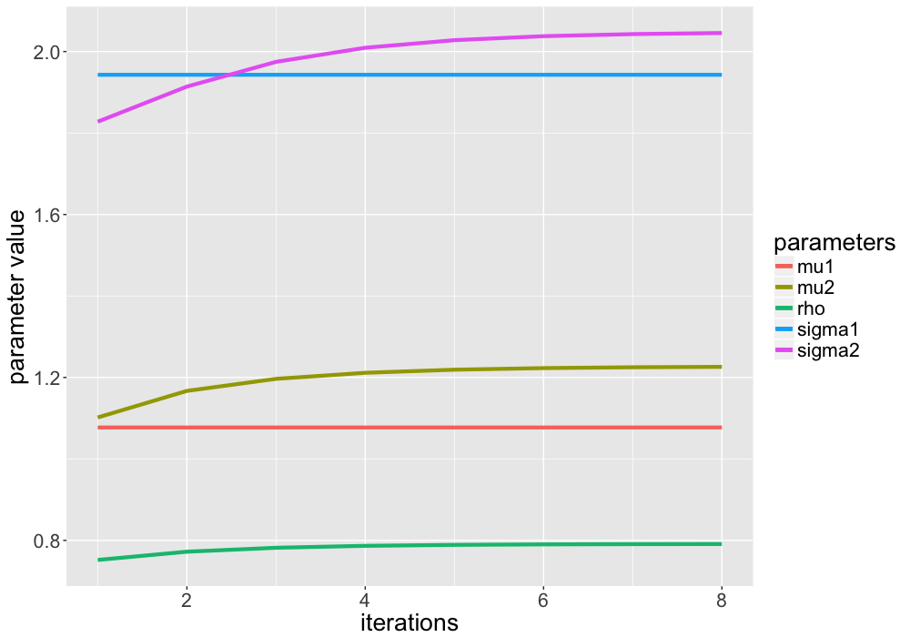
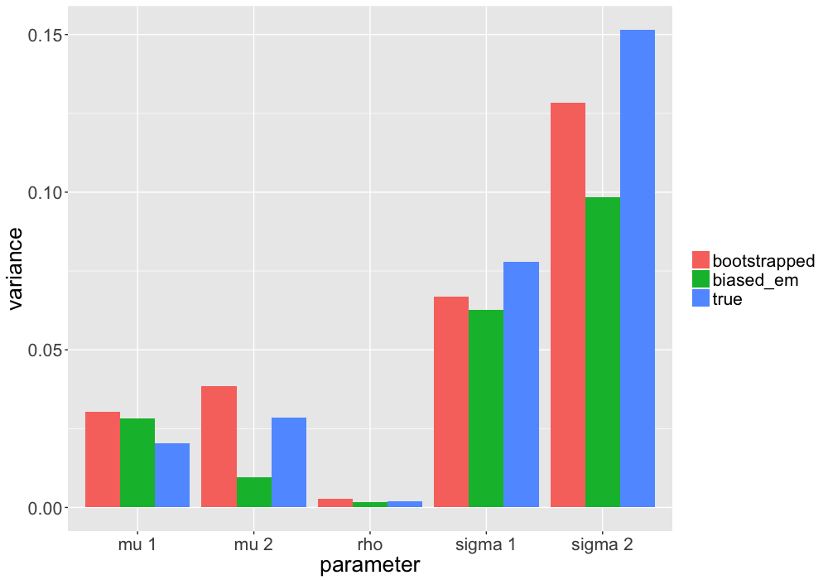
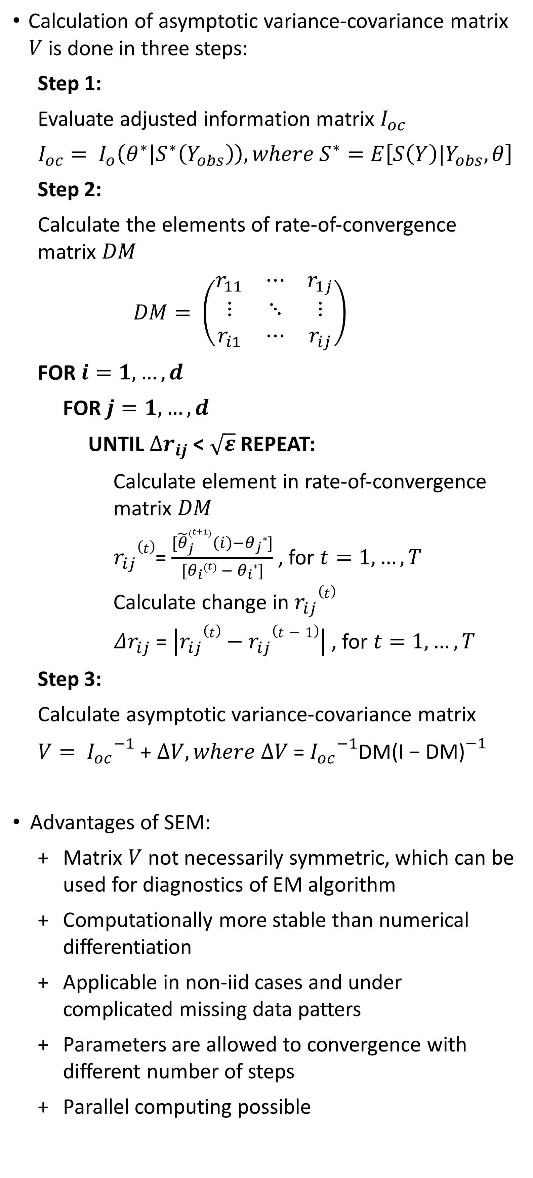


SEM Algorithm
Munch, J., Schreck, F., Höft, N.
Statistics M. Sc. - Joint masters program
Free University Berlin, Berlin, Germany
Humboldt University Berlin, Berlin, Germany
1. Introduction & Motivation
3. Supplemented EM algorithm
4. Simulation study
6. Discussion
Expectation-Maximization (EM) is one a method to obtain maximum likelihood estimates in incomplete data problems
Problem: Provides no asymptotic variance-covariance matrix for the parameters
However, this matrix is required for inference
SEM algorithm provides an asymptotic variance-covariance matrix for EM estimates (Meng & Rubin, 1991)
Disclaimer: SEM did not converge in our study.
Possible reasons: Numerical instability, coding errors
To produce similar (but adequate) results, we additionally implemented bootstrapping (see 5. Results)
Calculation of asymptotic variance-covariance matrix $V$ is done in three steps:
Step 1:
Evaluate adjusted information matrix $I_{oc}$
$$I_{oc}= I_{o}\left(θ^{∗} | S^{∗}\left(Y_{obs}\right)\right),where S^{∗}=E\left[S\left(Y\right)|Y_{obs},θ\right]$$
Step 2:
Calculate the elements of rate-of-convergence matrix $DM$
$$DM= \left(\begin{matrix}r_{11} & ⋯ & r_{1j} \\ ⋮ & ⋱ & ⋮ \\ r_{i1} & ⋯ & r_{ij}\end{matrix}\right)$$
FOR $i=1,…,d$
FOR $j=1,…, d$
UNTIL $∆r_{ij}$< $\sqrt{ε}$REPEAT:
Calculate element in rate-of-convergence matrix $DM$
$r_{ij}(t)$= $\frac{[{\tilde{θ}}_{j}^{\left(t+1\right)}\left(i\right)−θ_{j}∗]}{[θ_{i}\left(t\right) − θ_{i}∗]}$ , for $t=1, …,T$
Calculate change in $r_{ij}(t)$
$Δr_{ij}$ = $\left|r_{ij}(t)−r_{ij}(t−1)\right|$ , for $t=1, …,T$
Step 3:
Calculate asymptotic variance-covariance matrix
$V= {I_{oc}}^{−1}$ + $∆V, where ∆V$ = ${I_{oc}}^{−1}$DM${\text{(}\text{I}\text{ − }\text{DM}\text{)}}^{−1}$
Advantages of SEM:
Matrix $V$ not necessarily symmetric, which can be used for diagnostics of EM algorithm
Computationally more stable than numerical differentiation
Applicable in non-iid cases and under complicated missing data patters
Parameters are allowed to convergence with different number of steps
Parallel computing possible
Data simulation by random sampling from bivariate normal distribution:
$$Y= \left({Y1 \atop Y2}\right)\sim 𝒩\left(\left({1 \atop 1.5}\right),\left({2 \atop 1.8} {1.8 \atop 2.8}\right)\right)$$
MNAR pattern of missing data in $Y2$, fraction $τ=0.3$
Parameter vector $θ= \left(μ_{1},σ_{1}^{2},μ_{2},σ_{2}^{2},ρ\right)$
True variance-covariance matrix (consistent MC estimation) is compared with biased EM matrix and bootstrapping matrix
EM works well in our multi-parameter problem and algorithm converges fast
Complexity of SEM implementation depends on type of model
Numerical stability could not be achieved in our case
In contrast, an asymptotic variance-covariance matrix can relatively easily be obtained from bootstrapping
Bootstrapping delivers accurate results in our simulation study
Bootstrapping computationally by far more costly than SEM, however the performance increase of modern hardware marginalizes this problem
5. Results
Convergence of EM parameters
2. EM algorithm
7. Conclusion
In latent variable problems, (e.g. incomplete data problems), maximum likelihood estimation is analytically not possible
EM algorithm convergences to a possibly local optimum, depending on the starting values (Dempster et.al, 1977)
EM algorithm consists of two iteratively applied steps:
UNTIL $Δθ$ < $ε$ REPEAT:
E-step:
Find expected complete-data log-likelihood and treat $θ^{(t)}$ as the true parameter $θ$
$$Q\left(θ | θ^{(t)}\right)=E_{Y_{mis}|Y_{obs},θ^{(t)}}[logL(θ;Y_{obs},Y_{mis})]$$
M-step:
Update $θ^{(t)}$ by the value that maximizes the expected log-likelihood from the E-step
$θ^{(t+1)}={\underset{θ}{argmax}{Q\left(θ | θ^{(t)}\right)}}$
Calculate change in estimated parameters
$Δθ$ = $|θ^{(t+1)}−θ^{(t)}|$
In theory: SEM as an easy and convenient method to obtain variance-covariance estimates for ML parameters in missing data problems
In practice: Implementing a stable solution may be difficult, depending on the model
Few implementations of SEM, like for item response problems (Pritikin, 2016)
Comparison of SEM and Bootstrapping in small samples beyond the scope of this study
Comparison of parameter variances by calculation procedure
References
Dempster, A. P., Laird, N. M., & Rubin, D. B. (1977). Maximum likelihood from incomplete data via the EM algorithm. Journal of the royal statistical society. Series B (methodological), 1-38.
McLachlan, G., & Krishnan, T. (2007). The EM algorithm and extensions (Vol. 382). John Wiley & Sons.
Meng, X. L., & Rubin, D. B. (1991). Using EM to obtain asymptotic variance-covariance matrices: The SEM algorithm. Journal of the American Statistical Association, 86(416), 899-909.
Little, R. J., & Rubin, D. B. (2014). Statistical analysis with missing data (Vol. 333). John Wiley & Sons.
Pritikin, J. N. (2016). A computational note on the application of the Supplemented EM algorithm to item response models.

