Slide 1



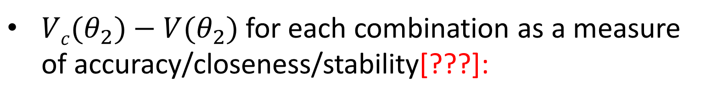

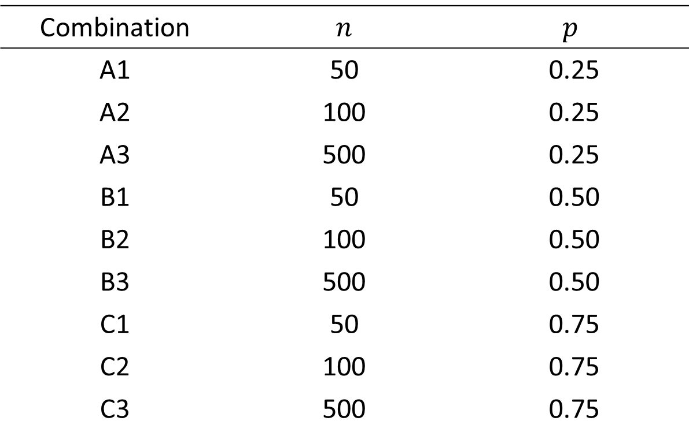

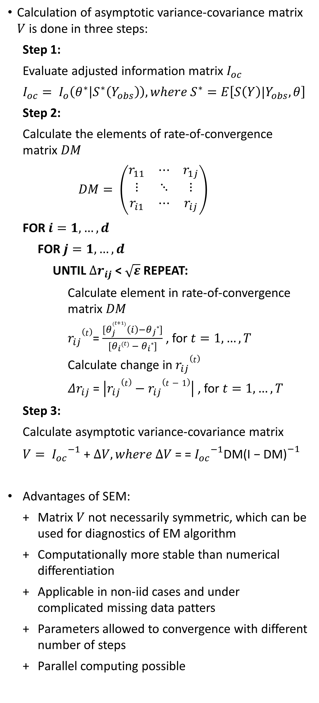
SEM Algorithm
Munch, J., Schreck, F., Höft, N.
Statistics M. Sc. - Joint masters program
Free University Berlin, Berlin, Germany
Humboldt University Berlin, Berlin, Germany
1. Motivation
3. Supplemented EM algorithm
4. Simulation study
6. Conclusion
Expectation-Maximization (EM) is one of the most popular tools to obtain Maximum Likelihood estimates in incomplete data problems
Problem: EM algorithm does not provide an asymptotic variance-covariance matrix
Such matrix is needed for asymptotically valid inference
Existing approaches computationally problematic and not generically applicable
SEM algorithm provides numerically stable asymptotic variance-covariance matrix for estimates obtained by EM
Calculation of asymptotic variance-covariance matrix $V$ is done in three steps:
Step 1:
Evaluate adjusted information matrix $I_{oc}$
$$I_{oc}= I_{o}\left(θ^{∗} | S^{∗}\left(Y_{obs}\right)\right),where S^{∗}=E\left[S\left(Y\right)|Y_{obs},θ\right]$$
Step 2:
Calculate the elements of rate-of-convergence matrix $DM$
$$DM= \left(\begin{matrix}r_{11} & ⋯ & r_{1j} \\ ⋮ & ⋱ & ⋮ \\ r_{i1} & ⋯ & r_{ij}\end{matrix}\right)$$
FOR $i=1,…,d$
FOR $j=1,…, d$
UNTIL $∆r_{ij}$< $\sqrt{ε}$REPEAT:
Calculate element in rate-of-convergence matrix $DM$
$r_{ij}(t)$= $\frac{[θ_{j}^{\left(t+1\right)}\left(i\right)−θ_{j}∗]}{[θ_{i}\left(t\right) − θ_{i}∗]}$ , for $t=1, …,T$
Calculate change in $r_{ij}(t)$
$Δr_{ij}$ = $\left|r_{ij}(t)−r_{ij}(t−1)\right|$ , for $t=1, …,T$
Step 3:
Calculate asymptotic variance-covariance matrix
$V= {I_{oc}}^{−1}$ + $∆V, where ∆V$ = = ${I_{oc}}^{−1}$DM${\text{(}\text{I}\text{ − }\text{DM}\text{)}}^{−1}$
Advantages of SEM:
Matrix $V$ not necessarily symmetric, which can be used for diagnostics of EM algorithm
Computationally more stable than numerical differentiation
Applicable in non-iid cases and under complicated missing data patters
Parameters allowed to convergence with different number of steps
Parallel computing possible
Data simulation by random draw from bivariate normal distribution:
$$Y= \left({Y1 \atop Y2}\right)\sim 𝒩\left(\left({0 \atop 0}\right),\left({1 \atop 0 } {0 \atop 1}\right)\right)$$
MNAR pattern of missing data in $Y2$
Parameter vector $θ= \left(θ_{1},θ_{2}\right)$, whereby
$$θ_{1}= \left(μ_{1},logσ_{1}^{2}\right), θ_{2}= \left(μ_{2},logσ_{2}^{2}, ρ\right)$$
Variation of number of observations ($n$) and fraction of missing values ($p$)
Simulation is run with nine combinations:
SEM works well in multi-parameter problems where only one variable contains missing data
Accuracy of the asymptotic variance-covariance matrix highly dependent on structure of data
Accuracy decreases with large fraction of missing values in data
Large number of observations needed, especially if in case of relatively many missing values
Combination | $n$ | $$p$$
A1 | 50 | 0.25
A2 | 100 | 0.25
A3 | 500 | 0.25
B1 | 50 | 0.50
B2 | 100 | 0.50
B3 | 500 | 0.50
C1 | 50 | 0.75
C2 | 100 | 0.75
C3 | 500 | 0.75
7. Discussion
SEM still used as an alternative to multiple imputation and bootstrapping methods
EM widely established in open-source and commercial statistical programs
SEM only rarely implemented
Implementations in IRTPRO and R (openmx, coarseDataTools)
SEM mostly used in item response problems
Refinements of SEM, like agile-SEM for item response models
2. EM algorithm
In latent variable problems, especially incomplete data problems, maximum likelihood estimation is analytically not possible
EM algorithm enables converge to optimum, which could be a local optimum depending on the starting values
EM algorithm consists of two iteratively applied steps:
UNTIL $Δθ$ < $ε$ REPEAT:
E-step:
Find expected complete-data log-likelihood and treat $θ^{(t)}$ as the true parameter $θ$
$$Q\left(θ | θ^{(t)}\right)=E_{Y_{mis}|Y_{obs},θ^{(t)}}[logL(θ;Y_{obs},Y_{mis})]$$
M-step:
Update $θ^{(t)}$ by the value that maximizes the expected log-likelihood from the E-step
$θ^{(t+1)}={\underset{θ}{argmax}{Q\left(θ | θ^{(t)}\right)}}$
Calculate change in estimated parameters
$Δθ$ = $|θ^{(t+1)}−θ^{(t)}|$
5. Results
$Vc(θ_{2})−V(θ_{2})$ for each combination as a measure of accuracy/closeness/stability[???]:
References
Dempster, A. P., Laird, N. M., & Rubin, D. B. (1977). Maximum likelihood from incomplete data via the EM algorithm. Journal of the royal statistical society. Series B (methodological), 1-38.
McLachlan, G., & Krishnan, T. (2007). The EM algorithm and extensions (Vol. 382). John Wiley & Sons.
Meng, X. L., & Rubin, D. B. (1991). Using EM to obtain asymptotic variance-covariance matrices: The SEM algorithm. Journal of the American Statistical Association, 86(416), 899-909.
Little, R. J., & Rubin, D. B. (2014). Statistical analysis with missing data (Vol. 333). John Wiley & Sons.
Pritikin, J. N. (2016). A computational note on the application of the Supplemented EM algorithm to item response models. arXiv preprint arXiv:1605.00860.

