Slide 1
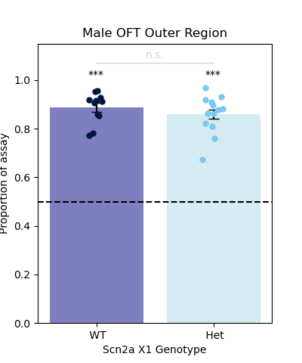
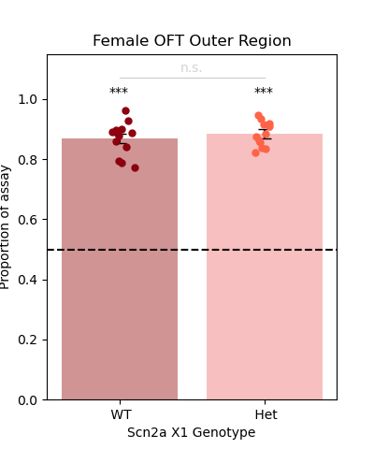
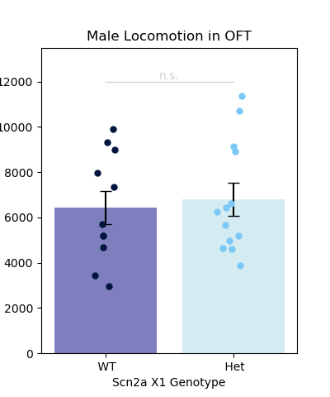
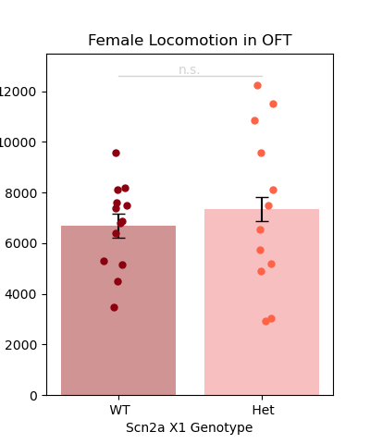
OFT
Male WT vs Het Distance (cm): p = 0.709, independent samples t-test
Female WT vs Het Distance (cm): p = 0.519, independent samples t-test
Male WT Time in Outer Region vs 0.5: p = 1.755e-09, 1-sample t-test, null = 0.50
Male Het Time in Outer Region vs 0.5: p = 1.273e-09, 1-sample t-test, null = 0.50
Male WT vs Het Time in Outer Region: p = 0.357, independent samples t-test
Female WT Time in Outer Region vs 0.5: p = 2.001e-11, 1-sample t-test, null = 0.50
Female Het Time in Outer Region vs 0.5: p = 3.593e-12, 1-sample t-test, null = 0.50
Female WT vs Het Time in Outer Region: p = 0.468, independent samples t-test

Slide 2
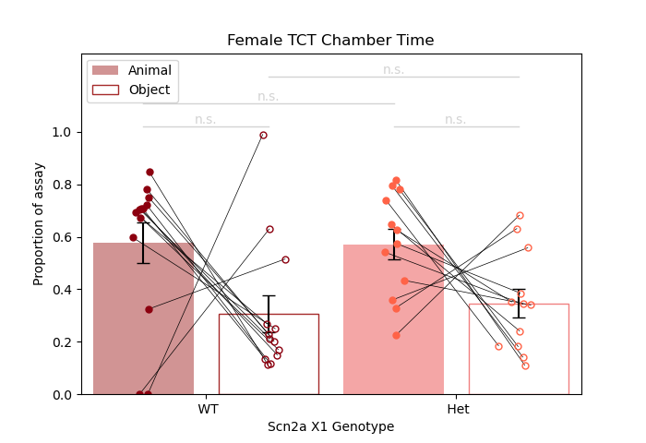
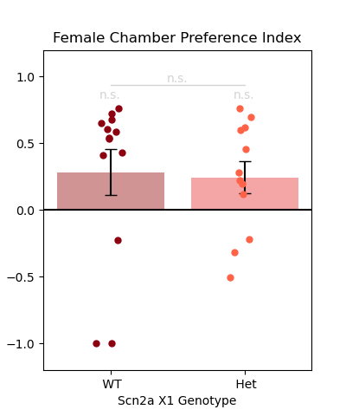
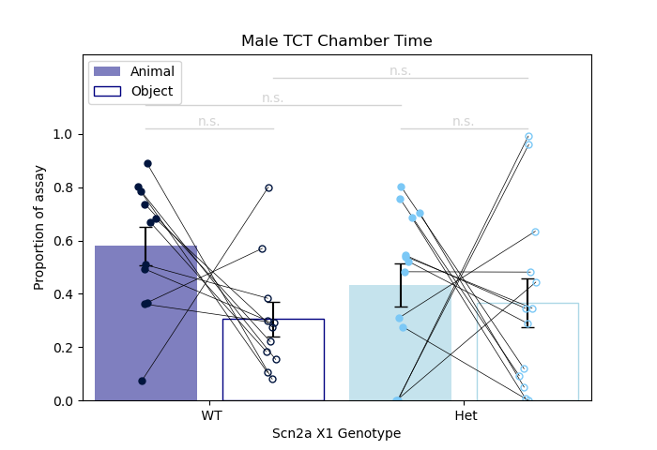
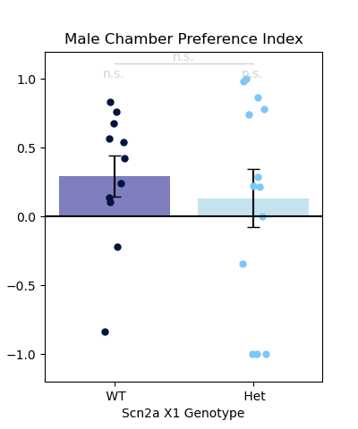
TCT (Chamber)
Female WT animal vs object chamber time: p = 0.168, wilcoxon signed-rank test
Female Het animal vs object chamber time: p = 0.068, paired t-test
Female WT vs Het animal chamber time: p = 0.683, mann-whitney u test
Female WT vs Het object chamber time: p = 0.341, mann-whitney u test
Female WT Chamber Index vs 0: p = 0.191, wilcoxon signed-rank test
Female Het Chamber Index vs 0: p = 0.067,
1-sample t-test, null = 0
Female WT vs Het Chamber Index: p = 0.463, mann-whitney u test
Male WT animal vs object chamber time: p = 0.102, wilcoxon signed-rank test
Male Het animal vs object chamber time: p = 0.69, paired t-test
Male WT vs Het animal chamber time: p = 0.201, independent samples t-test
Male WT vs Het object chamber time: p = 0.862, mann-whitney u test
Male WT Chamber Index vs 0: p = 0.073,
1-sample t-test, null = 0
Male Het Chamber Index vs 0: p = 0.534,
1-sample t-test, null = 0
Male WT vs Het Chamber Index: p = 0.553, independent samples t-test

Slide 3
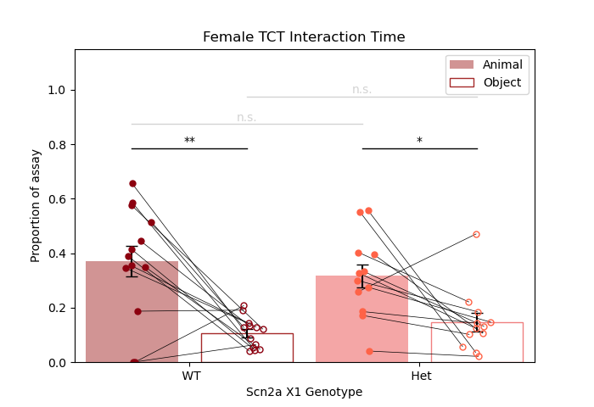
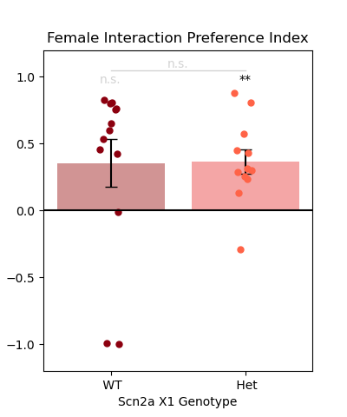
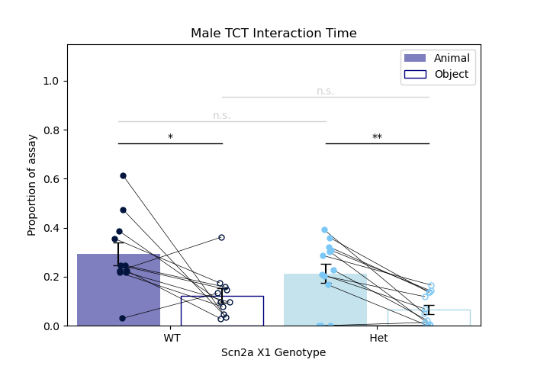
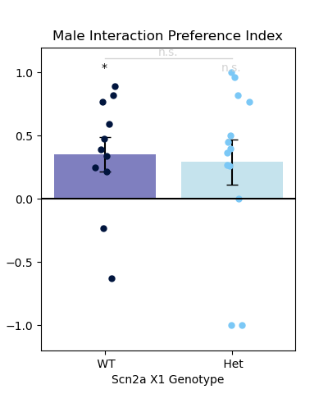
TCT (Interaction)
Female WT animal vs object interaction time: p = 1.476e-03, paired t-test
Female Het animal vs object interaction time: p = 0.016, wilcoxon signed-rank test
Female WT vs Het animal interaction time: p = 0.462, independent samples t-test
Female WT vs Het object interaction time: p = 0.497,
mann-whitney u test
Female WT Interaction Index vs 0: p = 0.191,
wilcoxon signed-rank test
Female Het Interaction Index vs 0: p = 1.719e-03,
1-sample t-test, null = 0
Female WT vs Het Interaction Index: p = 0.314,
mann-whitney u test
Male WT animal vs object interaction time: p = 0.024,
wilcoxon signed-rank test
Male Het animal vs object interaction time: p = 5.156e-03,
wilcoxon signed-rank test
Male WT vs Het animal interaction time: p = 0.191,
independent samples t-test
Male WT vs Het object interaction time: p = 0.093,
mann-whitney u test
Male WT Interaction Index vs 0: p = 0.028,
1-sample t-test, null = 0
Male Het Interaction Index vs 0: p = 0.141,
wilcoxon signed-rank test
Male WT vs Het Interaction Index: p = 0.862,
mann-whitney u test

