Slide 1
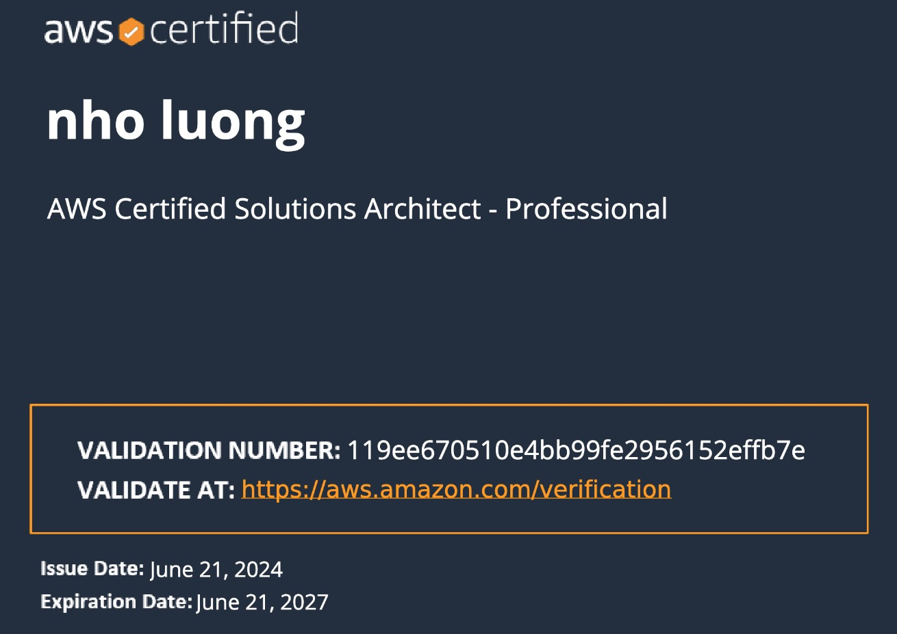

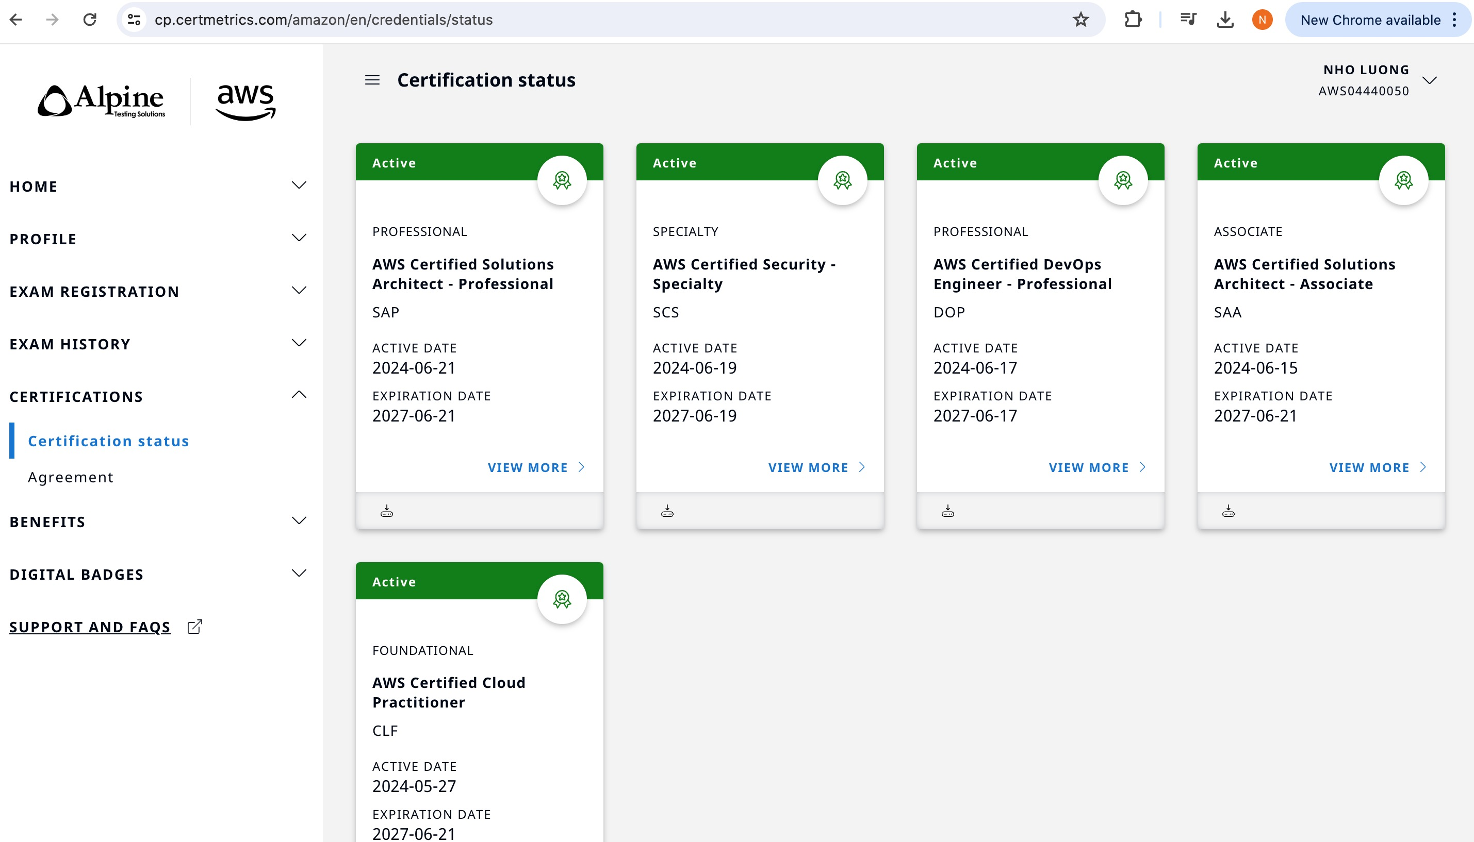
Terraform on AWS with Fargate & ECS
Author: Nho Luong
Skill: DevOps Engineer Lead

Slide 2
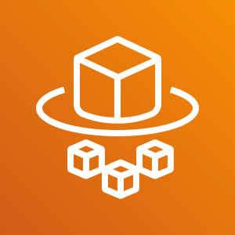

AWS Fargate & ECS
Demo Contents
Author: Nho Luong
Skill: DevOps Engineer Lead

Slide 3
Course Outline
Fargate & ECS - First Steps
Docker Fundamentals
Fargate & ECS Fundamentals
ECR – Elastic Container Registry
Load Balancing & Service Autoscaling
Continuous Integration & Continuous Delivery
Microservices Deployment without Service Discovery
Microservices Deployment with Service Discovery
Microservices Deployment with AWS App Mesh and X-Ray
Microservices Canary Deployment with AWS App Mesh
CloudFormation for Fargate Deployments
Author: Nho Luong
Skill: DevOps Engineer Lead

Slide 4

Physical Machines
Docker Fundamentals
Virtual Machines
Virtual Machine
Virtual Machine
Webservers
AppServers
Databases
Webservers
AppServers
Databases
Webservers
AppServers
Databases
Libs
Deps
Libs
Deps
Operating System
Operating System
Libraries
Dependencies
Hypervisor
Operating System
Hardware Infrastructure
Hardware Infrastructure
Author: Nho Luong
Skill: DevOps Engineer Lead

Slide 5
Physical Machines with Docker
Container
Container
Container
Webservers
AppServers
Databases
Libs
Deps
Libs
Deps
Libs
Deps
Docker
Operating System
Hardware Infrastructure
Author: Nho Luong
Skill: DevOps Engineer Lead

Slide 6
Virtual Machines with Docker
Virtual Machine
Virtual Machine
Container
Container
Container
Container
Container
Container
Webservers
AppServers
Databases
Webservers
AppServers
Databases
Libs
Deps
Libs
Deps
Libs
Deps
Libs
Deps
Libs
Deps
Libs
Deps
Docker
Docker
Operating System
Operating System
Hypervisor
Hardware Infrastructure
Author: Nho Luong
Skill: DevOps Engineer Lead

Slide 7
Advantages of using Docker
Flexible
Even the most complex applications can be containerized.
Lightweight
Containers leverage and share the host kernel, making them much more efficient in terms of system resources than virtual machines.
Portable
You can build locally, deploy to the cloud, and run anywhere.
Why Containers ?
Loosely Coupled
Containers are highly self sufficient and encapsulated, allowing you to replace or upgrade one without disrupting others.
Scalable
You can increase and automatically distribute container replicas across a datacenter.
Secure
Containers apply aggressive constraints and isolations to processes without any configuration required on the part of the user.
Author: Nho Luong
Skill: DevOps Engineer Lead

Slide 8
Docker - Architecture
nginxdemos/hello
Docker Daemon
Docker Registry
(Docker Hub)
nginxdemos/hello
Container-11
Images
Containers
Docker Host
docker pull nginxdemos/hello
docker run -p 82:80 -d nginxdemos/hello
Docker Client (My Desktop or Docker Host)
Author: Nho Luong
Skill: DevOps Engineer Lead

Slide 9
Fargate or ECS Objects
Task Definition
Cluster
ECS Objects
Service
Task
Author: Nho Luong
Skill: DevOps Engineer Lead

Slide 10
Fargate & ECS Fundamentals – Clusters Introduction
ECS Cluster Types
Fargate (Serverless)
EC2 + Linux
EC2 + Windows
Author: Nho Luong
Skill: DevOps Engineer Lead

Slide 11
Fargate & ECS Fundamentals – Cluster Features
Services
A service allows you to run and maintain a specified number of simultaneous instances of a task definition in an ECS cluster.
Tasks
A task is the instantiation of a task definition within a cluster
ECS Instances
Will be created when we create the cluster launch type of EC2+Linux or EC2+Windows
Metrics
CloudWatch Container Insights collects, aggregates, and summarizes metrics and logs from your containerized applications and microservices.
Clusters
(Fargate or ECS)
Scheduled Tasks
Used primarily for long running stateless services and applications.
Tags
ECS resources can be tagged with values that we define, to help us organize and identify them.
Capacity Providers
A capacity provider is used in association with a cluster to determine the infrastructure that a task runs on.
Update Cluster
Update the cluster settings primarily leading to Cluster Capacity Providers
Delete Cluster
Used to delete ECS EC2 or Fargate Clusters
Author: Nho Luong
Skill: DevOps Engineer Lead

Slide 12
Task Definitions
EC2 Launch Type
Task Definition Name
Task Definition – Parameters List
Task Role
Healthcheck
Network Mode
Environment
Task Execution IAM Role
Container Name
Environment Varibales
Fargate
Launch Type
Task Size (Memory, CPU)
Image
Container Timeouts
Container Definitions
Standard
Private Repo Authentication
Network Settings
Service Integration
Memory Limits (Soft, Hard)
Proxy Configuration
Storage & Logging
Port Mappings
Log Router Configuration
Resource Limits
Advanced
Volumes
Docker Labels
Author: Nho Luong
Skill: DevOps Engineer Lead

Slide 13






How ECR Works?
Developer
Docker Container
Push Images
Elastic Container Service - ECS
Pull Images and Run Containers
Docker Image
Docker Container
Pull Images
Elastic Container Registry - ECR
Elastic Kubernetes Service - EKS
Docker Container
On-Premise
Author: Nho Luong
Skill: DevOps Engineer Lead

Slide 14
Load Balancing & Service Autoscaling
Author: Nho Luong
Skill: DevOps Engineer Lead

Slide 15
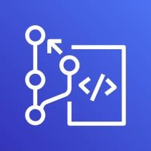
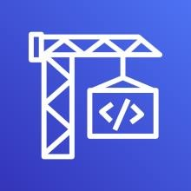



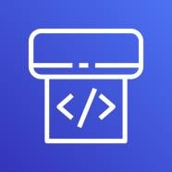
AWS Developer Tools or Code Services
Source
Build
Test
Deploy
Monitor
AWS CodeCommit
AWS CodeBuild
AWS CodeBuild + Third Party
Fargate
or ECS
Amazon CloudWatch
Author: Nho Luong
Skill: DevOps Engineer Lead
AWS CodePipeline

Slide 16




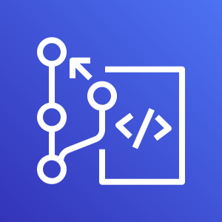






AWS Cloud
CI CD Process
Developer
CloudWatch
CodePipeline
Commit code changes
Local Git Repo
push
S3
CodeCommit
CodeBuild
Fargate or ECS
Simple Notification
Service
ECR
Staging
Production
Authorized
Approver
Task
Definition
Service
Container
Task
Definition
Service
Container
Elastic Container Service
Author: Nho Luong
Skill: DevOps Engineer Lead

Slide 17

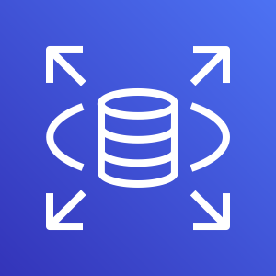


Microservices Deployment on AWS ECS – No Service Discovery
AWS Cloud
User Management Service
/usermgmt*
Task
Definition
Service
Container
Amazon RDS
Postman
Client
services.stacksimplify.com
Elastic Load Balancing (ELB)
End User
/notification*
Notification Service
Task
Definition
Service
Container
Simple Email
Service (SES)
/notification*
Email
API Developer
Author: Nho Luong
Skill: DevOps Engineer Lead

Slide 18


Microservices Deployment on ECS - with Service Discovery
AWS Cloud
User Management Service
/usermgmt*
Task
Definition
Service
Container
Amazon RDS
Postman
Client
services.stacksimplify.com
/notification*
Elastic Load Balancing (ELB)
AWS Cloud Map
Amazon Route 53
End User
/notification*
Notification Service
Task
Definition
Service
Container
Simple Email
Service (SES)
Email
API Developer
Author: Nho Luong
Skill: DevOps Engineer Lead

Slide 19
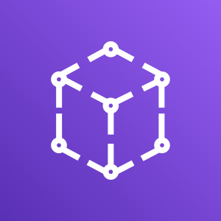
Microservices – with AWS AppMesh on ECS
AWS Cloud
Postman
Client
UMS Envoy Proxy
NS Envoy Proxy
Elastic Load
Balancer
App Mesh
User Management Service
Notification Service
API User
Notification Info AP
Proxy To Notification Info API
Egress 3306
Create User API
Send Notification API
End User
User Management Microservice
Notification Microservice
Egress 587
Amazon RDS
Simple Email
Service (SES)
Email
Author: Nho Luong
Skill: DevOps Engineer Lead

Slide 20
Microservices – Canary Deployments with AppMesh on ECS
AWS Cloud
App Mesh
Virtual Router
50% Traffic to V1
50% Traffic to V2
Postman
Client
UMS Envoy Proxy
NS Envoy Proxy – V1
NS Envoy Proxy – V2
Elastic Load
Balancer
User Management Service
Notification Service
Notification Service
API User
Proxy To Notification Info API
Notification Info API – V1
Notification Info API – V2
User Management Microservice
Notification Microservice
Notification Microservice
Author: Nho Luong
Skill: DevOps Engineer Lead

Slide 21



Fargate Deployments using CloudFormation
AWS Cloud
VPC
10.0.0.0/16
Public subnet
10.0.1.0/24
Internet
Task-1
Task Definition
Internet
Gateway
Elastic Load
Balancing
Task-2
Service
Fargate Cluster
Author: Nho Luong
Skill: DevOps Engineer Lead

Slide 22
AWS Fargate & ECS
Introduction
Author: Nho Luong
Skill: DevOps Engineer Lead

Slide 23
ECS & Fargate - Introduction
ECS – Elastic Container Service
Fargate – Serverless Container Service
ECS is a highly scalable, fast, container management service that makes it easy to run, stop, and manage Docker containers on a cluster.
We can host our cluster on a serverless infrastructure that is managed by Amazon ECS by launching our services or tasks using the Fargate launch type.
We can use Amazon ECS to schedule the placement of containers across our cluster based on our resource needs, isolation policies, and availability requirements.
Amazon ECS eliminates the need for us to operate our own cluster management and configuration management systems or worry about scaling our management infrastructure.
Author: Nho Luong
Skill: DevOps Engineer Lead

Slide 24
ECS & Fargate - Introduction
Amazon ECS can be used to create a consistent deployment and build experience, manage, and scale batch and Extract-Transform-Load (ETL) workloads, and build sophisticated application architectures on a microservices model.
Author: Nho Luong
Skill: DevOps Engineer Lead

Slide 25
AWS Fargate & ECS
First Steps
Author: Nho Luong
Skill: DevOps Engineer Lead

Slide 26
Fargate or ECS Objects
Task Definition
Cluster
ECS Objects
Service
Task
Author: Nho Luong
Skill: DevOps Engineer Lead

Slide 27
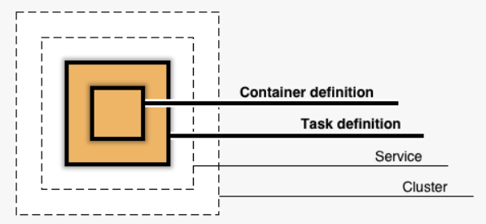
Fargate & ECS – First Steps
Container Definition
Nothing but container image and container level settings (Example: Container Image, Port, registry, Environment Variables to pass to container etc)
Task Definition
A task definition is a blueprint for our application and describes one or more containers through attributes.
Very few attributes are configured at the task level, but majority of attributes are configured per container.
It is a combination of multiple container definitions if we are using more than one container image in a Task.
Service
A service allows you to run and maintain a specified number (the "desired count") of simultaneous instances of a task definition in an ECS cluster.
Fargate Cluster
The infrastructure in a Fargate cluster is fully managed by AWS. Our containers run without we managing and configuring individual Amazon EC2 instances.
Task
A task is the instantiation of a task definition within a cluster.
After we have created a task definition for our application within Amazon ECS, we can specify the number of tasks that will run on our cluster (run task directly or configure to run from a service).
Each task that uses the Fargate launch type has its own isolation boundary and does not share the underlying kernel, CPU resources, memory resources, or elastic network interface with another task.
Author: Nho Luong
Skill: DevOps Engineer Lead

Slide 28
AWS Fargate & ECS
Clusters
Author: Nho Luong
Skill: DevOps Engineer Lead

Slide 29
Fargate & ECS Fundamentals – Clusters Introduction
We have 3 types of cluster templates available in ECS.
Fargate - Serverless
EC2 – Linux
EC2 - Windows
An ECS cluster is a logical grouping of tasks or services.
Clusters are Region-specific.
Clusters can contain tasks using both the Fargate and EC2 launch types.
ECS Cluster Types
Fargate (Serverless)
EC2 + Linux
EC2 + Windows
Author: Nho Luong
Skill: DevOps Engineer Lead

Slide 30
AWS Fargate & ECS
Cluster Features
Author: Nho Luong
Skill: DevOps Engineer Lead

Slide 31
Fargate & ECS Fundamentals – Cluster Features
Services
A service allows you to run and maintain a specified number of simultaneous instances of a task definition in an ECS cluster.
Tasks
A task is the instantiation of a task definition within a cluster
ECS Instances
Will be created when we create the cluster launch type of EC2+Linux or EC2+Windows
Metrics
CloudWatch Container Insights collects, aggregates, and summarizes metrics and logs from your containerized applications and microservices.
Clusters
(Fargate or ECS)
Scheduled Tasks
Used primarily for long running stateless services and applications.
Tags
ECS resources can be tagged with values that we define, to help us organize and identify them.
Capacity Providers
A capacity provider is used in association with a cluster to determine the infrastructure that a task runs on.
Update Cluster
Update the cluster settings primarily leading to Cluster Capacity Providers
Delete Cluster
Used to delete ECS EC2 or Fargate Clusters
Author: Nho Luong
Skill: DevOps Engineer Lead

Slide 32
AWS Fargate & ECS
Task Definition
Author: Nho Luong
Skill: DevOps Engineer Lead

Slide 33
Fargate & ECS Fundamentals – Task Definition
Task Definition
A task definition is required to run Docker containers in Amazon ECS
A task definition is a blueprint for our application and describes one or more containers through attributes.
Some attributes are configured at the task level, but majority of attributes are configured per container.
Task Definition Parameters - Core
The Docker image to use with each container in your task
How much CPU and memory to use with each task
The launch type to use, which determines the infrastructure on which our tasks are hosted (EC2 or Fargate)
The Docker networking mode to use for the containers in our task (Fargate defaults to awsvpc, where as EC2 supports docker networking models like Birdged, Host, None and awsvpc too).
The logging configuration to use for our tasks
Whether the task should continue to run if the container finishes or fails
Any data volumes that should be used with the containers in the task
And many more……..
Author: Nho Luong
Skill: DevOps Engineer Lead

Slide 34
Task Definitions
EC2 Launch Type
Task Definition Name
Task Definition – Parameters List
Task Role
Healthcheck
Network Mode
Environment
Task Execution IAM Role
Container Name
Environment Varibales
Fargate
Launch Type
Task Size (Memory, CPU)
Image
Container Timeouts
Container Definitions
Standard
Private Repo Authentication
Network Settings
Service Integration
Memory Limits (Soft, Hard)
Proxy Configuration
Storage & Logging
Port Mappings
Log Router Configuration
Resource Limits
Advanced
Volumes
Docker Labels
Author: Nho Luong
Skill: DevOps Engineer Lead

Slide 35
Fargate & ECS Fundamentals – Task Definition
Step-1: Create Task Definition
Task Role
IAM role that tasks can use to make API requests to authorized AWS services
Network Mode
For Fargate we have only option available is awsvpc in addition we will have Docker Bridge, Docker Host Only and None network modes. We will see them during ECS EC2 Cluster.
Task Execution Role
This role is required by tasks to pull container images and publish container logs to Amazon CloudWatch on our behalf.
Author: Nho Luong
Skill: DevOps Engineer Lead

Slide 36
Fargate & ECS Fundamentals – Task Definition
Create Task Definition
Task Size
The task size allows us to specify a fixed size for our task.
Task size is required for tasks using the Fargate launch type and is optional for the EC2 launch type.
Container level memory settings are optional when task size is set.
Task size is not supported for Windows containers.
Container Definition
Standard Settings
Container Name
Image: stacksimplify/dockerintro-springboot-helloworld-rest-api:1.0.0-RELEASE
Private Repo
Memory Limits
Port Mappings
Advanced Container Configurations
Storage & Logging: Log Configuration
Author: Nho Luong
Skill: DevOps Engineer Lead

Slide 37
AWS Fargate & ECS
Elastic Container Registry - ECR
Author: Nho Luong
Skill: DevOps Engineer Lead

Slide 38
Elastic Container Registry - ECR
Elastic Container Registry (ECR) is a fully-managed Docker container registry that makes it easy for developers to store, manage, and deploy Docker container images.
ECR is integrated with Elastic Container Service (ECS), simplifying our development to production workflow.
ECR eliminates the need to operate our own container repositories or worry about scaling the underlying infrastructure.
ECR hosts our images in a highly available and scalable architecture, allowing us to reliably deploy containers for our applications.
Integration with AWS Identity and Access Management (IAM) provides resource-level control of each repository.
With Amazon ECR, there are no upfront fees or commitments. We pay only for the amount of data you store in your repositories and data transferred to the Internet.
Author: Nho Luong
Skill: DevOps Engineer Lead

Slide 39
Elastic Container Registry - ECR
Benefits
Full managed
Secure
Highly Available
Simplified Workflow
Author: Nho Luong
Skill: DevOps Engineer Lead

Slide 40
How ECR Works?
Developer
Docker Container
Push Images
Elastic Container Service - ECS
Pull Images and Run Containers
Docker Image
Docker Container
Pull Images
Elastic Container Registry - ECR
Elastic Kubernetes Service - EKS
Docker Container
On-Premise
Author: Nho Luong
Skill: DevOps Engineer Lead

Slide 41
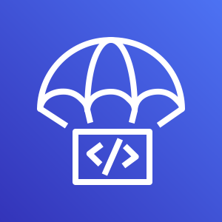
AWS Fargate & ECS
Continuous Integration & Continuous Delivery
CodeCommit
CodeBuild
CodeDeploy
CodePipeline
CloudWatch
Simple Notification Service
Author: Nho Luong
Skill: DevOps Engineer Lead

Slide 42
Stages in Release Process
Source
Build
Test
Production
Check-in source code
Peer review new code
Pull Request process
Compile Code & build artifacts (war ,jar, container images, Kubernetes manifest files)
Unit Tests
Integration tests with other systems.
Load Testing
UI Tests
Security Tests
Test Environments (Dev, QA and Staging)
Deployment to production environments
Monitor code in production to quickly detect errors
Deployment to production environments
Monitor code in production to quickly detect errors
Author: Nho Luong
Skill: DevOps Engineer Lead

Slide 43

Stages in Release Process
Source
Build
Test
Production
Author: Nho Luong
Skill: DevOps Engineer Lead

Slide 44
Continuous Integration
Source
Build
Test
Production
Automatically kick off a new release when new code is checked- in
Build and test code in a consistent, repeatable environment
Continually have an artifact ready for deployment
Author: Nho Luong
Skill: DevOps Engineer Lead

Slide 45
Continuous Delivery
Source
Build
Test
Production
Automatically deploy new changes to staging environments for testing
Deploy to production safely without affecting customers
Deliver to customers faster
Increase deployment frequency, and reduce change lead time and change failure rate
Author: Nho Luong
Skill: DevOps Engineer Lead

Slide 46
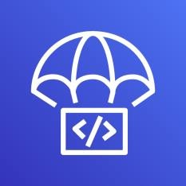
AWS Developer Tools or Code Services
Source
Build
Test
Deploy
Monitor
AWS CodeCommit
AWS CodeBuild
AWS CodeBuild + Third Party
CodeDeploy
Fargate
or ECS
Amazon CloudWatch
Author: Nho Luong
Skill: DevOps Engineer Lead
AWS CodePipeline

Slide 47
AWS Developer Tools or Code Services
Source
Build
Test
Deploy
Monitor
AWS CodeCommit
AWS CodeBuild
AWS CodeBuild + Third Party
Fargate
or ECS
Amazon CloudWatch
Author: Nho Luong
Skill: DevOps Engineer Lead
AWS CodePipeline

Slide 48
AWS CodeCommit
Author: Nho Luong
Skill: DevOps Engineer Lead

Slide 49
AWS CodeCommit - Introduction
Version Control Service hosted by AWS
We can privately store and manage documents, source code, and binary files
Secure & highly scalable
Supports standard functionality of Git (CodeCommit supports Git versions 1.7.9 and later.)
Uses a static user name and password in addition to standard SSH..
Author: Nho Luong
Skill: DevOps Engineer Lead

Slide 50






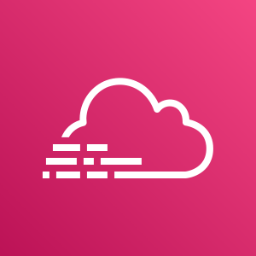
CodeCommit – Integration with AWS Services
AWS CodeStar
AWS CodeBuild
AWS CodePipeline
AWS Cloud9
AWS Amplify
AWS CloudFormation
AWS CodeCommit
Amazon Simple Notification Service
AWS Key Management Service
AWS Elastic Beanstalk
AWS CloudTrail
Amazon CloudWatch
Author: Nho Luong
Skill: DevOps Engineer Lead

Slide 51
CodeCommit - Steps
Developer
Local Git Repo
push
AWS Cloud
AWS CodeCommit
Author: Nho Luong
Skill: DevOps Engineer Lead

Slide 52
AWS CodeBuild
Author: Nho Luong
Skill: DevOps Engineer Lead

Slide 53
CodeBuild - Introduction
CodeBuild is a fully managed build service in the cloud.
Compiles our source code, runs unit tests, and produces artifacts that are ready to deploy.
Eliminates the need to provision, manage, and scale our own build servers.
It provides prepackaged build environments for the most popular programming languages and build tools such as Apache Maven, Gradle, and many more.
We can also customize build environments in CodeBuild to use our own build tools.
Scales automatically to meet peak build requests.
Author: Nho Luong
Skill: DevOps Engineer Lead

Slide 54
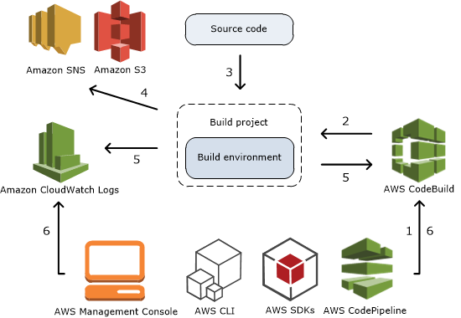
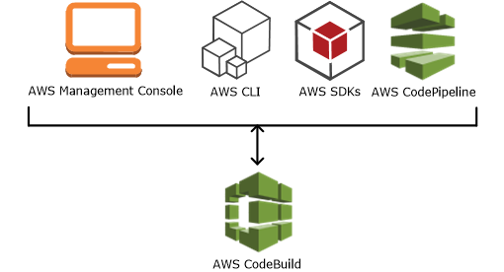
How to run CodeBuild?
How CodeBuild works?
Author: Nho Luong
Skill: DevOps Engineer Lead

Slide 55



Source
AWS CodeCommit
Amazon Simple Storage Service (S3)
GitHub
GitHub Enterprise
Bitbucket
AWS Managed Image
AWS CodeBuild
Amazon CloudWatch
Build Logs
Amazon EC2 Container Registry
Amazon Simple Notification Service
External Container Registry (Docker Hub)
Amazon Simple Storage Service (S3)
Build Notifications
Build Environment
Build Artifacts
AWS CodeBuild Architecture
Author: Nho Luong
Skill: DevOps Engineer Lead

Slide 56
CodeBuild - Steps
Developer
Commit code changes
Local Git Repo
push
AWS Cloud
AWS CodeCommit
AWS CodeBuild
Simple Storage
Service (S3)
Author: Nho Luong
Skill: DevOps Engineer Lead

Slide 57
AWS CodePipeline
Author: Nho Luong
Skill: DevOps Engineer Lead

Slide 58
CodePipeline - Introduction
AWS CodePipeline is a continuous delivery service to model, visualize, and automate the steps required to release your software.
Benefits
We can automate our release processes.
We can establish a consistent release process.
We can speed up delivery while improving quality.
Supports external tools integration for source, build and deploy.
View progress at a glance
View pipeline history details.
Author: Nho Luong
Skill: DevOps Engineer Lead

Slide 59




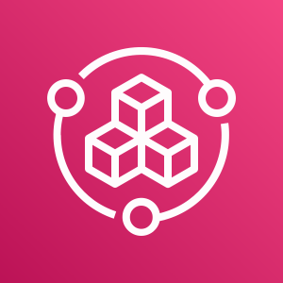
AWS CodePipeline Architecture
AWS CodePipeline
AWS CodeCommit
AWS CloudFormation
Amazon Elastic Container Service
AWS CodeBuild
Amazon CloudWatch
Amazon EC2 Container Registry
AWS CodeDeploy
Amazon Elastic Container Service (Blue/Green)
Simple Storage
Service (S3)
AWS Elastic Beanstalk
Jenkins
GitHub Webhooks
Simple Storage
Service (S3)
GitHub
AWS Service Catalog
Source
Build
Deploy
Monitor Source Changes
Author: Nho Luong
Skill: DevOps Engineer Lead

Slide 60
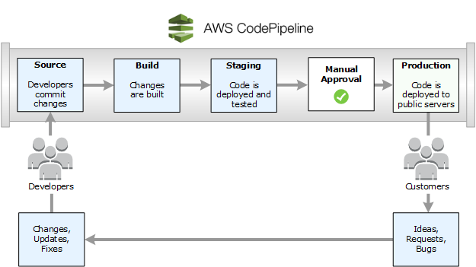
Continuous Delivery
Author: Nho Luong
Skill: DevOps Engineer Lead
©Amazon

Slide 61
AWS Cloud
CI CD Process
Developer
CloudWatch
CodePipeline
Commit code changes
Local Git Repo
push
S3
CodeCommit
CodeBuild
Fargate or ECS
Simple Notification
Service
ECR
Staging
Production
Authorized
Approver
Task
Definition
Service
Container
Task
Definition
Service
Container
Elastic Container Service
Author: Nho Luong
Skill: DevOps Engineer Lead

Slide 62
AWS Fargate & ECS
What are Microservices?
Author: Nho Luong
Skill: DevOps Engineer Lead

Slide 63
What are Microservices?
Microservices - also known as the microservice architecture - is an architectural style that structures an application as a collection of services that are
Highly maintainable and testable
Loosely coupled
Independently deployable
Organized around business capabilities
Owned by a small team
Author: Nho Luong
Skill: DevOps Engineer Lead

Slide 64
Microservices - Benefits
Developer independence: Small teams work in parallel and can iterate faster than large teams.
Isolation and resilience: If a component dies, you spin up another while and the rest of the application continues to function.
Scalability: Smaller components take up fewer resources and can be scaled to meet increasing demand of that component only.
Lifecycle automation: Individual components are easier to fit into continuous delivery pipelines and complex deployment scenarios not possible with monoliths.
Relationship to the business: Microservice architectures are split along business domain boundaries, increasing independence and understanding across the organization.
Author: Nho Luong
Skill: DevOps Engineer Lead

Slide 65
Microservices Deployment on AWS ECS – No Service Discovery
AWS Cloud
User Management Service
/usermgmt*
Task
Definition
Service
Container
Amazon RDS
Postman
Client
services.stacksimplify.com
Elastic Load Balancing (ELB)
End User
/notification*
Notification Service
Task
Definition
Service
Container
Simple Email
Service (SES)
/notification*
Email
API Developer
Author: Nho Luong
Skill: DevOps Engineer Lead

Slide 66
Microservices Deployment on ECS - with Service Discovery
AWS Cloud
User Management Service
/usermgmt*
Task
Definition
Service
Container
Amazon RDS
Postman
Client
services.stacksimplify.com
/notification*
Elastic Load Balancing (ELB)
AWS Cloud Map
Amazon Route 53
End User
/notification*
Notification Service
Task
Definition
Service
Container
Simple Email
Service (SES)
/notification*
Email
API Developer
Author: Nho Luong
Skill: DevOps Engineer Lead

Slide 67
Microservices – with AWS AppMesh on ECS
AWS Cloud
Postman
Client
UMS Envoy Proxy
NS Envoy Proxy
Elastic Load
Balancer
App Mesh
User Management Service
Notification Service
API User
Notification Info AP
Proxy To Notification Info API
Egress 3306
Create User API
Send Notification API
End User
User Management Microservice
Notification Microservice
Egress 587
Amazon RDS
Simple Email
Service (SES)
Email
Author: Nho Luong
Skill: DevOps Engineer Lead

Slide 68
Microservices – Canary Deployments with AppMesh on ECS
AWS Cloud
App Mesh
Virtual Router
50% Traffic to V1
50% Traffic to V2
Postman
Client
UMS Envoy Proxy
NS Envoy Proxy – V1
NS Envoy Proxy – V2
Elastic Load
Balancer
User Management Service
Notification Service
Notification Service
API User
Proxy To Notification Info API
Notification Info API – V1
Notification Info API – V2
User Management Microservice
Notification Microservice
Notification Microservice
Author: Nho Luong
Skill: DevOps Engineer Lead

Slide 69
AWS Fargate & ECS
Microservices Deployment
Author: Nho Luong
Skill: DevOps Engineer Lead

Slide 70
Microservices
User Management Microservice
Notification Microservice
Author: Nho Luong
Skill: DevOps Engineer Lead

Slide 71
Microservices
Postman
Client
Create User API
Send Notification API
List Users API
Health Status API
Email
End User
Delete User API
Health Status API
User Management Microservice
Notification Microservice
API Developer
Or
API User
Users DB
SMTP Server
Author: Nho Luong
Skill: DevOps Engineer Lead

Slide 72
Microservices Deployment on AWS ECS
AWS Cloud
User Management Service
/usermgmt*
Task
Definition
Service
Container
Amazon RDS
Postman
Client
services.stacksimplify.com
Elastic Load Balancing (ELB)
End User
/notification*
Notification Service
Task
Definition
Service
Container
Simple Email
Service (SES)
/notification*
Email
API Developer
Author: Nho Luong
Skill: DevOps Engineer Lead

Slide 73
AWS Fargate & ECS
Microservices
Service Discovery
Author: Nho Luong
Skill: DevOps Engineer Lead

Slide 74
Microservices Deployment on ECS with Service Discovery
AWS Cloud
User Management Service
/usermgmt*
Task
Definition
Service
Container
Amazon RDS
Postman
Client
services.stacksimplify.com
/notification*
Elastic Load Balancing (ELB)
AWS Cloud Map
Amazon Route 53
End User
/notification*
Notification Service
Task
Definition
Service
Container
Simple Email
Service (SES)
/notification*
Email
API Developer
Author: Nho Luong
Skill: DevOps Engineer Lead

Slide 75
AWS Fargate & ECS
Cloud Map
Author: Nho Luong
Skill: DevOps Engineer Lead

Slide 76
Complexity of modern architectures
Wide variety of resources
Complexity grows exponentially
Multiple versions and stages coexist
Infrastructure scales dynamically
Unhealthy resources are replaced
Author: Nho Luong
Skill: DevOps Engineer Lead

Slide 77
How to find resources to connect to?
Service Discovery
Finding the location of a service provider
myapp: {10.20.30.4:8080, 10.20.30.6:8080}
mylogs: {S3bucket1, S3bucket2}
Author: Nho Luong
Skill: DevOps Engineer Lead

Slide 78
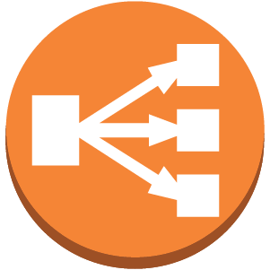
Server-side service discovery pattern
Connections are proxied
Discovery is abstracted away
Availability and capacity impact
Additional latency
Request
Request
Client
Service Provider
LB +
Service Registry
Register
Service Provider
Register
Service Provider
Author: Nho Luong
Skill: DevOps Engineer Lead

Slide 79
Client-side service discovery pattern
Clients connect directly to providers
Fewer components in the system
Clients must be registry-aware
Client-side load balancing
Request
Client
Service Provider
Register
Query
Service Provider
Register
Service
Registry
Service Provider
Register
Author: Nho Luong
Skill: DevOps Engineer Lead

Slide 80






Existing solutions require setup and management
Service registry
Service Registries
Author: Nho Luong
Skill: DevOps Engineer Lead

Slide 81








Build the dynamic map of your cloud
Author: Nho Luong
Skill: DevOps Engineer Lead

Slide 82
AWS Cloud Map - Introduction
AWS Cloud Map is a cloud resource discovery service.
With Cloud Map, you can define custom names for your application resources, and it maintains the updated location of these dynamically changing resources.
This increases your application availability because your web service always discovers the most up-to-date locations of its resources.
Cloud Map allows you to register any application resources, such as databases, queues, microservices, and other cloud resources, with custom names.
Cloud Map then constantly checks the health of resources to make sure the location is up-to-date.
The application can then query the registry for the location of the resources needed based on the application version and deployment environment.
Author: Nho Luong
Skill: DevOps Engineer Lead

Slide 83
AWS Cloud Map registry
microservices.local
Namespace
Service
Service Instance
notification-service
Name = notification-service DNS record = A TTL = 60 sec
Health Check = Yes
ECS Task-1 172.10.0.1
ECS Task-2 172.10.0.2
ECS Task-3 172.10.0.3
Author: Nho Luong
Skill: DevOps Engineer Lead

Slide 84
AWS Fargate & ECS
Microservices & App Mesh
Author: Nho Luong
Skill: DevOps Engineer Lead

Slide 85
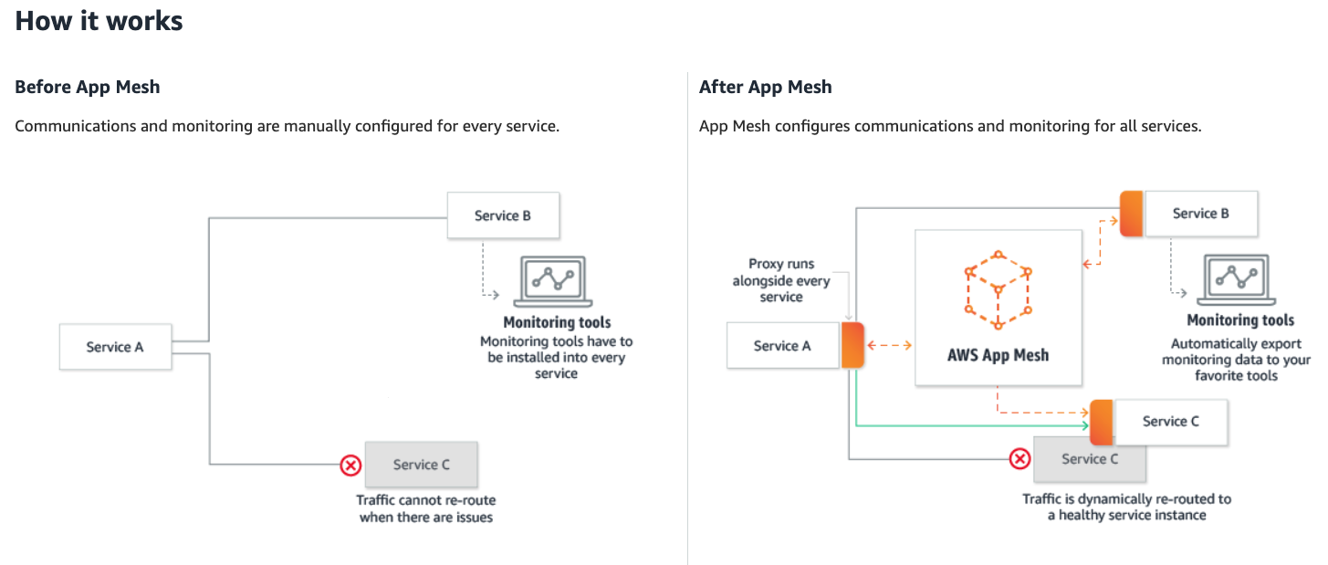
AWS App Mesh
Refernce: https://aws.amazon.com/app-mesh/
Author: Nho Luong
Skill: DevOps Engineer Lead

Slide 86
Microservices – without AWS AppMesh on ECS
AWS Cloud
User Management Service
Notification Service
Proxy To Notification Info API
Notification Info AP
Postman
Client
Create User API
Send Notification API
End User
Elastic Load
Balancer
User Management Microservice
Notification Microservice
Amazon RDS
Simple Email
Service (SES)
API User
Email
Author: Nho Luong
Skill: DevOps Engineer Lead

Slide 87
Microservices – with AWS AppMesh on ECS
AWS Cloud
Postman
Client
UMS Envoy Proxy
NS Envoy Proxy
Elastic Load
Balancer
App Mesh
User Management Service
Notification Service
API User
Notification Info AP
Proxy To Notification Info API
Egress 3306
Create User API
Send Notification API
End User
User Management Microservice
Notification Microservice
Egress 587
Amazon RDS
Simple Email
Service (SES)
Email
Author: Nho Luong
Skill: DevOps Engineer Lead

Slide 88
AWS Fargate & ECS
Microservices Canary Deployments with App Mesh
Author: Nho Luong
Skill: DevOps Engineer Lead

Slide 89
Microservices – Canary Deployments with AppMesh on ECS
AWS Cloud
App Mesh
Virtual Router
50% Traffic to V1
50% Traffic to V2
Postman
Client
UMS Envoy Proxy
NS Envoy Proxy – V1
NS Envoy Proxy – V2
Elastic Load
Balancer
User Management Service
Notification Service
Notification Service
API User
Proxy To Notification Info API
Notification Info API – V1
Notification Info API – V2
User Management Microservice
Notification Microservice
Notification Microservice
Author: Nho Luong
Skill: DevOps Engineer Lead

Slide 90
AWS Fargate & ECS
CloudFormation
Author: Nho Luong
Skill: DevOps Engineer Lead

Slide 91
Fargate Tasks – Public Subnet in a VPC
AWS Cloud
VPC
10.0.0.0/16
Public subnet
10.0.1.0/24
Internet
Task-1
Task Definition
Internet
Gateway
Elastic Load
Balancing
Task-2
Service
Fargate Cluster
Author: Nho Luong
Skill: DevOps Engineer Lead

Slide 92

Thank You
Author: Nho Luong
Skill: DevOps Engineer Lead

