Slide 1
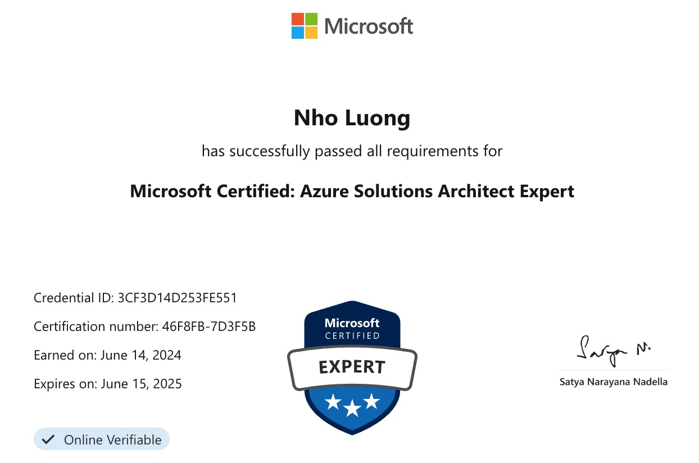
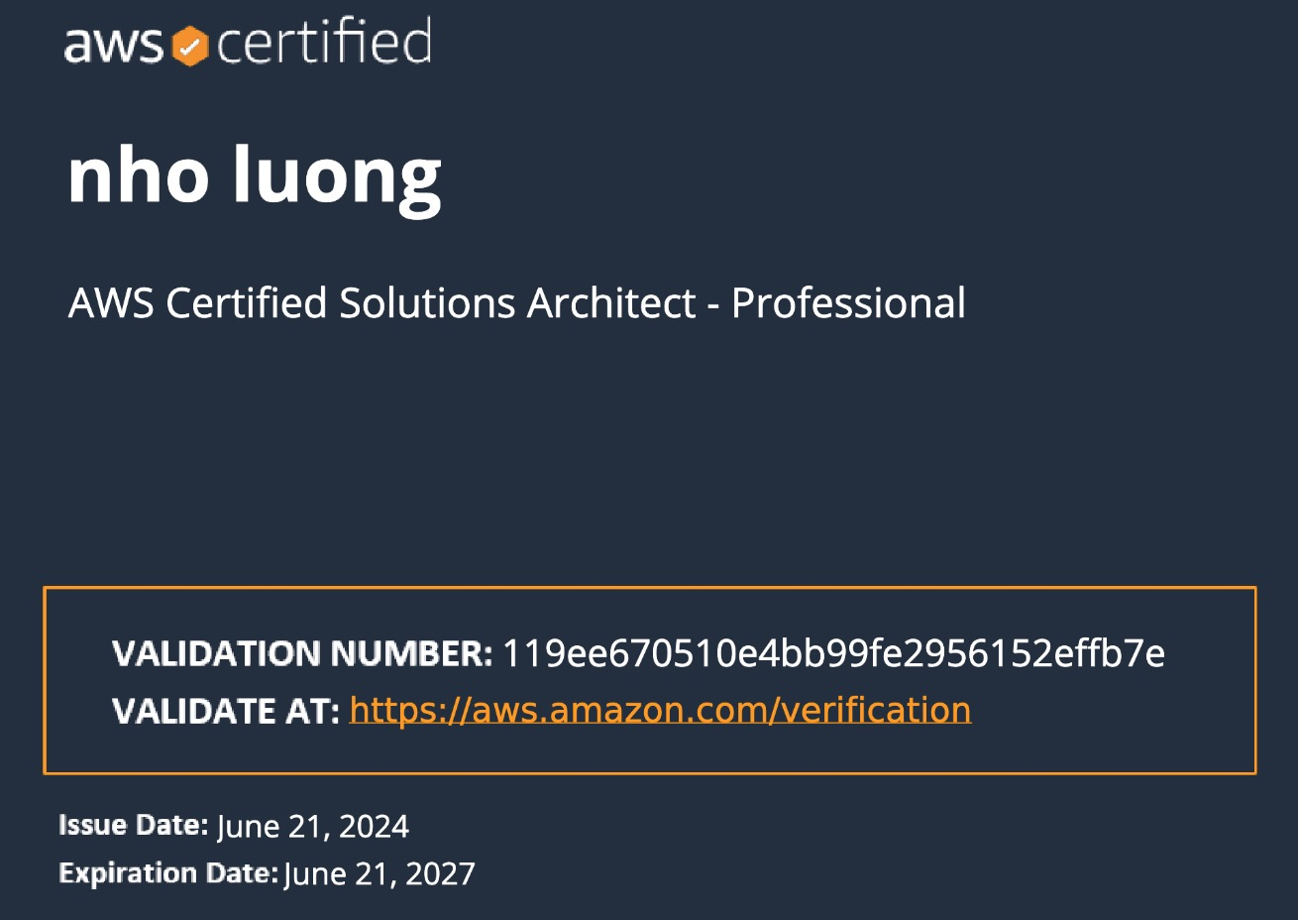

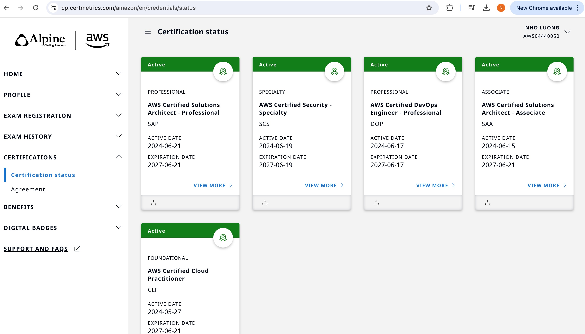
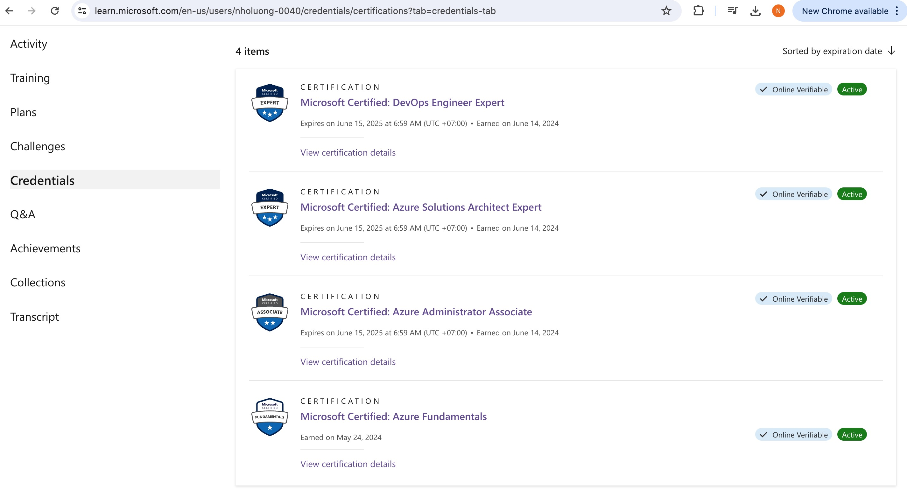
Docker Fundamentals
Author: Nho Luong
Skill: DevOps Engineer Lead
Author: Nho Luong
Skill: DevOps Engineer Lead

Slide 2
Docker
Introduction
Author: Nho Luong
Skill: DevOps Engineer Lead

Slide 3

What problems we have with Traditional Infra?
Traditional Approach
Installation & Configuration
Time consuming
Need to perform install/configs on every server and every environment (dev, qa, staging, production)
Compatibility & Dependency
Need to keep resolving issues related to libraries and dependencies
Inconsistencies across Environments
Very hard to track changes across Dev/QA/Staging and Prod environments and they end up with inconsistencies
Operational Support
Need more resources to handle operational issues on day to day basis
Server Support (hardware, software)
Patching releases
Developer Environments
When a new developer joins the team, time it takes to provision his development environment in traditional approach is time taking.
Webservers
AppServers
Databases
Libraries
Dependencies
Operating System
Hardware Infrastructure
Author: Nho Luong
Skill: DevOps Engineer Lead

Slide 4
Physical Machines
Virtual Machines
Virtual Machine
Virtual Machine
Webservers
AppServers
Databases
Webservers
AppServers
Databases
Webservers
AppServers
Databases
Libs
Deps
Libs
Deps
Operating System
Operating System
Libraries
Dependencies
Hypervisor
Operating System
Hardware Infrastructure
Hardware Infrastructure
Author: Nho Luong
Skill: DevOps Engineer Lead

Slide 5
Physical Machines with Docker
Container
Container
Container
Webservers
AppServers
Databases
Libs
Deps
Libs
Deps
Libs
Deps
Docker
Operating System
Hardware Infrastructure
Author: Nho Luong
Skill: DevOps Engineer Lead

Slide 6
Virtual Machines with Docker
Virtual Machine
Virtual Machine
Container
Container
Container
Container
Container
Container
Webservers
AppServers
Databases
Webservers
AppServers
Databases
Libs
Deps
Libs
Deps
Libs
Deps
Libs
Deps
Libs
Deps
Libs
Deps
Docker
Docker
Operating System
Operating System
Hypervisor
Hardware Infrastructure
Author: Nho Luong
Skill: DevOps Engineer Lead

Slide 7
Advantages of using Docker
Flexible
Even the most complex applications can be containerized.
Lightweight
Containers leverage and share the host kernel, making them much more efficient in terms of system resources than virtual machines.
Portable
You can build locally, deploy to the cloud, and run anywhere.
Why Containers ?
Loosely Coupled
Containers are highly self sufficient and encapsulated, allowing you to replace or upgrade one without disrupting others.
Scalable
You can increase and automatically distribute container replicas across a datacenter.
Secure
Containers apply aggressive constraints and isolations to processes without any configuration required on the part of the user.
Author: Nho Luong
Skill: DevOps Engineer Lead

Slide 8
Docker
Architecture
Author: Nho Luong
Skill: DevOps Engineer Lead

Slide 9
Docker - Terminology
Docker Daemon
The Docker daemon (dockerd) listens for Docker API requests and manages Docker objects such as images, containers, networks, and volumes.
Docker Client
Docker client can be present on either Docker Host or any other machine.
The Docker client (docker) is the primary way that many Docker users interact with Docker.
When you use commands such as docker run, the client sends these commands to dockerd (Docker Daemon), which carries them out.
The docker command uses the Docker API.
The Docker client can communicate with more than one daemon.
Docker Images
An image is a read-only template with instructions for creating a Docker container.
Often, an image is based on another image, with some additional customization.
For example, we may build an image which is based on the ubuntu image, but installs the Apache web server and our application, as well as the configuration details needed to make our application run.
Docker Containers
A container is a runnable instance of an image.
We can create, start, stop, move, or delete a container using the Docker API or CLI.
We can connect a container to one or more networks, attach storage to it, or even create a new image based on its current state.
When a container is removed, any changes to its state that are not stored in persistent storage disappear.
Docker Client (Optional)
Docker Daemon
Image-1
Container-11
Image-2
Container-21
Images
Containers
Docker Host
Author: Nho Luong
Skill: DevOps Engineer Lead

Slide 10
Docker - Terminology
nginxdemos/hello
Docker Daemon
Docker Registry
(Docker Hub)
nginxdemos/hello
Container-11
Images
Containers
Docker Host
docker pull nginxdemos/hello
Docker Registry or Docker Hub
A Docker registry stores Docker images.
Docker Hub is a public registry that anyone can use, and Docker is configured to look for images on Docker Hub by default.
We can even run our own private registry.
When we use the docker pull or docker run commands, the required images are pulled from our configured registry.
When we use the docker push command, our image is pushed to our configured registry.
docker run -p 82:80 -d nginxdemos/hello
Docker Client (My Desktop or Docker Host)
Author: Nho Luong
Skill: DevOps Engineer Lead

Slide 11

Thank You
Author: Nho Luong
Skill: DevOps Engineer Lead

