Slide 1
Modeling of National Football Teams
Max DePalma, Daniel Farias, Nicolas Homble, Austin Hou

Slide 2
Introduction
We model the performance of national football teams in order to predict future games
We use properties of Poisson Random Variables to construct two separate models
We use our tested models to predict the result of next month’s FIFA World Cup

Slide 3
Previous Literature
It is widely accepted that the Poisson random variable is a simple and effective modelling approach to the goals scored in sports.
Factors to consider:
Season predictions verus World Cup predictions
Historical data of club teams versus Historical data for national teams
Information gained from a match result, 1-0 or 2-0 or 4-0
We read papers from Karlis and Ntzoufras who initially presented the bivariate poisson distribution as a means of prediction and then there more recent paper in 2009 that addresses the robustness of the ideas discussed in their first paper

Slide 4
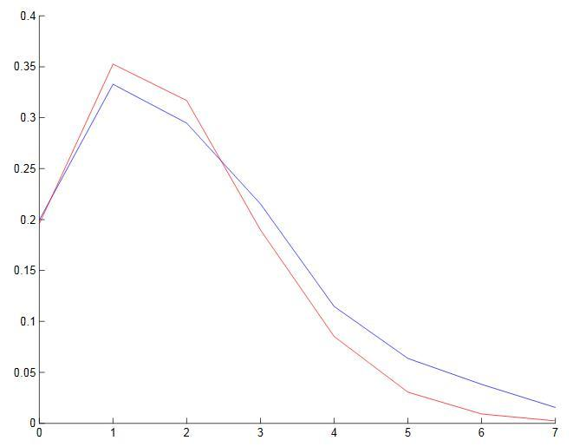
Brazil Scoring PDF (Red is Poisson)

Slide 5
Problem
Prediction of team performance at an international level
Try a couple approaches to model games
Model 1 is based on historical performance of each team
Model 2 is based on the current player statistics from FIFA videogames

Slide 6
Scores From Distributions
Each team has a distribution for offense and defense.
-Describes goals scored and conceded when matched against an average team
-For random variables O₁, D₁, O₂, and D₂ (offensive and defensive random variables for teams 1 and 2), we define the random variables S₁ and S₂ (Scores for each team) as follows:
-S₁ = (O₁*D₂)/A -S₂ = (O₂*D₁)/A
where A is the population average number of goals per game.
-Consequently, calculating the expected number of goals is simple:
E[S₁] = E[(O₁*D₂)/A] = E[O₁] * E[D₂] / A = λ_{O1} * λ_{D2}/ A

Slide 7
Examples Showing Our Rationale
E[O*D/A] = E[O]*E[D]/A = (λ_{O} *λ_{D})/A since the offensive and defensive distributions are independent
Assuming that A is 2, our model works for all of these cases, whereas averaging fails many of them
λ_{O} | 2 | 3 | 4 | 4 | 4
λ_{D} | 2 | 1.5 | 0.5 | 1 | 2
Mean | 2 | 2 | 2.25 | 2.5 | 3
Our Model | 2 | 2.5 | 1 | 2 | 4

Slide 8
Model One: Historical Performance

Slide 9
Model and Historical Data
We collected historical data for the top 120 national teams based on ELO rankings.
Every international game is available at eloratings.net
Data was parsed and formatted using Ruby.
Both of the teams lambda parameters get updated over time. As the team plays
new games, the value goes up or down with the performance of that game.

Slide 10
Algorithm
All teams’ lambdas are initiated as the overall average
Approximately 1.4 goals score/conceded per game
Iterate through every game in chronological order starting in 1870, adjusting the lambdas after every result.
Given the opponent’s defense, λ_{D2}, and the score, s, the update function calculates
g(λ_{D2}, s) = E[O₁ | D₂ = λ_{D2}, S = s]
It averages this expected lambda with the current lambda, given some weight, K:
λ_{O1-new} = (K*λ_{O1-old} + c*g(λ_{D2}, s)) / (K + 1)
c is 2 for important matches, and 1 for friendlies.
The inverse is done to find λ_{D1-new}, given goals conceded. The same procedure is used to update the opposing team.

Slide 11
Comparison with SPI
SPI rankings, by Nate Silver, offer generally similar results
Attacking | Our Model | SPI
Brazil: | 3.630651 | 3.4
Germany: | 3.480482 | 3.1
Spain: | 2.515815 | 2.8
Holland: | 2.442403 | 2.4
Argentina: | 2.416903 | 2.9
Defensive | Our Model | SPI
Brazil: | 0.489058 | 0.5
France: | 0.615275 | 0.6
Spain: | 0.653256 | 0.5
Russia: | 0.680237 | 0.7
Colombia: | 0.698077 | 0.4

Slide 12
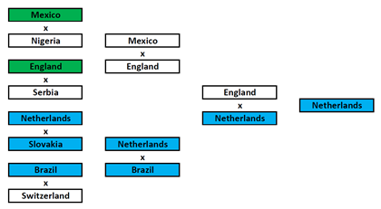
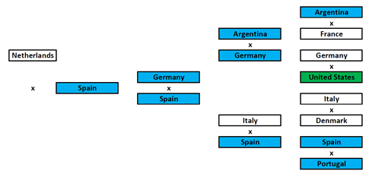
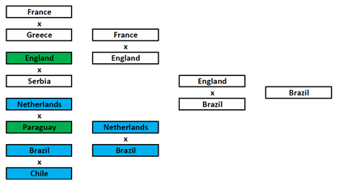
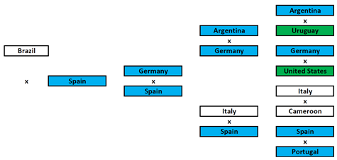
Verification
The model was used to predict the results of the 2010 FIFA World Cup.
The results are compared to the official FIFA rankings.
Both models correctly predict 19 of the 31
countries in each of the stages
Our model predicts 16 countries in the exact
spot, whereas FIFA only predicts 14 correctly.

Slide 13
Verification
We use historical data up to 2012 in order to generate models and test them on all games played in 2013 and 2014 of only World Cup teams.
Overall accuracy for our model: 61.1%
For FIFA: 58.2%
Overall accuracy for only top teams: 82.1%
For FIFA: 75.0%

Slide 14
Further Simulation
We simulated the 2014 World Cup one million times by sampling from a Poisson Distribution, and we got the following winners:
Brazil - 18.8209 %
Germany - 13.3955 %
Spain - 10.3612 %
England - 8.5338 %
Argentina - 8.457 %
Portugal - 8.0737 %
The Netherlands- 5.0886 %

Slide 15
Model Two: Player Performance

Slide 16
The Model and EA Sports Data
We utilize player ratings from EA Sports available in the FIFA 14 video games
The data was collected from fuzwiz.com and futhead.com
We model each player by a single Poisson Distribution.
For offensive players, they represent part of λ_{O}.
For defensive players, they represent part of λ_{D}.

Slide 17
The Model
If each attacking player is represented by a Poisson Distribution with parameter λ_{Oi}, the attacking distribution for the team as a whole is another Poisson:
P(λ_{O1}) + P(λ_{O2}) + … + P(λ_{On}) = P(λ_{O}), where λ_{O}= λ_{O1}+ λ_{O2}+ … + λ_{On}
Thus, we can approach the problem from the perspective of teams with an expected defensive and offensive performance.
For calculating score we used a slightly different average scored (1.5)

Slide 18
Algorithm
Players were classified as offensive (strikers, forwards, wings, etc.) and defensive (keeper, backs, defensive midfielders, etc.).
Using each player’s overall score, the offensive and defensive scores for each team were calculated as a mean:
O = 1/N * ΣO_{Pi}, where O_{Pi} represents the score for each offensive player Pi on the team. The defense scores were calculated in the same way.
These ratings were fitted against club team standings at the end of the 2014 season
We came up with two curves:
OffensiveTransform: offensive rating → expected goals per game
DefensiveTransform: defensive rating → expected number of goal conceded

Slide 19
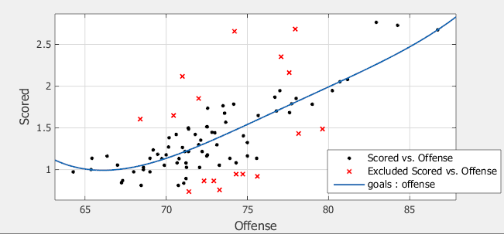
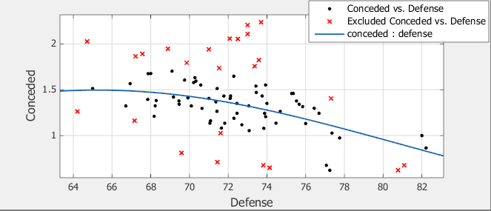
Curve Fitting

Slide 20
Verification
Generated lambdas were used to predict the outcomes of past games.
This was compared to the actual outcomes of matches from 2006 to 2014
Peak accuracy was 79.9% for 2014 games.
This makes sense, as player data is up-to-date, and past years had different teams
Along this logic, it did not make sense to verify our model with the previous world cup results like we did in the first model

Slide 21
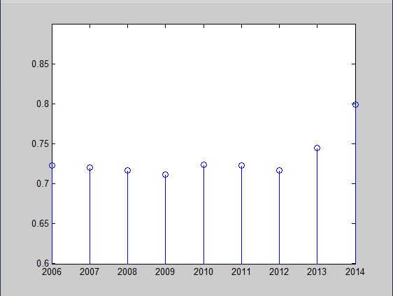
Verification
Model accuracy vs. minimum year predicted
Here we show the percentage of historical matches
we were able to predict correctly (result-wise). Actually
coming up with the score for a match is very difficult

Slide 22
Further Simulation
We simulated the 2014 World Cup by sampling from a Poisson Distribution, and we got the following winners:
Spain – 15.6%
Argentina – 12.3%
Italy – 11.8%
Portugal – 9.6%
Brazil – 7.3%

Slide 23
Validity of Model
Past just verification, we should address where the ratings stem from in the first place. If the ratings are just a reflection of win rate, then we simply have a model that can mimic its test data but have little predictive power.
This is why we chose to come up with a team rating based off of the players and not the teams standing.
FIFA determines team rating through match history only. EA is thorough in their rating (still subjective).
A player’s rating is dependent on their position
A player has over 10 fields for ranking

Slide 24
Summary & Comparison
The first model seemed to match SPI much better
The “offensive” sub-ratings had stronger correlation than “defensive” in model 2
The second model has the advantage of having greater detail pertaining to current data

Slide 25
Shortcomings
Model 1:
There is not as much international data, which is what Model 1 is based on
Model 2:
Ratings were not entirely consistent across different leagues
Team Dynamic is not factored in for Model 2

Slide 26
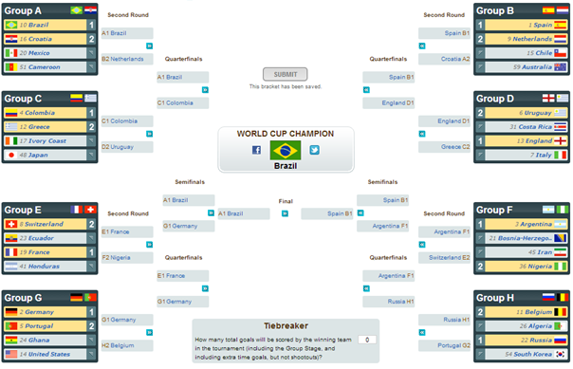
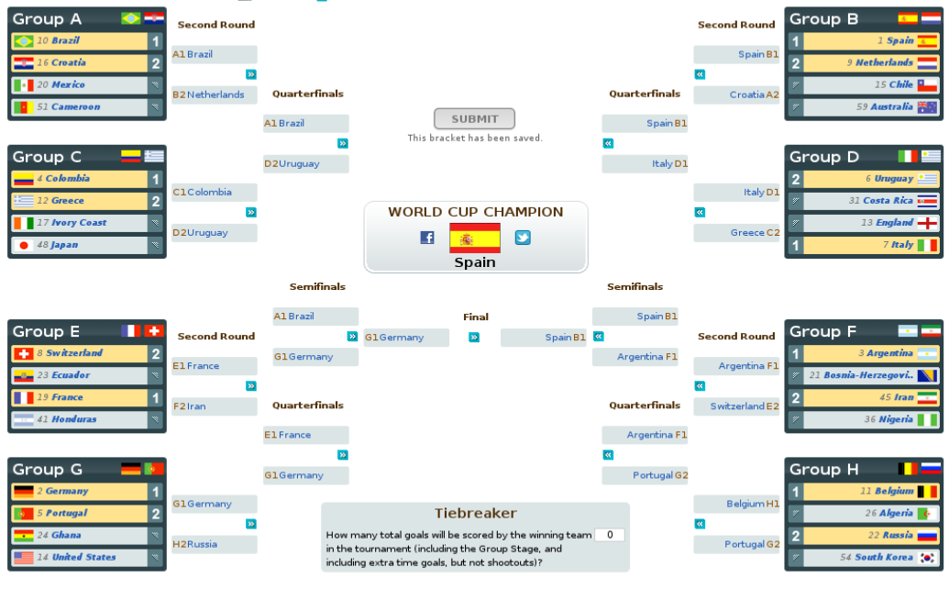
World Cup Predictions
History-Based Model
Player Rating Model

