Slide 1
Association Analysis using R
Used “arules” package to mine frequent itemsets, Apriori algorithm implementation.
Most categories have low support and confidence
Page visits concentrates in 7 out of 17 categories (support threshold = 1%):
Frequent categories: Front Page, On-Air, News, Local, Tech, Sports, and Business. (support >= 1%)
Less frequent categories: Weather, MSN-News, Misc., MSN-Sports, Living, Health, Summary, Opinion, Travel, BBS (support <1%)
Page visits tend to concentrate in one or two categories:
61% with size = 1
31% with size = 2
8% with size >= 3

Slide 2
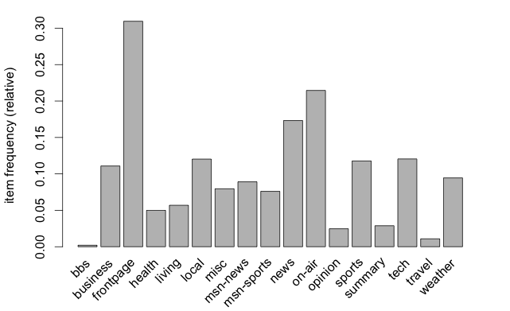
Item Frequency

Slide 3
Itemset Size Distribution

Slide 4
Rules Visualization with arulesViz
37 rules : min support = 1%, min confidence = 30%
Visualization types:
Scatter plot
Matrix (3DMatrix)
Grouped
Graph
Parallel coordinate

