Slide 2
Mining User Access Patterns from Web Application Logs
CSC 7442 - Data Mining
Brandon Oubre, Chester Parrott, Michael Thomas, Ai Tran
Notes:
Introduce the group and project name

Slide 3
Introduction
[Ai Tran]

Slide 4
Overview
Introduction
Association Analysis
Sequential Analysis
Markov Analysis
Conclusion

Slide 5
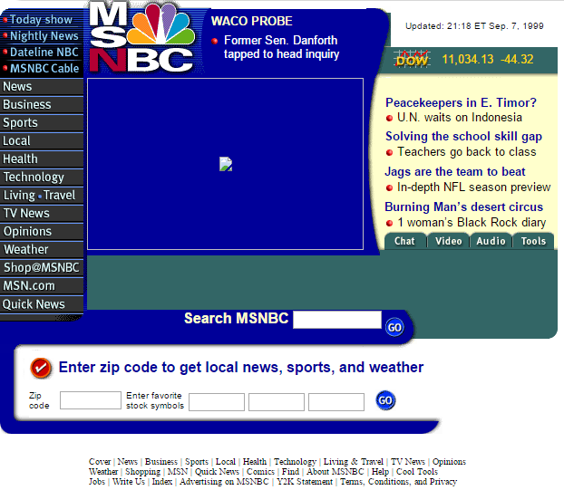
MSNBC.com (circa. September 1999)
The Movie: Sixth Sense was new in theaters
Michael Johnson captured the 400 M. world record
Lance Armstrong won his first Tour de France
The initial release of Napster
Apple Computer released the first iBook
Microsoft releases Windows 98 Second Edition
Bluetooth announced.
Billions spent on Y2K bug
Myspace is introduced to the internet
http://web.archive.org/web/19990908015206/http://msnbc.com/news/default.asp

Slide 6
MSNBC.com Anonymous Web Data Data Set
The data comes from Internet Information Server (IIS) logs for msnbc.com and news-related portions of msn.com for the entire day of September, 28, 1999 (Pacific Standard Time).
Each sequence in the dataset corresponds to page views of a user during that twenty-four hour period.
Each event in the sequence corresponds to a user's request for a page in a specific category
Number of users (sequences): 989818
Average number of visits per user: 5.7
Number of URLs per category: 10 to 5000
The categories are "frontpage", "news", "tech", "local", "opinion", "on-air", "misc", "weather", "health", "living", "business", "sports", "summary", "bbs" (bulletin board service), "travel", "msn-news", and "msn-sports".
https://archive.ics.uci.edu/ml/datasets/MSNBC.com+Anonymous+Web+Data

Slide 7
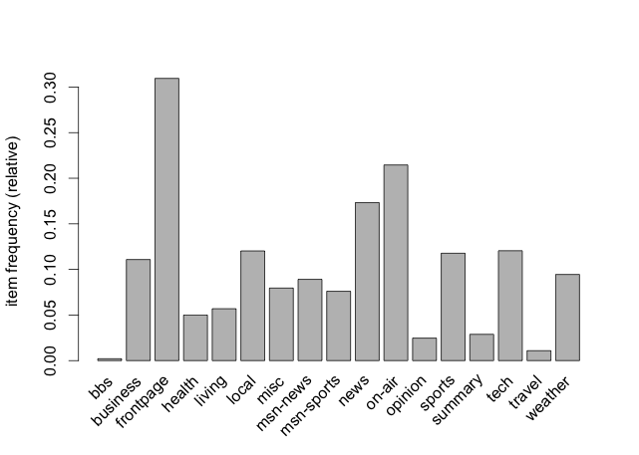
Item Frequency

Slide 8
Research Questions
Can we cluster the different types of users that access the system by the categories they accessed
What is the association/correlation between different site categories
Given a user has accessed category c₁, what is the likelihood they will access category c₂, given c₂, what is the likelihood they will access category c₃, ..., given category c_{k-1}, what is the likelihood they will visit category c_{k}
What is the best way to construct a visual model such as a: Petri-Net, Bayes Net, Markov Process, or similar formal model to describe how users interacted with MSNBC in the observed time period
How did users interact with the website?

Slide 9
Approaches
Association Analysis [Ai, Brandon, Michael]
What rules can we learn from the inclusion of categories in sequences?
Sequential Analysis [Ai, Chet, Michael]
What rules can we learn from the ordering of the sequences?
Markov Decision Process (MDP) Analysis [Chet]
What can we learn from the probability distribution of category transitions?

Slide 10
Tools
R, Matlab, Python, C#
Visual Studio 2013 Ultimate
Microsoft Excel 2013
yEd Graph Visualization Software
github.com [source control]

Slide 11
Association Analysis
Apriori Algorithm in C#, R, and Matlab
[Brandon Oubre]

Slide 12
Apriori Approach
Apriori is an algorithm for frequent item set mining and association rule learning … can be used to determine association rules which highlight general trends … this has applications in domains such as market basket analysis.
– Wikipedia
Apriori 3-ways
C# custom code - Brandon
Matlab - Michael
R – Ai
What page categories appear together in a sequence (without respect to order)?

Slide 13
Apriori Implementation
C#
Implemented Apriori from scratch and made optimizations for the data set. Allows for fast data compression and quick bitwise arithmetic for generation algorithms.
R Package
Used “arules” package to mine frequent itemsets, Apriori algorithm implementation.
Rules Visualization with “arulesViz” package
Matlab Package
Used a vanilla Apriori implementation from Matlab central
Duplicated the other implementation of Apriori

Slide 14
Apriori Results
Data has issues with support and confidence
Page visits tend to concentrate in one or two categories:
73% with size = 1
18% with size = 2
9% with size >= 3
Frontpage most heavily weighted category

Slide 15
Apriori Results
Rule | Confidence (>= .3) | Lift
news, misc -> local | 0.5211 | 3.7681
summary -> on-air | 0.4806 | 1.9483
misc -> on-air | 0.4134 | 1.6758
local, misc -> news | 0.384 | 1.9282
news, local -> misc | 0.377 | 4.1209
opinion -> news | 0.3659 | 1.837
health -> news | 0.3494 | 1.7541
misc -> local | 0.3357 | 2.4273
living -> news | 0.3015 | 1.5138

Slide 16
Itemset Size Distribution

Slide 17
Rules Visualization with arulesViz
17 rules : min support = 1%, min confidence = 50%
Visualization types:
Scatter plot
Grouped
Graph
Parallel coordinate

Slide 18
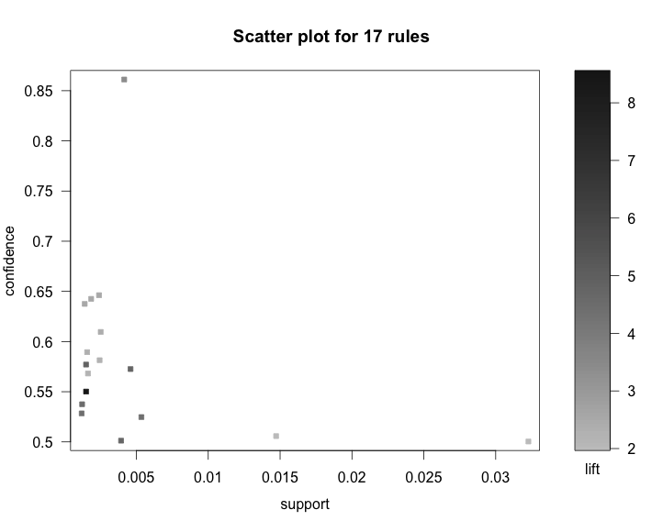
Visualization

Slide 19
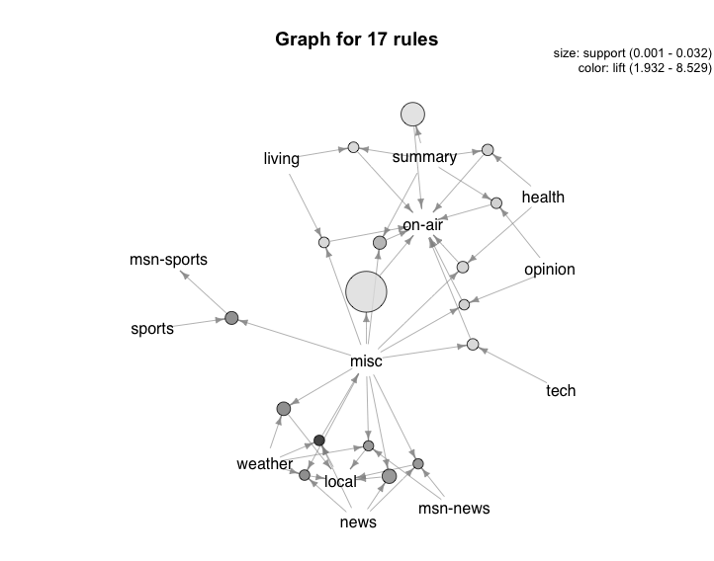
Results

Slide 20
Sequential Analysis
Various algorithms in Python, C#
[Michael Thomas]

Slide 21
Sequential Approach
Association mining only finds pages that tend to occur together within the same record
Learn the typical order in which pages are viewed
How do users browse the site?
How do users move between topics?
Sequences only contained elements with a single event corresponding to the order the pages were accessed
i.e. <{a},{b},{a},{c}>, <{a},{b},{a}>, <{d}>
Notes:
Remove the last two bullet points if nobody checked what happens if we remove the repeating subsequences

Slide 22
Sequential Implementation
Ignore “front-page” views
Use a low support threshold to find sequences and subsequences longer than 1 element long (minsup = 0.01)
Extracted all sequences above a support threshold
Started with 1-sequences and gradually increased length, maintaining a list of frequent sequences
When longest frequent sequences have been found, exit
Python program completed analysis in 17 seconds and no challenges from memory usage.

Slide 23
Sequential Results
Sample output from Python code
Highly significant sequences had low support (<5%)
Longer sequences found tended to repeat the same website topic
Users browsing between different pages within the same topic
Did give interesting 2-sequences
('on-air', 'misc') | 3.4%
('misc', 'on-air') | 2.8%
('misc', 'local') | 2.7%
('news', 'local') | 2.3%
('weather', 'weather', 'weather') | 5.9%
('weather', 'weather', 'weather', 'weather', 'weather', 'weather') | 3.3%
('weather', 'weather', 'weather', 'weather', 'weather', 'weather', 'weather') | 2.5%

Slide 24
Sequential Results
misc
3.4%
On-air
2.8%
2.7%
1.5%
business
1.6%
1.9%
1.8%
local
news
2.2%
Sup = 2.5%
weather
weather
weather
weather
weather
weather
weather
Sup = 1.5%
On-air
misc
On-air
misc
Sup = 1.5%
misc
misc
On-air
On-air
Notes:
Network showing the connections that the sequential mining algorithm found with the % support – each of these sequences was two elements long
At the bottom
Examples of some of the longer sequences identified. Weather^7 an example of how people generally stayed in the same section of the website
Next two: shows interconnection between misc and On-air.

Slide 25
Markov Decision Process Analysis
C# and Excel
[Chester Parrott]

Slide 26
Markov Decision Processes
Discrete Time Stochastic Processes
Markov Property:
A stochastic process has the Markov property if the conditional probability distribution of future states of the process (conditional on both past and present values) depends only upon the present state, not on the sequence of events that preceded it - Wikipedia
Stateless (what do I know now, because I forgot everything up until now…)
Google’s PageRank Algorithm Assumes Web-Users are Stochastic Agents
Frequency Counter Algorithm

Slide 27
Implementation
Given a sequence that looks like: ATTGTATTTATTGTATTT (length 18)
Count each transition and keep a record of each in an adjacency matrix
Calculate row statistics of Adjacency Matrix (normalize)
Generate Graphics
Filter Edges Below Certain p value
L/R | A | G | T
A | 0 | 0 | 100%
G | 0 | 0 | 100%
T | 27% | 18% | 55%
L/R | A | G | T
A | 0 | 0 | 4
G | 0 | 0 | 2
T | 3 | 2 | 6
100%
55%
100%
A
T
G
27%
18%
100%
55%
100%
A
T
G
27%

Slide 28
Implementation Summary
We generate the probability distribution for every transition that exists in the data set
Iteratively filter out transitions below a certain probability threshold
Observe connected components
With full MDP model, we can also answer questions like the following
P(G|A) = P(T|A)*P(G|T)
P(T|A) = 100%
P(G|T) = 18%
P(G|A) = 100%*18% = 18%
100%
55%
100%
A
T
G
27%
18%

Slide 29
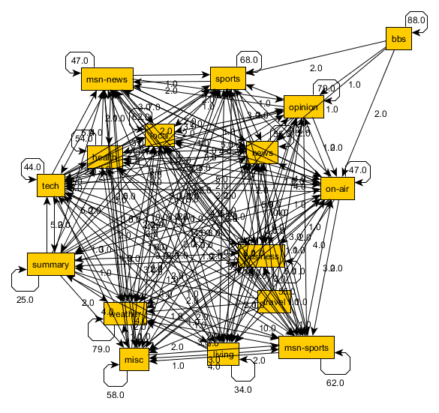
Results: MDP With 1% Filter (covers ~99.64% of Transitions)
?

Slide 30
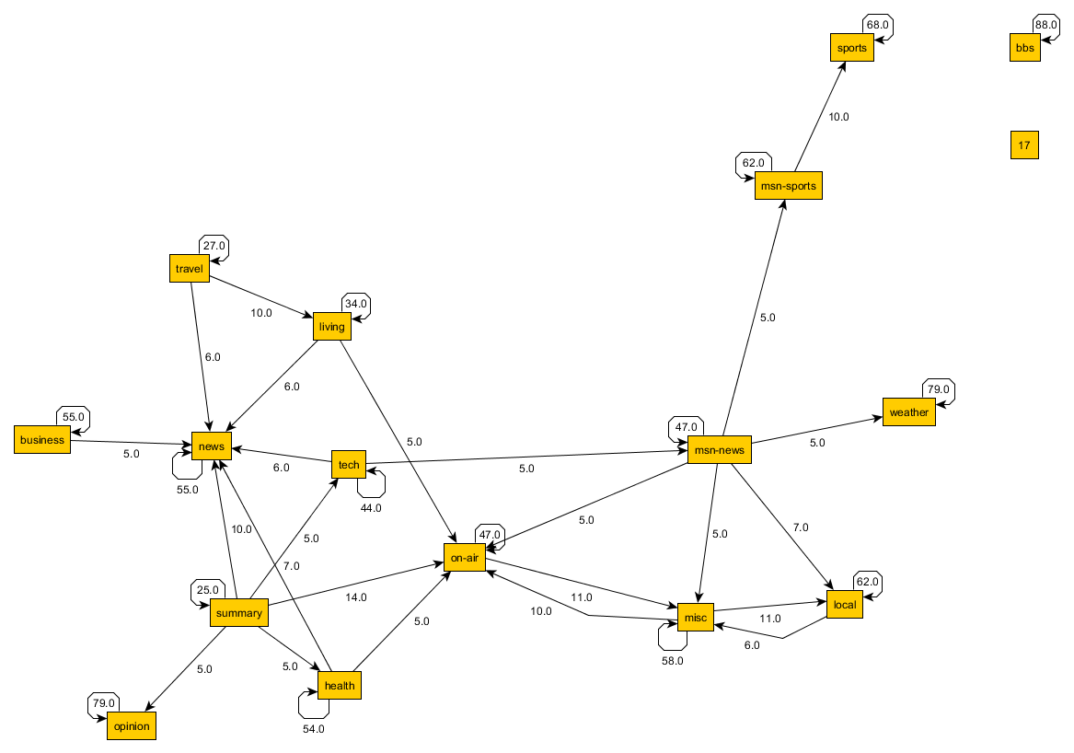
Results: MDP With 5% Filter (covers ~78.82% of Transitions)

Slide 31
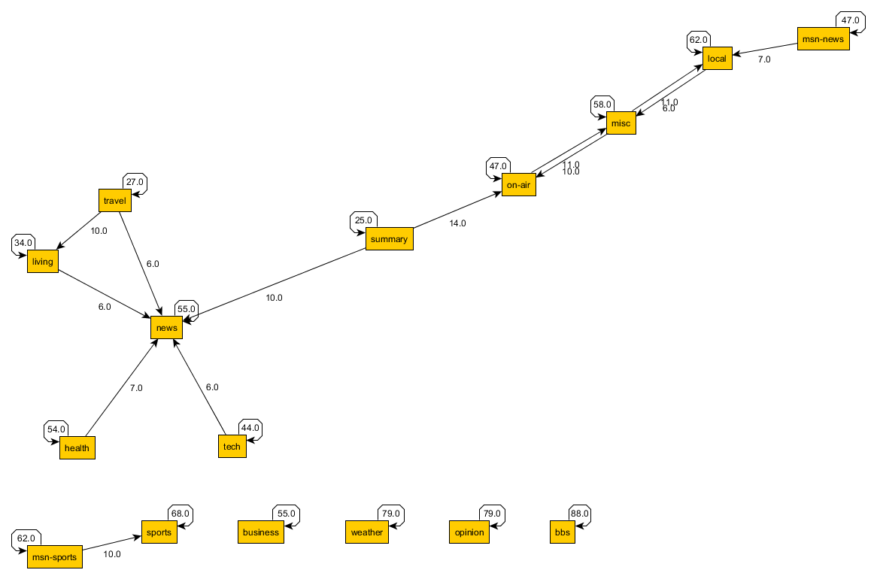
Results: MDP With 6% Filter (covers ~74.41% of Transitions)

Slide 32
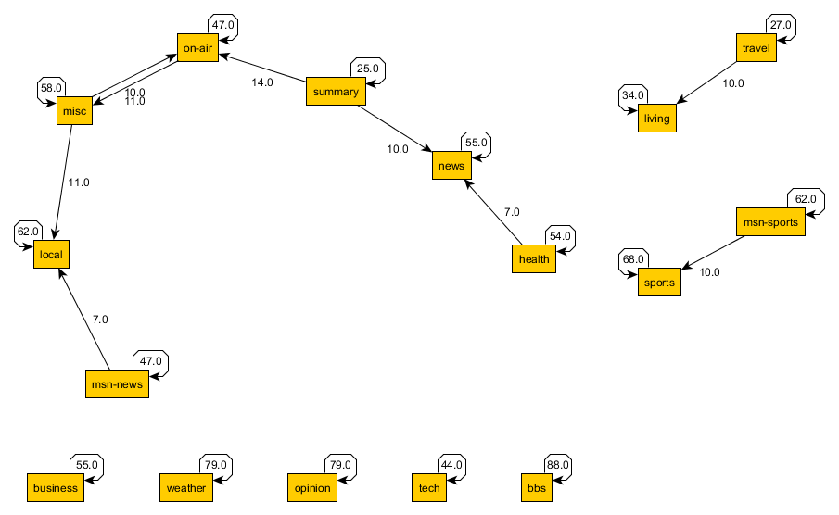
Results: MDP With 7% Filter (covers ~73.00% of Transitions)

Slide 33
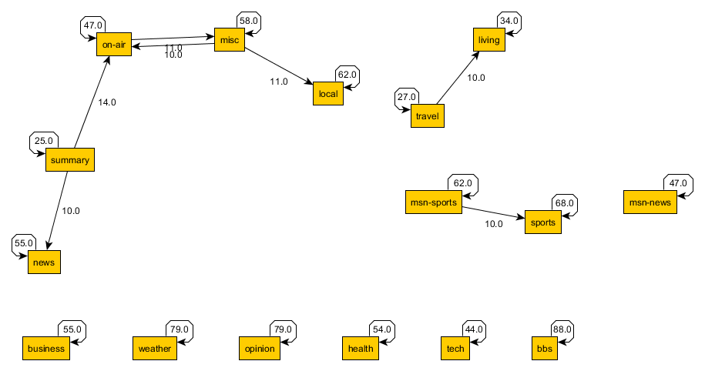
Results: MDP With 10% Filter (covers ~70.82% of Transitions)

Slide 34
Conclusion
[Finally!]
[Make them stop talking!]

Slide 35
Summary
Association analysis provided categories most likely to appear together
(without order)
Sequence analysis provided categories most likely to appear together
(with respect to order)
MDP Analysis provided transition distribution representative of the dataset
Holistic approach was helpful in understanding how users interacted with site

Slide 36


