Slide 1
REAL OP-AMP LIMITATIONS
INPUT BIAS CURRENT, I_{BIAS}
INPUT OFFSET VOLTAGE, V_{OS}
BANDWIDTH
RISE TIME & SLEW RATE

Slide 2
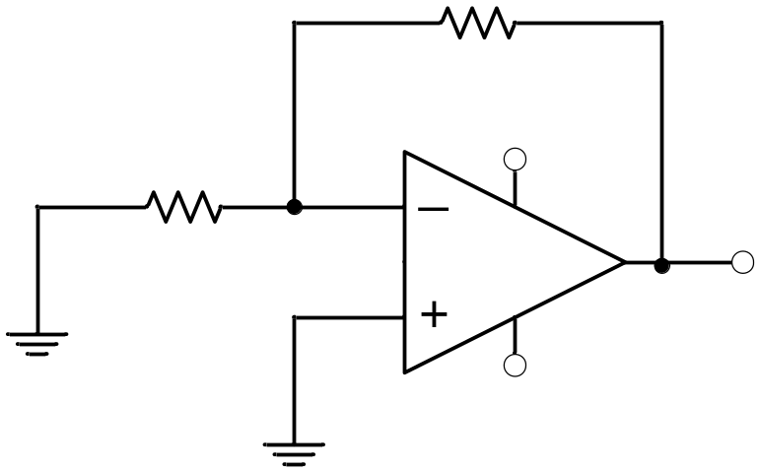
INPUT BIAS CURRENT
Consider the analysis of op-amp inverting amplifier with I_{BIAS} taken into account.
R_{F}
I_{F}
+V
R₁
I_{BIAS}
I₁
V⁻
V_{o}
V⁺
-V

Slide 3
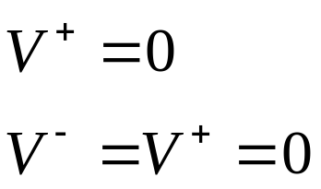
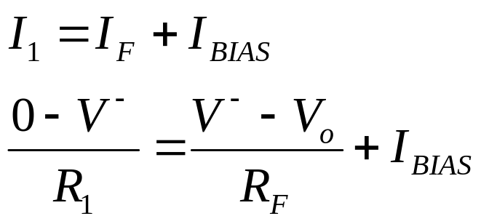
If the input to the above amplifier is grounded, then according to ideal characteristics, there should be no output, i.e. V_{o} should be 0V.
As the + terminal is grounded,
Writing KCL equations at the – terminal,

Slide 4
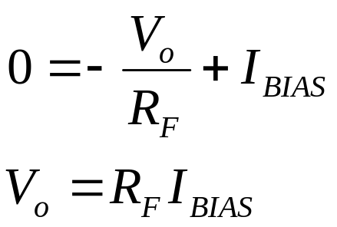
Substituting for V⁻, (V⁻ = 0)
As stated earlier, I_{BIAS} is very small, but when a large RF is used, there will be a considerable amount of voltage at the output.
To correct this deviation of the real op-amp for ideal characteristics, a resistor R is usually connected to the + terminal.
The value of R is chosen as (R₁||R_{F}).

Slide 5
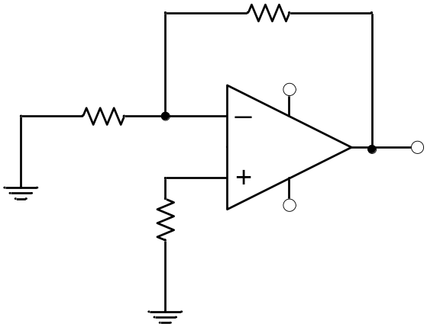


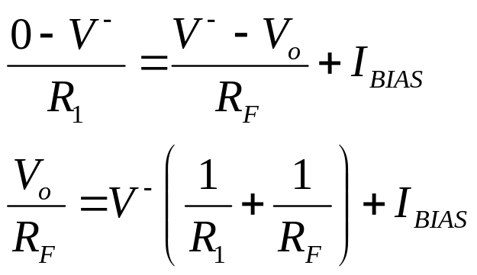
R_{F}
I_{F}
R₁
+V
V⁻
I_{BIAS}
V_{o}
I₁
V⁺
R
-V
In this case,
Writing KCL equations at the - terminal,

Slide 6


Substituting for V⁻ as,
Now V_{o} is zero, as required.

Slide 7
INPUT OFFSET VOLTAGE
Even when the bias current correcting resistor R is used, there could still be a few mV at the output when the inputs of the op-amp are grounded.
To correct this problem, a small DC voltage can be applied at the input (+ve or –ve, as required) to drive the output voltage to zero.
Known as input offset voltage, V_{OS}

Slide 8
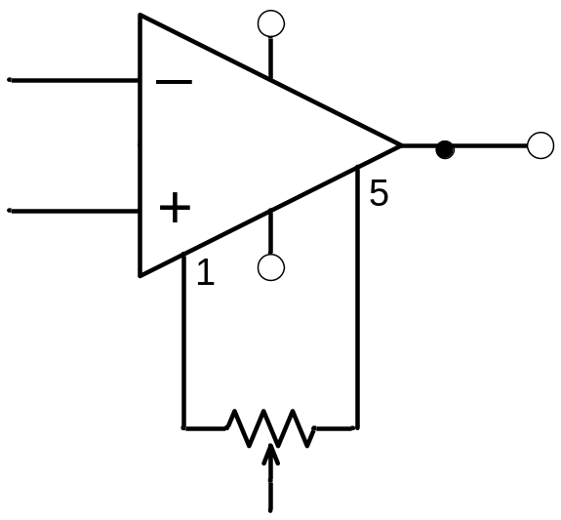
Figure shows the recommended setup for setting the input offset voltage.
10 kΩ
-V

Slide 9

BANDWIDTH
The BW of an op-amp circuit depends on the A_{CL} of the op-amp circuit.
The BW limitation of an op-amp is specified by the GBW parameter in the op-amp data sheet.
GBW is constant, i.e. if A_{CL} higher, BW is lower and vice versa.

Slide 10
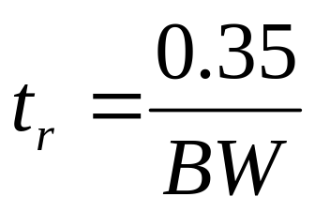
RISE TIME & SLEW RATE
Rise Time, t_{r} is a measure of how fast the op-amp responds to transient input. It is inversely proportional to the system BW.
How to derive this equation, please refer to Appendix B (Floyd) page 941 ~ 942.

Slide 11
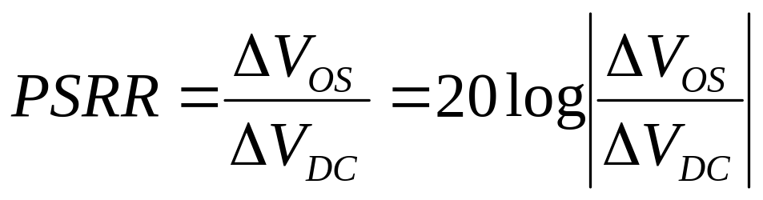
Power Supply Rejection Ratio
In practice, the power supply voltages change causing the dc biasing currents of the internal transistors to change.
As a result, the V_{OS} will also change.
Also known as SVRR (Supply Voltage Rejection Ratio) or PSS (Power Supply Sensitivity)

Slide 12
example
For 741 op-amp, PSRR_{max} = 150 μV/V
If DC supply voltage change from V_{DC} = ±15V to ±12V,
Then, Δ V_{DC} = 2 x 15 – 2 x 12 = 6 V
And ΔV_{OS} = PSRR x Δ V_{DC} = 900 μV

