Slide 1
Study of Flow Regime for Two Phase Gas-Liquid Flow in Large Diameter Riser
Presented by
Nazmul Hossain
University of Houston | Mechanical Engineering

Slide 2
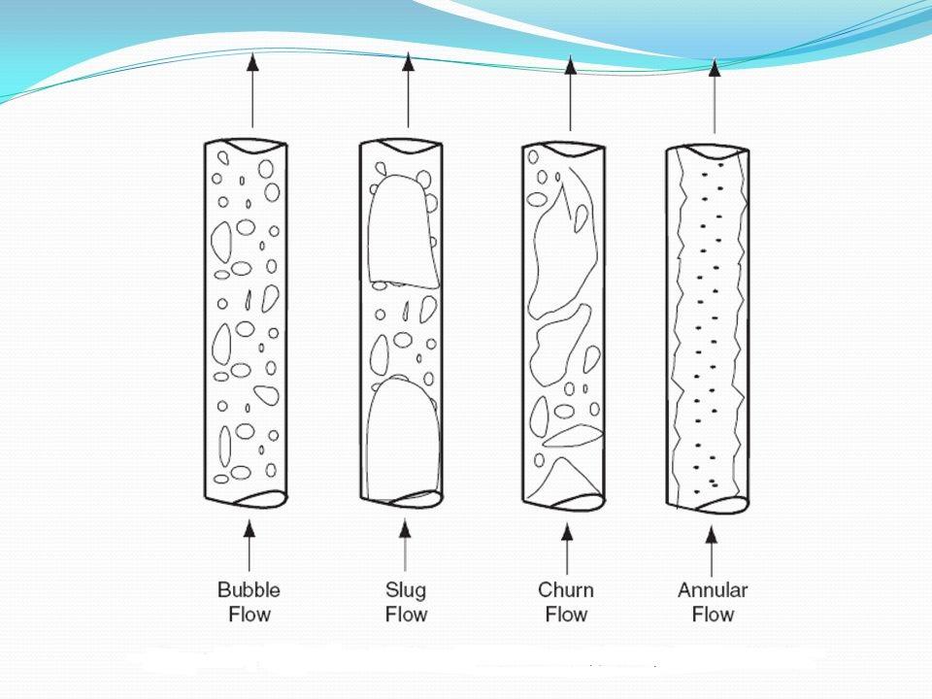
Types of Flow Regime
Bubble Flow
Slug Flow
Churn Flow
Annular Flow
Flow regime-experiment
Annular Flow
Vertical upward two phase flow regime [Shoham, 1982]
University of Houston | Mechanical Engineering
1

Slide 3
Objectives
Air-water 2-phase flow simulation
Axisymmetric upward Slug flow simulation
Develop Flow pattern map for two large diameter pipe and their comparison
Validating result from highly cited literature
University of Houston | Mechanical Engineering
2

Slide 4
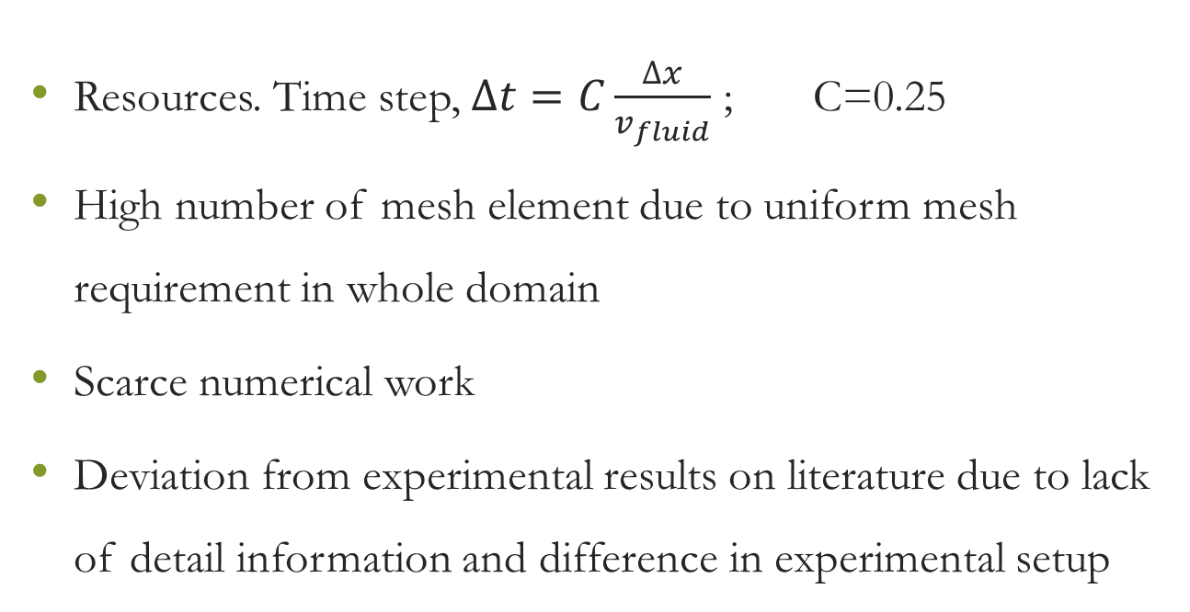
Challenges
Resources. Time step, $∆t=C\frac{∆x}{v_{fluid}}$ ; C=0.25
High number of mesh element due to uniform mesh requirement in whole domain
Scarce numerical work
Deviation from experimental results on literature due to lack of detail information and difference in experimental setup
University of Houston | Mechanical Engineering
3

Slide 5
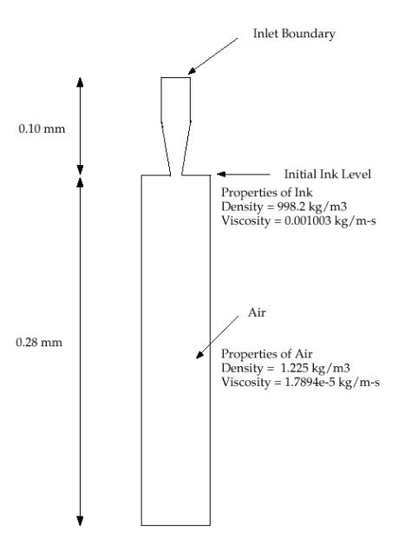
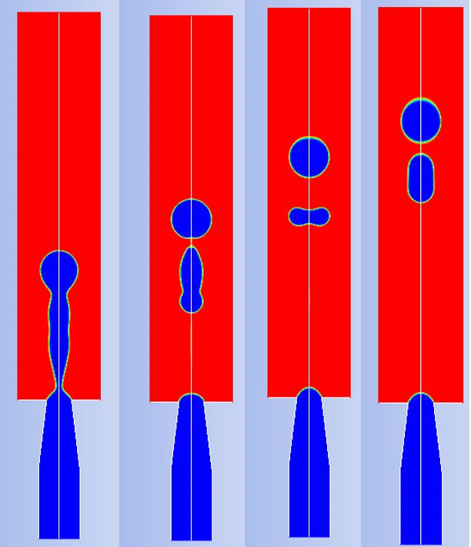
Simulation-1
University of Houston | Mechanical Engineering
4

Slide 6
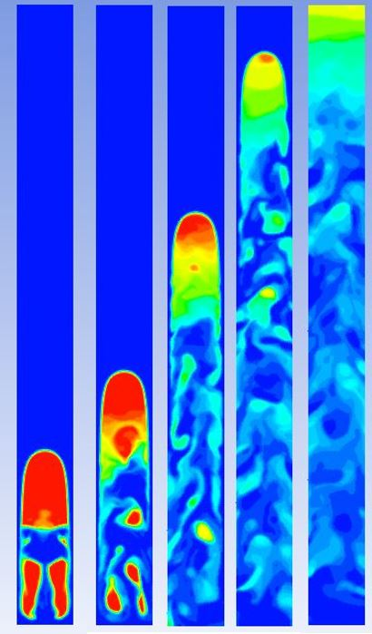
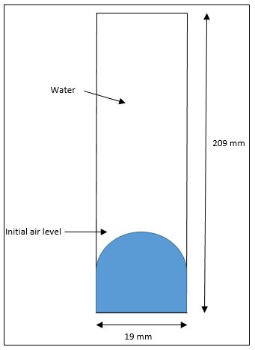
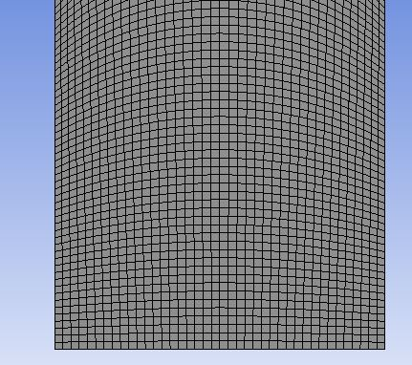
Simulation-2
Mesh
Schematic Diagram
Taylor bubble in symmetric pipe
University of Houston | Mechanical Engineering
5

Slide 7
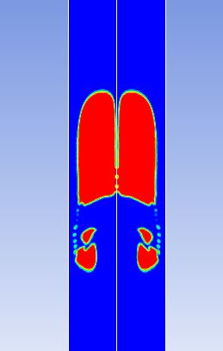
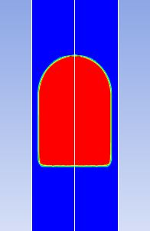
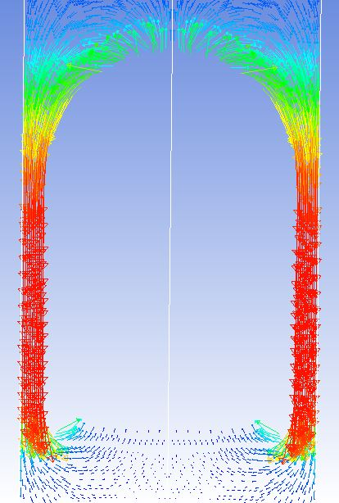
Axisymmetric Slug Flow
Axisymmetric Slug (Re=84)
Axisymmetric Slug (Re=1290)
Velocity Vector
Axisymmetric Slug (Re=1290)
University of Houston | Mechanical Engineering
6

Slide 8
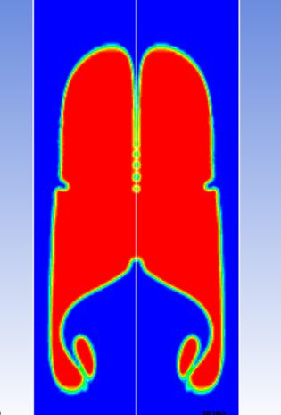
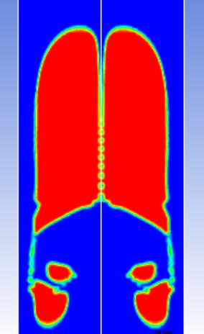
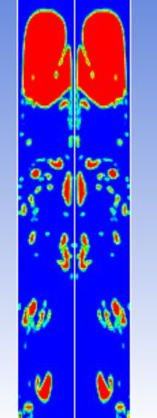
Axisymmetric Slug Flow
Axisymmetric Slug (Re=2500)
University of Houston | Mechanical Engineering
7

Slide 9
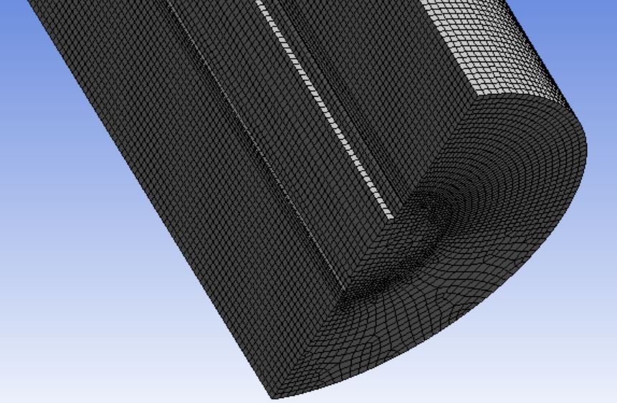
Mesh – 3D Riser
University of Houston | Mechanical Engineering
8

Slide 10
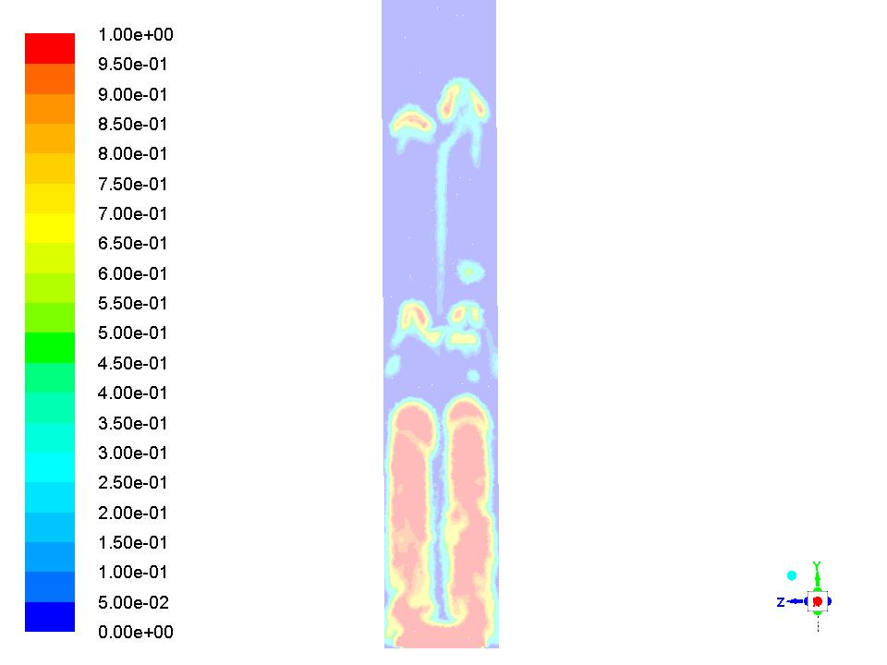
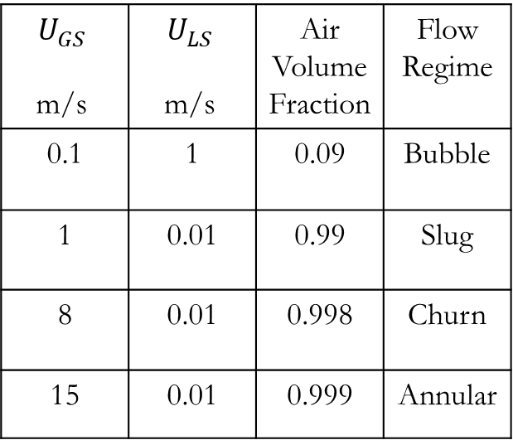
3D-Vertical Riser
$$U_{GS}$$ m/s | $$U_{LS}$$ m/s | Air Volume Fraction | Flow Regime
0.1 | 1 | 0.09 | Bubble
1 | 0.01 | 0.99 | Slug
8 | 0.01 | 0.998 | Churn
15 | 0.01 | 0.999 | Annular
Figure: Flow in 25 mm diameter vertical riser
University of Houston | Mechanical Engineering
9

Slide 11
Thank You
University of Houston | Mechanical Engineering

