Slide 1
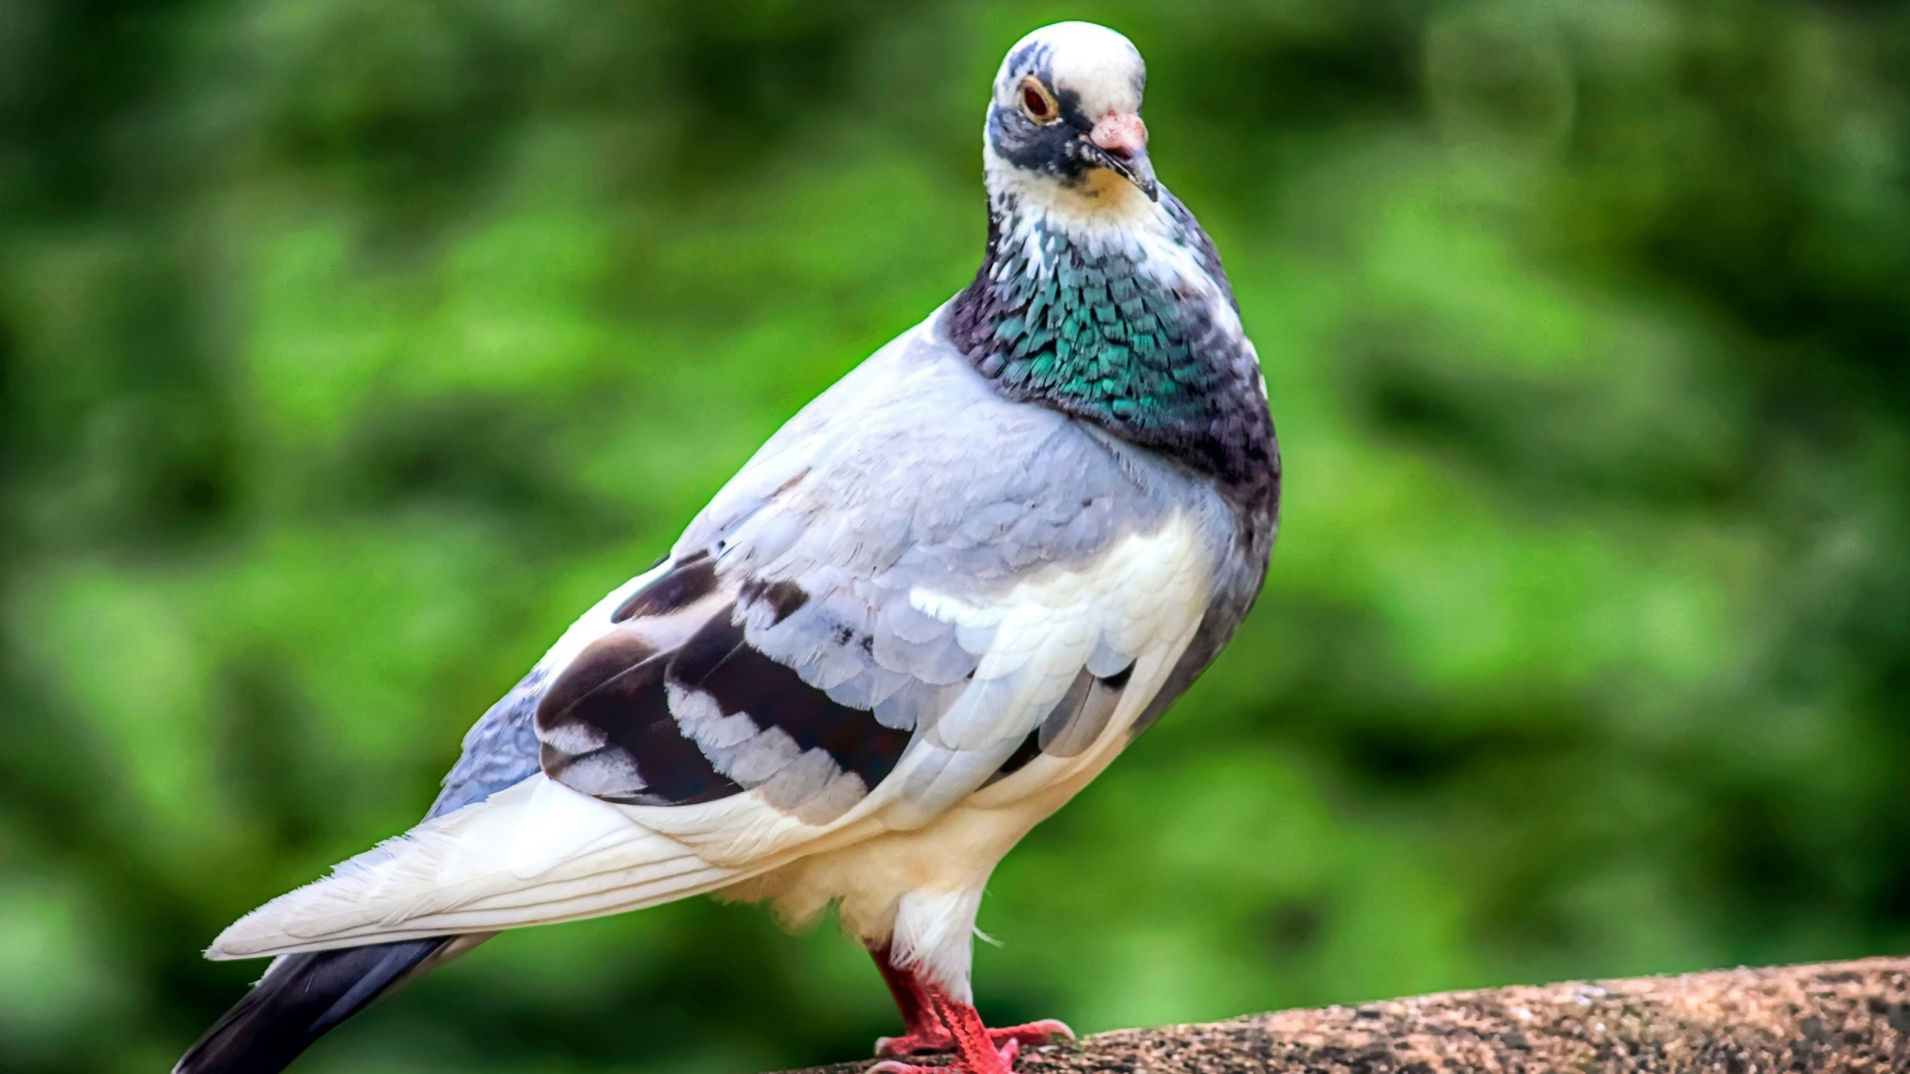


G8
BÀI THUYẾT TRÌNH
APPLYING PIGEONHOLE PRINCIPLE TO DAYLY LIFE

Slide 2
Đỗ Nguyên Thanh Tùng
BÀI THUYẾT TRÌNH
G8
Nguyễn Trần Ngọc Hải
APPLYING PIGEONHOLE PRINCIPLE TO DAYLY LIFE
PHạm Thanh Giang
Trần Xuân Thịnh
Đặng Hải Quang
Nguyễn Thị Triệu

Slide 3
Đỗ Nguyên Thanh Tùng
BÀI THUYẾT TRÌNH
G8
Nguyễn Trần Ngọc Hải
APPLYING PIGEONHOLE PRINCIPLE TO DAYLY LIFE
PHạm Thanh Giang
Trần Xuân Thịnh
Đặng Hải Quang
Nguyễn Thị Triệu

Slide 4
The Story of Dirichlet
Content
Chapter 1
The Pigeonhole principle
Chapter 2
Applying
Chapter 3

Slide 5
1
Content
The Story of
Dirichlet
Chapter 1
The Story of Dirichlet
Chapter 2
The Pigeonhole principle
Chapter 3
Applying

Slide 6
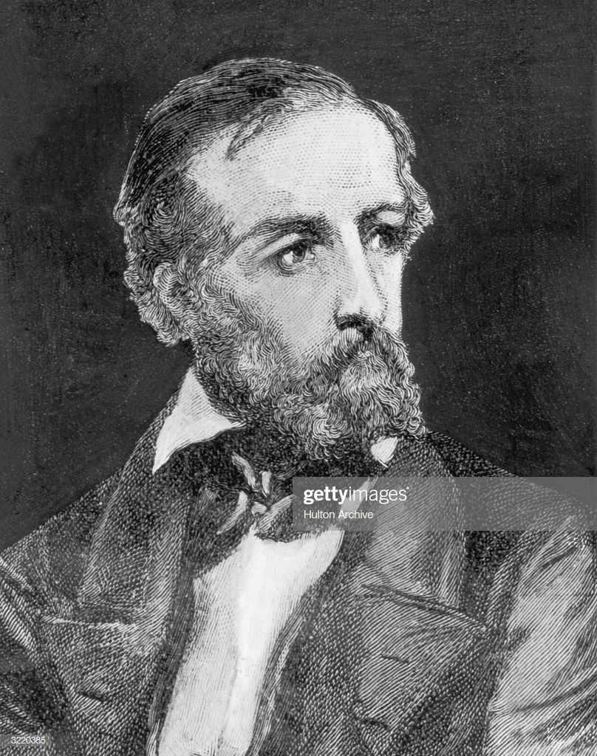
1. THE STORY OF DIRICHLET
Content
1
Chapter 1
1805-1859
The Story of Dirichlet
The Story of
Dirichlet
Chapter 2
The Pigeonhole principle
Chapter 3
Applying

Slide 7
1
The Story of
Dirichlet
1. THE STORY OF DIRICHLET
Content
Chapter 1
1805-1859
The Story of Dirichlet
Chapter 2
The Pigeonhole principle
Chapter 3
Applying

Slide 8
1. THE STORY OF DIRICHLET
1805-1859
Born in Germany

Slide 9
1. THE STORY OF DIRICHLET
1805-1859
Born in Germany
Studied at the University of Paris

Slide 10
1. THE STORY OF DIRICHLET
1805-1859
Born in Germany
Studied at the University of Paris
TPP was first stated in 1834

Slide 11
1. THE STORY OF DIRICHLET
1805-1859
Born in Germany
Studied at the University of Paris
TPP was first stated in 1834

Slide 12
Studied at the University of Paris
TPP was first stated in 1834
Born in Germany
1805-1859
1. THE STORY OF DIRICHLET

Slide 13
The pigeonhole principle
Studied at the University of Paris
TPP was first stated in 1834
Born in Germany
1805-1859
2
1. THE STORY OF DIRICHLET

Slide 14
2. THE PIGEONHOLE PRINCIPLE
2
The pigeonhole principle

Slide 15
2
The pigeonhole principle
What is the
Pigeon-Hole
Principle ?
2. THE PIGEONHOLE PRINCIPLE

Slide 16
2
The pigeonhole principle
2. THE PIGEONHOLE PRINCIPLE
What is the
Pigeon-Hole
Principle ?

Slide 17










2. THE PIGEONHOLE PRINCIPLE
What is the
Pigeon-Hole
Principle ?

Slide 18

2. THE PIGEONHOLE PRINCIPLE
What is the
Pigeon-Hole
Principle ?

Slide 19


2. THE PIGEONHOLE PRINCIPLE

Slide 20










2. THE PIGEONHOLE PRINCIPLE

Slide 21

2. THE PIGEONHOLE PRINCIPLE

Slide 22
3
2. THE PIGEONHOLE PRINCIPLE
Applying
If p Pigeons are put into h pigeonholes with p>h, then at least one pigeonhole must contain more than one item
If p Pigeons are put into h pigeonholes with p>h, then at least one pigeonhole must contain more than one item

Slide 23
If p Pigeons are put into h pigeonholes with p>h, then at least one pigeonhole must contain more than one item
If p Pigeons are put into h pigeonholes with p>h, then at least one pigeonhole must contain more than one item
3. Applying
3
Applying

Slide 24
3
3. Applying
Applying

