Slide 1

Analysis of Power Production
Phuong Nguyen and Hugo Villegas

Slide 2
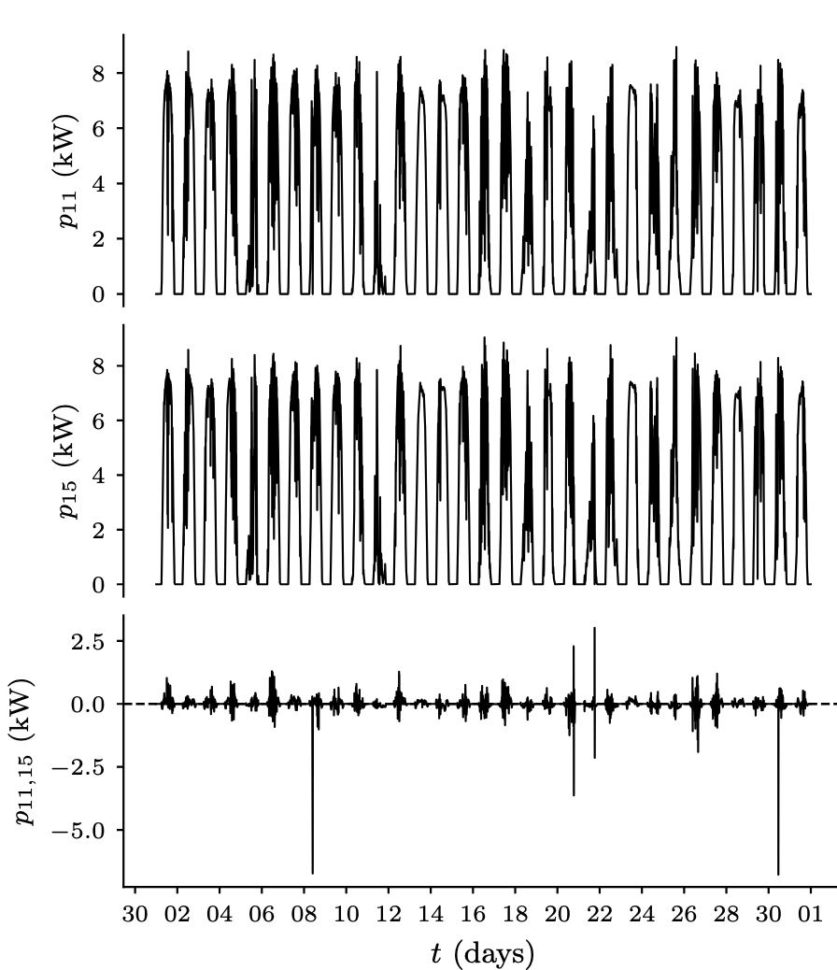
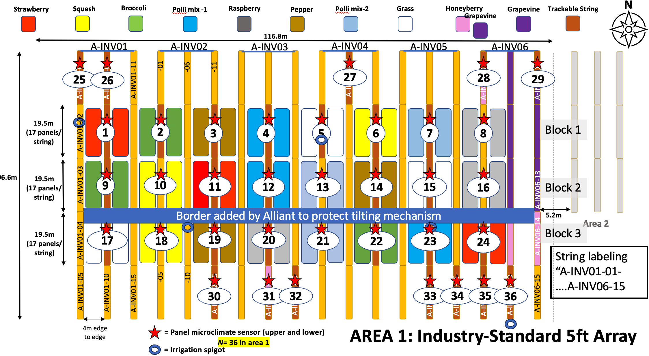
Time-Series Power Measurements
Each string rating within an experimental unit is 9.0-kW ca.
power from exp. unit 11 (strawberry)
power from exp. unit 15 (grass or control)
power from exp. unit 11 minus 15

Slide 3
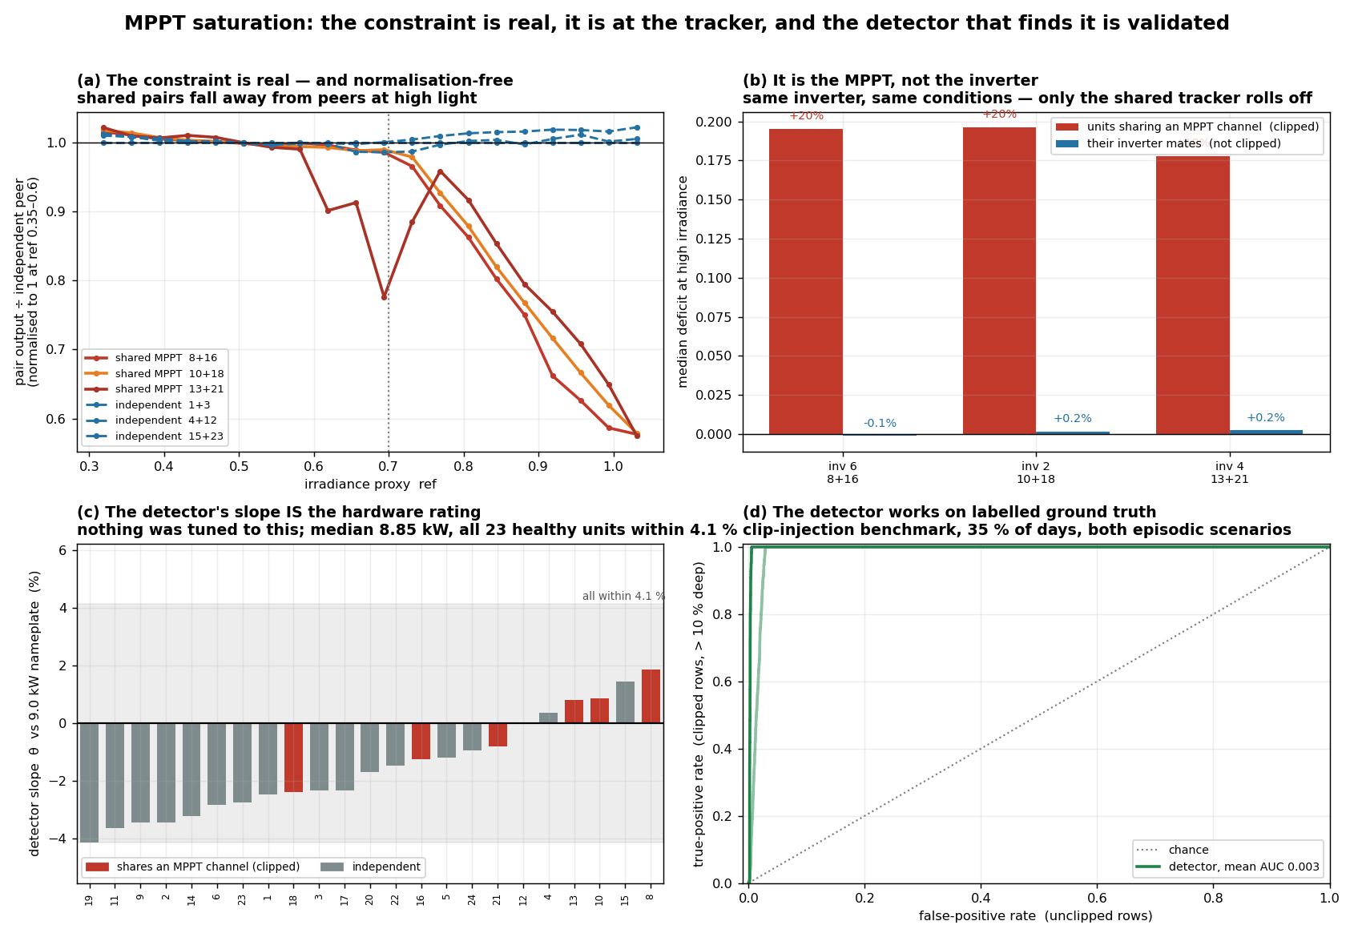
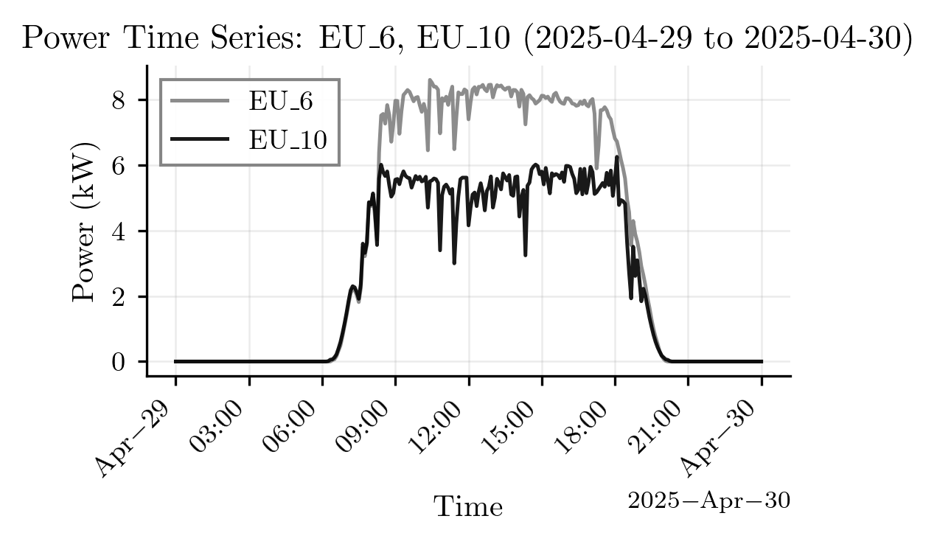

Explain about saturated problem
Shared MPPT pair | Saturated | Severe
eu_8 + eu_16 | 386.6 h | 7.1 h
eu_10 + eu_18 | 539.8 h | 13.0 h
eu_13 + eu_21 | 342.8 h | 7.2 h
Total | 1,269.2 h | 27.3 h
What saturation is
The pair sum stops rising while irradiance keeps rising: the two units share one MPPT channel, the tracker runs out of headroom, and the shortfall is lost energy.
Detection (vat-v1)
  expected = theta(t) * ref
  deficit = 1 - measured / expected
  moderate: > 15 % for 15 min
  severe: > 30 % for 30 min
theta(t) is a slope in watts, so it can be checked against the 9.0 kW nameplate - and it reproduces it to within 4.1 %.
Four independent validations: (a) normalisation-free peer comparison on real data, (b) the inverter topology natural experiment, (c) the 9.0 kW nameplate cross-check, (d) injected ground truth.

Slide 4
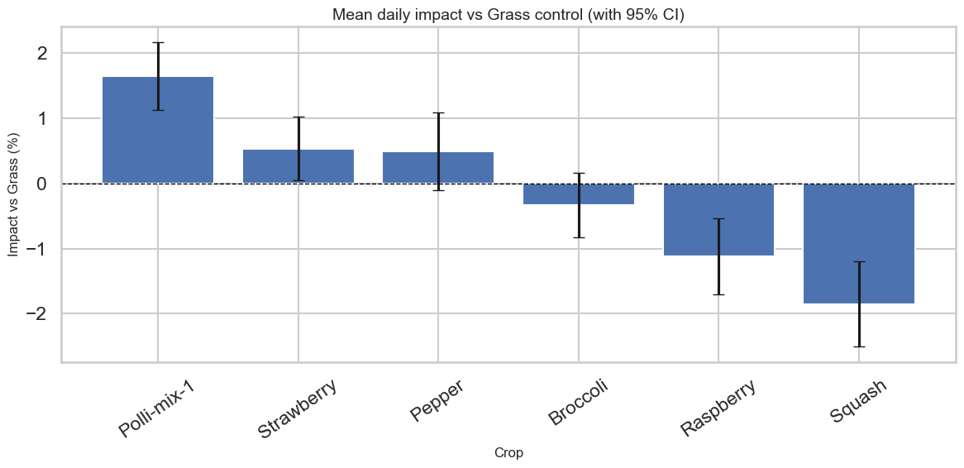
Results: 1,269.2 sampled hours of saturation across three shared MPPT channels, 27.3 h of it severe
Shared MPPT pair | moderate | severe | flagged days | apparent lost energy
eu_8 + eu_16 | 386.6 h | 7.1 h | 115 | 1,873 kWh
eu_10 + eu_18 | 539.8 h | 13.0 h | 147 | 2,538 kWh
eu_13 + eu_21 | 342.8 h | 7.2 h | 104 | 1,709 kWh
Total | 1,269.2 h | 27.3 h | - | 6,120 kWh
Energy is integrated over the detector gate domain (ref >= 0.70 and s > 0.6*expected). The same estimator applied to three pairs on independent trackers attributes only 409 kWh to them - 7 % of the claimed loss - and across all 117 cross-inverter independent pairs the median phantom loss is 92 kWh/pair. That is the residual precision of the energy figure.
The seasonal structure is coherent: flags peak in May-July, vanish in the acquisition gaps and when the pairs are off, and show a secondary peak on cold, clear February days.
Canonical artefact: saturation_flags.csv (51,005 x 21), regenerated from vat-v1 and locked by sat_work/canonical/CANONICAL_vat-v1.json. Guarded by 51 regression tests.
Known limitation: the raw deficit column is only defined inside the decision domain (ref >= 0.70, both units active, no data-quality flag); it is NaN elsewhere by design.

