Slide 1
Greedy Function Approximation:
A Gradient Boosting Machine
Jerome H. Friedman · Annals of Statistics, 2001
Reading + from-scratch implementation
LS Boost · LAD TreeBoost · M (Huber) TreeBoost

Slide 2
Roadmap
1.
Why we need this paper — the problem and the literature
2.
The key insight: gradient descent in function space
3.
Three regression algorithms: LS, LAD, Huber TreeBoost
4.
The terminal-region update — the practical heart of TreeBoost
5.
From-scratch implementation in Python
6.
Experiments: convergence, robustness, shrinkage
7.
What the results reveal & the paper's lasting impact
Friedman (2001) — Greedy Function Approximation
2 / 20

Slide 3
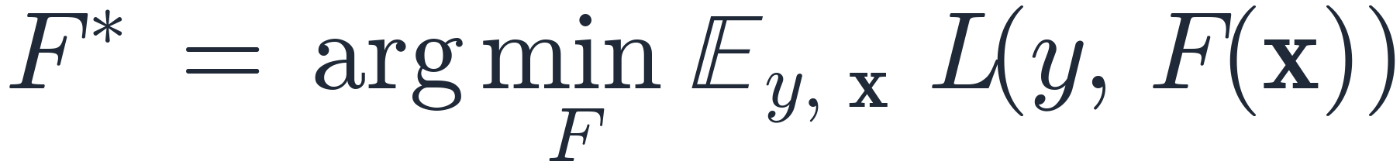
The function-estimation problem
Given training data {(x_i, y_i)} for i = 1, …, N, find a function F : X → ℝ minimizing the expected loss
Concrete losses:
• Regression:
• Classification:
Most existing methods restrict F to a parametric family and tackle a hard joint optimization. This paper takes a non-parametric, stagewise route.
Friedman (2001) — Greedy Function Approximation
3 / 20

Slide 4
Where this paper sits
Before (1995–2000)
This paper
•
AdaBoost (Freund & Schapire, 1996) — re-weights examples; tied to exponential loss.
•
One unifying view: boosting is gradient descent in function space.
•
Plug in any differentiable loss.
•
LogitBoost (Friedman, Hastie, Tibshirani, 2000) — binomial likelihood via Newton steps.
•
Concrete algorithms for LS, LAD, Huber, and K-class logistic.
•
Basis-function methods: MARS, RBF networks, SVM, neural nets.
•
Adds tools to interpret tree boosters.
After: XGBoost (2014), LightGBM (2017), CatBoost (2017) — all extend this paradigm.
Friedman (2001) — Greedy Function Approximation
4 / 20

Slide 5
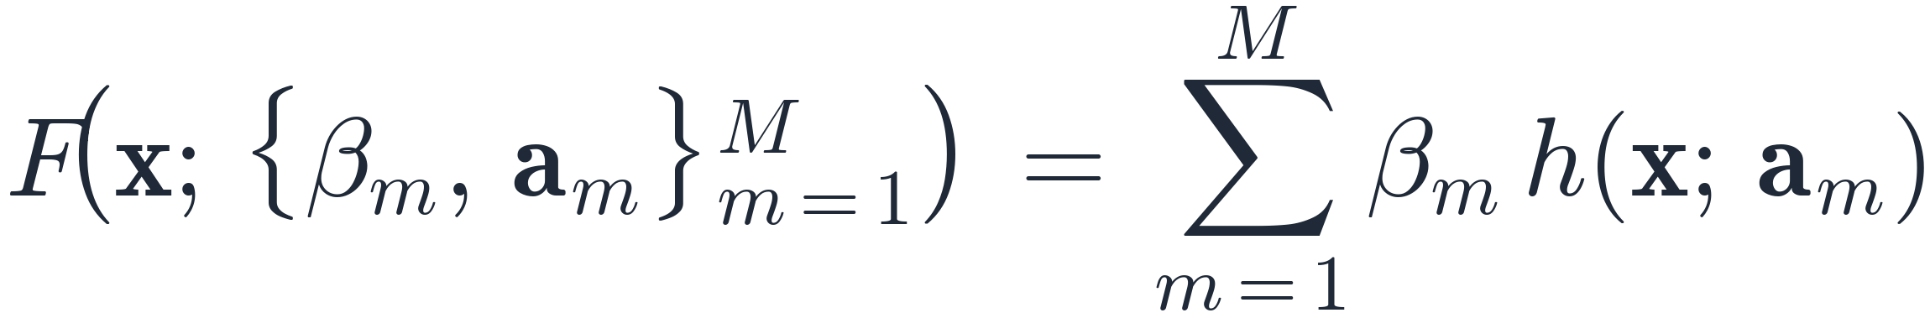
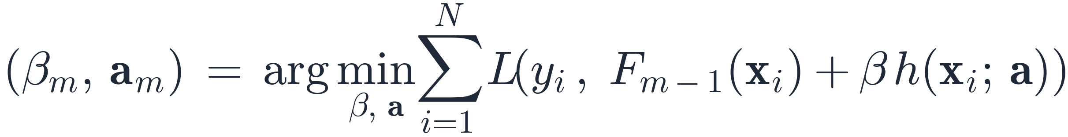
Stagewise additive expansions
Approximate F by a sum of simple “weak learners”:
•
h(x ; a) — a small parametric function (e.g. a regression tree).
•
Joint optimization over all (β_m, a_m) is generally hard.
Greedy stagewise alternative — at each step m:
Eq. (9) of the paper. Previous terms are frozen — no re-fitting.
Friedman (2001) — Greedy Function Approximation
5 / 20

Slide 6
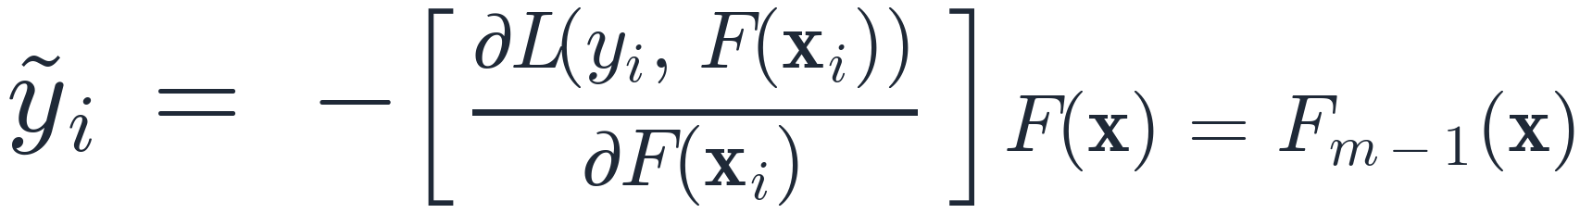
The key insight
Boosting = numerical optimization in function space
Treat F(x_i) at each training point as a free parameter. The negative gradient at iteration m is
These are the pseudo-responses: the direction in which moving F(x_i) most reduces the loss.
Why this matters: the gradient is only defined at the training points. Fit a weak learner h(x ; a_m) to the pseudo-responses by least squares — that's the smooth, generalizable approximation to the unconstrained gradient.
Friedman (2001) — Greedy Function Approximation
6 / 20

Slide 7
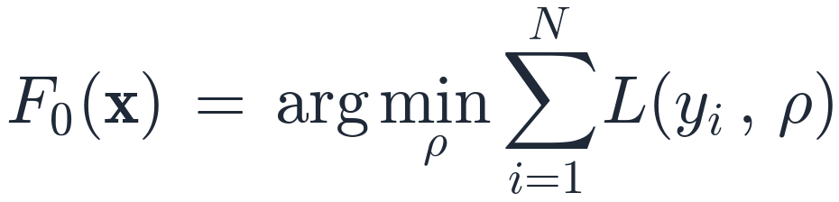

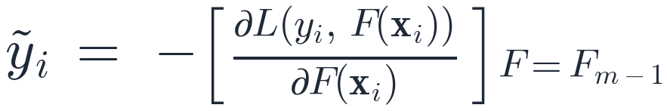
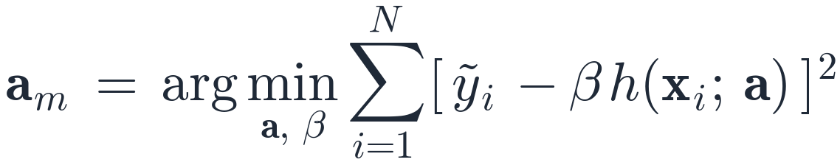
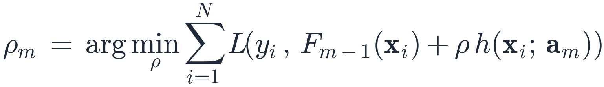
Algorithm 1 — Gradient Boost (generic)
1.
# initialize
2.
3.
# pseudo-responses
4.
# least-squares fit
5.
# 1-D line search
6.
# update
•
Line 3 is loss-specific. Everything else is the same machinery.
•
Line 4 is least squares — fast and well-understood, regardless of the original loss.
•
Line 5 is a 1-D line search in the original loss.
Friedman (2001) — Greedy Function Approximation
7 / 20

Slide 8
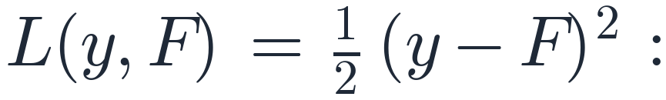

Algorithm 2 — LS Boost
With
•
Pseudo-response:
•
Line 4:
fits the current residuals — the line search becomes trivial.
•
Initial constant:
Reduces to the classical “fit residuals iteratively” recipe — the reality check for the framework.
# src/treeboost/losses.py
class LeastSquaresLoss(Loss):
def initial_prediction(self, y): return float(np.mean(y))
def negative_gradient(self, y, F): return y - F # residuals
def leaf_update(self, y, F, idx): return float(np.mean((y - F)[idx]))
Friedman (2001) — Greedy Function Approximation
8 / 20

Slide 9
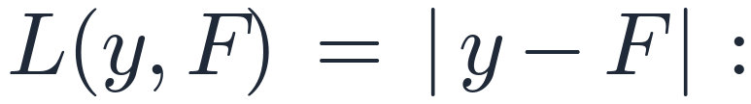


Algorithm 3 — LAD TreeBoost
With
•
Pseudo-response:
•
Tree fit:
by least squares to the signs of the residuals.
•
Initial constant:
Crucial step: the per-leaf update is the median of residuals in the leaf, not the leaf mean. The tree's leaf values are overwritten with these medians.
This is equation (18) specialized to L₁. It is what makes the method robust.
Friedman (2001) — Greedy Function Approximation
9 / 20

Slide 10
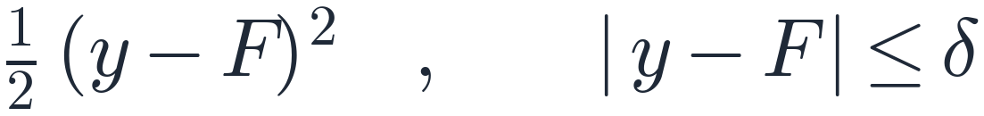
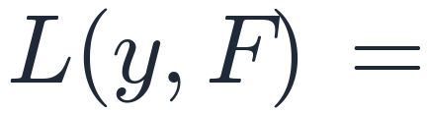

Algorithm 4 — M TreeBoost (Huber)
Quadratic for small residuals, linear in the tail:
{
•
Adaptive δ:
•
Pseudo-response:
Leaf update is Friedman's 1-step Newton-like adjustment around the leaf median:
where
Friedman (2001) — Greedy Function Approximation
10 / 20

Slide 11
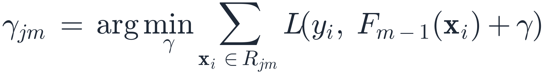
The terminal-region update — the secret sauce
Two stages per iteration when the weak learner is a tree:
1.
Build a J-leaf tree by least squares on the pseudo-responses ỹ.
2.
Re-solve a tiny 1-D problem inside each leaf using the original loss:
3.
Update:
Why this is the crux: the LS-fit tree is a fast, smooth gradient direction; the loss-specific γ_jm re-injects the original loss's geometry — robust medians for LAD, clipped sums for Huber, Newton steps for logistic.
Friedman (2001) — Greedy Function Approximation
11 / 20

Slide 12
From-scratch implementation
One clean abstraction does all the work:
class Loss(ABC):
def initial_prediction(self, y): ... # F_0
def negative_gradient(self, y, F): ... # ỹ_i (line 3)
def leaf_update(self, y, F, indices): ... # γ_jm (eq. 18)
def update_state(self, y, F): ... # e.g. Huber's δ_m
Three losses implement this contract; the boosting loop is loss-agnostic.
TREE.PY
LOSSES.PY
MODEL.PY
CART-style regression tree, best-first growth, vectorized split search. set_leaf_values() lets the boosting driver overwrite leaf means with γ.
LS / LAD / Huber, each ~30 LOC. HuberLoss.update_state sets δ_m at each iteration.
TreeBoostRegressor drives Algorithms 2 / 3 / 4 with shrinkage ν.
No scikit-learn, XGBoost, LightGBM, or CatBoost. Only numpy for arrays. 30 passing pytest tests.
Friedman (2001) — Greedy Function Approximation
12 / 20

Slide 13
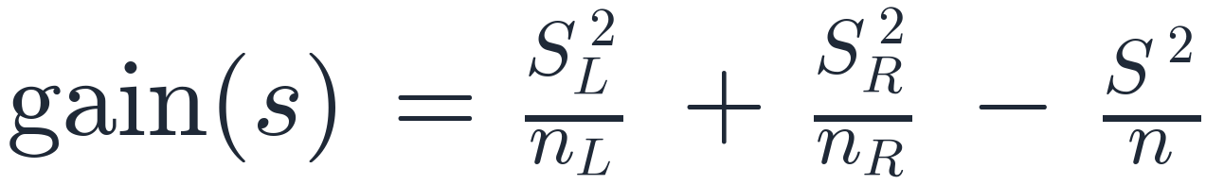
Custom regression tree (the weak learner)
•
Best-first growth — repeatedly expand the leaf with the highest SSE-reduction split until max_leaves = J is reached.
•
Vectorized split search — sort each feature column, pre-compute cumulative sums of ỹ, evaluate all valid split points in one shot:
•
Honors J directly — same complexity knob the paper uses (Section 5).
•
Leaf-id API (apply, set_leaf_values) — boosting driver maps each row to its leaf, computes γ_jm per leaf, and overwrites the LS leaf means.
Roughly 200 lines, deterministic, and readable. Built for correctness over throughput.
Friedman (2001) — Greedy Function Approximation
13 / 20

Slide 14
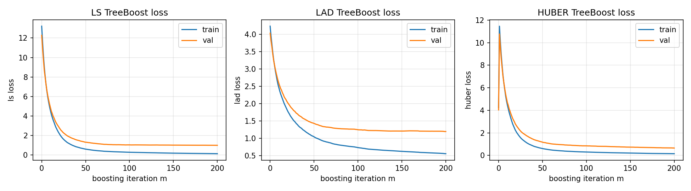
Experiment 1 — convergence on a clean signal
Friedman-#1 target
Train / test:
Boosting:
Loss | test MSE | test MAE
LS | 1.989 | 1.136
LAD | 2.309 | 1.194
Huber | 1.977 | 1.124
Under Gaussian noise: LS ≈ Huber; LAD pays the classical small efficiency cost.
Train (blue) and validation (orange) loss curves per iteration.
Friedman (2001) — Greedy Function Approximation
14 / 20

Slide 15
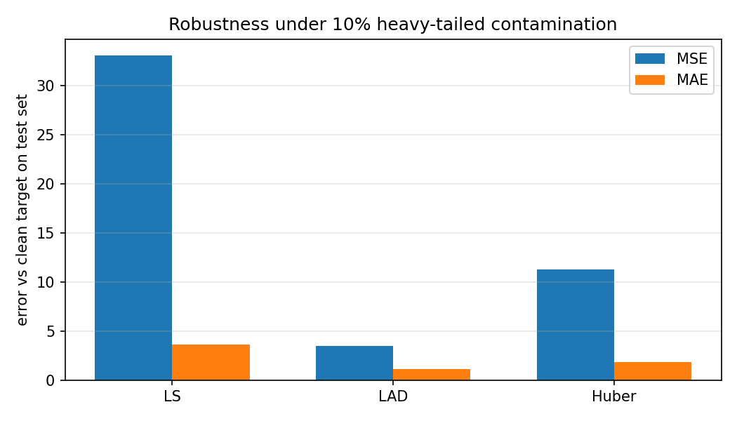
Experiment 2 — robustness under contamination
Same target, but 10% of training labels perturbed by heavy-tailed shocks
Loss | clean MSE | clean MAE
LS | 33.04 | 3.63
LAD | 3.49 | 1.17
Huber | 11.28 | 1.84
•
LS collapses — squared loss is dominated by outliers.
•
LAD recovers almost completely (medians ignore extremes).
•
Huber is much better than LS, ranking depends on δ.
Clean-test error per loss under 10% contamination.
Friedman (2001) — Greedy Function Approximation
15 / 20

Slide 16
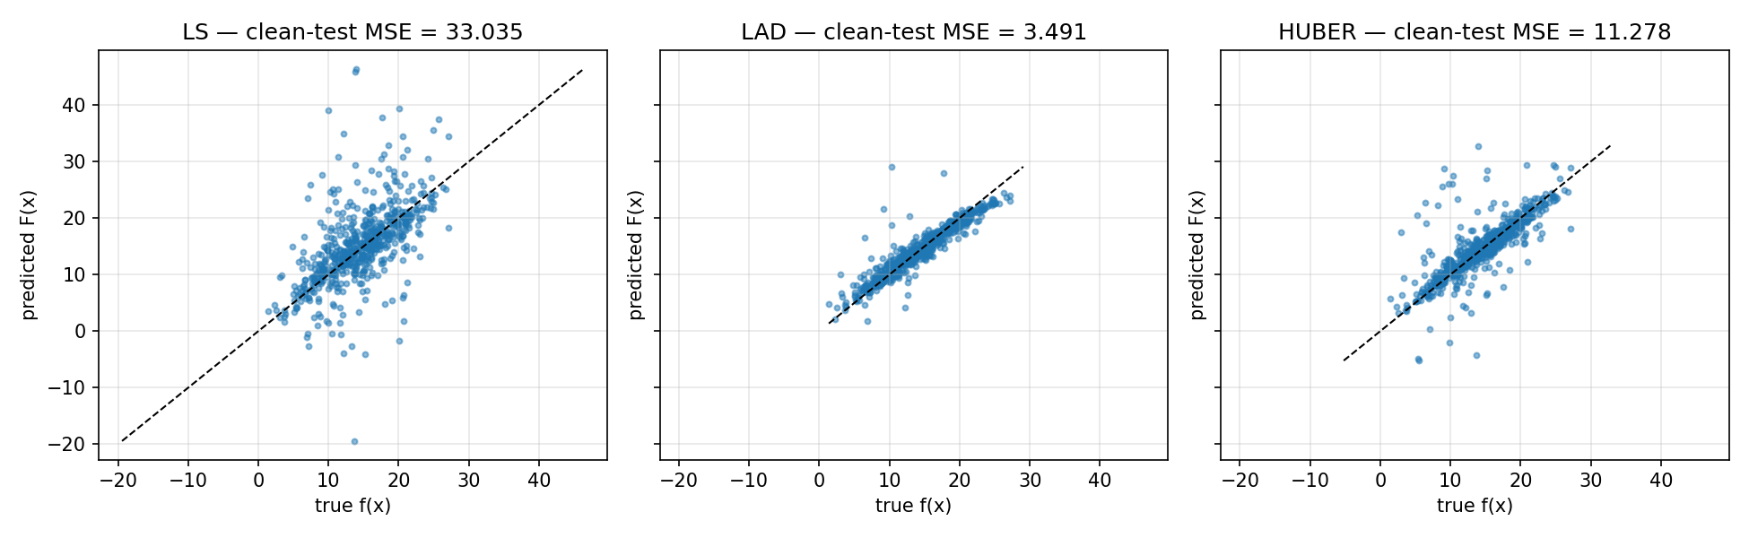
Predicted vs true under contamination
LS predictions drift well off the diagonal; LAD and Huber stay calibrated despite the noisy training labels. This is the picture Section 4 of the paper promises.
Friedman (2001) — Greedy Function Approximation
16 / 20

Slide 17
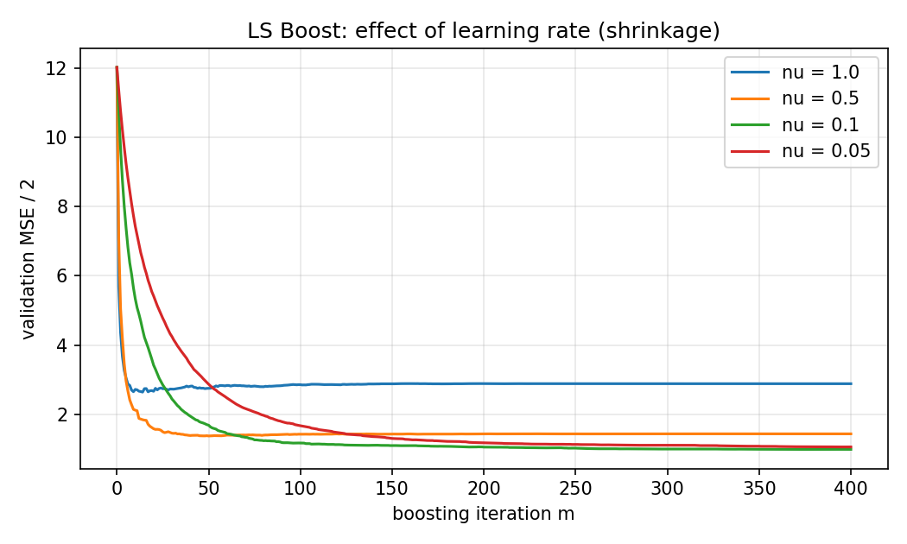
Experiment 3 — shrinkage trade-off
LS Boost on the clean signal, sweeping the learning rate ν.
•
ν = 1.0 : hits the floor in ~30 iterations, then plateaus.
•
ν = 0.1 : lower final validation MSE — but takes ~150–200 trees.
•
ν = 0.05 : slowest; needs more iterations to compete.
Reproduces the standard recommendation that emerged from this paper: moderate shrinkage + larger M generalizes better.
Validation MSE/2 vs boosting iteration for several ν values.
Friedman (2001) — Greedy Function Approximation
17 / 20

Slide 18
What worked & what didn't
WORKED
HONEST LIMITS
•
The 3-method Loss interface kept the boosting loop tiny and loss-agnostic.
•
CART splitter is correct but slow — fine for a few hundred trees, not industrial.
•
Best-first tree growth honored J cleanly with no extra plumbing.
•
No subsampling, no influence trimming (regression scope by design).
•
Unit tests written against the paper's equations (e.g. Algorithm 4 leaf update) caught the real bugs early.
•
Huber's exact ranking depends strongly on the quantile chosen for δ.
•
Experiments reproduced the qualitative paper claims: LS = reality check, LAD/Huber robust, shrinkage helps.
•
LAD training loss is non-monotone per-iteration because sign(r) discards magnitude.
Friedman (2001) — Greedy Function Approximation
18 / 20

Slide 19
What the results reveal & lasting impact
What the results reveal
•
Function-space framing isn't just exposition. Once Loss exposes three methods, adding a new regression loss takes minutes.
•
The terminal-region update is the practical heart. Without it, LAD would degenerate; with it, leaves carry medians and the method is genuinely robust.
•
Robustness has a small efficiency cost. LAD ≈16% worse than LS on clean data; LS ≈10× worse than LAD under contamination — the asymmetry favors using a robust default.
•
Shrinkage = nearly-free regularization. Smaller ν, larger M, better generalization, more compute.
The paper's lasting impact
•
Unified boosting. Loss-agnostic boosting became the standard framing.
•
Modern descendants: XGBoost (2014, 2nd-order, regularization, sparsity), LightGBM (2017, histograms, leaf-wise growth), CatBoost (2018, ordered boosting, target encoding).
•
Interpretation tools (variable importance, partial dependence) come straight from this paper's TreeBoost section.
Friedman (2001) — Greedy Function Approximation
19 / 20

Slide 20
Thank you
Questions?
Code, tests, experiments, and analysis writeup are all in the project repo.
src/treeboost/ · tests/ · experiments/ · analysis.md · README.md

