Slide 1
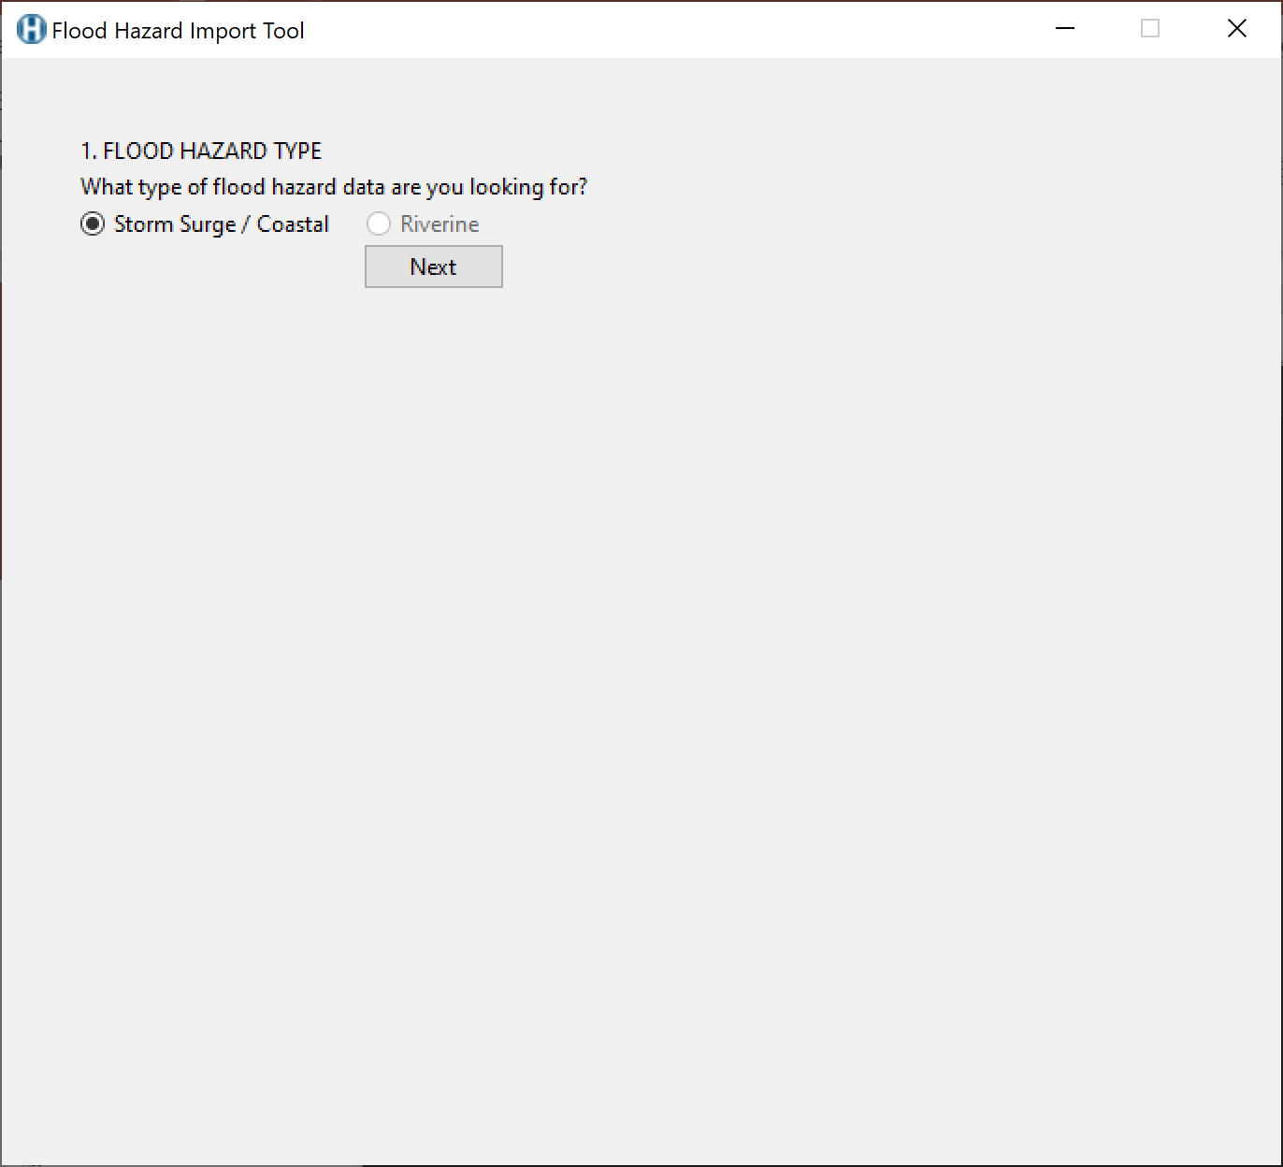
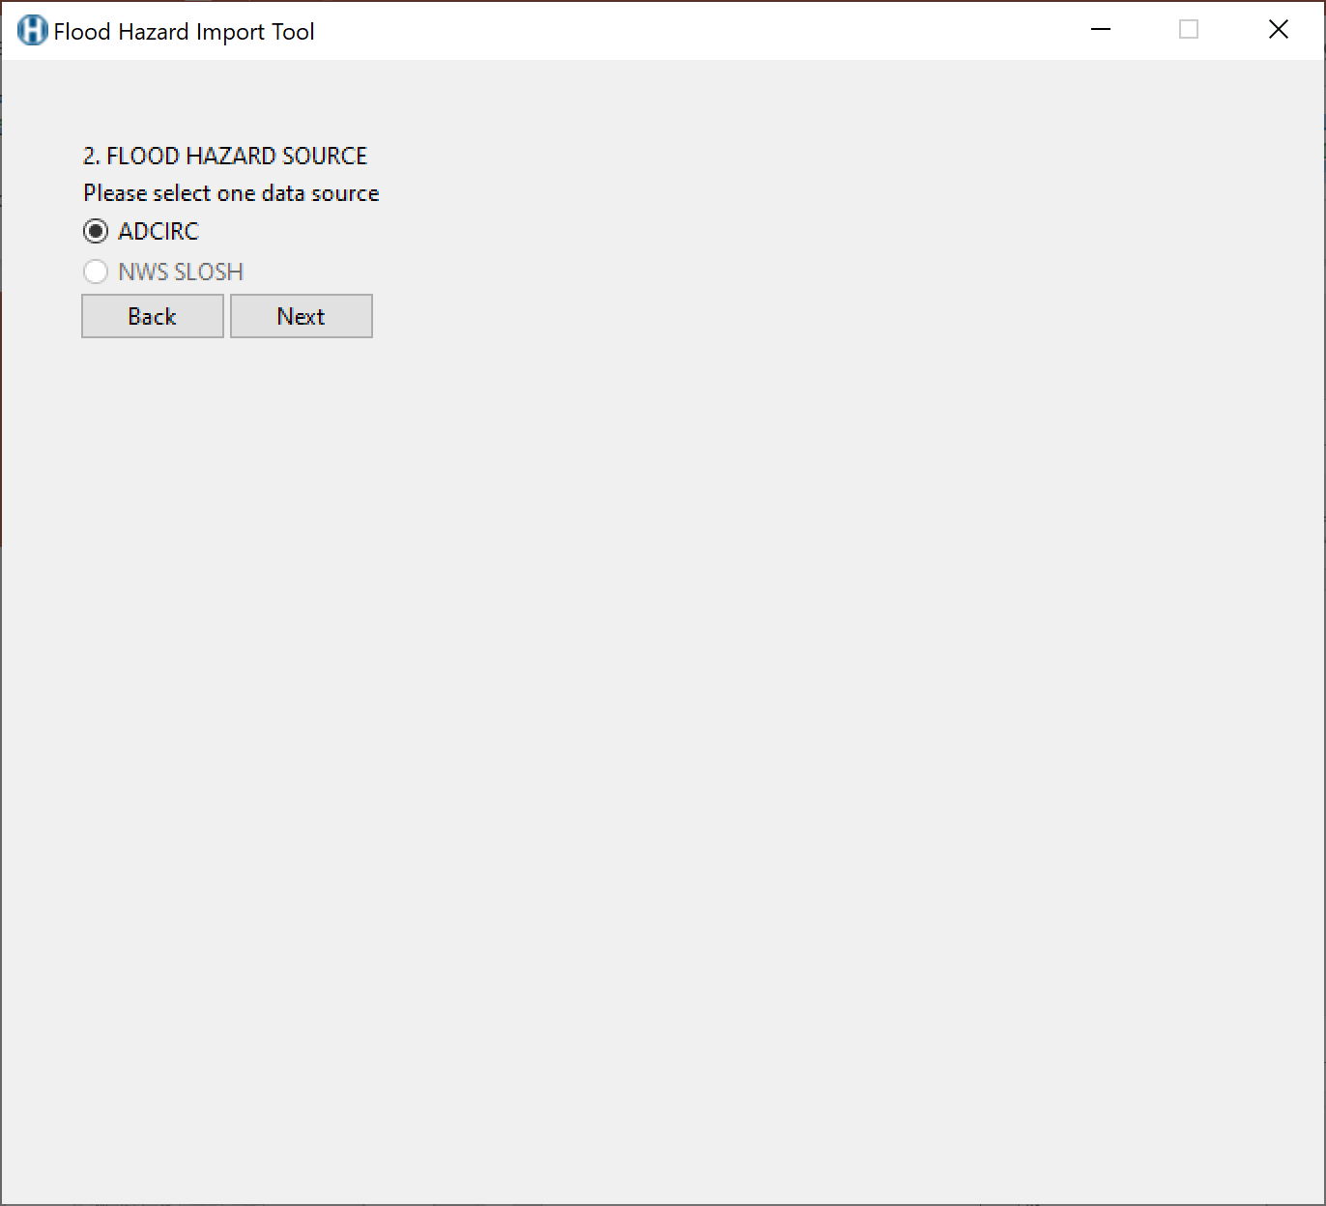
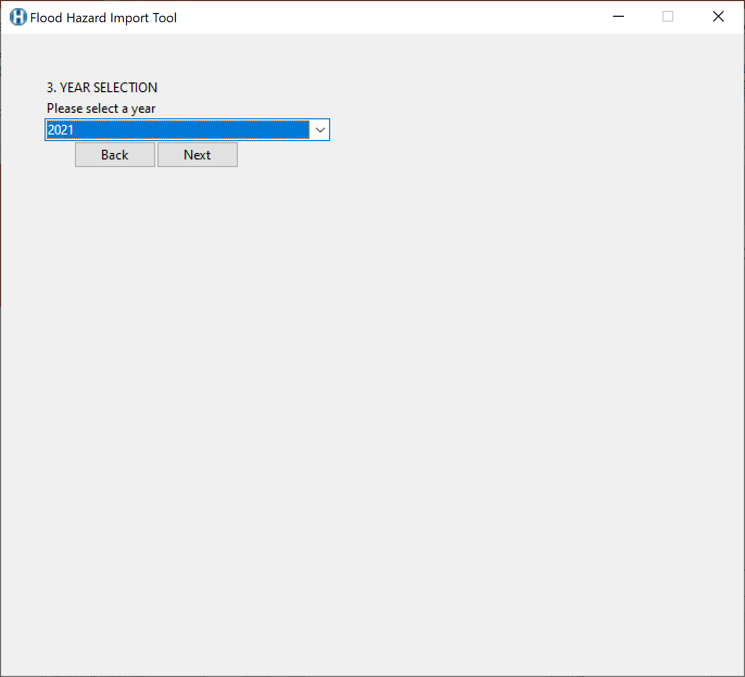
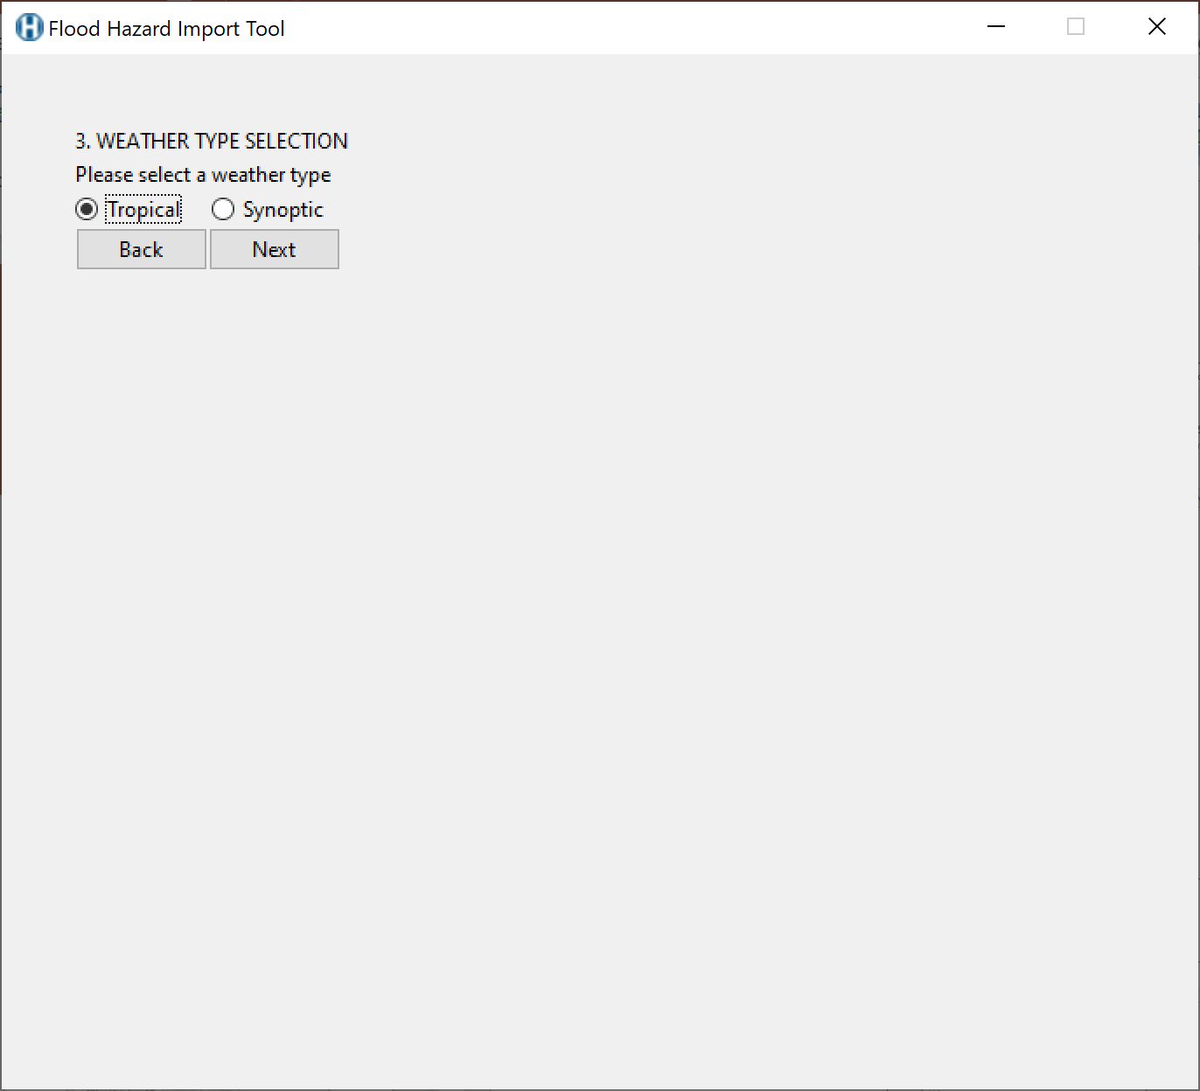
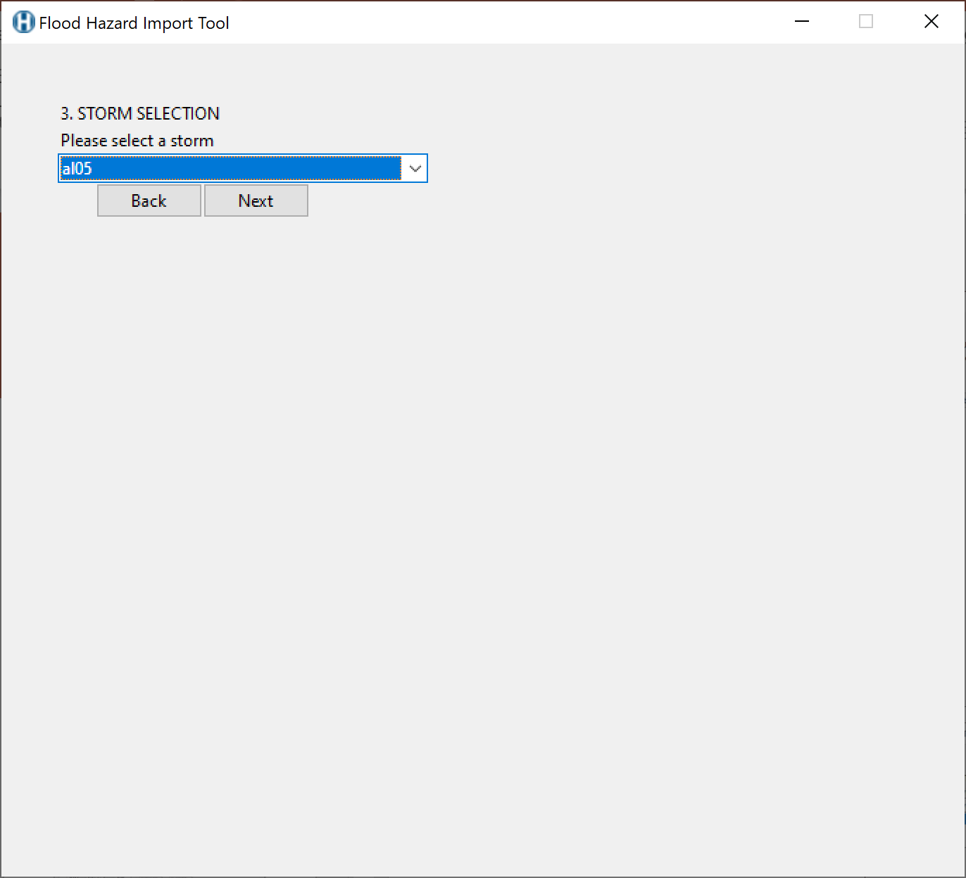

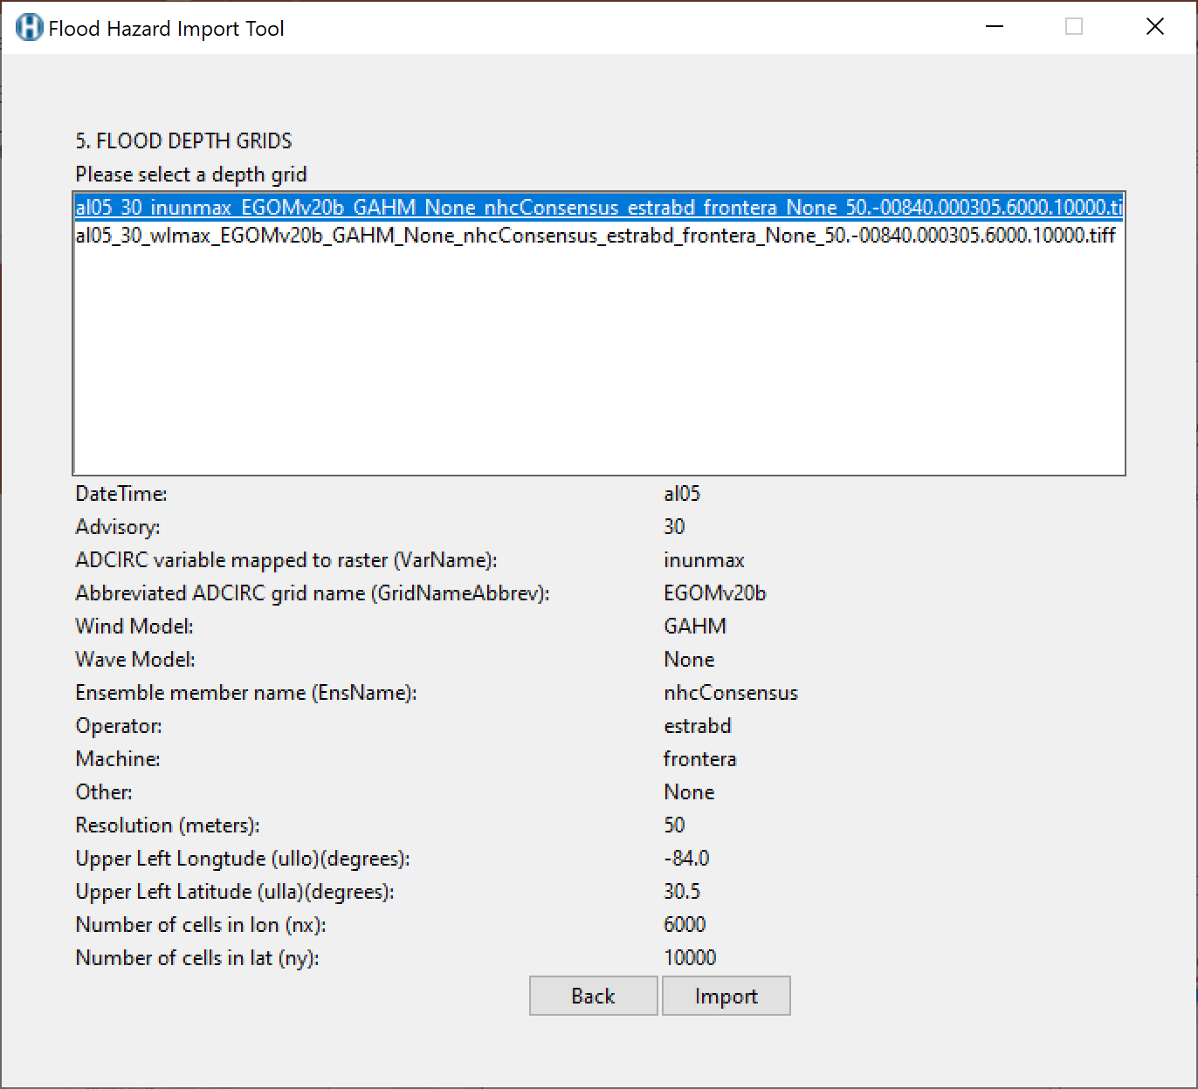

Slide 2
FLOOD HAZARD IMPORT TOOL
SELECT FLOOD HAZARD TYPE:
[Hazard Type]
SELECT FLOOD HAZARD SOURCE:
[Data Source]
FLOOD HAZARD SOURCE SEARCH PARAMETERS:
ADCIRC
[Year List ]
o Synoptic o Tropical Events
[ Storm List ]
[Advisory List]
(i) button to new window, hover text,
doc with more info on each key/value
AVAILABLE FLOOD HAZARD FILES:
File 1
File 2
File 3
File 4
File 5
File 6
File 7
File 8
File 9
SELECTED FILE PROPERTIES (i):
Key | Value
Key | Value
Key | Value
Key | Value
Key | Value
Key | Value
Key | Value
Key | Value
Key | Value
OPTIONS:
[x] Project to UTM Zone
[Feet | Meters | CM ] Input Depth Units
[x] Overwrite Existing Hazard Data
[_] Clip to Study Region (user select SR|browse to input polygon|define min/max x/y)
Import Selected File Button
Browse to Existing Hazard Data Button
Quit Button

Slide 3
FLOOD HAZARD IMPORT TOOL
1 SELECT FLOOD HAZARD TYPE:
Hazard Type
4 AVAILABLE FLOOD HAZARD FILES:
File 1
File 2
File 3
File 4
File 5
File 6
File 7
File 8
File 9
2 SELECT FLOOD HAZARD SOURCE:
[Data Source]
3 FLOOD HAZARD SOURCE SEARCH PARAMETERS:
[Year List ]
[WeatherType]
[Storm List ]
[Advisory List]
Search by Study Region
*Only some data sources can support searching by SR
ADCIRC
Search
parameters
(i) button to new window, hover text,
doc with more info on each key/value
SELECTED FILE PROPERTIES (i):
Key | Value
Key | Value
Key | Value
Key | Value
Key | Value
Key | Value
Key | Value
Key | Value
Key | Value
Blank space to adjust as necessary for other data source search parameters.
OPTIONS:
[x] Project to UTM Zone
[Feet ] Input Depth Units (ft, m, cm; feet by default)
[x] Overwrite Existing Hazard Data
[_] Clip to Study Region
Project by default
Download and Import Selected File
Could warn user if already exists and prompt
[Select SR | Select polygon | Enter min/max x/y]
Browse for Existing Hazard Data to Import
Quit

Slide 4
Flood Hazard Type Selection:
o Riverine
(USGS, NOAA, NHD+,
Stream Stats,
FEMA MSC)
o Storm Surge / Coastal
(ADCIRC, SLOSH,
FEMA MSC, NOAA SLR)
Flood Hazard Source Selection:
o USGS
o NOAA
o NHD+
o Stream Stats
o FEMA MSC
o ADCIRC
o SLOSH
o NOAA SLR
Next
Quit Button

Slide 5
Flood Hazard Type:
Storm Surge
Flood Hazard Source:
ADCIRC
Search Parameters:
ADCIRC
Year List
WeatherType Radio Button (Synoptic/Global | Tropical Events)
Storm List (based on year)
Advisory List (based on storm, year)
USGS ?
MSC ?
NHD+ ?
Stream Stats ?
SLOSH ?
Is there plan to use Synoptic? Large global files that need to be clipped.
Concentrate on Tropical? Doug
This could be a long list of dates for synoptic weathertype
Options:
[True] Project to UTM Zone
[Feet| Meters|CM ] Input Depth Units (must be feet at import)
[True] Overwrite Existing Hazard Data
[False] Clip to Study Region (user select SR|browse to input polygon|define min/max x/y)
Parameters will be different for each source
Rename file?
Rename clipped files?
Available Files:
File 1
File 2
File 3
File 4
Selected File Properties:
Key (i) | Value
Key (i) | Value
Key (i) | Value
Key (i) | Value
(i) button to new window, hover text,
doc with more info on each key/value
Back Button
Import Selected File Button
Browse to Existing Hazard Data Button
Quit Button

Slide 6
