Slide 1

A Full student Enrollment and Learning Management System Presentation

Slide 2
Project analysis slide 2
Supervised By
Presented By
Sadia Tasnim Barsha
Lecturer & Exam Coordinator,
Department of Computer Science and Engineering
Sonargaon University (SU)
Md. Zubair Rahman
ID: CSE1801013067
Sumiya Rahman
ID: CSE1801013073
Alif Ahmed
ID: CSE1801013065
Md. Ashraful
ID: CSE1801013029

Slide 3
Project analysis slide 3
Introduction
Deals with all kind of student details, academic related reports, course details, session details, session and course wise lecture documents, teacher information and other resource related details too.
It tracks all the details of a student from the day one to the end of his course which can be used for all reporting purpose.
tracking of attendance, payment ledger, registration, live chat, student application, drop semester, mark input, post update, important notices, feedback, final exam result etc.
The Student Enrollment and Learning Management System is an automated version of manual Student Information System.
ECOLOGICAL ANALYSIS

Slide 4
Project analysis slide 4
Project Goal and Objectives
It is a management information system for education establishments to manage student data.
Provide capabilities for registering students in courses, admitting students, tracking student attendance and submitting students’ documents and Result.
Ensure data integrity, privacy, and security in an open-access environment.
To collect easily session wise and course wise lecture any time from online.

Slide 5
Project analysis slide 5
Motivation
It is an online base software. So that, student collect their every course lecture and important document anytime from anywhere.
Sometimes student collect their important file or document by pen drive. It is long time process and file would be missing. The system is very secure. User can easily access and collect.
Manage session and course wise document.
Get student and teacher details.
Manage and view feedback and notice.
Show result, notice and another important document.

Slide 6
Project analysis slide 6
Tools and Platform
Software Type | Software | Used For | Critical (Y/N)
OS | Windows 10, 8.1 | Server | Y
Database | XAMPP(MySQL | Database | Y
IDE | Pycharm Pro, Visual Studio Code | Development | N
Source Control | Git hub | Version Control | Y

Slide 7
Project analysis slide 7
Components
Student features.
Teacher features.
Administrator features and Super admin

Slide 8
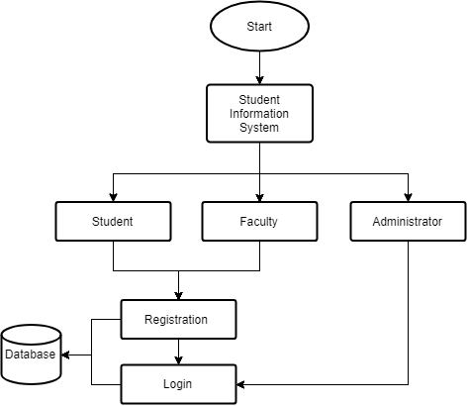
Project analysis slide 7
Figure : Data Flow Diagram for SELMS Components

Slide 9
Project analysis slide 8
Student Features
Dashboard
Profile
Update Profile
Change Password
Payment Ledger
Registration
Live Chat
Student Application
Drop semester
Live Result

Slide 10
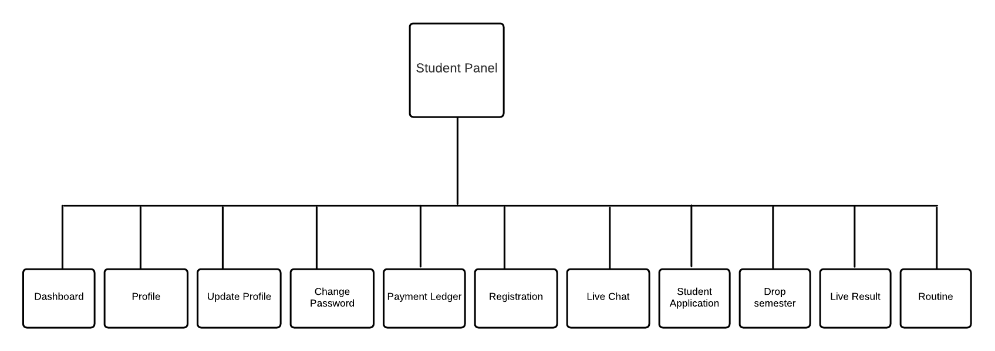
Project analysis slide 8
Figure : Data Flow Diagram for Student Features

Slide 11
Project analysis slide 10
Work Process
Firstly, Student registered SU SELMS System with their required all information.
After registered SELMS then Login this system and get Home page.
They send and receive feedback.
Get semester result.
Join live class.
Get course registration
Show notice.
Get Student details information.

Slide 12
Project analysis slide 11
Teacher Features
Dashboard
Profile
Profile Update
Change Password
Live Chat
Mark Input
Students
Routine
Result Publish
Post update

Slide 13
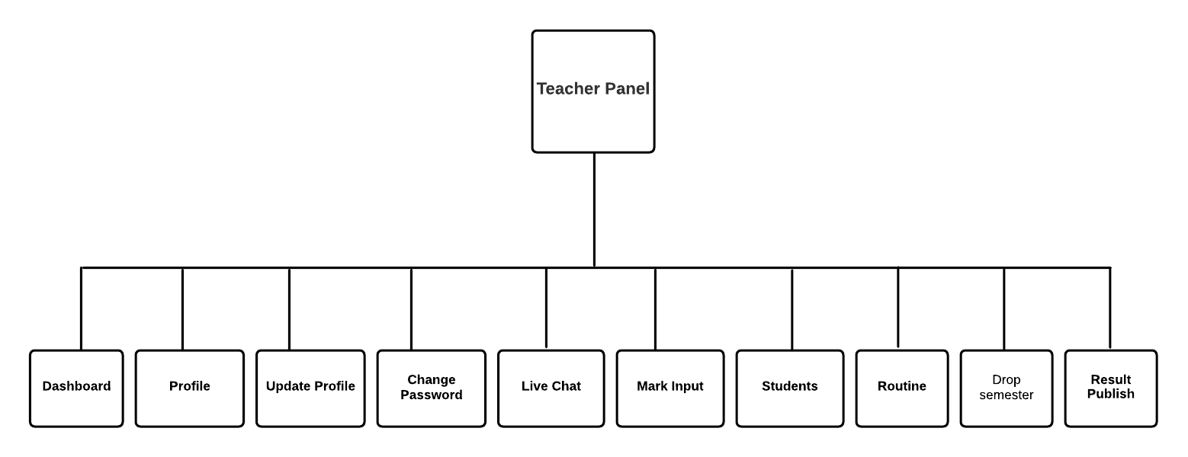
Project analysis slide 11
Figure : Data Flow Diagram for Teacher Features

Slide 14
Project analysis slide 11
Work Process
Firstly, Teacher registered SU SELMS System with their required all information.
After registered SELMS then Login this system and get Home page.
They send and receive feedback.
Publish result.
Assign mark.
Update post.
Get student list.
Show notice.
Get Teacher details information

Slide 15
Project analysis slide 11
Administrator Features
Batch Info
Courses
Offered Courses
Semesters
Groups
Users
Application Type models
Drop Semester
Mark Distribution
Registered Course
Student application
Student Feedback
Student info

Slide 16
Project analysis slide 11
Teacher Department
Teacher Designation
Teacher Faculty
Teacher List

Slide 17
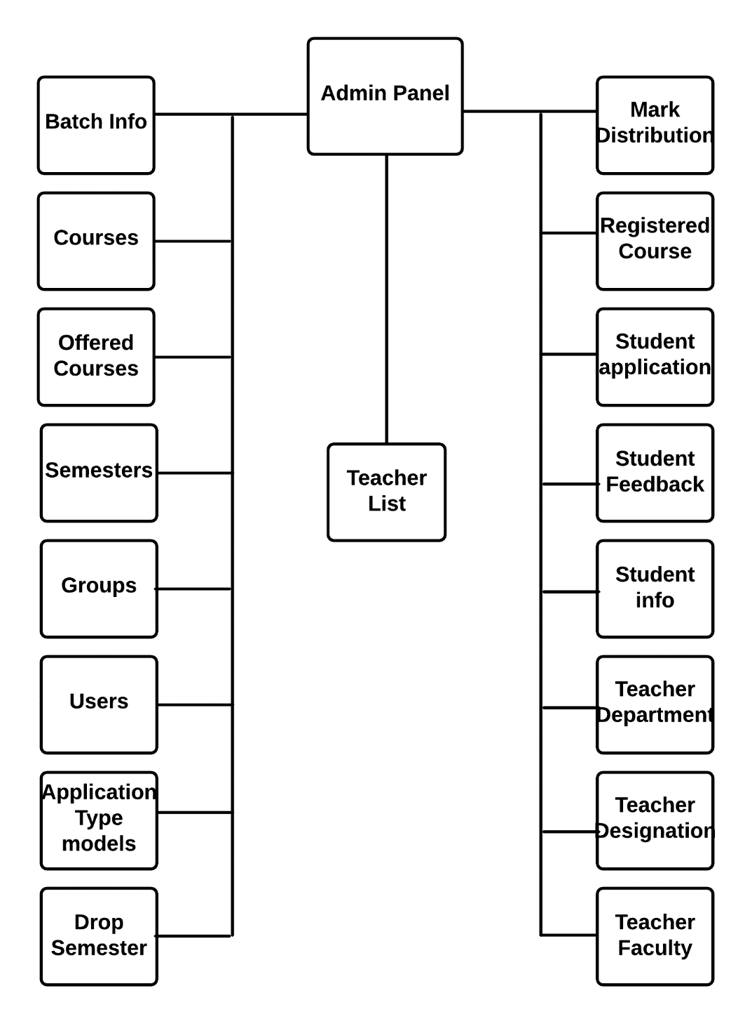
Project analysis slide 11
Figure : Data Flow Diagram for Admin Features

Slide 18
Project analysis slide 11
Work Process:
Firstly, Student registered SU SELMS System with their required all information.
After registered SELMS then Login this system and get Home page (Document management).
They send and receive feedback.
Publish semester result with details and generate mark sheet.
Give notice.
Teacher details information.
Student details Information.
App Student.
Add Teacher.
Handel each and every panel.

Slide 19
Project analysis slide 11
Project Team
Team Member | Role | Reports To | Responsibility
Sadia Tasnim Barsha | Project Supervisor |  | Manage all project activities
Md. Zubair Rahman | Team Leader | Project Supervisor | Project Manage and development
Sumiya Rahman | Team member | Team Leader | Assist and Design Support
Alif Ahmed | Team member | Team Leader | Assist and Design Support
Md. Ashraful | Team member | Team Leader | Assist and Design Support

Slide 20
Project analysis slide 11
Future plan
Student will be able to see their every semester gap status.
Student will be able to request get extra credit.
Student will be able to choose semester wise offered course.
Live chat option will be updated and authentication will be added.
Classroom api will added.
Direct online money transaction.
Manage all information related to rooms, mess, goods, etc. Track details of menu, reduce food expenses and optimize room allocation.
Maintain student’s every day attendance period wise. Generate attendance related reports on-demand for the stakeholders.

Slide 21
Project analysis slide 11
Conclusion
Student Information System in online based software. It is very helpful for educational institute. Student and teacher can easily maintain their section wise document. It serves as a helpful approach for the users. Thus, the project is the user-friendly approach.

Slide 22
Project analysis slide 11
Thank you everyone
Any question?

