Slide 1

Understanding the distribution of health needs using Population Segmentation An applied comparison of methods
Richard Wood Ben Murch Adrian Pratt
@BNSSGAnalytics

Slide 2


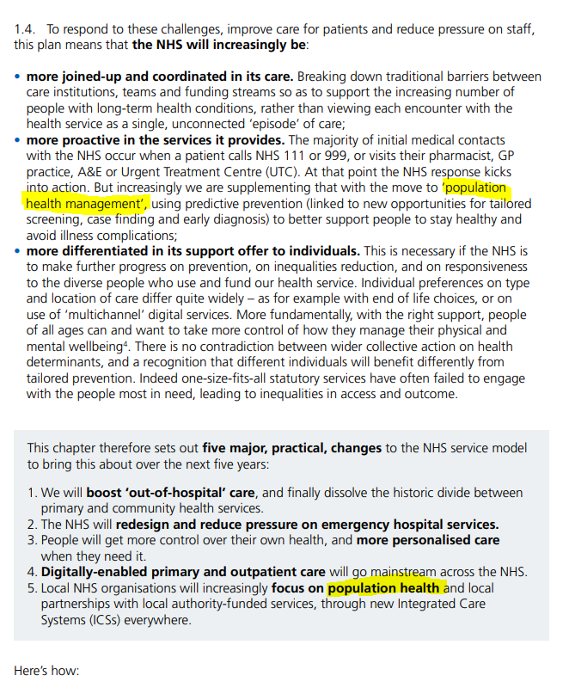
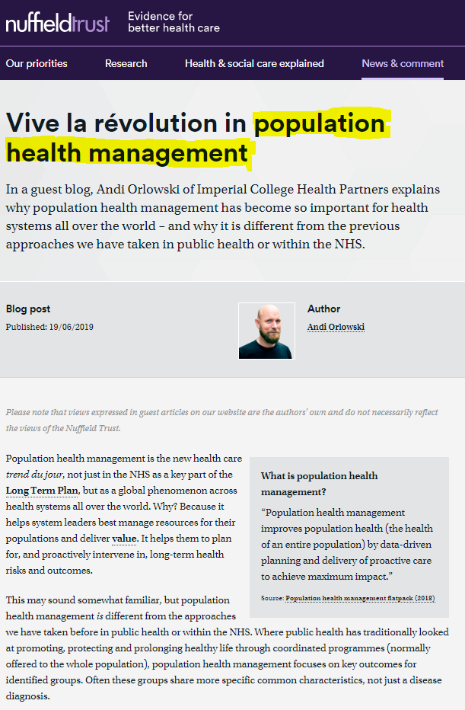
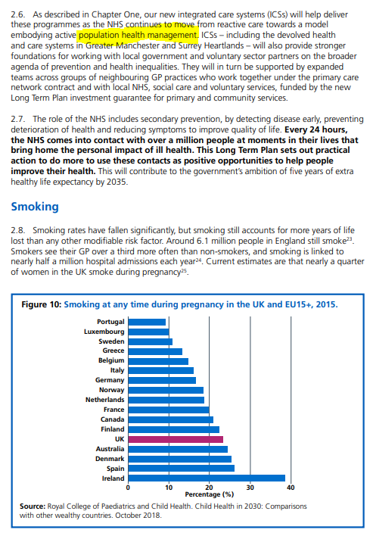
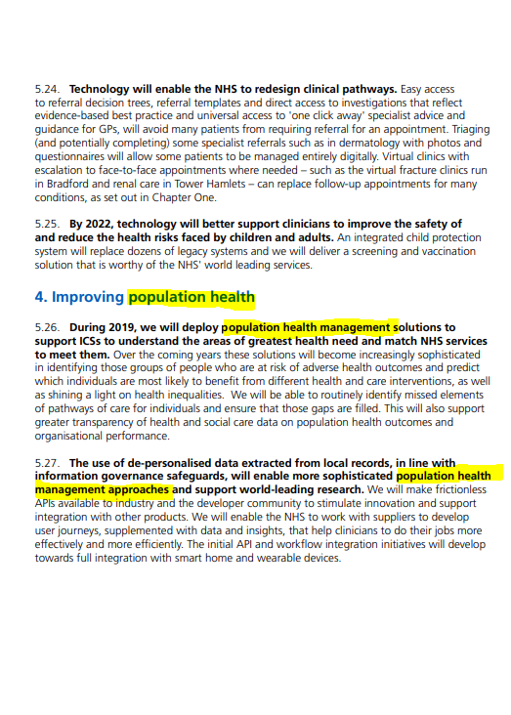

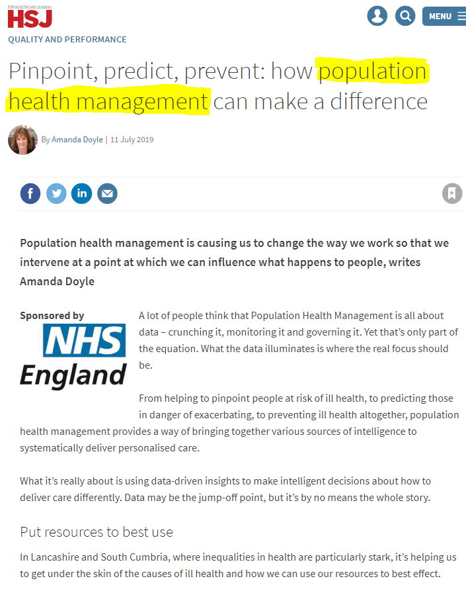
Population Health Management

Slide 3
What is PHM?
“Population Health Management focuses on key outcomes for identified groups. Often these groups share more specific common characteristics, not just a disease diagnosis”
“PHM is the concept of gathering data and insights about population health and wellbeing across multiple care and service settings, with a view to identifying the main health care needs of the community and adapting services accordingly”
Nuffield Trust
“During 2019, we will deploy PHM solutions to support ICSs to understand the areas of greatest health need and match NHS services to meet them. Over the coming years these solutions will become increasingly sophisticated in identifying those groups of people who are at risk of adverse health outcomes”
Deloitte
NHS Long Term Plan

Slide 4
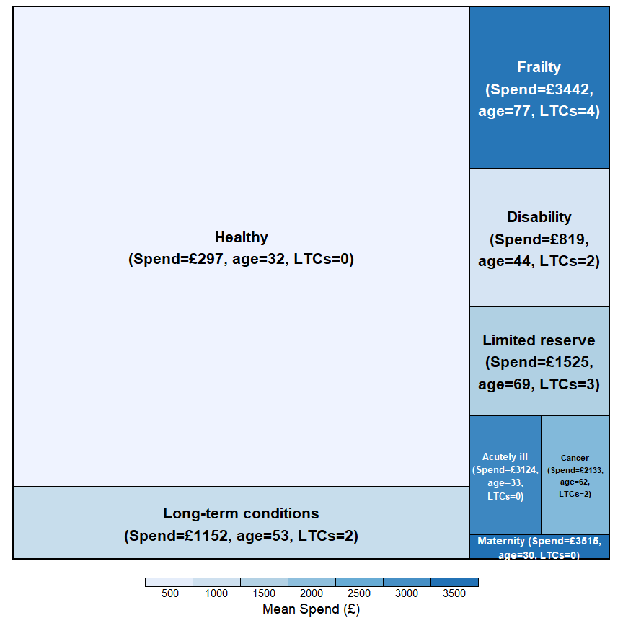
Example segmentation
Block size represents segment population
Colour depth represents spend differential

Slide 5
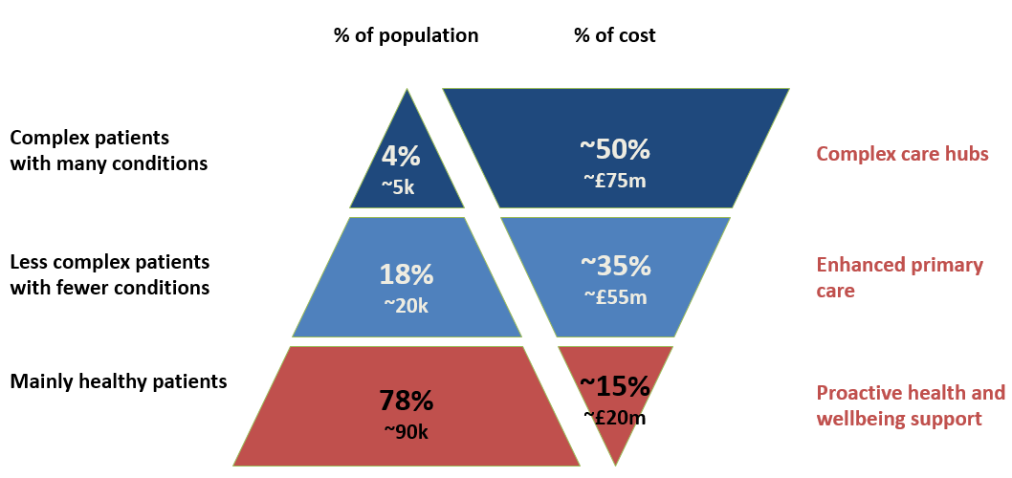
Why segment?
Cut through the complexity of large and unwieldy datasets in making sense of the key patient-related attributes that drive the most significant differences in some targeted measure of interest
Activity or spend can be targeted in representing healthcare need
Identified segments thereafter amenable to tailored interventions
E.g. Complex Care Hub for the most seriously ill patients
From Somerset Symphony project

Slide 6

Aim
To review a number of Population Segmentation methods side-by-side in a consistent manner using a common dataset…
…that identify meaningful and interpretable population cohorts which are heterogeneous between and homogeneous within
To open up a range of options allowing clinicians and managers an informed choice on which approach to use for their situation

Slide 7
Outline of introduction
Setting and data
Methods
Comparison
Discussion

Slide 8



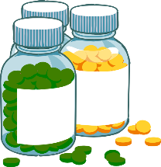
Data requirements
1. SETTING AND DATA
Attributes Demographic – age, sex, ethnicity Clinical – listed chronic conditions, obesity, frailty scores Other – deprivation, smoking status, housebound
Activity Primary Care contacts – GP and nurse appointments Secondary Care contacts – outpatient, inpatient, A+E Prescriptions – medicines

Slide 9
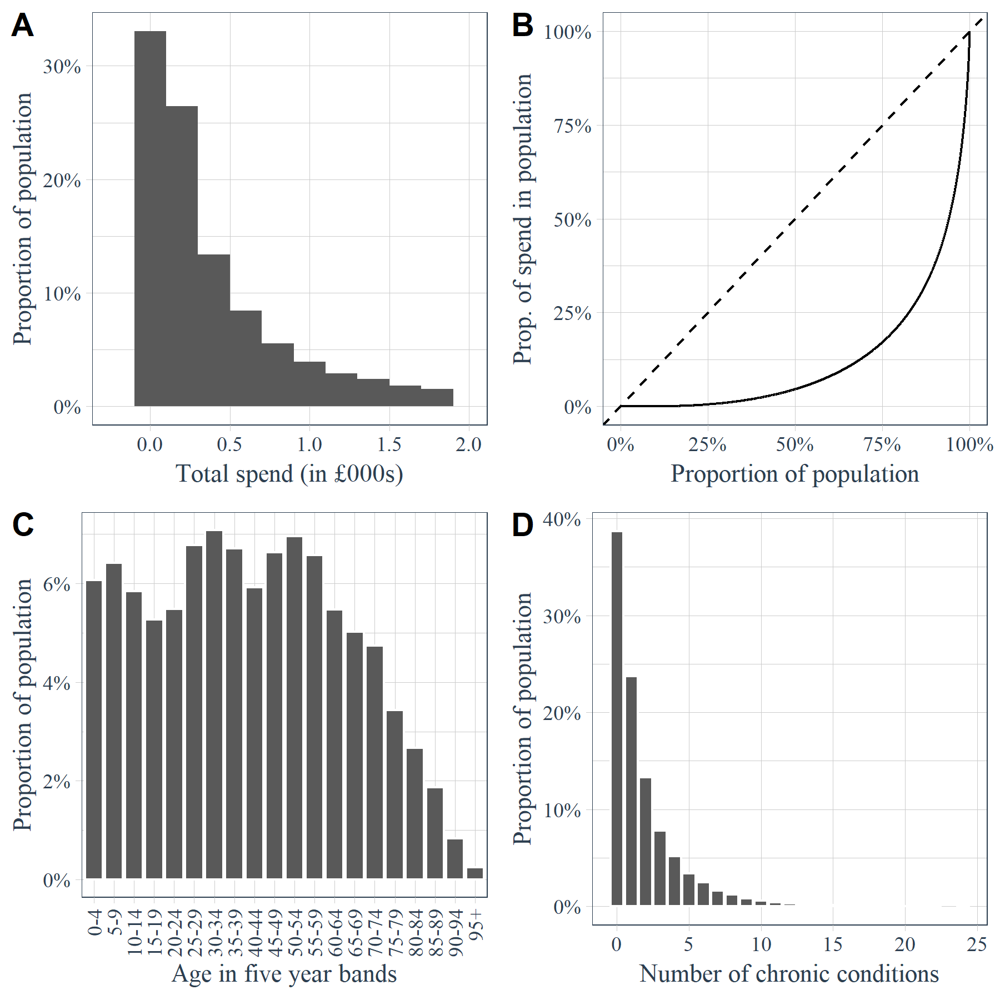
Sample data at a glance (n=51,072)
1. SETTING AND DATA
Inequal distribution
Gini 0.75
80/20 rule holds
Highly skewed
Mean £853
Median £240
61.3% of people have at least one chronic condition
Multi-modal population in Bristol area

Slide 10
Outline of introduction
Setting and data
Methods
Comparison
Discussion

Slide 11
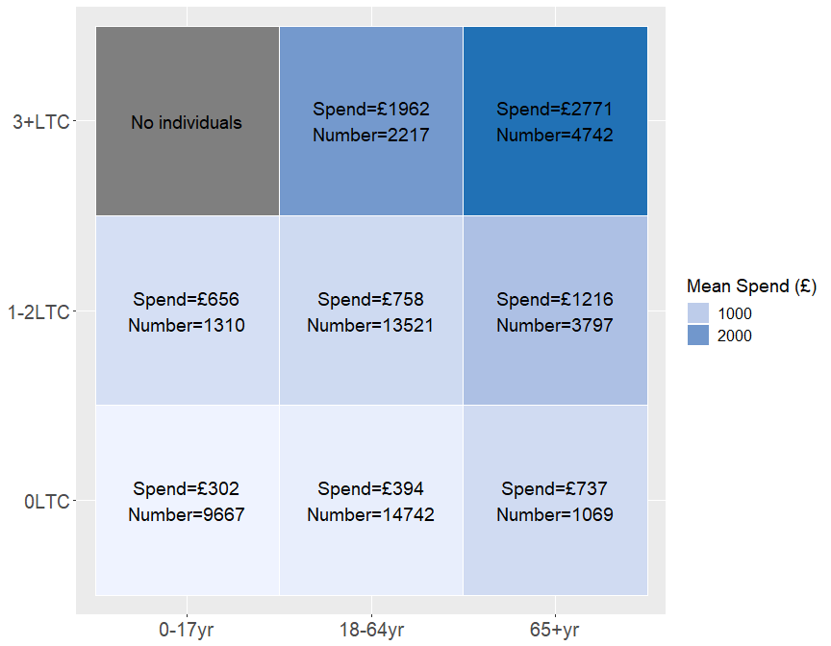
Judgemental splits
2. METHODS
Most basic approach
Simply obtain segments by making arbitrary splits on explanatory variables (patient attributes)
E.g. by age and chronic condition count
Age (0-12, 13-17, 18-49, 50-74, 75+)
Sex (male/female)
Chronic conditions (0-4, 5-9, 10-14, 15+)
Age and chronic conditions (0-17, 18-64, 65+ by CCs 0-4, 5-10, 11+)

Slide 12
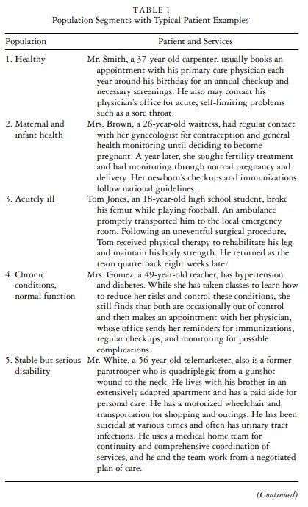
Prescribed binning criteria
2. METHODS
Bin patients according to preset rules defining segment membership
No guarantee that rules will be:
Discriminative
Relevant to geography/setting
Appropriate to targeted measure
Some rules not well-defined
Bridges to Health
Lynn et al, 2017 “Bridges to Health”
Low et al, 2017 (Singapore)
Joynt et al, 2017 (USA Medicare)
Electronic Frailty Index (UK, four levels)

Slide 13
Decision trees
2. METHODS
A “derived” approach
Objectively seeks discrimination in target variable (spend)
Segment names and definitions may be less intuitive
CART (Breiman method)
Conditional inference trees
C5.0 (information gain)
CHAID (Chi-square significance testing)

Slide 14
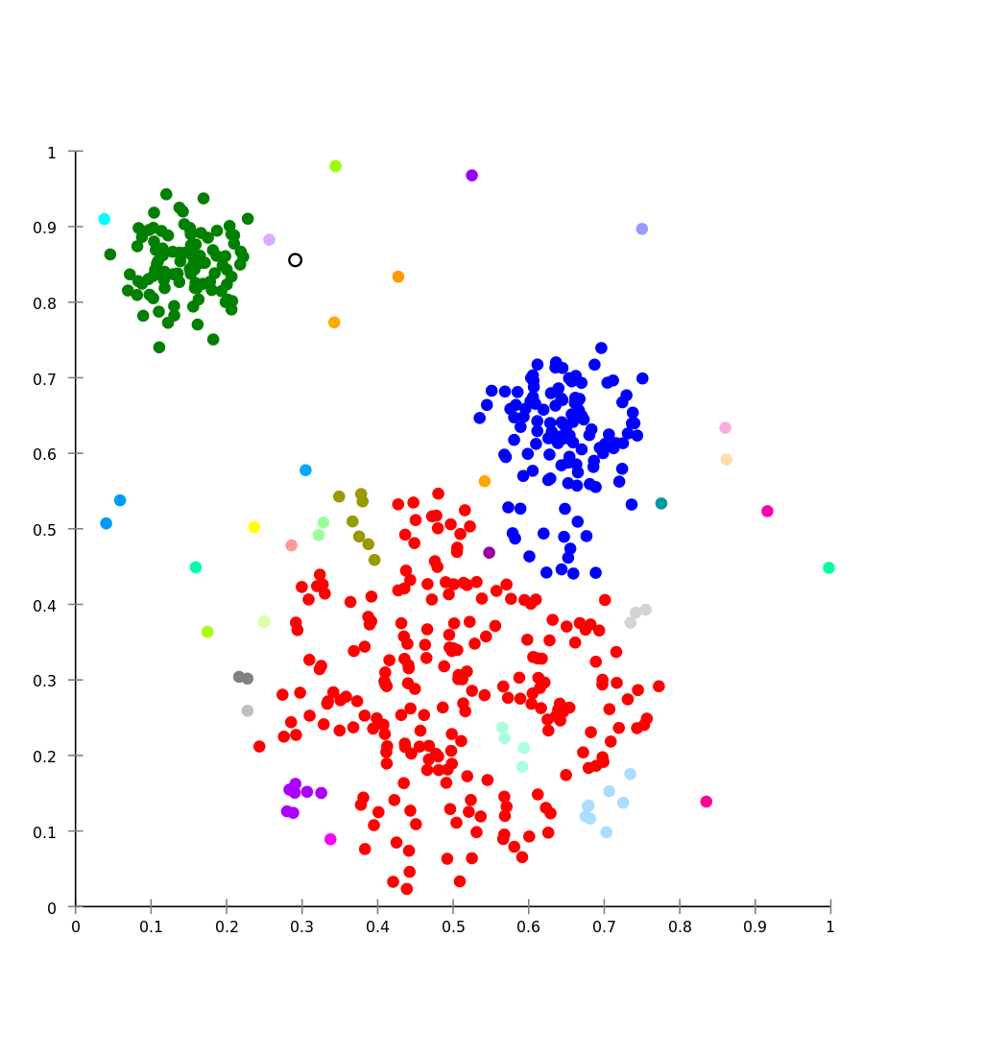
Cluster analysis
2. METHODS
Also a derived approach
Finds groups where observations are most similar
Non-objective: similarity driven by attributes and not target
Need to define “k” upfront
k-means (mean Euclidean distance)
k-modes (Hamming distance)
k-prototypes (numeric + categorical data)
k-medoids (sum of square distance)

Slide 15
Outline of introduction
Setting and data
Methods
Comparison
Discussion

Slide 16
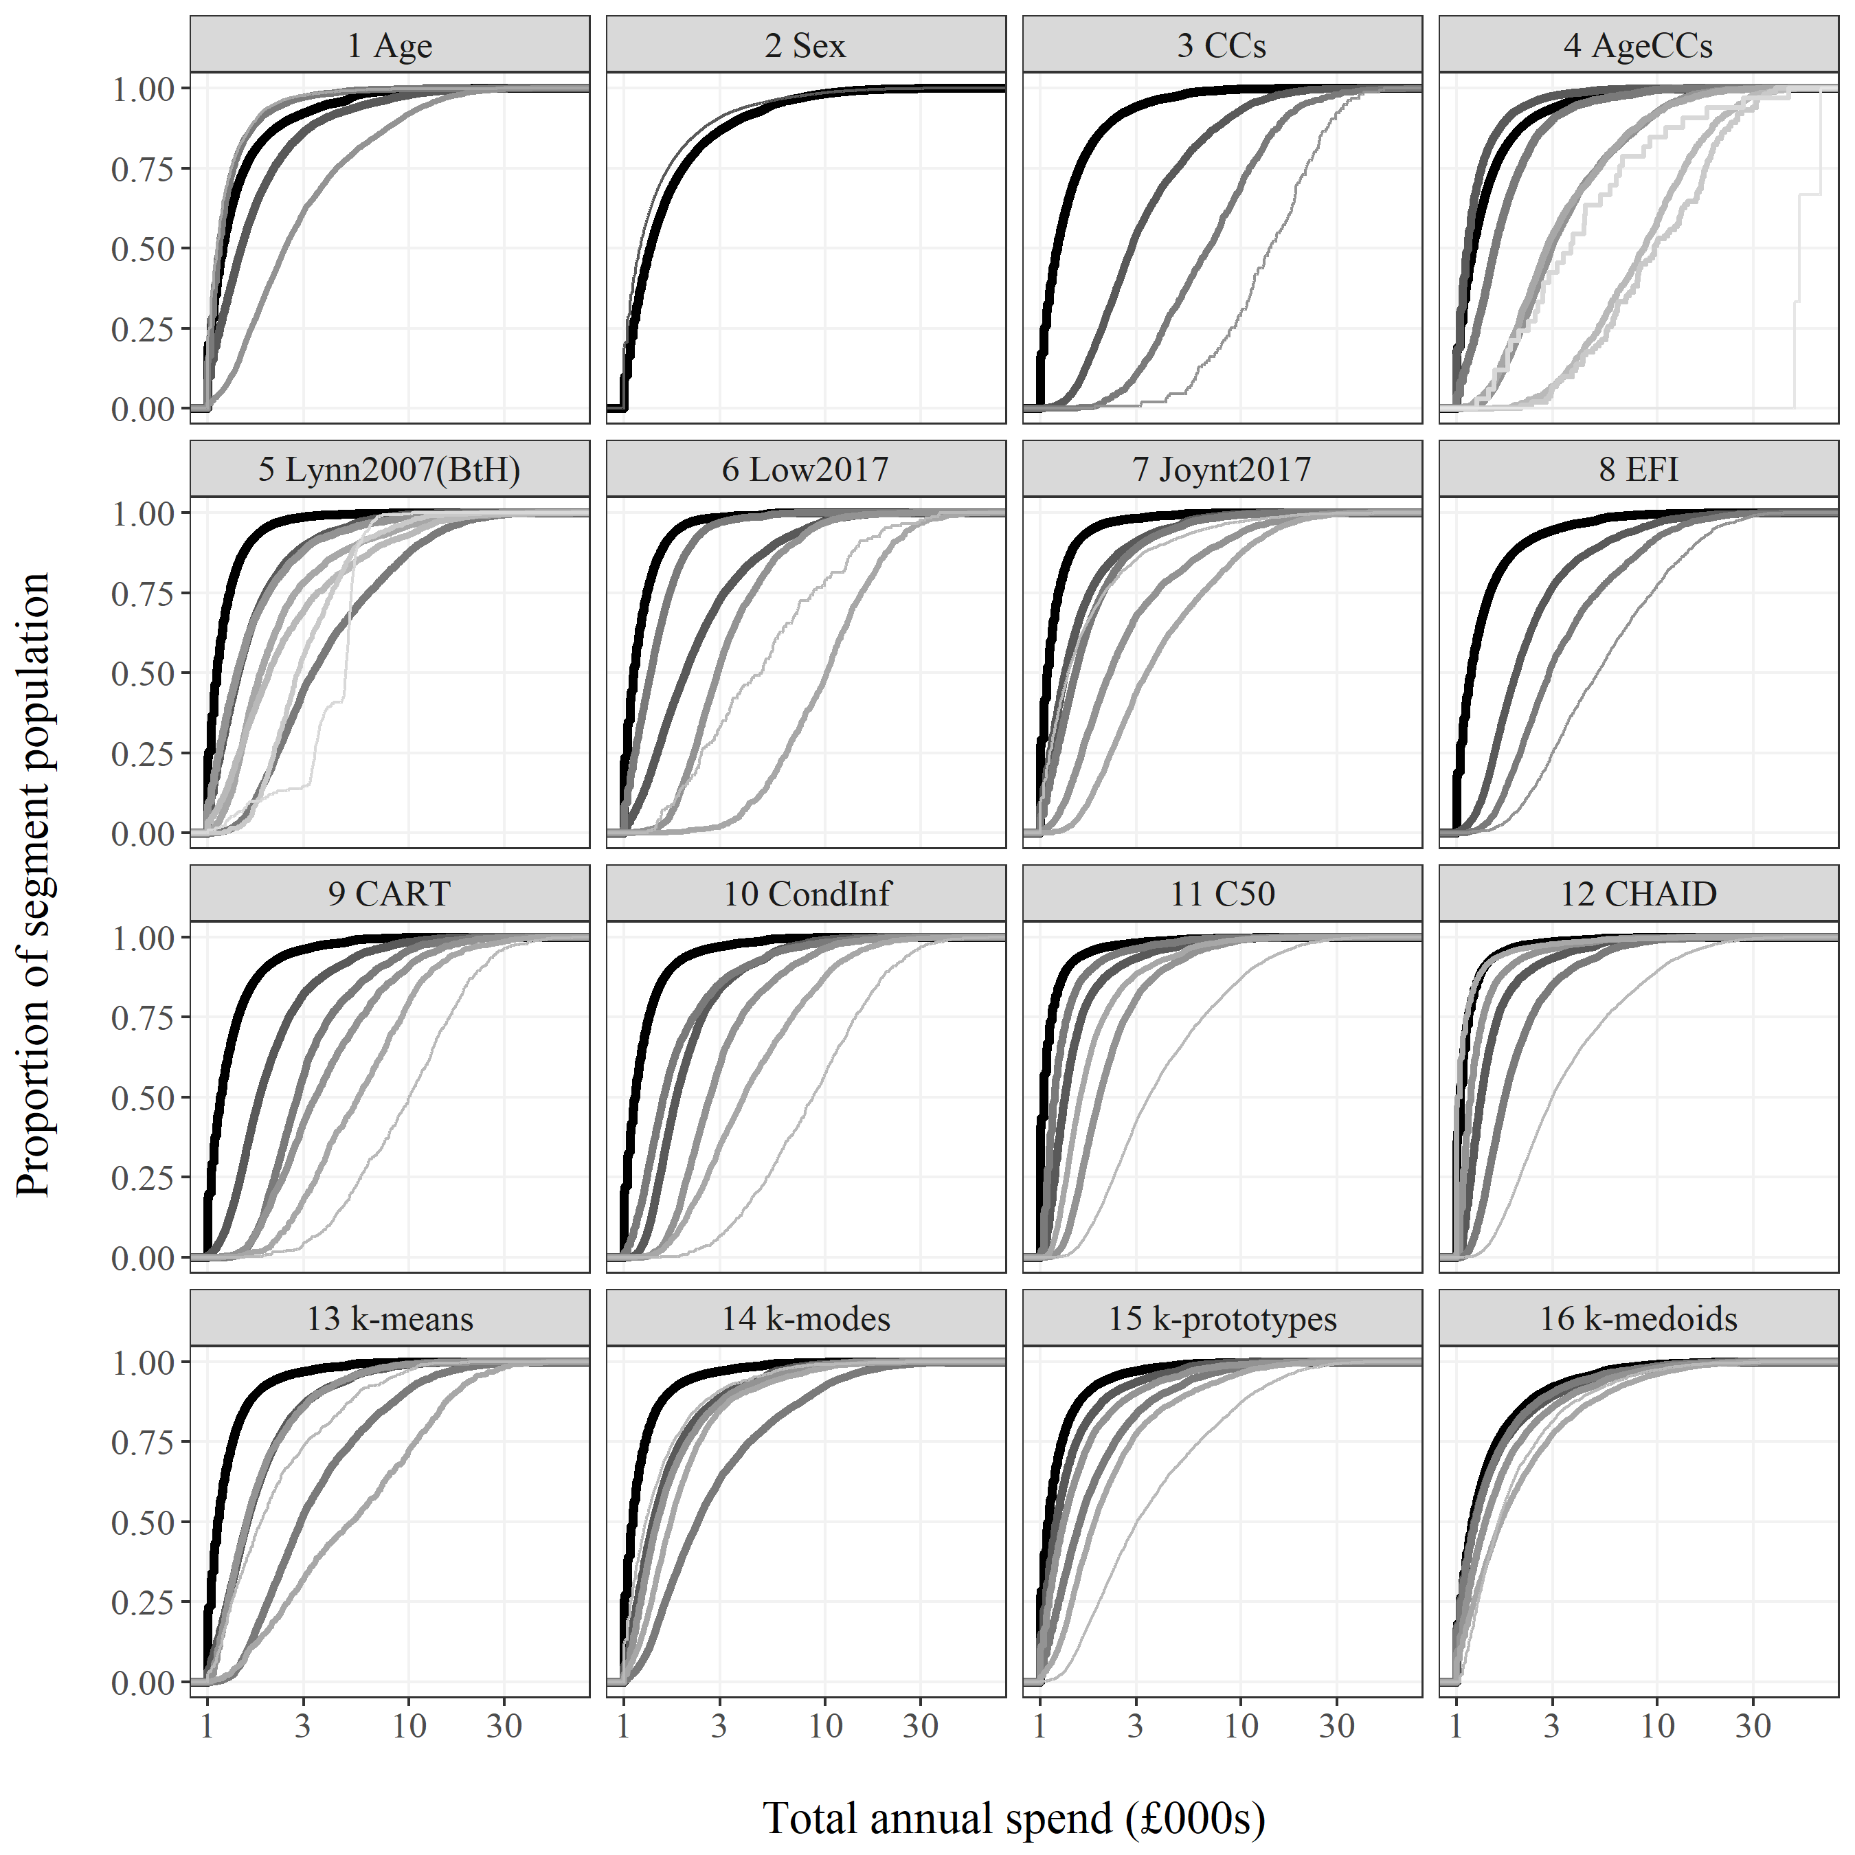
Segment-level spend distributions
3. COMPARISON
Can understand:
Number of segments
Spend profile
Number in segment
Rules of thumb:
Closer lines = less discrimination
More volatility = less homogeneity
Consistent progression in line shading = larger less expensive to smaller more costly
Maternity segment

Slide 17
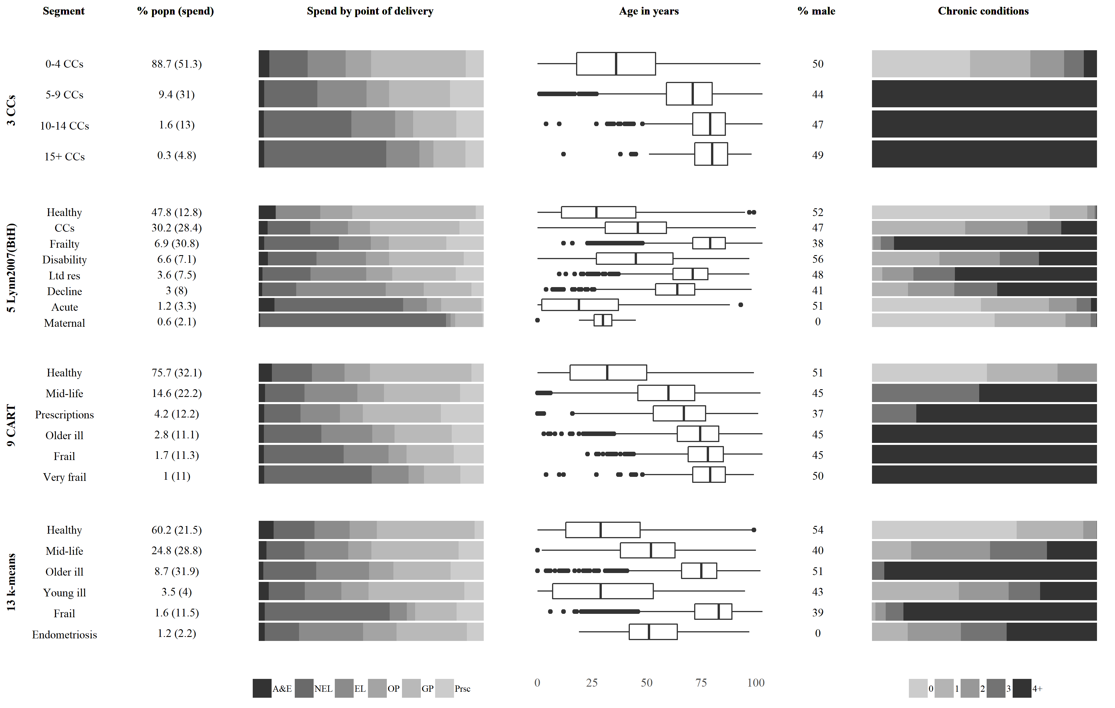
Spend and attributes differential
3. COMPARISON

Slide 18

Reduction in variance (spend)
3. COMPARISON
To be useful for PHM, methods must be discriminative
Assessed through:
A mixed bag of results
Some methods “cheat”
Category | Method | Variance | Reduction
Baseline | Baseline | 5,433,321 | -
Judgemental | Age | 4,912,301 | 10%
 | Sex | 5,418,924 | 0%
 | Chronic conditions | 3,516,112 | 35%
 | Age and chronic conditions | 3,505,768 | 35%
Prescribed binning | Bridges to Health | 4,275,849 | 21%*
 | Low2017 | 3,145,663 | 42%*
 | Joynt2017 | 4,376,765 | 19%
 | Elec Frailty Index | 4,319,655 | 20%
Decision trees | CART | 3,352,816 | 38%
 | Conditional infererence | 3,403,747 | 37%
 | C5.0 | 4,017,665 | 26%
 | CHAID | 4,180,762 | 23%
Clustering | K-means | 4,088,182 | 25%
 | K-modes | 4,647,659 | 14%
 | k-prototypes | 4,564,590 | 16%
 | K-medoids | 5,331,346 | 2%
* methods in which activity is used as an explanatory variable

Slide 19
Outline of introduction
Setting and data
Methods
Comparison
Discussion

Slide 20
Considerations for practical use
4. DISCUSSION
Discrimination vs segment interpretability
CHAID achieves just 4% better discrimination than Joynt2017 method
Really worth this given that Joynt has very comprehendible binning rules?
Implementation complexity
Performing a judgemental split is trivial
Performing FAMD based k-medoids requires specialist skillset
Availability of explanatory variables
Different methods require use of different variables
Derived methods should have lots of candidate variables to choose from
Also raises computational issues

Slide 21
Conclusions
4. DISCUSSION
There is not necessarily a right or wrong method for descriptive population segmentation – many factors to weigh w.r.t. discrimination and practicality
Cluster analysis on-the-whole unsuitable – computationally expensive, lacking discrimination, laborious pre-processing
Prescribed binning e.g. Bridges to Health: unlikely to achieve high levels of discrimination, but may be more interpretable and useful for benchmarking
Decision trees arguably preferred option since they offer a sound conceptual fit to the problem and promote good, data-derived discrimination
Otherwise, if insufficient data or expertise, then judgemental splits focusing on the number of chronic conditions should be favoured

Slide 22
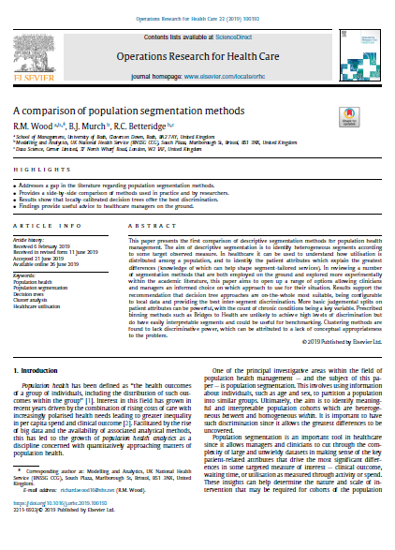
Wood, R. M., Murch, B. J., & Betteridge, R. C. (2019). A comparison of population segmentation methods. Operations Research for Health Care, 100192.
@BNSSGAnalytics
richard.wood16@nhs.net

Slide 23
Outline of today’s workshop
Understanding the data
Basic segmentation by age
Inclusion of long-term conditions alongside age
Decision tree segmentation
Bridges to Health segmentation
Report generation via Rmarkdown
Further work on R-based PHM suite

