Slide 1

Introduction to Machine Learning: Understanding the Basics
“Just as electricity transformed almost everything 100 years ago, today I actually have a hard time thinking of an industry that I don’t think AI (Artificial Intelligence) will transform in the next several years.” ~Andrew Ng
Ameer Sohail Syed – Data Engineer, NHS
NHS Python Community, 12th April 2024
Source: AI and Machine Learning - top minds quotes - (four.co.uk)

Slide 2
Who's Joining Us Today?
Healthcare Professionals
Anyone passionate about the intersection of technology and healthcare
IT Professionals

Slide 3
Agenda
Introduction
ML In Healthcare
Understanding ML Types
Q&A followed by Recap.
Simple Regression
The BMI Predictor Game
Strategies of ML
FDP with ML

Slide 4
By end of the session today
Understand and explain what is Machine Learning (ML)
How can we use ML in Health care
Understand a little bit of ML terminology
Learn about some Machine Learning Types
Understand and differentiate between Supervised and Unsupervised Learning
Differentiate between Classification and Regression Problem
Learn to use and navigate through Google Collab
Strategies to deal with ML problems
Get an idea of ML features in FDP

Slide 5
Motivation
Be part of new digital applications
A new way to look into the world
Stay updated

Slide 6
The definition
Mitchell’s definition of ML: “A computer program is said to learn from experience E with respect to some class of tasks T and performance measure P, if its performance at tasks in T, as measured by P, improves with experience E.”
Source: Machine Learning | SpringerLink

Slide 7
What is Machine learning?
Algorithms in computers
Write instructions and software tells the computer how to solve a problem
Machine learning
You give an input and let computer create the rules

Slide 8

The Difference
Machine learning shifts the focus from manual rule creation to autonomous rule learning, enabling computers to adapt and improve from experience.

Slide 9
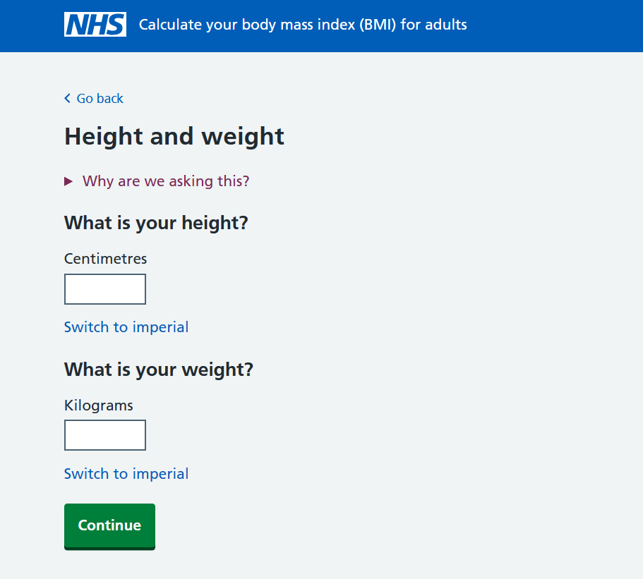
Example
Approach using rules
BMI = weight (kg) / height^2 (m^2)
Approach using ML
Creates own rules
Height and weight - Calculate your body mass index (BMI) for adults - NHS (www.nhs.uk)

Slide 10
Why Machine Learning for Operations ?
EHR maintenance
Flow Forecasting
Automation of Services

Slide 11
Why Machine Learning for Clinicians ?
Recommendation system
Support in Diagnosis (Partial/Full Human support)
Improving health Predictions

Slide 12

Machine Learning in Action: Streamlining Healthcare
Patient entry
Triage/ initial assessment
Data Systems
Policy and Governance
ML Analysis
Indirect influence
Hospital Administration
Clinical Decision Support
Ongoing care and monitoring

Slide 13
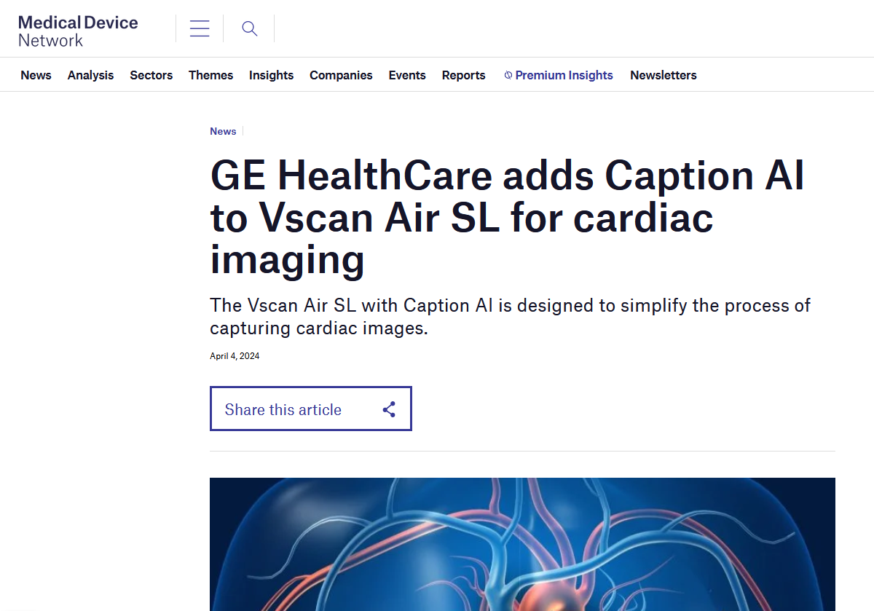
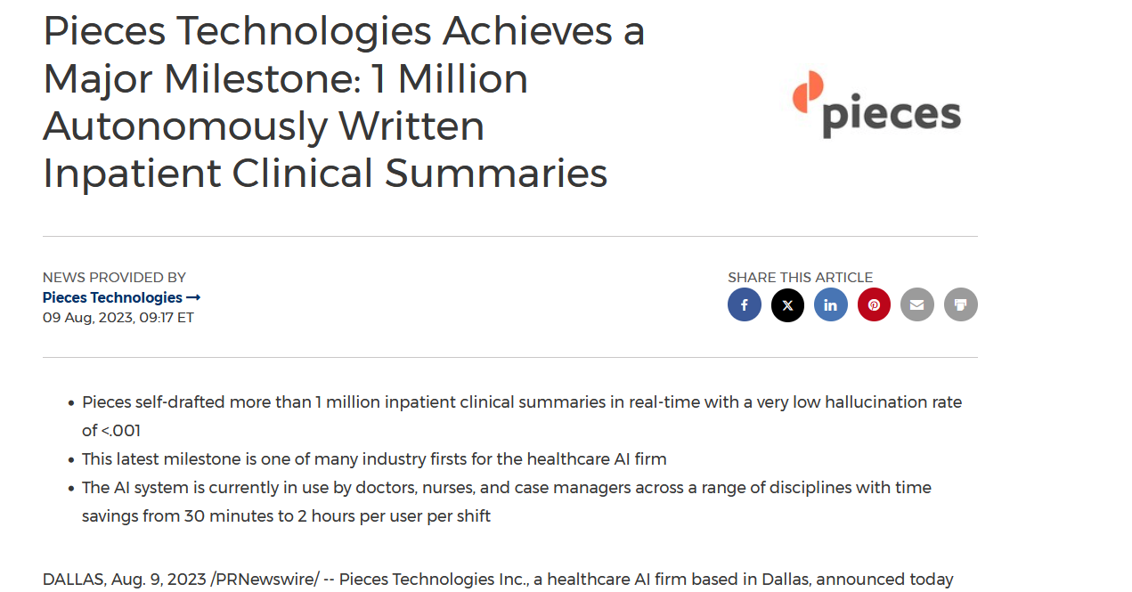
Latest breakthroughs in Healthcare
Source: https://www.medicaldevice-network.com/news/ge-healthcare-caption-ai-vscan-air-sl/
https://www.prnewswire.com/news-releases/pieces-technologies-achieves-a-major-milestone-1-million-autonomously-written-inpatient-clinical-summaries-301896907.html

Slide 14
Some terminology to be aware of
Dataset
Accuracy
Dimensions/ Features
Training data – Test data
Model

Slide 15
Understanding Machine Learning Types
Machine Learning Techniques
Unsupervised Learning
Supervised Learning
Clustering
Regression
Classification
Reinforcement Learning

Slide 16
Supervised learning
Training on Labelled Dataset
Input is the training data
Output is the values interested to predict

Slide 17
Examples
Predict pathways
Readmission risk
Resource Allocation

Slide 18
Limitations
Data Quality
Data Privacy
INterpretability

Slide 19
Unsupervised learning
Full data utilization
No Labels needed
Algorithm creates the labels

Slide 20
Examples
Anomaly detection in Health records
Patient Segmentation
Services clustering

Slide 21
Limitations
Interpretability
Dependent on data quality
No definitive answers

Slide 22
Supervised Learning
Notional Data
BMI | Body Fat
22.5 | 18
27.8 | 34
25.3 | 26
28.4 | 25
26.5 | 24
24.1 | 22
30.2 | 33
23.6 | 20
22.0 | 19

Slide 23
Simple Regression

Slide 24
Supervised Learning : Classification
Notional Data
Age | Physical Activity
35 | High
45 | Low
50 | Low
28 | High
65 | Low

Slide 25

It's Game Time!
BMI_Regressor.ipynb - Colab (google.com)

Slide 26
Strategies in ML

Slide 27

Lot of decisions to make
Deciding which algorithms to chose
Train more ?
Spend more time collecting data

Slide 28
Some things to keep in mind
First algorithm might not work
No one size fits all
Powerful models might not be the efficient
Systematic engineering process

Slide 29
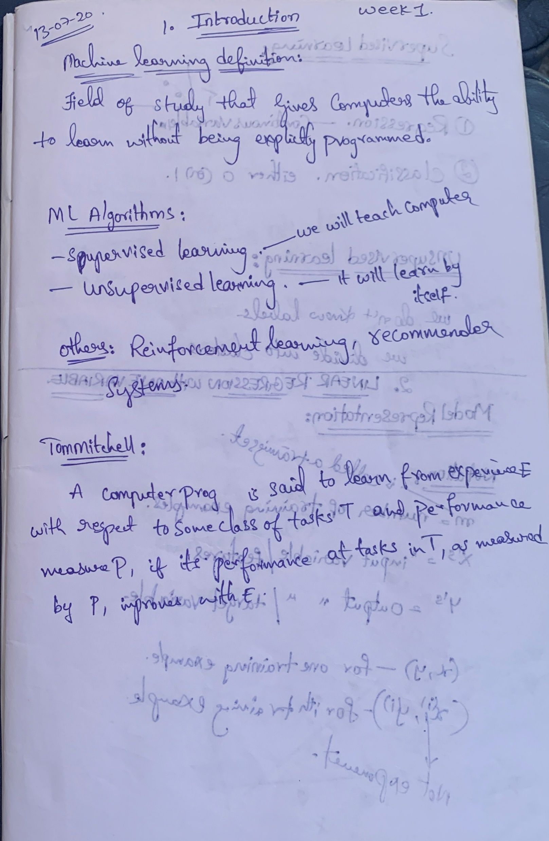
remember that every expert was once a beginner.

Slide 30
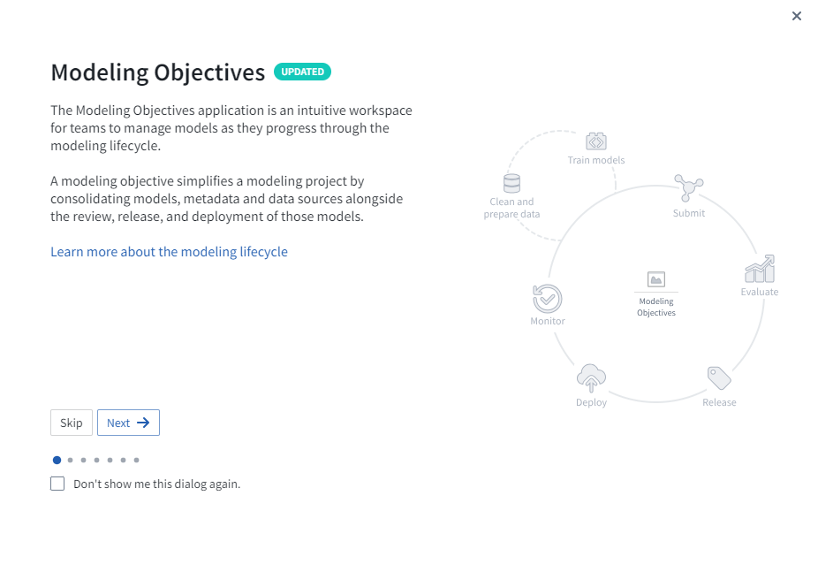
Foundry FDP Platform

Slide 31
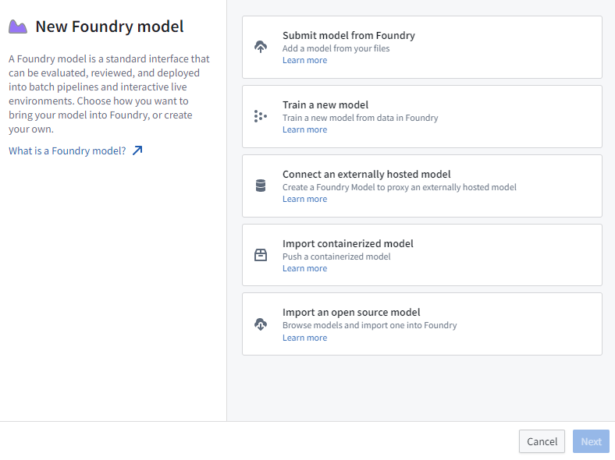
Foundry FDP Platform

Slide 32
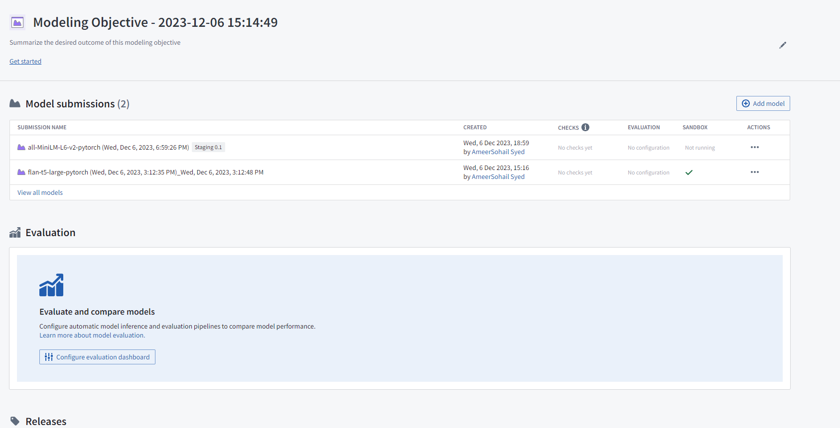
Foundry FDP Platform

Slide 33
End of session
Thank you!
Resources: https://github.com/nhs-pycom/machine-learning-for-everybody
Feedback: https://forms.office.com/e/EQzxPwsTFc

