Slide 1

Introduction to Machine Learning: Understanding the Basics
“Just as electricity transformed almost everything 100 years ago, today I actually have a hard time thinking of an industry that I don’t think AI (Artificial Intelligence) will transform in the next several years.” ~Andrew Ng
Ameer Sohail Syed – Data Engineer, NHS
NHS Python Community, 12th April 2024
Source: AI and Machine Learning - top minds quotes - (four.co.uk)

Slide 2
About me
MSC DATA SCIENCE AT LSBU
WORKED AS DATA RESEARCH ANALYST AT LSBU
STARTED ML JOURNEY
2020
2022
2023
2024
WORKED AS DATA ANALYST AT
E-COMMERCE BASED STARTUP
TRISTAR ONLINE PTY LTD, AU
WORKED WITH DATA SCIENTISTS AND PYTHON DEVELOPERS
AUTHORED A CHAPTER FOR “Explainable Artificial Intelligence in Medical Decision Support Systems”
JOINED NHS
CREDITS: Ready To use Personal Timeline PPT And Google Slides (slideegg.com)

Slide 3
Who's Joining Us Today?
Healthcare Professionals
Anyone passionate about the intersection of technology and healthcare
IT Professionals

Slide 4
Agenda for 12/04/2024
Introduction
ML In Healthcare
Understanding Supervised Learning
Q&A followed by Recap.
Regression Vs Classification
The BMI Predictor Game
Strategies of ML
FDP with ML

Slide 5
By end of the session today
Understand and explain what is Machine Learning (ML)
How can we use ML in Health care
Understand a little bit of ML terminology
Learn about Supervised learning
Differentiate between Classification and Regression Problem
Learn to use and navigate through Google Collab
Strategies to deal with ML problems
Get an idea of ML features in FDP

Slide 6
Motivation
Be part of new digital applications
A new way to look into the world
Stay updated

Slide 7
AI vs ML
Artificial Intelligence
Machine Learning

Slide 8

What is Artificial Intelligence?
System that exhibits human like capabilities
Example:
Virtual assistants

Slide 9
The definition
Mitchell’s definition of ML: “A computer program is said to learn from experience E with respect to some class of tasks T and performance measure P, if its performance at tasks in T, as measured by P, improves with experience E.”
Source: Machine Learning | SpringerLink
In Simple, Machine learning is when computer gets better at doing something the more it practices, just like humans learn from experience.

Slide 10
What is Machine learning?
Algorithms in computers
Write instructions and software tells the computer how to solve a problem
Machine learning
You give an input and let computer create the rules

Slide 11
The Difference
Machine learning shifts the focus from manual rule creation to autonomous rule learning, enabling computers to adapt and improve from experience.

Slide 12
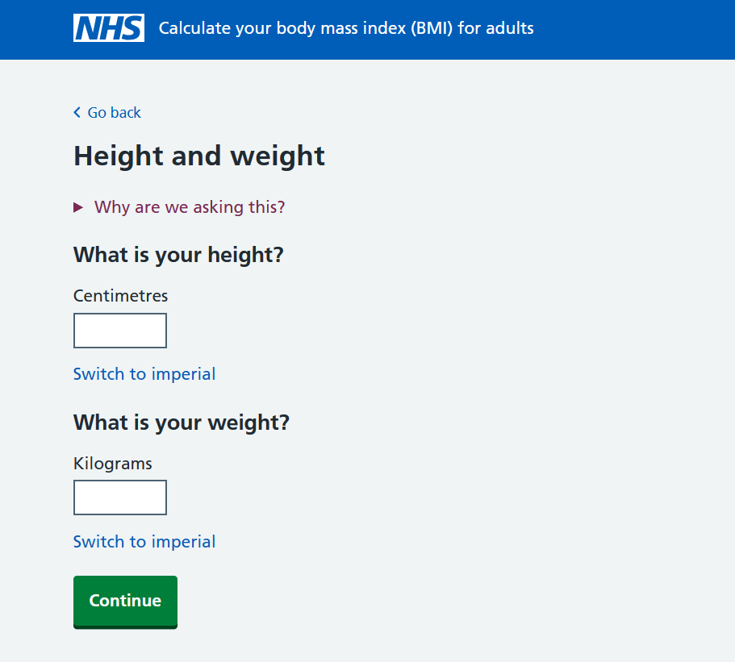
Example
Approach using rules
BMI = weight (kg) / height^2 (m^2)
Height and weight - Calculate your body mass index (BMI) for adults - NHS (www.nhs.uk)

Slide 13
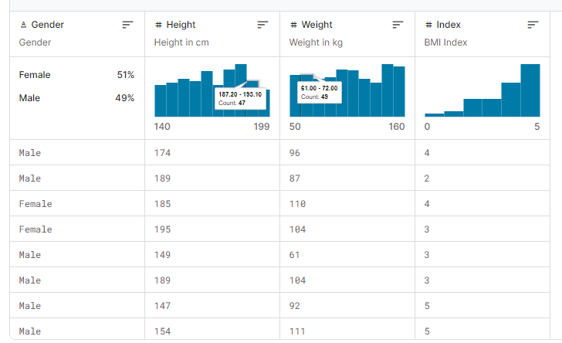
Adding more factors
This data contains the columns:
Gender : Male / Female
Height : Number (cm)
Weight : Number (Kg)
Index : 0 - Extremely Weak 1 - Weak
2 - Normal
3 - Overweight 4 - Obesity
5 - Extreme Obesity
Data Source: BMI Dataset (kaggle.com)
Credits:Kaggle: Your Machine Learning and Data Science Community

Slide 14
Why Machine Learning for Operations ?
Virtual assistants
Flow Forecasting
EHR maintenance

Slide 15
Why Machine Learning for Clinicians ?
Recommendation system
Support in Diagnosis (Partial/Full Human support)
Improving health Predictions

Slide 16

Machine Learning in Action: Streamlining Healthcare
Patient entry
Triage/ initial assessment
Data Systems
Policy and Governance
ML Analysis
Indirect influence
Hospital Administration
Clinical Decision Support
Ongoing care and monitoring

Slide 17
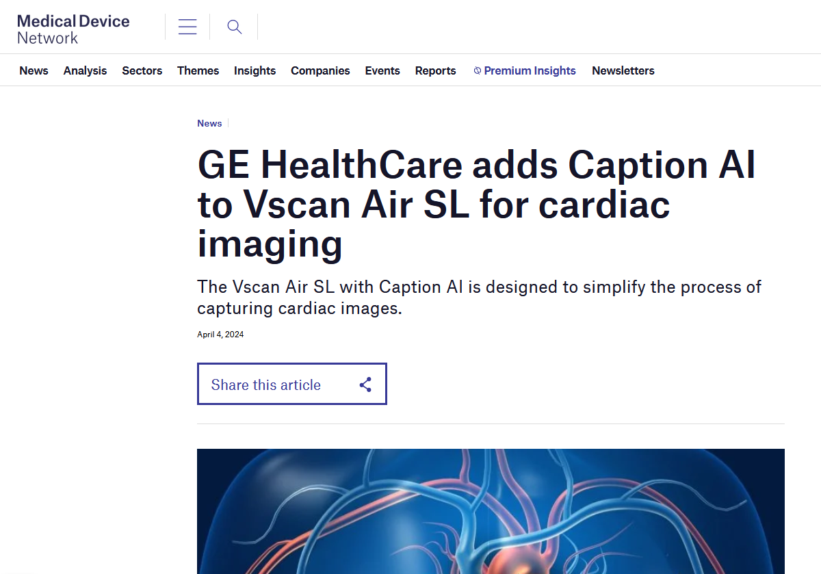
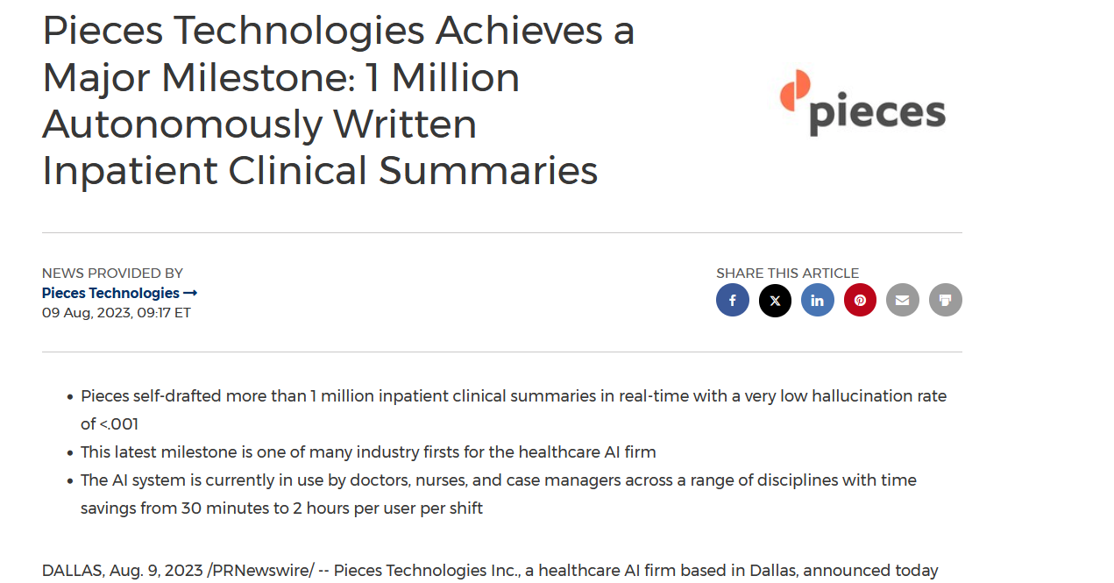
Latest breakthroughs in Healthcare
Source: https://www.medicaldevice-network.com/news/ge-healthcare-caption-ai-vscan-air-sl/
https://www.prnewswire.com/news-releases/pieces-technologies-achieves-a-major-milestone-1-million-autonomously-written-inpatient-clinical-summaries-301896907.html

Slide 18
Some terminology to be aware of
Dataset / Dataframe
Accuracy
Dimensions/ Features/Variables
Training data – Test data
Model

Slide 19
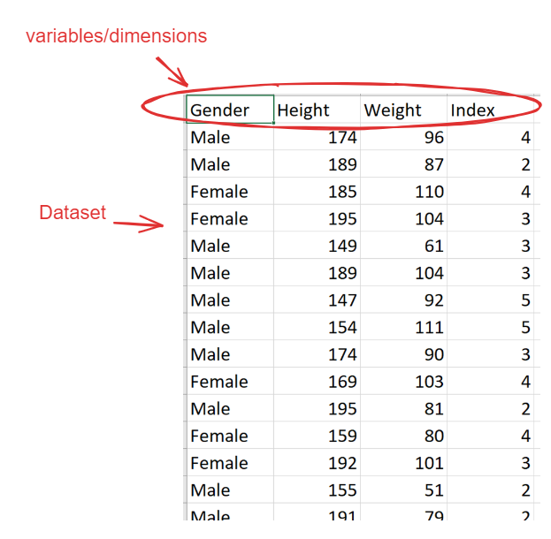
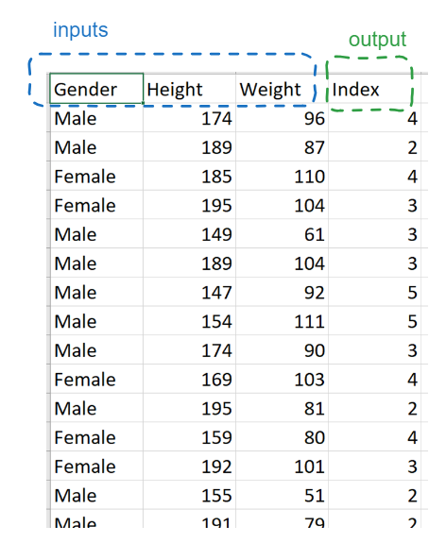
Total count: 501 records
80% Train: 400 records
20% Test: 101 records
Data Source: BMI Dataset (kaggle.com)

Slide 20
Supervised learning
Training on Labelled Dataset
Input is the training data
Output is the values interested to predict

Slide 21
Examples
Predict pathways
Readmission risk
Resource Allocation

Slide 22
Limitations
Data Quality
Data Privacy
Interpretability

Slide 23

Studying relationships between variables
Explore how one variable/feature effects another
Graphical analysis

Slide 24
Jump to White Board

Slide 25
Supervised Learning
Weight | Index
96 | 4
87 | 2
110 | 4
104 | 3
61 | 3
104 | 3
92 | 5
111 | 5
90 | 3
Data Source: BMI Dataset (kaggle.com)

Slide 26
Simple Regression

Slide 27
Supervised Learning : Classification
Notional Data
Age | Physical Activity
35 | High
45 | Low
50 | Low
28 | High
65 | Low

Slide 28

It's Game Time!
BMI_Regressor.ipynb - Colab (google.com)

Slide 29
Strategies in ML

Slide 30

Lot of decisions to make
Deciding which algorithms to chose
Train more ?
Spend more time collecting data

Slide 31
Some things to keep in mind
First algorithm might not work
No one size fits all
Powerful models might not be the efficient
Systematic engineering process

Slide 32
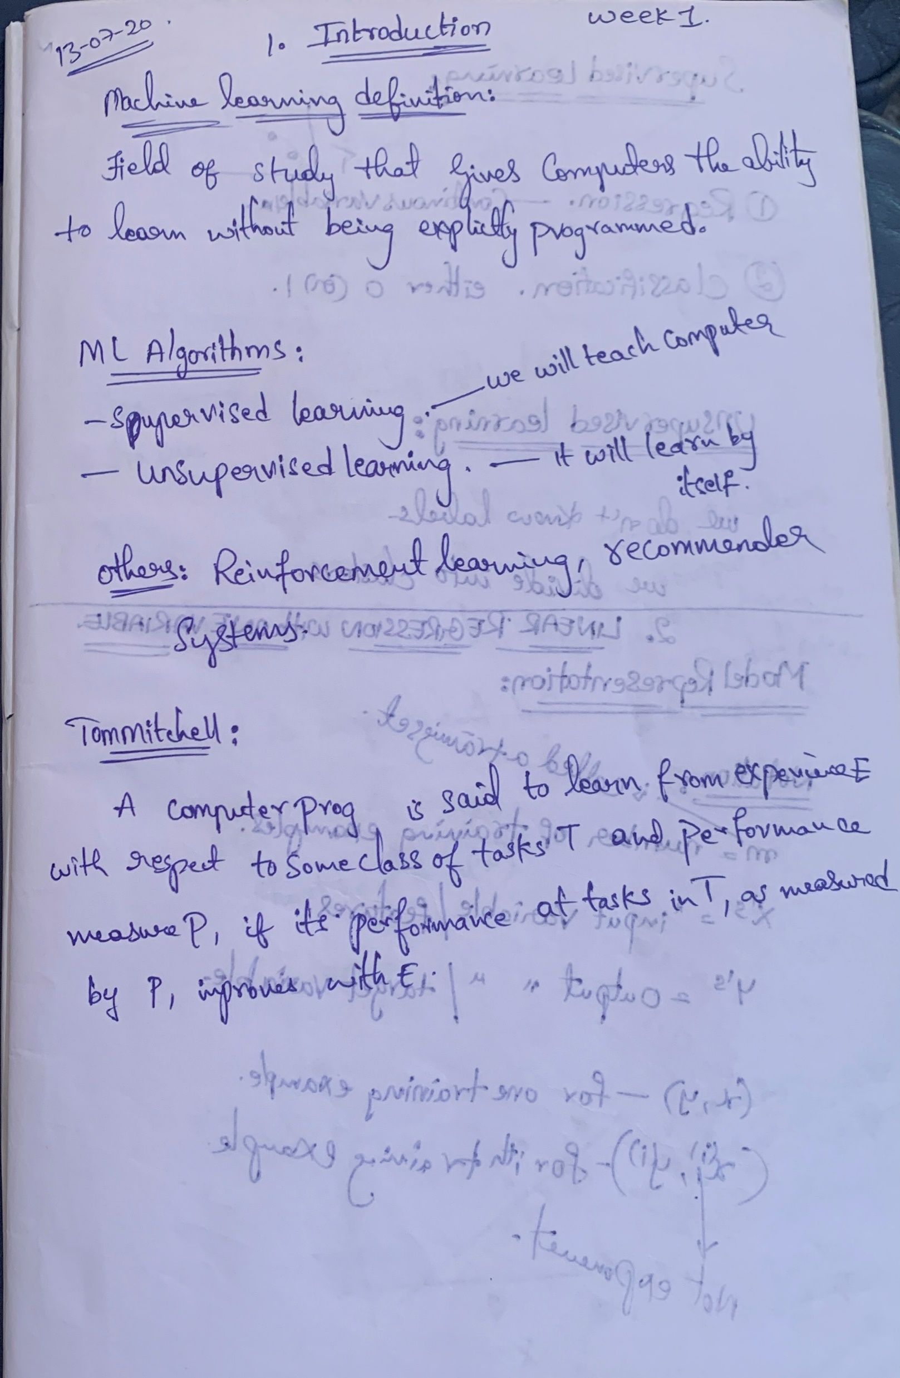
remember that every expert was once a beginner.

Slide 33
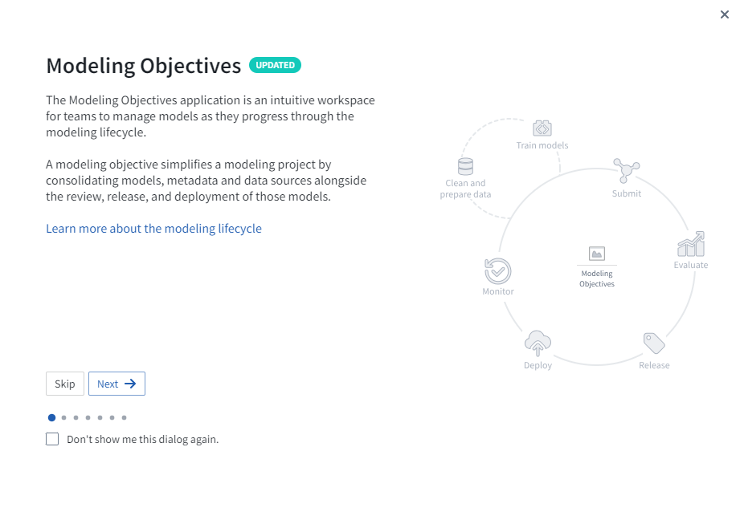
Foundry FDP Platform

Slide 34
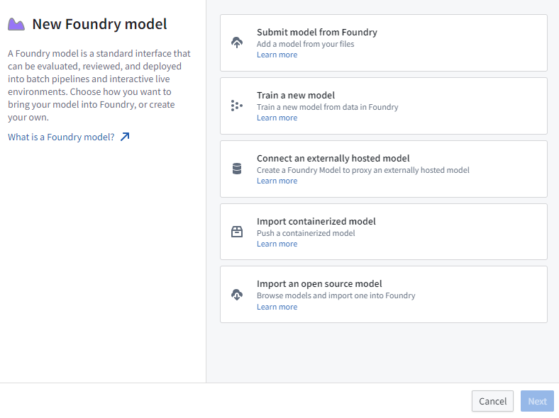
Foundry FDP Platform

Slide 35
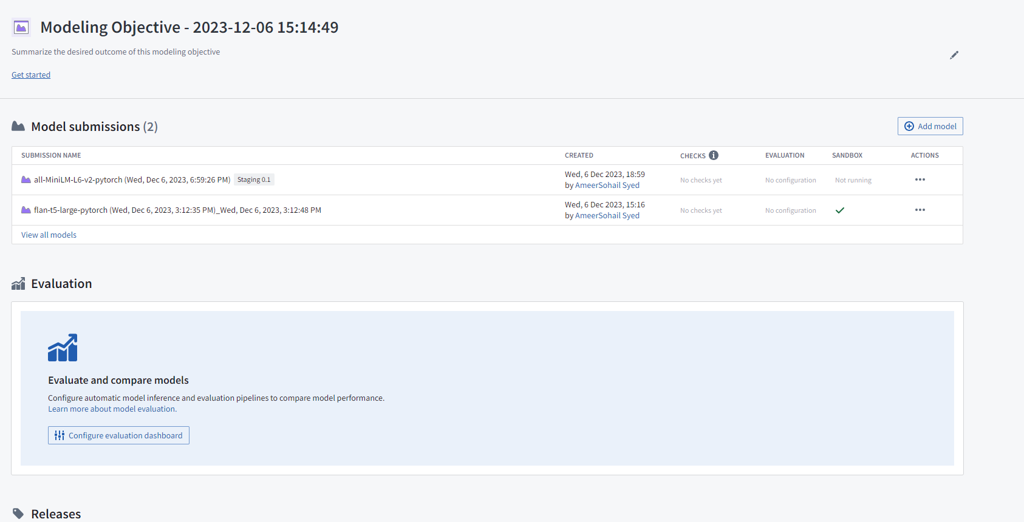
Foundry FDP Platform

Slide 36
End of session
Thank you!
Resources: https://github.com/nhs-pycom/machine-learning-for-everybody
Feedback: https://forms.office.com/e/EQzxPwsTFc

