Slide 1
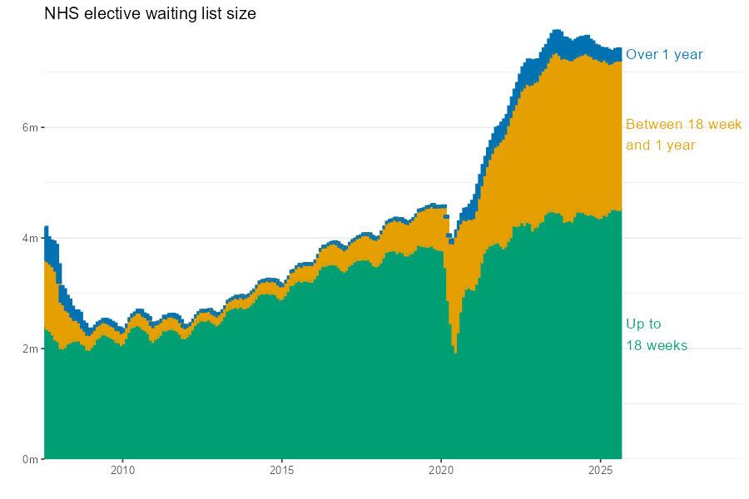
Using open data and open source code to create an open elective waiting lists modelling tool (RTT Planner)
Seb Fox
SW Decision Support Network

Slide 2
Outline
The elective waiting list challenge
Open data
Open source
Open tool
Collaboration

Slide 3
Outline
The elective waiting list challenge
Open data
Open source
Open tool
Collaboration

Slide 4
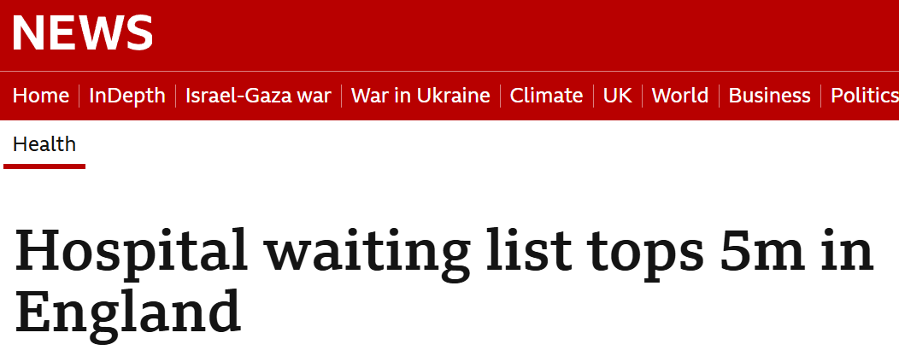
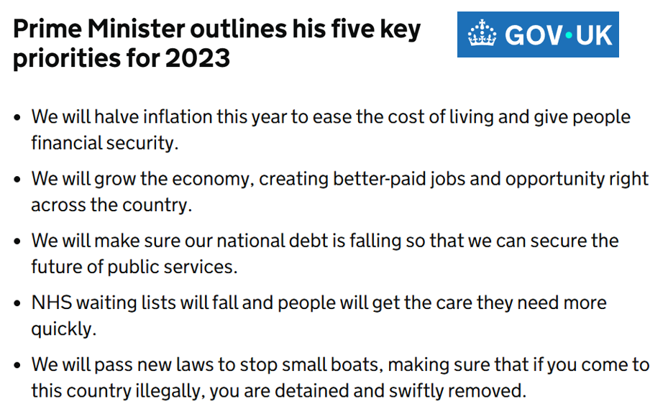
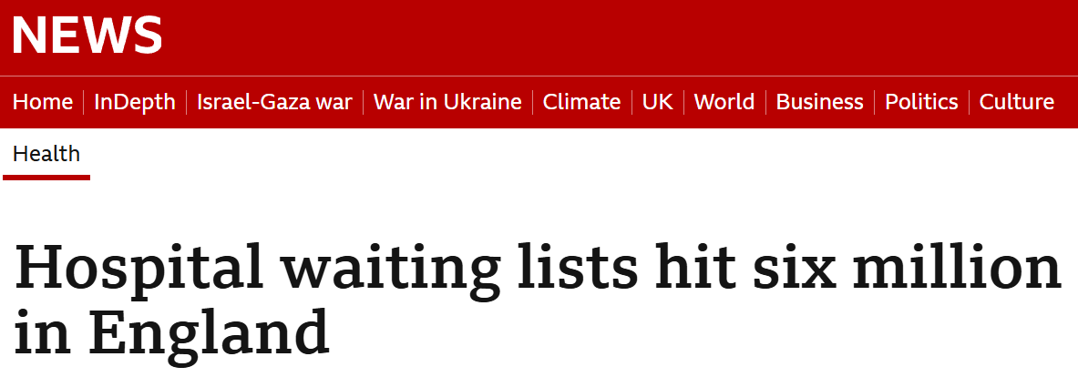
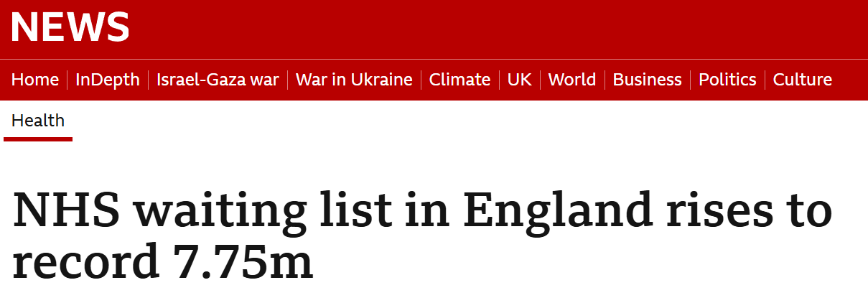
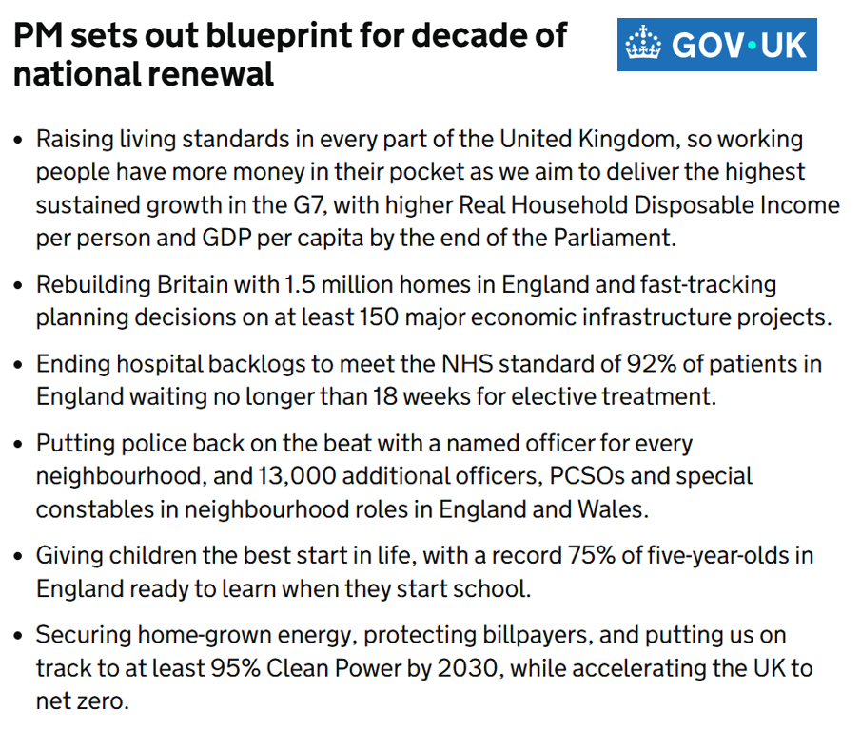
PM Sunak
PM Starmer

Slide 5
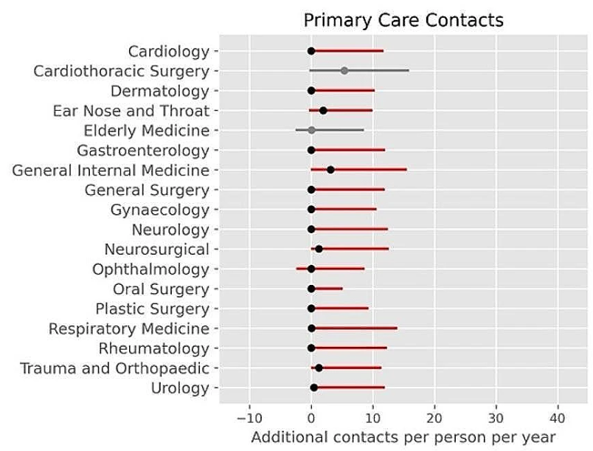
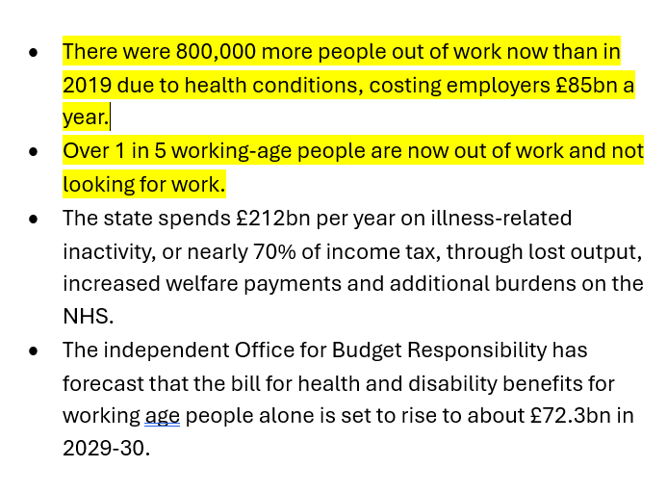
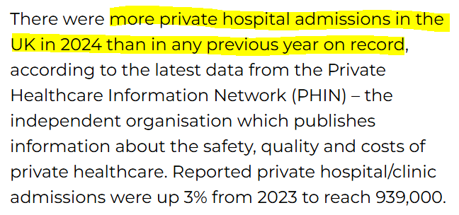

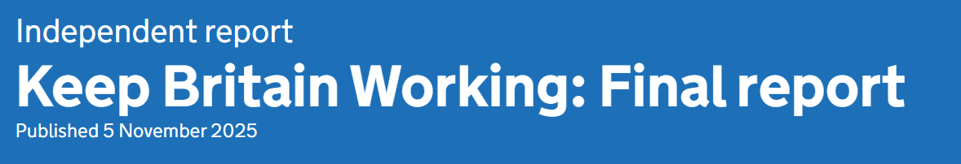



Why is this a problem?
More patient harm and healthcare usage
More people economically inactive
More ‘inequality’

Slide 6
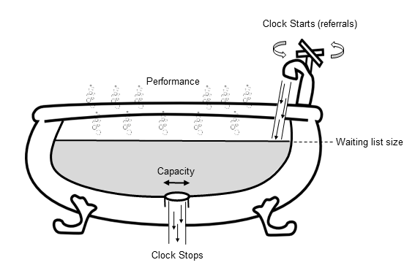
Anatomy of a waiting list
Reneging
Become inoperable
Learn to live with condition
Go private
Die
Wood, R. M. (2021). Unravelling the dynamics of referral-to-treatment in the NHS. Health Systems, 10(2), 131-137.

Slide 7
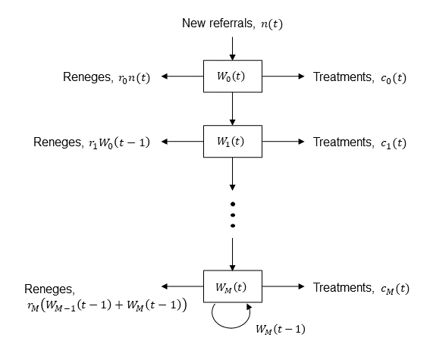
Modelling mechanics
7
Extending to the ‘multi-stock’ compartmental model – the ‘engine’ of the RTT Planner tool
Now in discrete-time (monthly)
If referrals are not treated and do not renege, they move to the next compartment at the next time-step (month)
Each compartment therefore starts with the remainder from the previous compartment at the end of the previous month
This conveniently aligns to the structure of the RTT statistics data
Number waiting 0-1 months at time t
Number waiting 1-2 months at time t
Wood, R. M., & Worthington, D. J. (2025). A compartmental modelling methodology to support strategic decision making for managing the elective hospital waiting list; application in England’s NHS. Health Care Management Science, 28(2), 259-273.

Slide 8
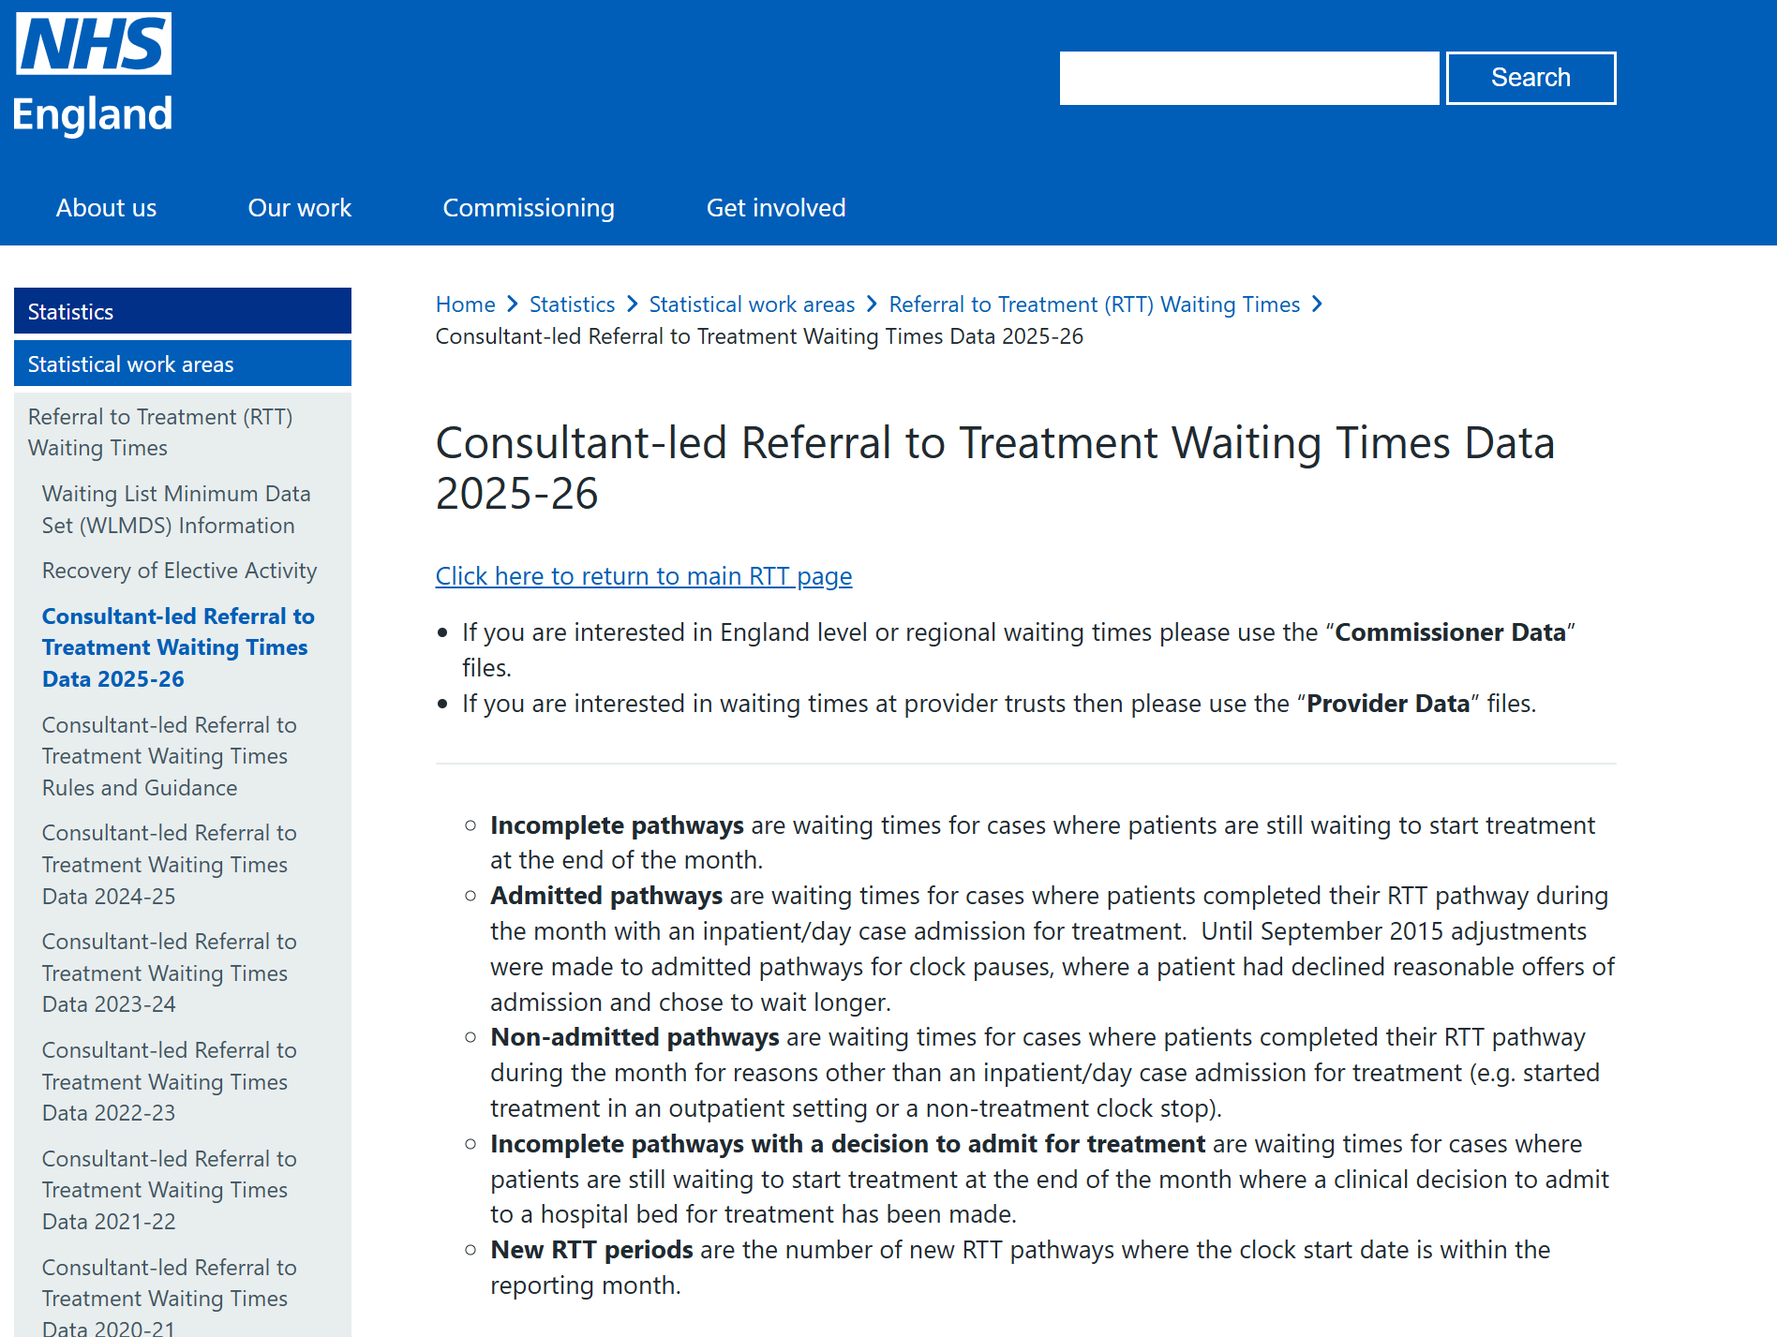
Open data
What’s missing?
Waiting list size change
=
New additions (referrals)
minus
Treatments
minus
Reneges
Waiting list size
Treatments
Referrals

Slide 9
Outline
The elective waiting list challenge
Open data
Open source
Open tool
Collaboration

Slide 10
Outline
The elective waiting list challenge
Open data
Open source
Open tool
Collaboration

Slide 11

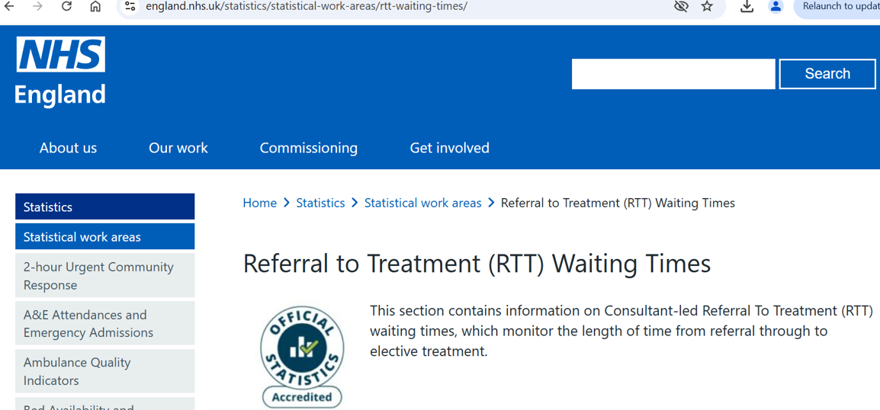






Technical collaboration
RTT Planner
NHSRtt (R package) – the “engine”
RTTShiny (R package) – the “front end”
NHS RTT data
Multiple developers
Shiny server
Public GitHub

Slide 12
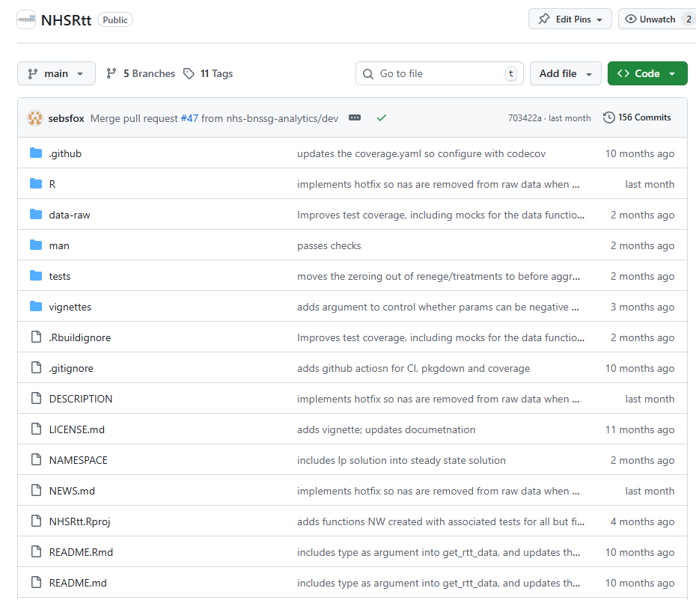
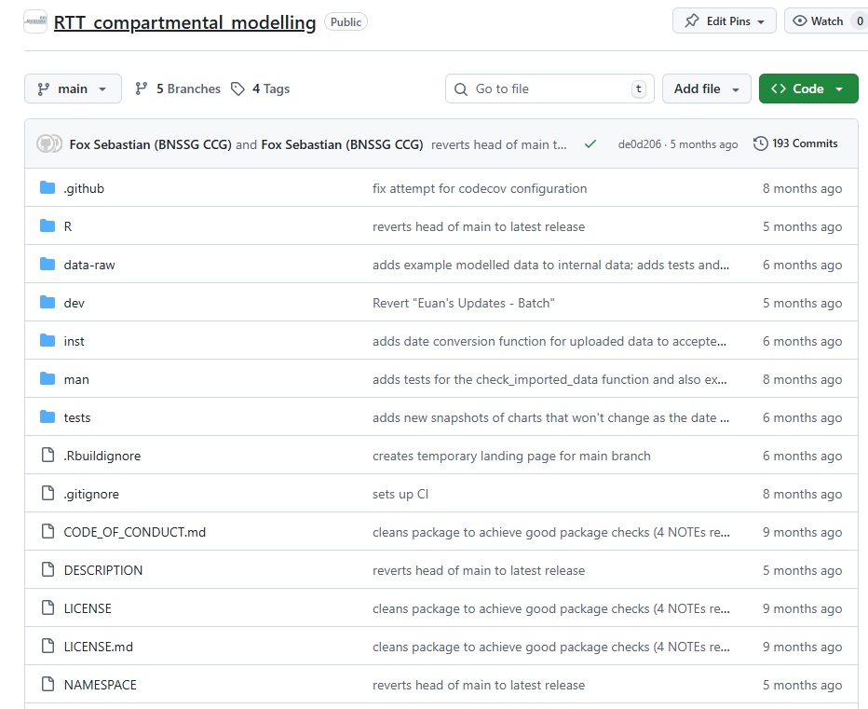
Open source
Data acquisition and modelling engine:
https://github.com/nhs-bnssg-analytics/NHSRtt
The RShiny tool:
https://github.com/nhs-bnssg-analytics/RTT_compartmental_modelling

Slide 13
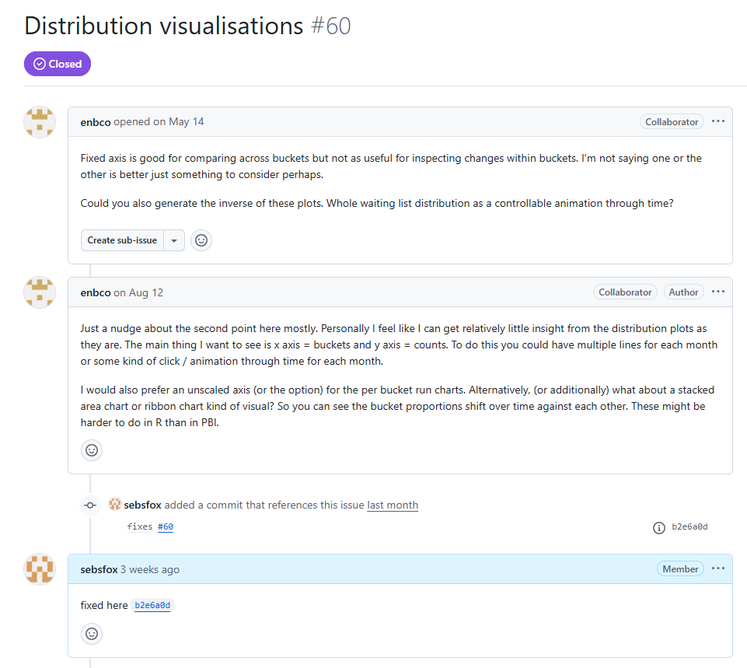
Issues

Slide 14
Outline
The elective waiting list challenge
Open data
Open source
Open tool
Collaboration

Slide 15
Outline
The elective waiting list challenge
Open data
Open source
Open tool
Collaboration

Slide 16

Live demo…

Slide 17
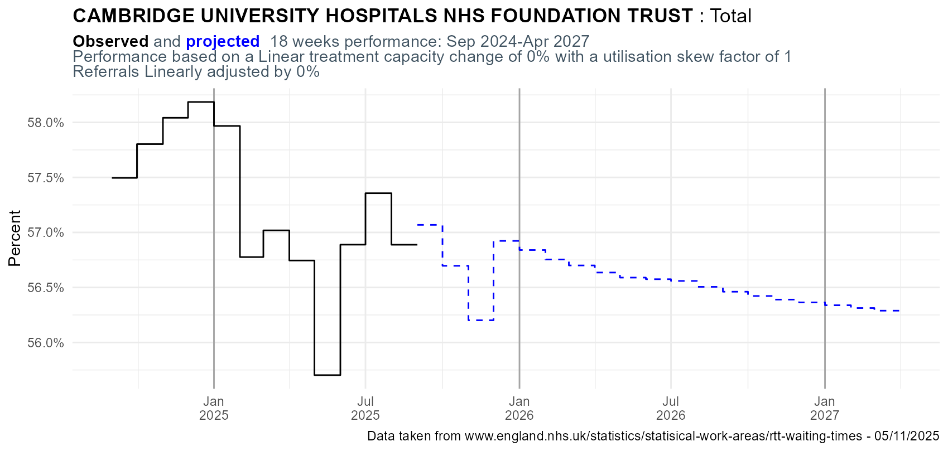
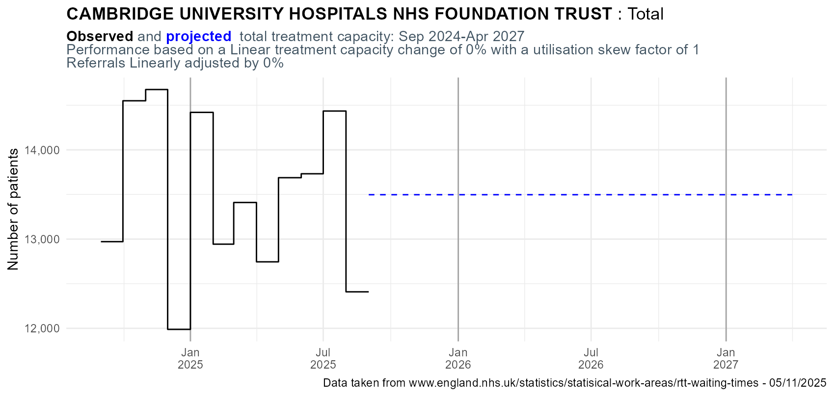
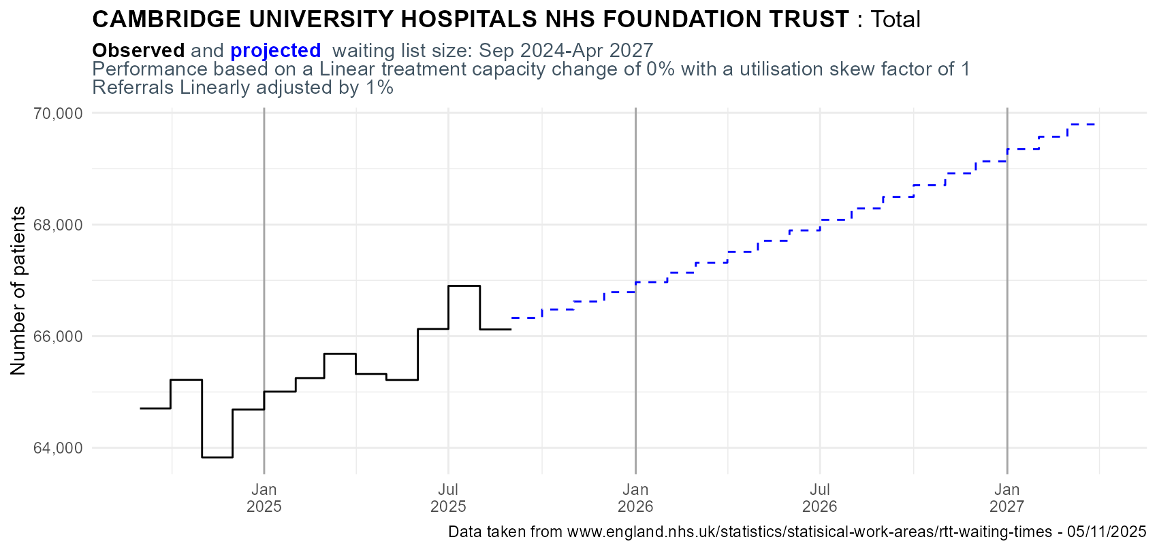
Cambridge University Hospitals – Total specialties
18 WEEK PERFORMANCE
“Do-nothing” scenario
1 % annual referral increase
0% annual capacity change
56.2%
Mar27
CAPACITY
WAITING LIST SIZE
13.5k
Mar27
69.8k
Mar27

Slide 18
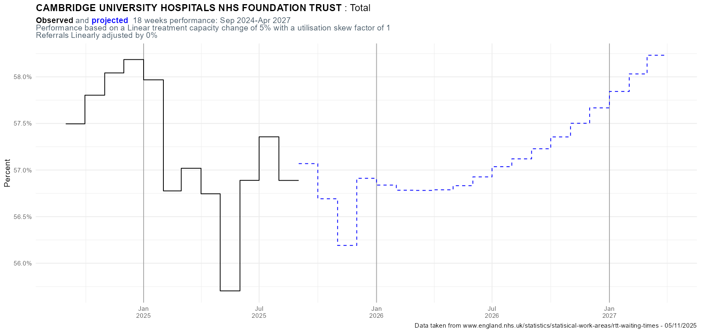
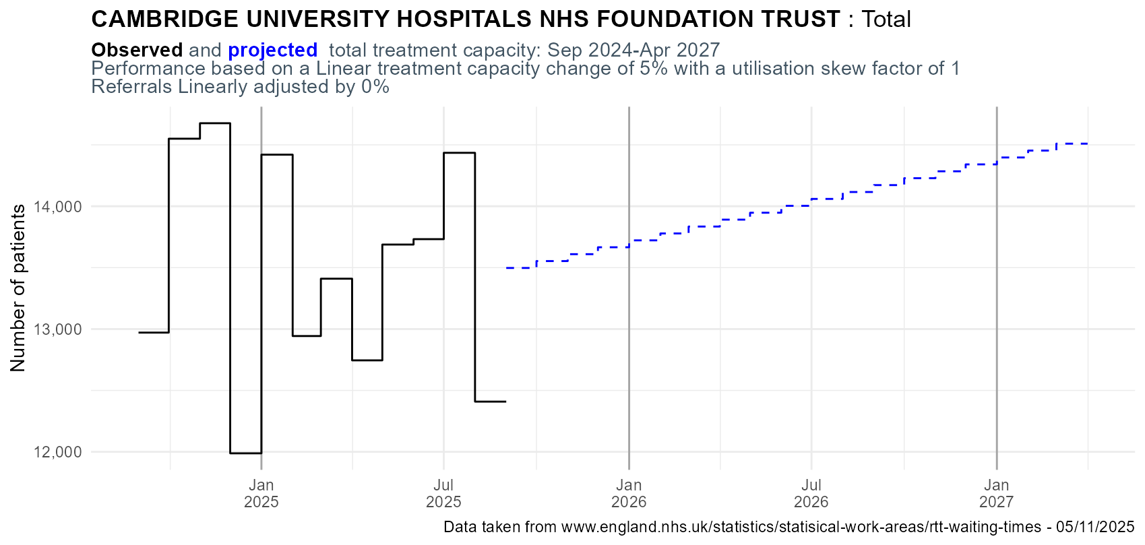
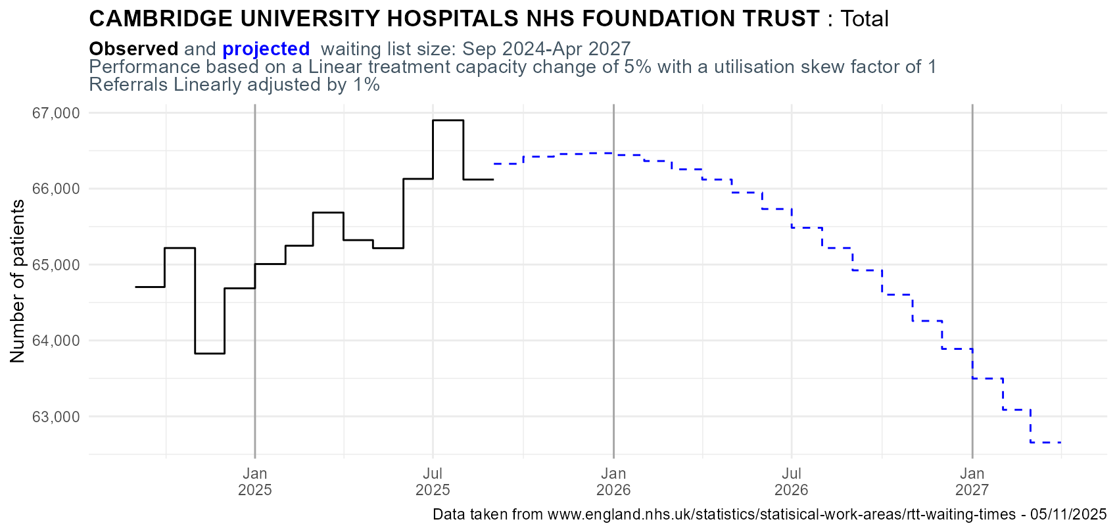
Cambridge University Hospitals – Total specialties
18 WEEK PERFORMANCE
“Increase capacity” scenario
1 % annual referral increase
5% annual capacity change
58.1%
Mar27
CAPACITY
WAITING LIST SIZE
62.7k
Mar27
14.5k
Mar27

Slide 19
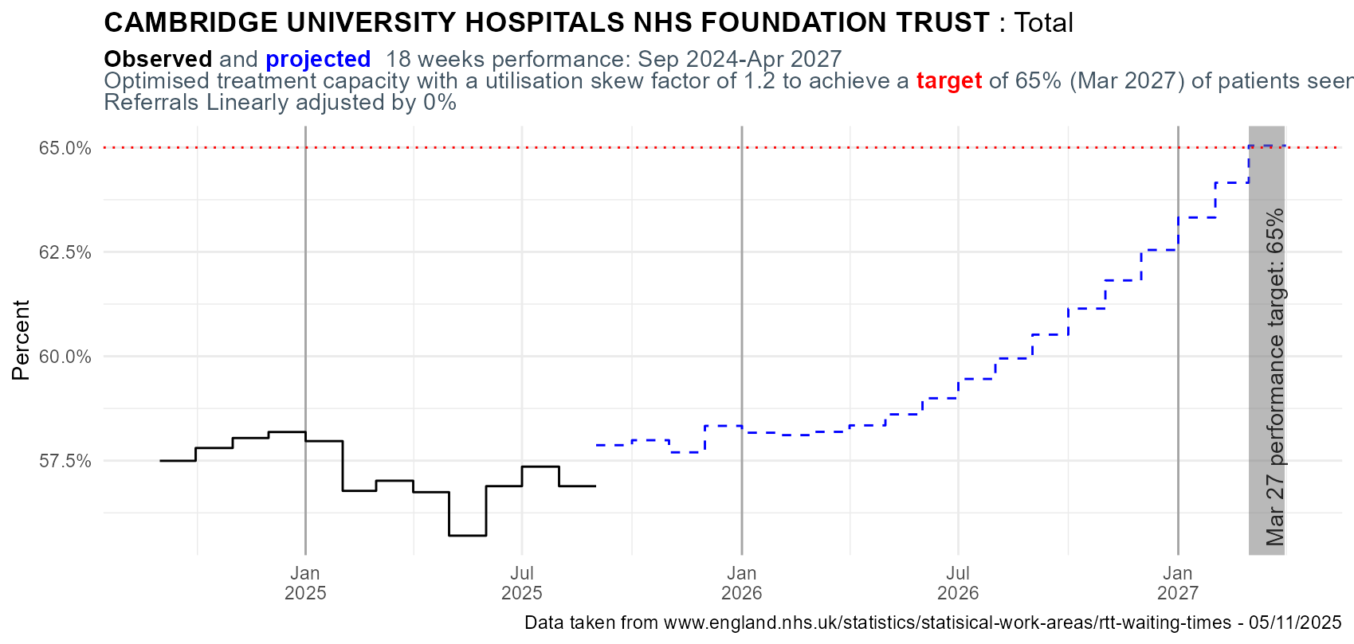
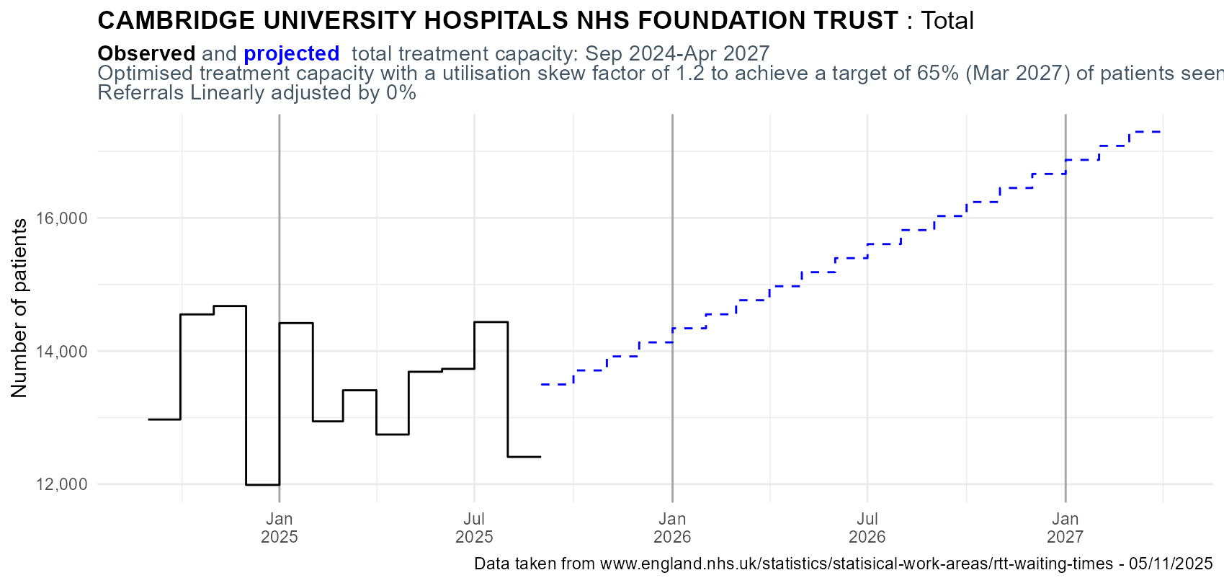
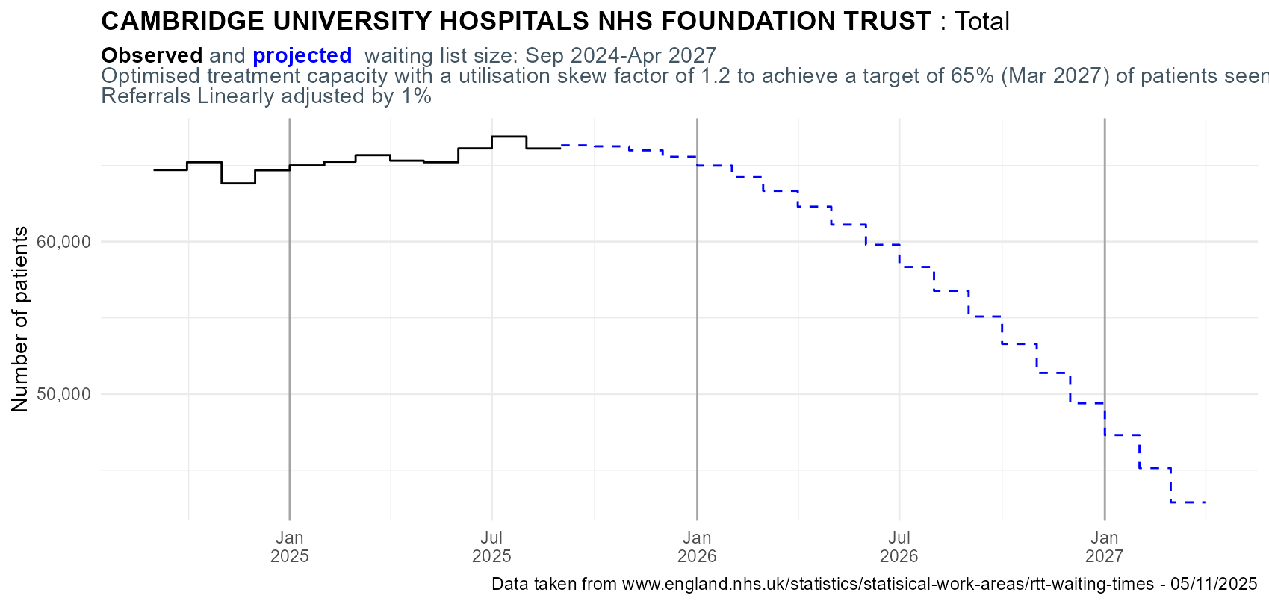
Cambridge University Hospitals – Total specialties
18 WEEK PERFORMANCE
“Optimise capacity” scenario – allowing some flexibility on how capacity is applied
1 % annual referral increase
Scenario to get to 65% performance by March 2027
65.0%
Mar27
CAPACITY
WAITING LIST SIZE
42.8k
Mar27
17.4k
Mar27

Slide 20
Outline
The elective waiting list challenge
Open data
Open source
Open tool
Collaboration

Slide 21
Outline
The elective waiting list challenge
Open data
Open source
Open tool
Collaboration

Slide 22
Collaboration
Concept
Devon and BNSSG ICBs
Theory
BNSSG
Durham Uni
Strategy Unit
Devon ICB
Reqs & feedback
Trusts
ICBs
NHSE SW
Coordination
SW DSN
Future strategy
BNSSG
Durham Uni
Strategy Unit
NHSE
No. 10
Dev
BNSSG
SW DSN
NHSE SW
Glouc. ICB
Comms
BNSSG
Analyst X
NHSR
Strategy Unit

Slide 23
Contact:
Dr Rich Wood and Sebastian Fox
Rich.wood16@nhs.net &
Sebastian.fox3@nhs.net or Sebastian.fox@dhsc.gov.uk (from 8th December)
Access the tool: https://connect.strategyunitwm.nhs.uk/rtt_compartmental_modelling/
See our recent blog: https://nhsrcommunity.com/blog/collaborative-working-rtt-planner.html

