Slide 1
Sharpening my Python skills through self-development of web scraping bank complaints data
RPYSOC 24
Presented by: Kenneth (Kin) Quan
Notes:
Standard title slide

Slide 2
Introduction
How I gain experience in Python while maintaining your business-as-usual service
By “experience” I mean all the following:
Technical Knowledge
Ways of Working
Building Capability

Slide 3
Context
To progress in my career, I need to gain a range of experience like web scraping and Git.
How do I gain if I’m working on projects or platforms that cannot use these technologies?
The NHS provides continuing professional development:
“… give you the opportunity to identify any training and development needs with your manager, making it easier to progress through the NHS bands and potentially earn more money.”

Slide 4
The Scope

Slide 5
Defining my project
Skills I want to learn:
Web scraping with Python
Version Controlling in GitHub
The data:
Complaints from the Financial Ombudsman Service
The aim:
Scraping bank complaints data and presenting them in a table with metadata

Slide 6
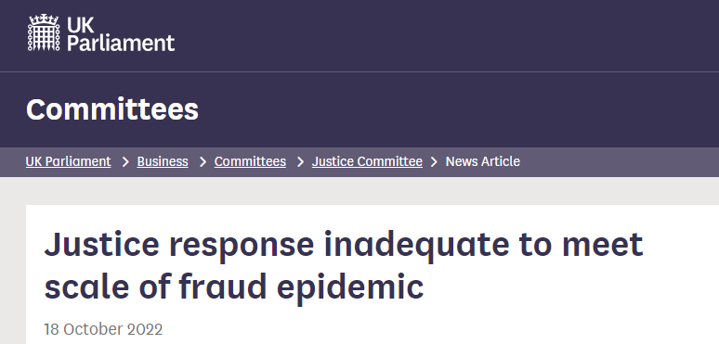
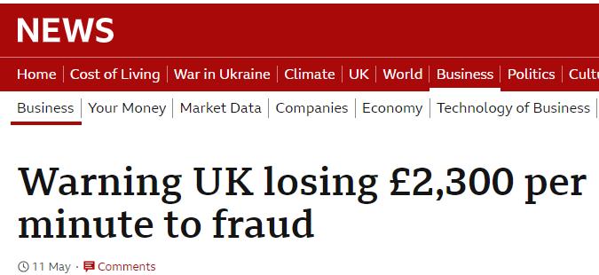

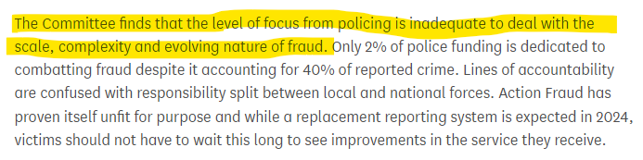
Why bank fraud?

Slide 7
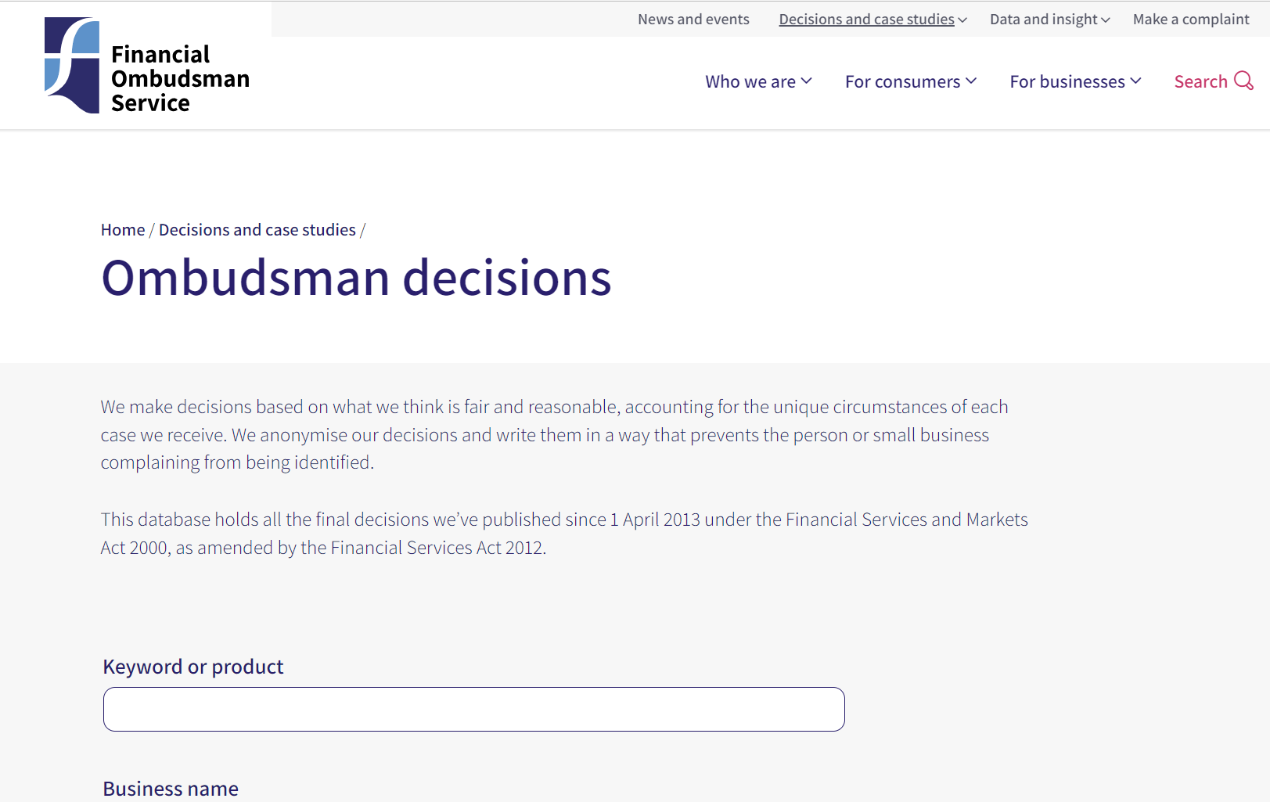
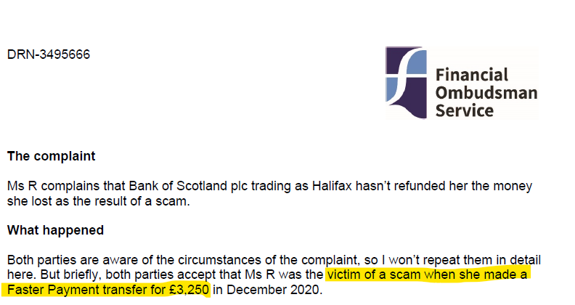
What does the data look like?

Slide 8
Capabilities required for my project
The Hardware
Corporate Laptop
The Software
Git
With my GitHub account
Anaconda with Python
Using Spyder as IDE
The Time
Ad hoc ~ 0.5 day(s) per week

Slide 9
Way of working for my project
Vertical or Thin slice approach
Developing a basic end to end feature – just enough to be usable and deliver value.
RAP approach
Version controlling code using branches:
Working on a new branch and using a Pull Request
Committing regularly with small pieces of work
Good coding practices
Well documented code
Storing Parameters via TOML File
Adding required libraries in requirements.txt

Slide 10
The Implementation

Slide 11
Process Map – The thin slice
Scraping Search Data
Scraping Complaints Data
Wrangling Complaints Data
Selecting Key Features from Complaints Data
Initiating an Output

Slide 12
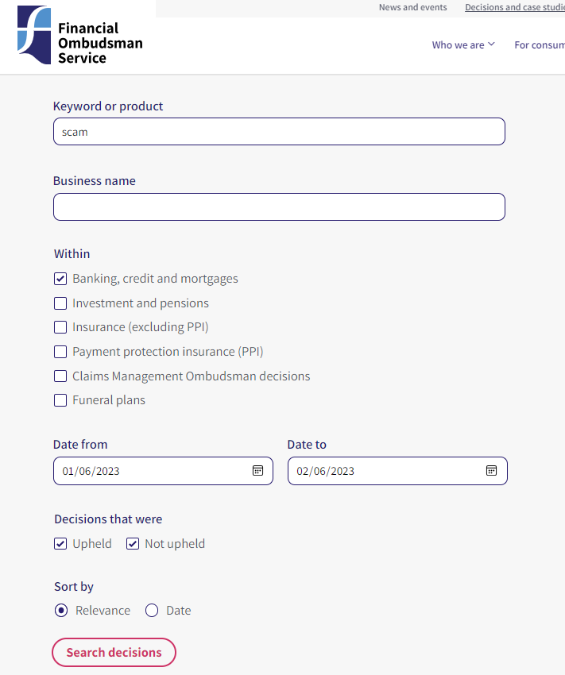
Scraping Search Data – Getting the URL
Search Term
https://www.financial-ombudsman.org.uk/decisions-case-studies/ombudsman-decisions/search?Keyword=scam&IndustrySectorID%5B1%5D=1&DateFrom=2023-06-01&DateTo=2023-06-02&IsUpheld%5B1%5D=1&IsUpheld%5B0%5D=0&Sort=relevance
Date Range

Slide 13
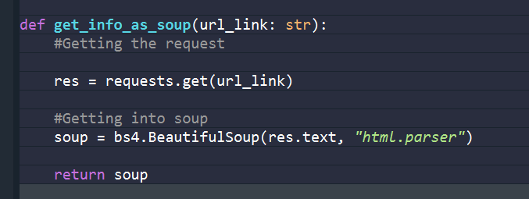
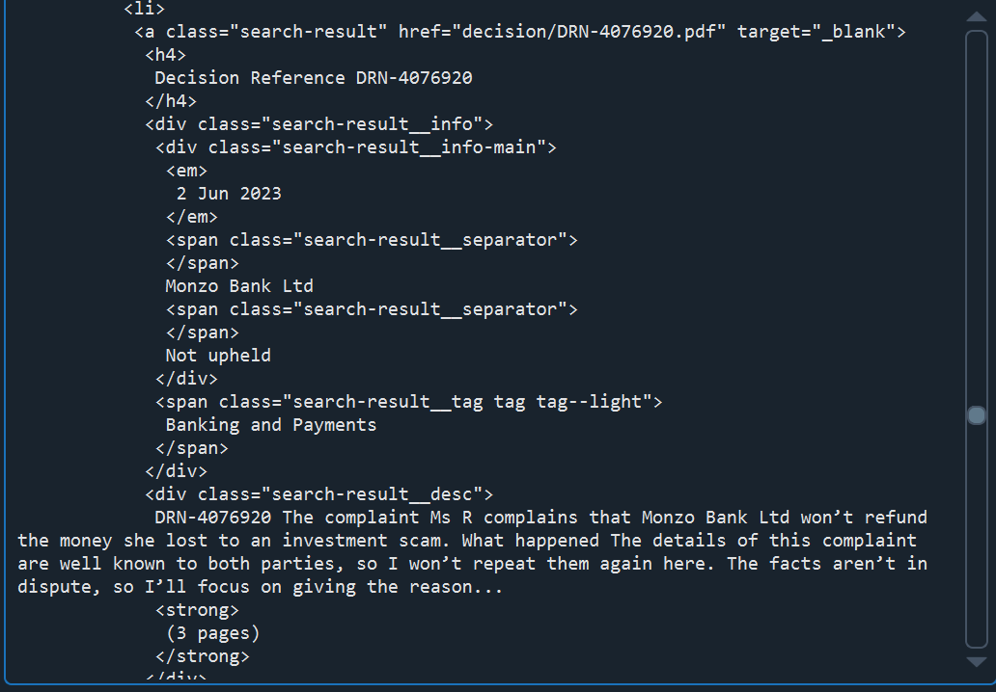
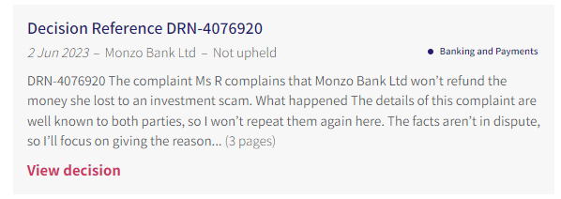





Scraping Complaints Data – Getting the information

Slide 14
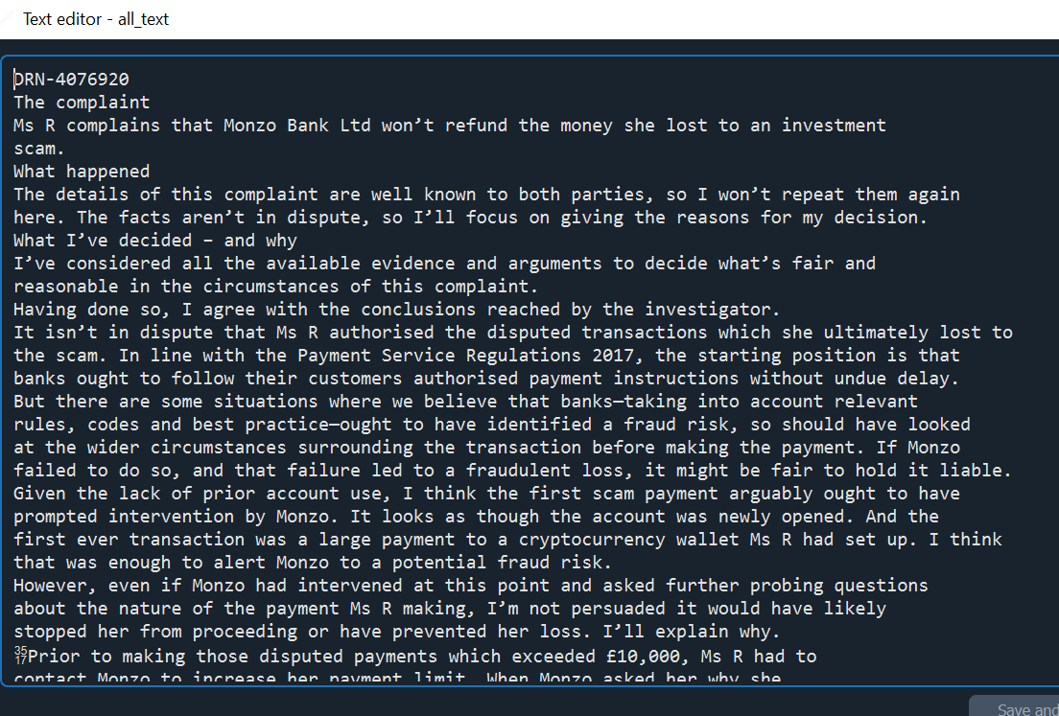
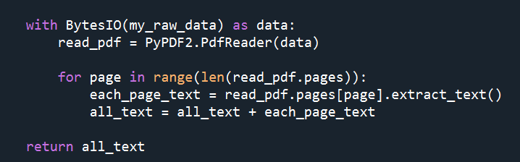
Wrangling Complaints Data

Slide 15
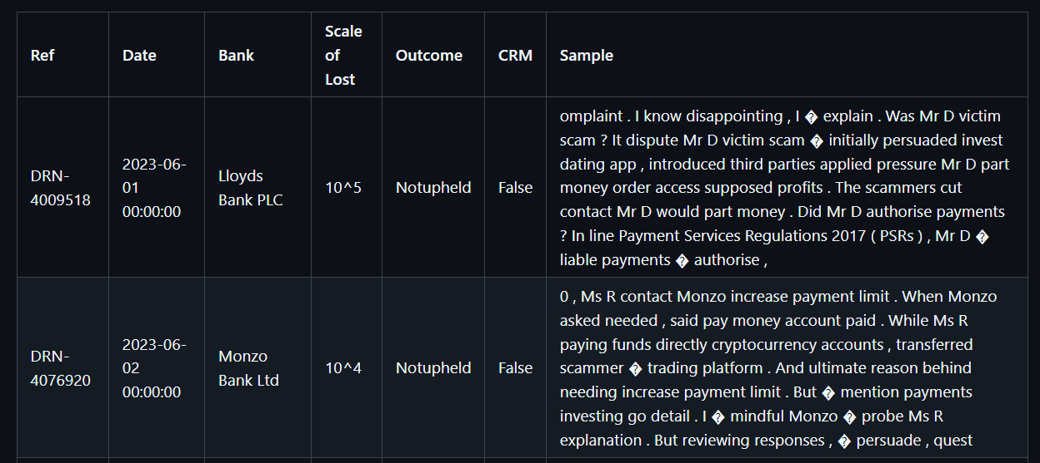
Final Product

Slide 16
The Retrospective

Slide 17
Retrospective – What have I leant
It is hard to get the tech stack right – corporate laptops and Python don’t work well together
Solution: Talk to I.T., be specific what is the minimum required
It is hard to balance writing good code and progression of the work
Solution: Plan, allocate time to refactor code
It is hard to find a natural stopping point
Solution: Have a strict acceptance criteria

Slide 18
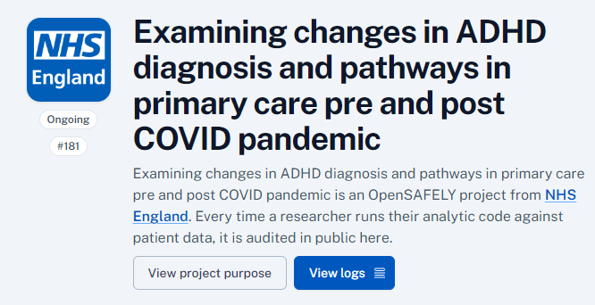
Case Study 1: OpenSAFELY
OpenSAFELY is a secure, open-source software platform for analysis of electronic health records (EHR) data. Deployed within the secure data centres of one of the largest EHR providers, OpenSAFELY-TPP
These secures portal allows for computation of NHS GP records while maintaining privacy preserving features, for example pseudonymisation and obfuscation of granular records to the end user.

Slide 19
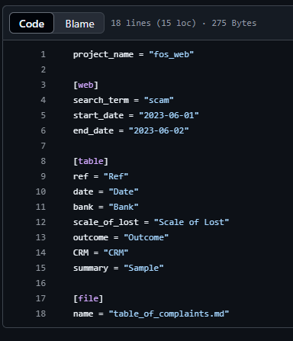
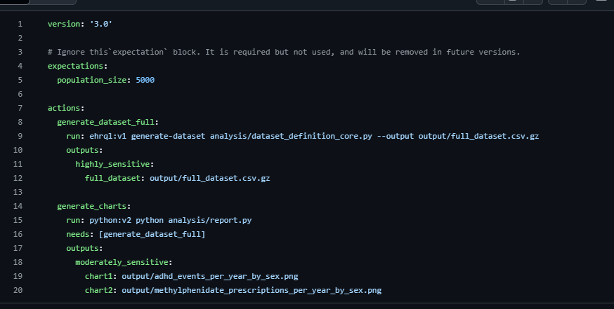
Ways of working – Storing Parameters

Slide 20
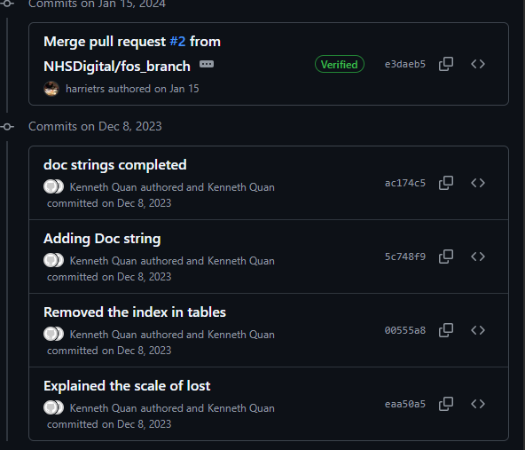
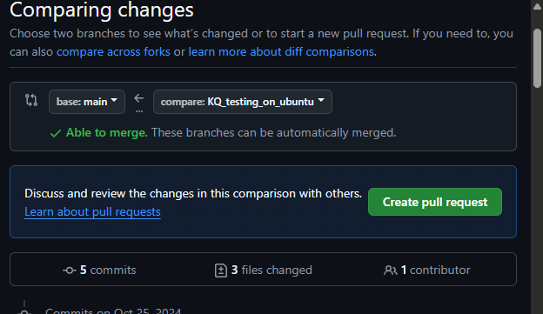
Ways of working – Pull requests

Slide 21
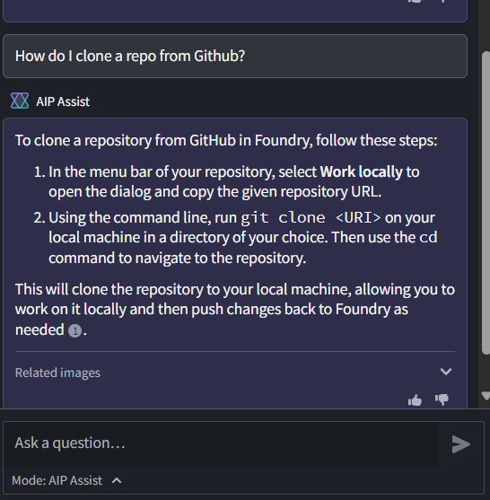
Case Study 2: Federated Data Platform
The NHS Federated Data Platform (FDP) is software that will enable NHS organisations to bring together operational data into a single platform
To deliver RAP, I must understand and test the RAP capabilities and functionality of FDP

Slide 22
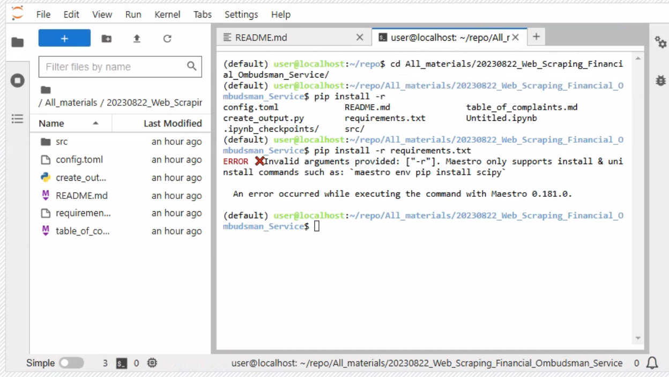
Building Capabilities – How to install libraries

Slide 23
Conclusion
I have been using my continuous professional development build a RAP for web scraping
By building the RAP it provided both vision and instinct on what does “good RAP” looks like
I can bring these skills to new projects and technologies.

Slide 24
Thank You
GitHub: github.com/NHSDigital/datascience-seminars
Email: england.datascience@nhs.net

