Slide 1

This Patient Does Not Exist
Generating Synthetic Patient Data with a Wasserstein GAN
R/PySoc Conference 2024

Slide 2
Arthur Walker
Snapshot Datetime: Tuesday 6th August 2022
Age: 76
Marital Status: Married
Address IMD Decile: 1 (Most deprived)
Gender: Male
NEWS score: 0
Time since Admission: 14 hours
Past year ED attendances: 0
Past year emergency admissions: 0
Current Waiting lists: Ophthalmology
Past Year Procedures: Dialysis
Current specialty: Diabetic Medicine
Current ward: Ward 25 (Diabetic Medicine ward)
Fit for Discharge response: No - Requires treatment that can only be delivered in hospital
Manual handling RAG: Red
Falls and Confusion RAG: Amber
Mental Capacity RAG: Green
Time until fit for discharge: 24 hours
Time until discharged: 76 hours
Synthetic Data

Slide 3
Why is synthetic data useful?
Randomised synthetic data with independent features | Randomised synthetic data with retained feature correlations (E.g. GANs)
Can be shared without exposing identifiable data | Can be shared without exposing identifiable data
Gives representative indication of data types and ranges | Gives representative indication of data types, ranges and feature relationships
No statistical correlations | Retains feature correlations
Cannot be used for machine learning or deep insights | Can be used for deep data analysis and machine learning (if the synthetic data is good enough)
Computationally cheap | Computationally expensive (for many column datasets)

Slide 4
Our use case
Our trust participated a Google/NHSE hackathon in May 2024
We wished to focus on using patient-level data insights to support the discharge process
Unfortunately, we did not have the data protection agreements to allow identifiable trust data within the Google cloud platform
So instead, I offered to create synthetic data based on trust data
It was… challenging…
But I was able to produce synthetic data good enough for use in early-stage model development… and our team won the people’s choice award!

Slide 5

Our use case
Our trust participated a Google/NHSE hackathon in May 2024
We wished to focus on using patient-level data insights to support the discharge process
Unfortunately, we did not have the data protection agreements to allow identifiable trust data within the Google cloud platform
So instead, I offered to create synthetic data based on trust data
It was… challenging…
But I was able to produce synthetic data good enough for use in early-stage model development – and our team won the people’s choice award

Slide 6
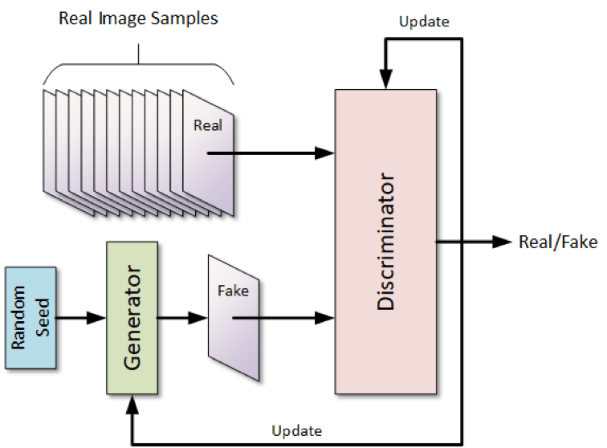
What is a GAN?
GAN - Generative Adversarial Network
These models are used in all modern AI image generation
Generator: Produces samples based on a random seed, and learns to trick the discriminator
Discriminator: Learns to distinguish real from fake samples
Note: The Generator never has any direct opportunity to learn from original data

Slide 7
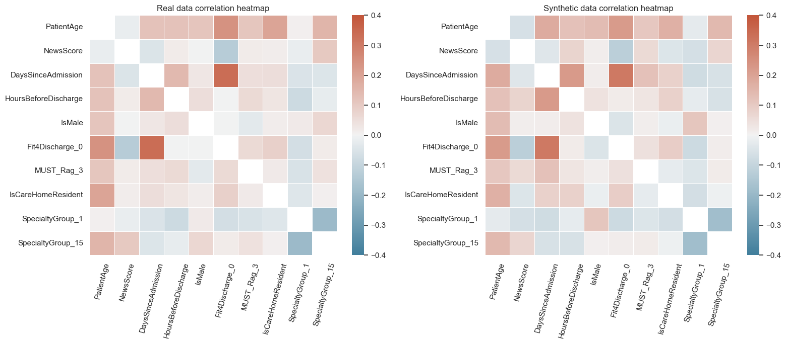
How well did our GAN work?

Slide 8
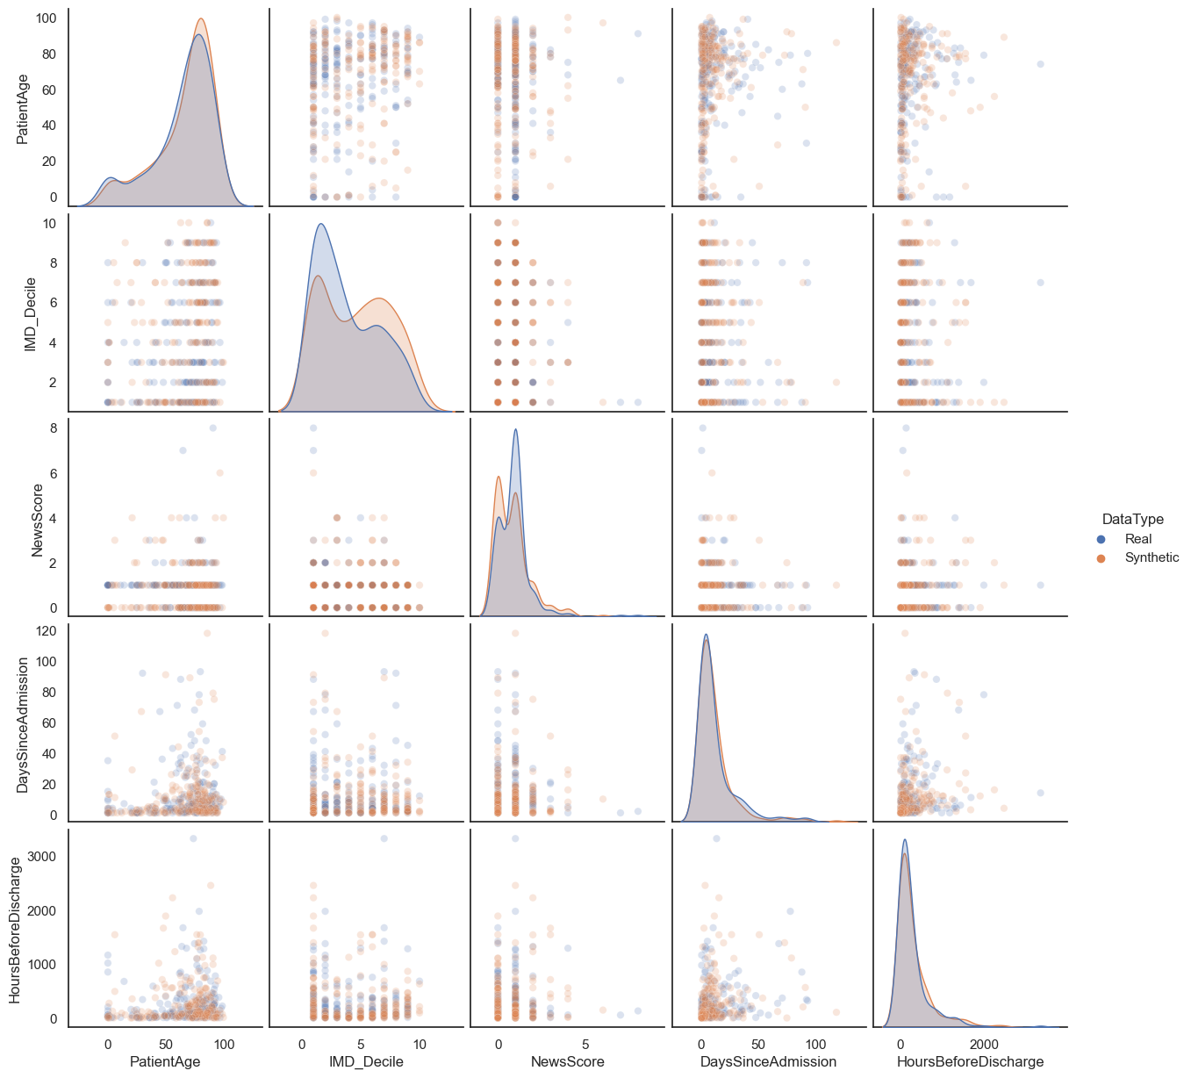
How well did our GAN work?

Slide 9
Tools used
GANs were built using Python Tensorflow
The functional API from tf.keras was used to design the network structure
Raw tensorflow was used to apply the custom loss function needed, within a compiled training loop
Training was done using a small virtual server with specs comparable to a typical laptop – No GPU was available
Training times ranged from hours to days for different runs
Model snapshots were trained at regular intervals
Performance was good for datasets with 100-200 columns, but training times became very long for larger datasets

Slide 10
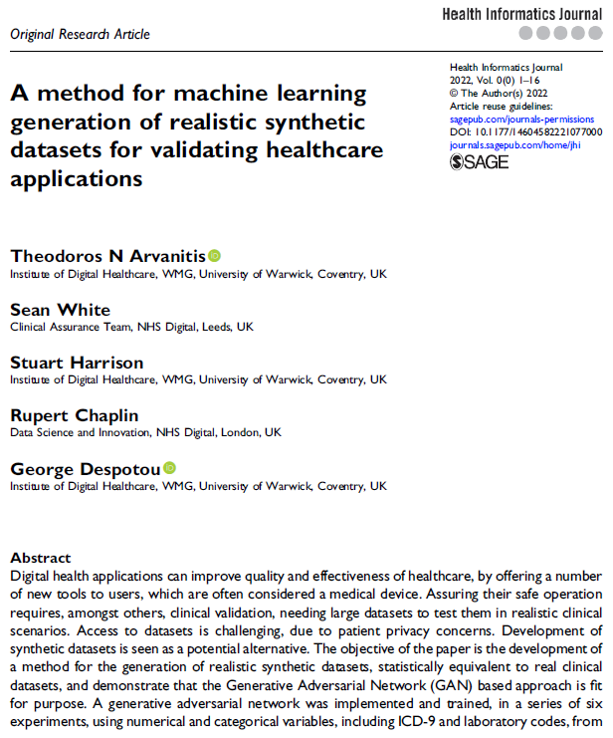
Tips for building a GAN 1 – Use a Wasserstein GAN
A Wasserstein GAN is a type of GAN in which the discriminator returns a plausibility score, rather than a probability
This gives a linearly differentiable loss function
I.e. it prevents the generator getting discouraged when the fake data is producing is unconvincing
In Short: Wasserstein GANs train much better than traditional GANs – use them!

Slide 11
Tips for building a GAN 2 – Use the right Activations
Different data outputs have different structures (e.g. linear, Boolean, 1-hot categorical sets)
Choosing the right activation function for your output layers makes it much easier for the model to fit these types
If you’re working with multiple types, use a generator with multiple output layers (easy to do with the tf.keras functional API)
Data Type | Output Activation
Linear | Sigmoid (with unit scaled data)
Boolean | Sigmoid
1-hot categorical | Softmax

Slide 12
Tips for building a GAN 3 – Use a wide discriminator
A capable discriminator is essential to a successful GAN – it should be larger and more capable than the generator
To be successful, the discriminator should be able to retain the ability to spot older failures by the generator at the same time as learning new ones – otherwise the generator and discriminator may end up chasing each other in circles
Narrow hidden layers make it much harder for the discriminator to retain this kind of memory

Slide 13
Thank you!
Please find me later if you’d like to talk more about the nerdy detail of working with neural networks!

