Slide 1
I’m an opensource girl in an excel world - the benefits of openxlsx2

Slide 2
Introduction

Slide 3
Contents
Reproducible analytical pipelines and Excel
Creating simple excel files in R
Creating complex excel files in R

Slide 4
Reproducible analytical pipelines (RAP)
Automated analytical processes
Minimise manual steps
Open source
Version control
Modular, reusable code
Code sharing
Documentation
Testing
Peer-review
https://nhsdigital.github.io/rap-community-of-practice/
https://analysisfunction.civilservice.gov.uk/support/reproducible-analytical-pipelines/
Notes:
RAP- reproducible analytical pipelines (https://nhsdigital.github.io/rap-community-of-practice/)
Code sharing and re-use can reduce workload
Often less error prone
We can build in tests to our process
Version control can improve QA process

Slide 5
Reproducible analytical pipelines (RAP)
Automated analytical processes
Less error prone
More efficient processes
Improved quality of analysis
Improved trust in the analysis
Minimise manual steps
Open source
Version control
Modular, reusable code
Code sharing
Documentation
Testing
Peer-review
https://nhsdigital.github.io/rap-community-of-practice/
https://analysisfunction.civilservice.gov.uk/support/reproducible-analytical-pipelines/
Notes:
RAP- reproducible analytical pipelines (https://nhsdigital.github.io/rap-community-of-practice/)
Code sharing and re-use can reduce workload
Often less error prone
We can build in tests to our process
Version control can improve QA process

Slide 6
Use of Excel in public services
Why excel?
Accessible and quick (basic analysis)
Formatting and visualisations
Aesthetically pleasing
Complex analysis in excel is possible
Notes:
Accessible and quick way for people without coding skills to do basic analysis and view data
Can store data with some formatting and visualisation
Complex analysis in excel is possible but error prone and time-consuming.
People very often want to continue to have excel output

Slide 7
Use of Excel in public services
Why excel?
Why not Excel?
Accessible and quick (basic analysis)
Formatting and visualisations
Aesthetically pleasing
Complex analysis in excel is possible
Error prone
Time consuming (complex analysis)
Inefficient
Not built for automation
Notes:
Accessible and quick way for people without coding skills to do basic analysis and view data
Can store data with some formatting and visualisation
Complex analysis in excel is possible but error prone and time-consuming.
People very often want to continue to have excel output

Slide 8
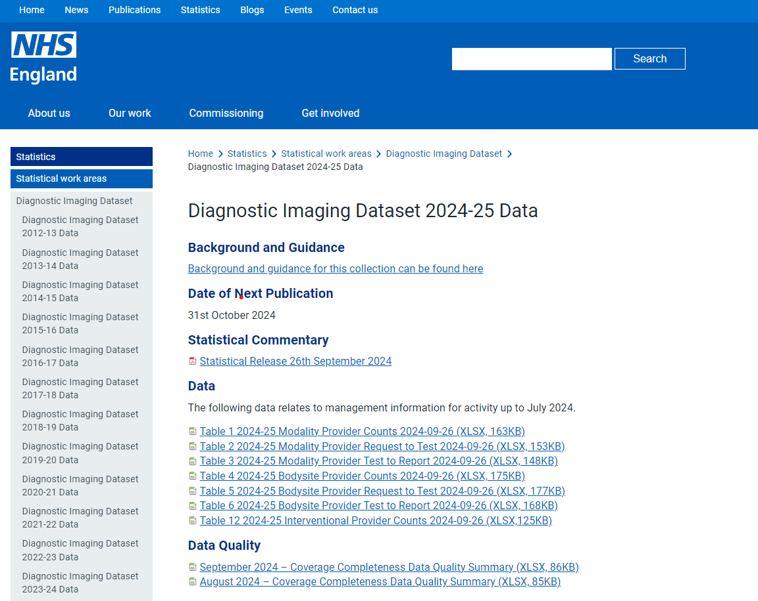
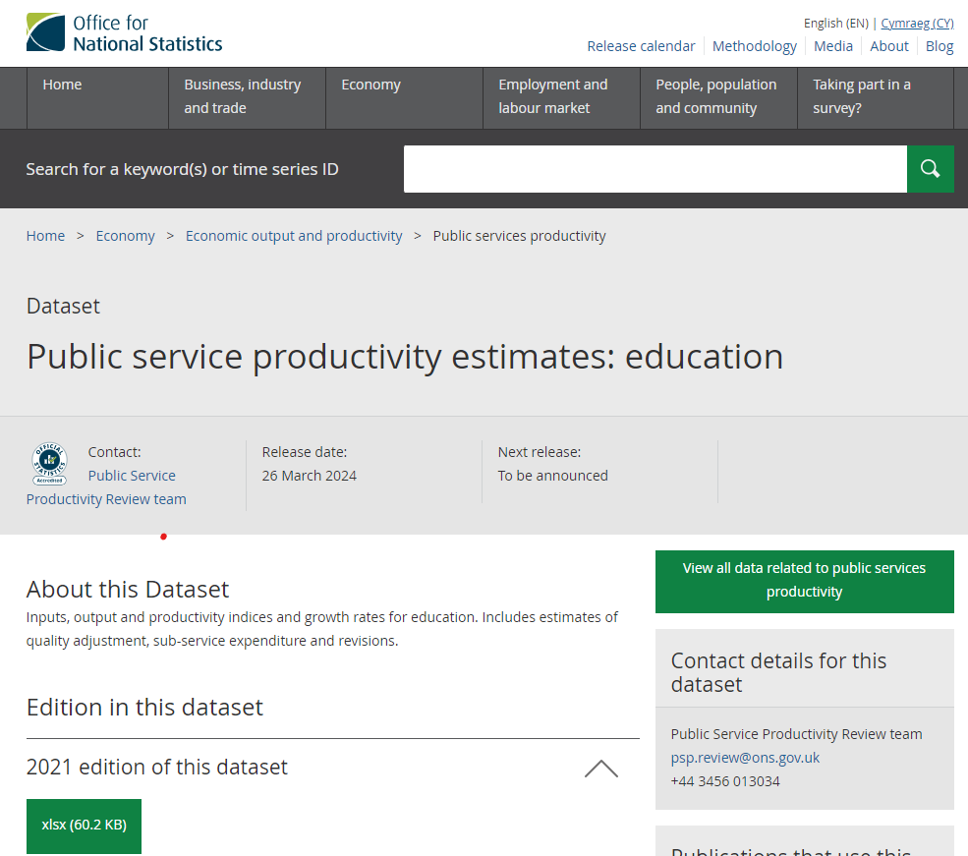
Use of Excel in public services

Slide 9
Use of Excel in public services
Many stakeholders still want Excel outputs
(even in reproducible analytical pipelines)

Slide 10


Creating Excel from R
writexl
quick, simple, basic
xlsx
requires Java
openxlsx
Advanced formatting
No Java
XLConnect
requires Java
openxlsx2
More advanced formatting
Nicer syntax
this is possible in python too (e.g. xlsxwriter)
Notes:
writexl - simple, quick running time, limited formatting options
requires Java, so setup can be tricky
openxlsx - does not require Java, advanced formatting options
openxlsx2 - does not require Java, upgrade to openxlsx with slightly more functionality

Slide 11
Openxlsx2 features
Images
Complex styling
Pivot tables
Conditional formatting
Plots
Multiple tabs
Formulae
Notes:
using templates
add formulae to cells
conditional formatting (including icons)
pivot tables
plots and images
complex styling

Slide 12

Openxlsx2 features
Images
Complex styling
Pivot tables
Conditional formatting
Plots
Multiple tabs
Formulae
“your scientists were so preoccupied with whether or not they could, they didn’t stop to think if they should”
- Jurassic Park
Notes:
using templates
add formulae to cells
conditional formatting (including icons)
pivot tables
plots and images
complex styling

Slide 13
When to consider openxlsx2
Well suited
Part of a RAP
Output needs to be Excel
Complex formatting
Analysis repeated

Slide 14
When to consider openxlsx2
Well suited
Part of a RAP
Output needs to be Excel
Complex formatting
Analysis repeated
Might not be worth it
Complex spreadsheet for one-off analysis
Formatting not required
Alternative output more appropriate

Slide 15
How to use openxlsx2

Slide 16
How to use (basic example)?
wb<-wb_workbook()
wb<-wb |>
wb_add_worksheet(tab_name,tab_color = wb_color("blue")) |>
wb_add_data(tab_name,iris)
wb_save(wb,"outputs/simple_demo.xlsx", overwrite = TRUE)

Slide 17
How to use (basic example)?
wb<-wb_workbook()
wb<-wb |>
wb_add_worksheet(tab_name,tab_color = wb_color("blue")) |>
wb_add_data(tab_name,iris) |>
wb_add_font(tab_name, dimensions_heading, name="Calibri",
size = 11, bold = "single", color=wb_color("navy") ) |>
wb_add_fill(tab_name, dimensions_heading,color = wb_color("beige")) |>
wb_add_border(tab_name, dimensions_heading) |>
wb_set_col_widths(tab_name, cols = 1:5, widths=c(10,10,10,10,20))
wb_save(wb,"outputs/simple_demo.xlsx", overwrite = TRUE)

Slide 18
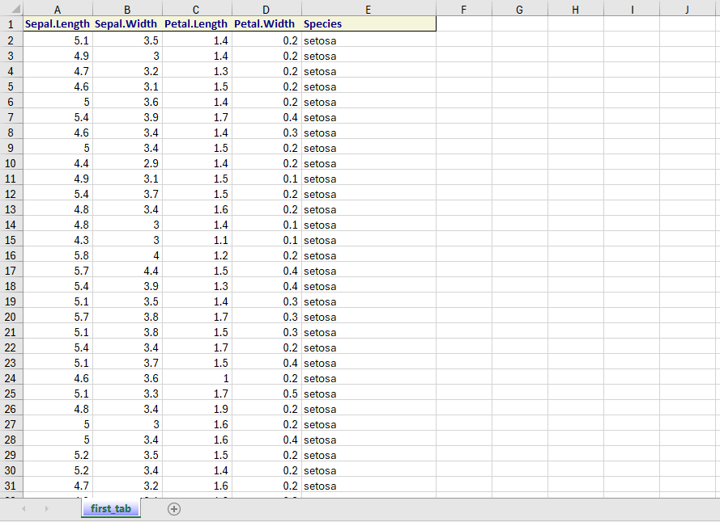
Simple demo

Slide 19
How to use (basic example)?
piping syntax- these functions do not modify in place
wb<-wb_workbook()
wb<-wb |>
wb_add_worksheet(tab_name,tab_color = wb_color("blue")) |>
wb_add_data(tab_name,iris) |>
wb_add_font(tab_name, dimensions_heading, name="Calibri",
size = 11, bold = "single", color=wb_color("navy") ) |>
wb_add_fill(tab_name, dimensions_heading,color = wb_color("beige")) |>
wb_add_border(tab_name, dimensions_heading) |>
wb_set_col_widths(tab_name, cols = 1:5, widths=c(10,10,10,10,20))
wb_save(wb,"outputs/simple_demo.xlsx", overwrite = TRUE)

Slide 20
How to use (basic example)?
chaining syntax- these functions modify in place
wb<-wb_workbook()
wb $
add_worksheet(tab_name,tab_color = wb_color("blue")) $
add_data(tab_name,iris)$
add_font(tab_name, dimensions_heading, name="Calibri", size = 11, bold = "single", color=wb_color("navy") ) $
add_fill(tab_name, dimensions_heading,color = wb_color("beige")) $
add_border(tab_name, dimensions_heading) $
set_col_widths(tab_name, cols = 1:5, widths=c(10,10,10,10,20))
wb$save("outputs/simple_demo.xlsx", overwrite = TRUE)

Slide 21
Building up complexity
Column headers
Main body
Separate formatting for 1 section
wb<-wb |> wb_add_data(tab_name,iris) |>
wb_add_font(tab_name, dimensions_heading, name="Calibri",
size = 11, bold = "single", color=wb_color("navy") ) |>
wb_add_fill(tab_name, dimensions_heading,color = wb_color("beige")) |>
wb_add_border(tab_name, dimensions_heading) |>
wb_set_col_widths(tab_name, cols = 1:5, widths=c(10,10,10,10,20))
Notes:
What about more complex document designs?
If we want to format the main body differently, we will need to repeat add_font, add_border and add_fill with different dimensions
We can use functions to build complex reports.

Slide 22
Building up complexity
Column headers
Main body
(formatted)
Separate formatting for 2 sections
wb<-wb |> wb_add_data(tab_name,iris) |>
wb_add_font(tab_name, dimensions_heading, name="Calibri",
size = 11, bold = "single", color=wb_color("navy") ) |>
wb_add_fill(tab_name, dimensions_heading,color = wb_color("beige")) |>
wb_add_border(tab_name, dimensions_heading) |>
wb_set_col_widths(tab_name, cols = 1:5, widths=c(10,10,10,10,20))
wb<-wb |> wb_add_data(tab_name,iris) |>
wb_add_font(tab_name, dimensions_heading, name="Calibri",
size = 11, bold = "single", color=wb_color("navy") ) |>
wb_add_fill(tab_name, dimensions_heading,color = wb_color("beige")) |>
wb_add_border(tab_name, dimensions_heading) |>
wb_set_col_widths(tab_name, cols = 1:5, widths=c(10,10,10,10,20))
Notes:
What about more complex document designs?
If we want to format the main body differently, we will need to repeat add_font, add_border and add_fill with different dimensions
We can use functions to build complex reports.

Slide 23
Building up complexity
Column headers
Column headers
Main body
(formatted)
Bold row headers
Simple columns
Conditionally formatted column
Separate formatting for 2 sections
Separate formatting for 4 sections
wb<-wb |> wb_add_data(tab_name,iris) |>
wb_add_font(tab_name, dimensions_heading, name="Calibri",
size = 11, bold = "single", color=wb_color("navy") ) |>
wb_add_fill(tab_name, dimensions_heading,color = wb_color("beige")) |>
wb_add_border(tab_name, dimensions_heading) |>
wb_set_col_widths(tab_name, cols = 1:5, widths=c(10,10,10,10,20))
wb<-wb |> wb_add_data(tab_name,iris) |>
wb_add_font(tab_name, dimensions_heading, name="Calibri",
size = 11, bold = "single", color=wb_color("navy") ) |>
wb_add_fill(tab_name, dimensions_heading,color = wb_color("beige")) |>
wb_add_border(tab_name, dimensions_heading) |>
wb_set_col_widths(tab_name, cols = 1:5, widths=c(10,10,10,10,20))
wb<-wb |> wb_add_data(tab_name,iris) |>
wb_add_font(tab_name, dimensions_heading, name="Calibri",
size = 11, bold = "single", color=wb_color("navy") ) |>
wb_add_fill(tab_name, dimensions_heading,color = wb_color("beige")) |>
wb_add_border(tab_name, dimensions_heading) |>
wb_set_col_widths(tab_name, cols = 1:5, widths=c(10,10,10,10,20))
wb<-wb |> wb_add_data(tab_name,iris) |>
wb_add_font(tab_name, dimensions_heading, name="Calibri",
size = 11, bold = "single", color=wb_color("navy") ) |>
wb_add_fill(tab_name, dimensions_heading,color = wb_color("beige")) |>
wb_add_border(tab_name, dimensions_heading) |>
wb_set_col_widths(tab_name, cols = 1:5, widths=c(10,10,10,10,20))
Notes:
What about more complex document designs?
If we want to format the main body differently, we will need to repeat add_font, add_border and add_fill with different dimensions
We can use functions to build complex reports.

Slide 24
Building up complexity
Column headers
Column headers
Main body
(formatted)
Bold row headers
Simple columns
Conditionally formatted column
Title
Date and metadata
Column headers
Bold row headers
Colour conditional formatting
Text columns
Traffic light conditional formatting
Separate formatting for 2 sections
Separate formatting for 4 sections
wb<-wb |> wb_add_data(tab_name,iris) |>
wb_add_font(tab_name, dimensions_heading, name="Calibri",
size = 11, bold = "single", color=wb_color("navy") ) |>
wb_add_fill(tab_name, dimensions_heading,color = wb_color("beige")) |>
wb_add_border(tab_name, dimensions_heading) |>
wb_set_col_widths(tab_name, cols = 1:5, widths=c(10,10,10,10,20))
wb<-wb |> wb_add_data(tab_name,iris) |>
wb_add_font(tab_name, dimensions_heading, name="Calibri",
size = 11, bold = "single", color=wb_color("navy") ) |>
wb_add_fill(tab_name, dimensions_heading,color = wb_color("beige")) |>
wb_add_border(tab_name, dimensions_heading) |>
wb_set_col_widths(tab_name, cols = 1:5, widths=c(10,10,10,10,20))
wb<-wb |> wb_add_data(tab_name,iris) |>
wb_add_font(tab_name, dimensions_heading, name="Calibri",
size = 11, bold = "single", color=wb_color("navy") ) |>
wb_add_fill(tab_name, dimensions_heading,color = wb_color("beige")) |>
wb_add_border(tab_name, dimensions_heading) |>
wb_set_col_widths(tab_name, cols = 1:5, widths=c(10,10,10,10,20))
wb<-wb |> wb_add_data(tab_name,iris) |>
wb_add_font(tab_name, dimensions_heading, name="Calibri",
size = 11, bold = "single", color=wb_color("navy") ) |>
wb_add_fill(tab_name, dimensions_heading,color = wb_color("beige")) |>
wb_add_border(tab_name, dimensions_heading) |>
wb_set_col_widths(tab_name, cols = 1:5, widths=c(10,10,10,10,20))
wb<-wb |> wb_add_data(tab_name,iris) |>
wb_add_font(tab_name, dimensions_heading, name="Calibri",
size = 11, bold = "single", color=wb_color("navy") ) |>
wb_add_fill(tab_name, dimensions_heading,color = wb_color("beige")) |>
wb_add_border(tab_name, dimensions_heading) |>
wb_set_col_widths(tab_name, cols = 1:5, widths=c(10,10,10,10,20))
wb<-wb |> wb_add_data(tab_name,iris) |>
wb_add_font(tab_name, dimensions_heading, name="Calibri",
size = 11, bold = "single", color=wb_color("navy") ) |>
wb_add_fill(tab_name, dimensions_heading,color = wb_color("beige")) |>
wb_add_border(tab_name, dimensions_heading) |>
wb_set_col_widths(tab_name, cols = 1:5, widths=c(10,10,10,10,20))
Mean (highlighted)
wb<-wb |> wb_add_data(tab_name,iris) |>
wb_add_font(tab_name, dimensions_heading, name="Calibri",
size = 11, bold = "single", color=wb_color("navy") ) |>
wb_add_fill(tab_name, dimensions_heading,color = wb_color("beige")) |>
wb_add_border(tab_name, dimensions_heading) |>
wb_set_col_widths(tab_name, cols = 1:5, widths=c(10,10,10,10,20))
wb<-wb |> wb_add_data(tab_name,iris) |>
wb_add_font(tab_name, dimensions_heading, name="Calibri",
size = 11, bold = "single", color=wb_color("navy") ) |>
wb_add_fill(tab_name, dimensions_heading,color = wb_color("beige")) |>
wb_add_border(tab_name, dimensions_heading) |>
wb_set_col_widths(tab_name, cols = 1:5, widths=c(10,10,10,10,20))
Separate formatting for 8 sections
Notes:
What about more complex document designs?
If we want to format the main body differently, we will need to repeat add_font, add_border and add_fill with different dimensions
We can use functions to build complex reports.

Slide 25
Building up complexity
Column headers
Column headers
Main body
(formatted)
Bold row headers
Simple columns
Conditionally formatted column
Title
Date and metadata
Column headers
Bold row headers
Colour conditional formatting
Text columns
Traffic light conditional formatting
Separate formatting for 2 sections
Separate formatting for 4 sections
What about multiple tabs?
Mean (highlighted)
Separate formatting for 8 sections
Notes:
What about more complex document designs?
If we want to format the main body differently, we will need to repeat add_font, add_border and add_fill with different dimensions
We can use functions to build complex reports.

Slide 26
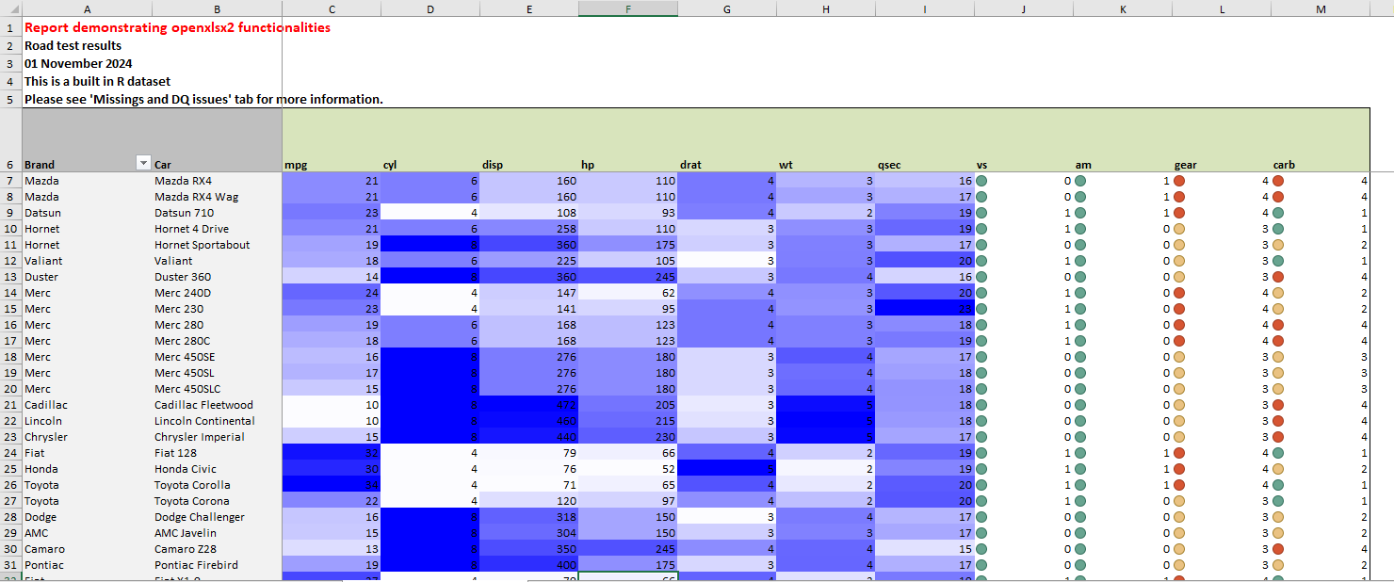
More complex reports

Slide 27
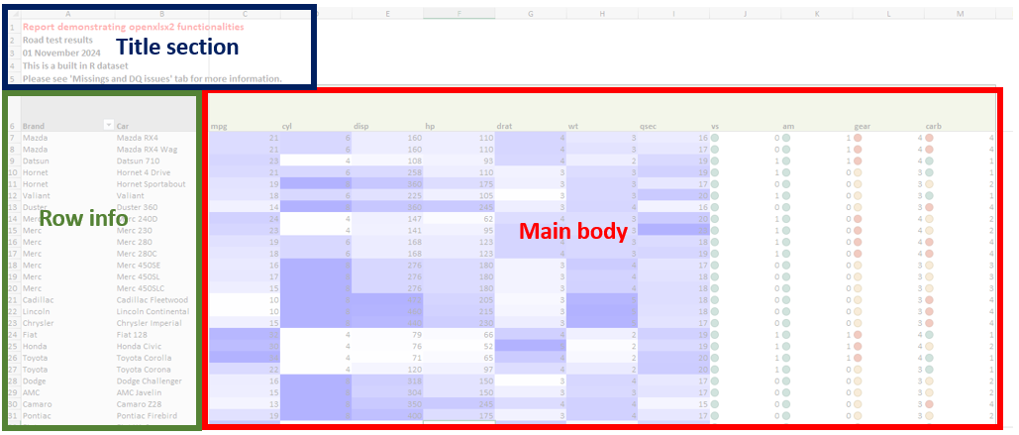
More complex reports

Slide 28
More complex reports
For loop to create each sheet
report_sheets is a list containing the parameters and data.
Iterate through it, calling write_sheet function
wb <- create_new_workbook("code/template_excel.xlsx")
for (sheet in report_sheets) {
wb <- wb |>
write_sheet(
sheet_info = sheet$sheet_params,
data_list = sheet$data,
date_to_print = date_running
)
}

Slide 29
write_sheet function
Build up the sheet
Create the sheet then add each section sequentially
wb <-
create_new_sheet(wb, sheet_info$tab_name, style_info$sheet_colour) |>
add_title_section(sheet_info$tab_name,
dimensions$title_dimensions, title_text)

Slide 30
write_sheet function
Build up the sheet
Create the sheet then add each section sequentially
wb <-
create_new_sheet(wb, sheet_info$tab_name, style_info$sheet_colour) |>
add_title_section(sheet_info$tab_name,
dimensions$title_dimensions, title_text) |>
add_row_info_section(sheet_info$tab_name,
dimensions$row_info_dimensions,
data_list$row_info)

Slide 31
write_sheet function
Build up the sheet
Create the sheet then add each section sequentially
wb <-
create_new_sheet(wb, sheet_info$tab_name, style_info$sheet_colour) |>
add_title_section(sheet_info$tab_name,
dimensions$title_dimensions, title_text) |>
add_row_info_section(sheet_info$tab_name,
dimensions$row_info_dimensions,
data_list$row_info) |>
add_main_body(
sheet_name = sheet_info$tab_name,
main_data = data_list$main_data,
main_dimensions = dimensions$main_dimensions,
style_name = style_info$sheet_style)

Slide 32
add_main_body function
Add style elements that apply to all main body sections, then call functions to add specific styling
This allows us to keep consistent formatting apart from main body of sheet
Specific styling:
if (style_name == "conditional_format_all") {
wb <-
wb |> add_main_style_conditional_format_all(
sheet_name,
main_dimensions,
main_data)

Slide 33
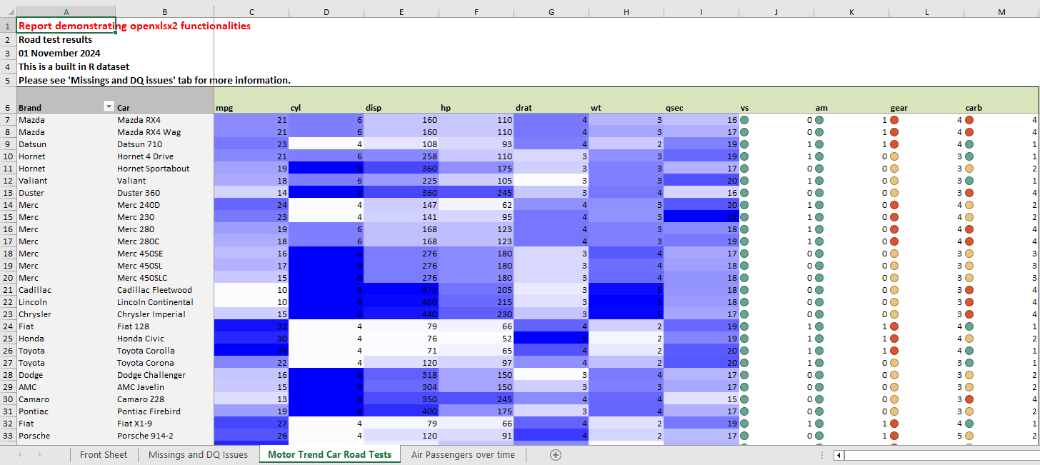
Sheets with different styles

Slide 34
add_main_body function
Add style elements that apply to all main body sections, then call functions to add specific styling
This allows us to keep consistent formatting apart from main body of sheet
Specific styling:
if (style_name == "months_with_total") {
wb <-
wb |> add_main_style_months_with_total(
sheet_name,
main_dimensions,
main_data)

Slide 35
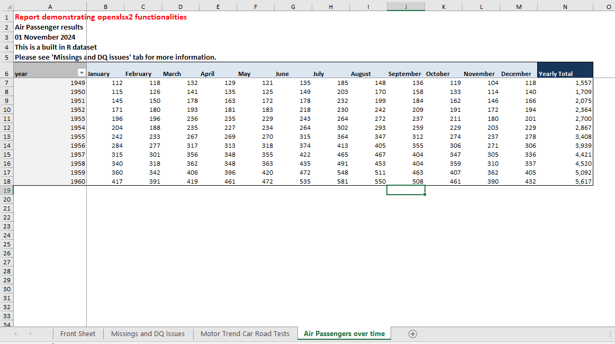
Sheets with different styles

Slide 36
add_main_body function
Add style elements that apply to all main body sections, then call functions to add specific styling
This allows us to keep consistent formatting apart from main body of sheet
Specific styling:
if (style_name == "new_style") {
wb <-
wb |> add_main_style_NEW_STYLE(
sheet_name,
main_dimensions,
main_data)

Slide 37
Openxlsx2 conclusions
openxslxs2 can help (if you really need Excel)
Can create simple or complex excel files easily
Functions can help

Slide 38
Open-source spreadsheet alternative
What are your options for creating an open source spreadsheet?
readODS (no formatting)
Convert to ODS manually
Convert to ODS within R.
department-for-transport/odsconvertr
code:
devtools::install_github("department-for-transport/odsconvertr")
library(odsconvertr)
convert_to_ods("demo.xlsx")
note, functionality limited - e.g. conditional formatting will disappear
Notes:
readODS allows you to write to ODS but text formatting is not possible

Slide 39

Acknowledgements
This work was based on a project with NHS England- Elective Analysis and RAP teams
With thanks to Debbie Moon, Chelsea Scott, Nicola Stubbs, Laura Burton, Warren Davies and Jen Struthers
Code is available at https://github.com/agem-advanced-analytics/

Slide 40
https://github.com/agem-advanced-analytics/

