Slide 1
MLOps in the NHS
Operationalising machine learning via open-source tools
21st Nov 2024 London
Notes:
- Introduction and welcoming
- Two presenters
- Who we are – d-fine
- Objective of the talk: Coming from this Multi-industry view and agnostic approach – We are not here to promote tools but to showcase how can opr can be achieved via open-source
- Motivation: From podcast for a radiology-based algorithm – This needed training versions of around 500 and doing this with the traditional setup without MLops would have been a very consuming task also not feasible for a productive ML

Slide 2




Challenges with scaling Machine Learning (ML) in a healthcare setting
Fragmentation of systems
Organizational change management
The NHSE has 90,000 data flows originating from 7,000 healthcare providers across hundreds of organisations
Fragmentation leads to challenges in building united infrastructures for scaled projects
Building skills and expertise for development and maintenance is a necessity for progress
Unrealistic expectations about the potential of ML - interventions are not defined or do not add value
Data quality and privacy
Validation
Around 200 million docs of unstructured and 1 trillion rows of hospital legacy data
Personal data de-identified before processing/subject to on-prem requirements
Rigorous testing and validation is done based on different requirements of each trust and new local data
Notes:
Key point:
- initiatives on unifying the data but some of the data’s value is locked in hospitals via silos
Building skills and expertise for development and maintenance is a necessity for progress – this is true for deployment and monitoring scaled systems
- Unrealistic expectation and intervention are not defined
- One of the biggest organisations in the UK in terms of data generated
- On data quality – The complexity of modularity of data is needed to tackle real-world problems – Like Data needed for Demand modelling (not just EHR but also Social care in various formats)
- Privacy of identification means that most data needs to be run in federated Environments and on-prem (meaning redeployment of models in secure pipelines)
- From the validation perspective – The aspect on requirements is rather local – Making the process difficult,

Slide 3
ML projects in the real world (sometimes!) Root causes of ML projects’ failures
Primary reasons for ML project failures
Unfortunate detours of ML projects on their road to production
01 Planning problems
02 Scoping problems
Solution doesn’t solve the problem
Lack of explainability
Solution takes too long to develop
Insufficient time for skills acquisition
03 Experimentation issues
04 Development issues
Non-reproducible results
Over-engineered complexity
Unstable/fragile code
Late-stage implementation change
05 Deployment issues
06 Evaluation issues
Scalability issues
Inadequate architecture
Drift causing instability
Can’t explain solution value
[1] Machine Learning Engineering for the Real World : step-by-step guide, Databricks, Manning Publications Co. 2021
The problems highlighted in orange are issues that can potentially be addressed by MLOps techniques
Notes:
- So – in reality, quite a few projects fail in the real world.
- Some figures from Nuance suggest that 95% of projects fail in a clinical setting
- We have some reports on why these fail – with the largest segment on Fragility and technology
- Some can be addressed by solved by this concept of MLOps which James will introduce later
- The highlighted issues are very prominent and can be solved with MLOps

Slide 4








What we mean by productive ML A productive ML system effectively solves real-world problems, where the model is trusted and managed for evolving new data
Reliable: model that does not crash or cause impact on other systems
Available the model operates when it’s needed
Performant: The model performs well at the task it was designed
Auditable: the model was changed can be tracked
Explainable: the ability to describe how a model arrives at its decisions
Fair: shouldn’t use features that may unfairly bias predictions
Operationally
resilient
Trusted
Infrastructure
Productive ML
User
Data Sources: Data sources that keep its performance over time with no data drift
Infrastructure : Seamlessly fitting into existing workflows and IT infrastructure
Business logic
External
valuation
Robust monitoring setup: Incorporating systems for tracking performance, detecting drift, and updating models as needed to ensure continued effectiveness
Integration
tested
Relevance
Integrated
Monitored
Notes:
Key point:
Operation resilient – If we had a model that handled triage direction, we want it to function in the correct way – also if our system is connected to other systems, we want it to have minimal downstream effect. We need our system to be reliable and work on demand with no latency. It also has to be user friendly.

Slide 5
The actual model is only a small part of an enterprise Machine Learning system
Idea
Data
Model
Ops
Integration
Sampling
Resource
Management
Integration
and
Embedding
Machine
Learning
Model
Monitoring
Design
Thinking
Requirements
Engineering
Data
Collection
Pre-
Processing
Serving
Infrastructure
CI / CD
Setup
Software
Development
Meta data
management
Back
testing
Feasibility
Analysis
Feature
Engineering
Dashboards
Data
Cleaning
Configuration
Model
Serving
APIs
Testing
Model
Evaluation
Hyper
parameter
tuning
Sophisticated MLOps concepts automate all machine learning specific process steps.
Notes:
- The main focus – that the Machine learning system is much more than the model
- The most important aspect for scale is Data, and Ops, Integration is the biggest struggle for scale
- The operation part is also part is where the impact happens for linking the value to other systems – Think Scaled radiology Image recognition (EHR, Scanner Software, Management system )

Slide 6
The classic data science workflow is not always suitable for productive ML Many projects start off the experimentation stage in notebooks
Data-Dump
Potentially not executable on productive data
Experiments are not tracked and are not reproducible
ML
ML-Pipeline (Experiment)
Data extraction and exploration
Pre-processing
Model training
Model evaluation
Trained model
ML Engineering and operations are separated
Pre-production
Production
Dev & Ops
Model and application code may not be separated
Test
data
Productive
data
Application code
Registry
Code
Deployment
Development / Test
hosting
Productive
hosting
Trained model
Models not continuously re-trained on new data
Model creation and productive usage are classically completely decoupled, requiring manual development and deployment for each new model version.
Notes:
Key point:
- Segregated training and deployment pipelines – potentially leads to issues accessing production data
- No experiment tracking, means results are not easily reproducible
- Modelling & application code may not be separated properly, leading to convoluted builds
- No iterative workflow with respect to deployment, re-training etc
There must be a better way in doing this

Slide 7
MLOps is the extension of DevOps principles in the context of Machine Learning
Challenges
Extension of DevOps in context of Machine Learning use cases
The transition from "prototype" to "production" is usually associated with great effort
Data science and ML model development involves a lot of experimentation and is typically an iterative process
This does not fit well in the classical software development approach and can result in a segmented approach to model training and deployment
Model versioning
Pipeline deployment
Data versioning
Experiment tracking
Pipelines
Tracking
Code
Plan
Release
Deploy
Benefits of an MLOps approach
Serving
ML
DEV
OPS
Faster time to production in a more automated/tools-assisted approach
From prototype to production in a self-service approach, orchestrated by a single team
Easier collaboration and access to data and compute resources
Reusability of components, sophisticated versioning of code and models
Re-Training
Build
Test
Operate
Evaluation
Monitor
Performance Evaluation
Productive Retraining
Model training
Model serving
End-to-end MLOps processes are an integral aspect of a resource-efficient and agile business approach.
Notes:
Key points:
- Take the concept of DevOps, which is a partnership between developers and IT operations to iteratively integrate and deploy code, and apply to the machine learning pipeline.
- All the issues we have seen on the previous slide (disaparate codebase for model & application code, segregated training, lack of robust tracking, no automated training or serving of models) can be solved via taking devops approaches and leveraging them in a machine learning context.

Slide 8
With ML-Ops, modern methods integrate with proven agile IT processes
Exploration
Application Code
MLOps
Experiments are tracked, everything is reproducible
Orchestrated ML pipeline (experiment)
Registry
Data extraction
Pre- processing
Model training
Model evaluation
Source Code
No refactoring necessary to run on productive data
ML Engineering and operations are integrated
Deployment
Productive data
Models can be re-trained on productive/new data
Pipeline
Code
Automated ML pipeline (experiment)
Model registry
Data extraction
Pre-Processing
Model training
Model evaluation
Trained model
Trigger re-execution
Performance monitoring
Model serving
API
Productive
hosting
Models and applications are separated
By separating model and application code, as well as additional deployment of the ML pipeline
and performance monitoring, ML applications can be adaptively re-trained in production.
Notes:
Solves issues via:
- orchestrated training pipeline can be run via triggers, and experiments are tracked → have a monitored and auditable training workflow
- deployment of model & application code is split, model and application code are hosted separately
- ML engineering and operations have a clear separation, meaning iterative deployments are possible
- top is model experiments, bottom is productive model
- performance is monitored and if necessary can automatically trigger re-training/hyper parameter tuning

Slide 9
The end-to-end MLOps workflow
Develop
Versioning
Track
Serve
MLOps provides tools for efficient and fast development of new use cases. This starts with containerized Deep Learning environments, IDE integration and workflow tools.
MLOps provides measures for reproducibility and sharing not only for code, but also for curated features and model artefacts.
Experiment tracking makes ML reproducible
Moving to production is assisted with fast serving solutions that support various use cases, from multi-model serving to GPU-support.
ML
Frameworks
Notebooks
IDEs
Annotation
Tools
Code
Features
Models
Experiments
Pipelines
Features
Models
Develop
Versioning
Track
Serve
Pipelines
Train
Deploy
Monitor
Pre
Processing
Continuous
Training (CT)
Evaluation
Hyper
Parameter
Scalable
Infrastructure
CI/CD
Container
Dashboards
Re-Training
Trigger
Pipelines
Train
Deploy
Monitor
Pipelines are a series of modelling and pre/post-processing steps that are used to automate the process of training and deploying ML models via CI/CD.
Hyper-parameter tuning is performed with detached training jobs on scalable infrastructure.
Automatic deployment of models to a productive environment enables seamless integration.
Tracking model performance allows re-training/re-tuning and online learning.
Sophisticated implementation of MLOps considers the end-to-end process, but starting with single steps already yields great benefit.
Notes:
Highlight collaboration potential between trusts → develop stage.
1. Develop
In the development phase, data scientists and engineers collaborate to preprocess data, select algorithms, and build models through exploratory data analysis and feature engineering.
2. Pipelines
Automation is introduced through pipelines that streamline data ingestion, preprocessing, model training, and evaluation using CI/CD practices to reduce errors and improve speed.
3. Versioning
Versioning is implemented to track changes in datasets, models, and code using tools Git, ensuring reproducibility and accountability throughout the ML lifecycle.
4. Train
The training phase involves executing the machine learning model on prepared datasets, often utilizing distributed training and hyperparameter tuning techniques for optimal performance.
5. Track
Metrics and performance indicators are logged during training using tools like MLflow or TensorBoard to monitor the model’s effectiveness and facilitate experiment comparisons.
6. Deploy
Once optimized, the model is packaged and deployed into a production environment using containerization and automated strategies to minimize risks and downtime.
7. Serve
The model is made available for inference through APIs or as part of applications, focusing on low-latency responses for real-time and batch predictions.
8. Monitor
Ongoing monitoring of model performance, prediction accuracy, and data drift is crucial to trigger alerts and implement corrections to maintain reliability and effectiveness.

Slide 10







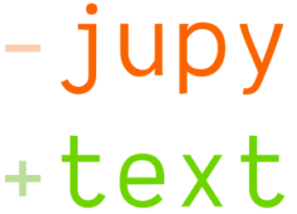







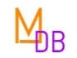






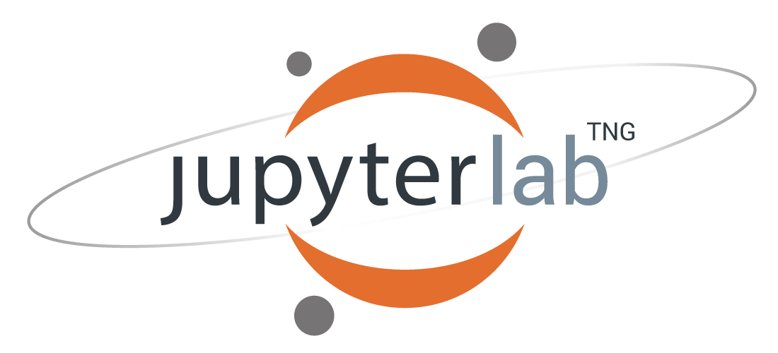





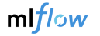


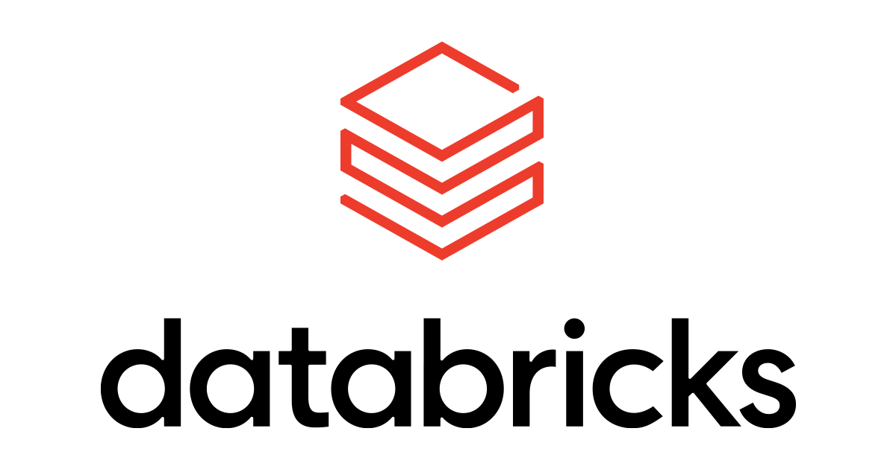












It is already easy to get lost in the MLOps tool landscape⁰¹
Commercial
ML
Frameworks
Notebooks
IDEs
Annotation
Tools
Code
Features
Models
Experiments
Pipelines
Features
Models
Develop
Versioning
Track
Serve
Platforms
Pipelines
Train
Deploy
Monitor
Pre
Processing
Continuous
Training (CT)
Evaluation
Hyper
Parameter
Scalable
Infrastructure
CI/CD
Container
Dashboards
Re-Training
Trigger
Open Source
01 https://github.com/visenger/awesome-mlops

Slide 11
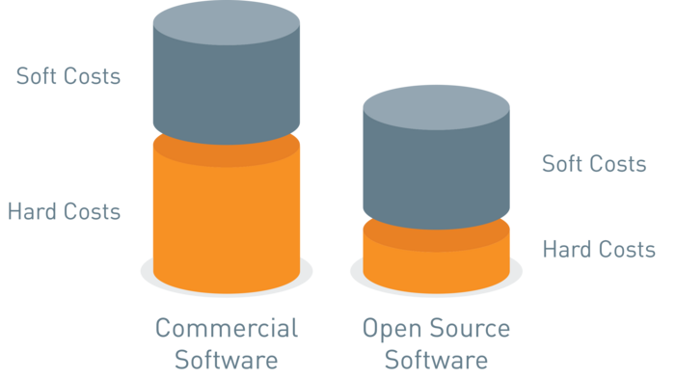
Open source vs. Commercial
Pros
Cost-effective: Often free to use, giving cost-savings for licensing fees
Customizable: Can often be easily customized
Large community: Some projects have active communities that offer support
Flexibility: Can potentially be integrated with other systems
Procurement: no licensing fees or vendor lock-in, which makes onboarding simpler
Cons
Limited Support: No enterprise support, which can lead to problems in providing stable services
Stability: May not be as stable as proprietary software, which can lead to more bugs and other issues
Security: May not be as secure as proprietary software, as anyone can view and potentially exploit the source code
Legal: Situation for building commercial products be unclear or confusing
Open Source
Commercial
User-Experience: Generally considered more user-friendly
Support: Offers better technical support and SLAs as well as faster fixes
Stability: Typically, more reliable, tested better and more secure
Features: May have more features
Licensing fees: Can become quite expensive
Inflexible: May be tied to proprietary file formats and protocols
Vendor lock-in: May have vendor lock-in, making it difficult to switch to another provider
Source: https://www.aoe.com/en/insights/open-source-blogpost.html
There are trade-offs in both cases, but good results can be achieved via open-source approaches
Notes:
Lean towards the open source but point out the obvious pros and cons of each approach.
Highlight procurement → no licenses needed, easy to onboard, quick way for a smaller team to get setup. This can then be migrated to bigger solutions → can be used as a PoC.
Commercial – pros are support & stability. Cons are expense and vendor lock in.
Open source – pros are cost, flexibility & procurement. Cons are support, stability & security.

Slide 12

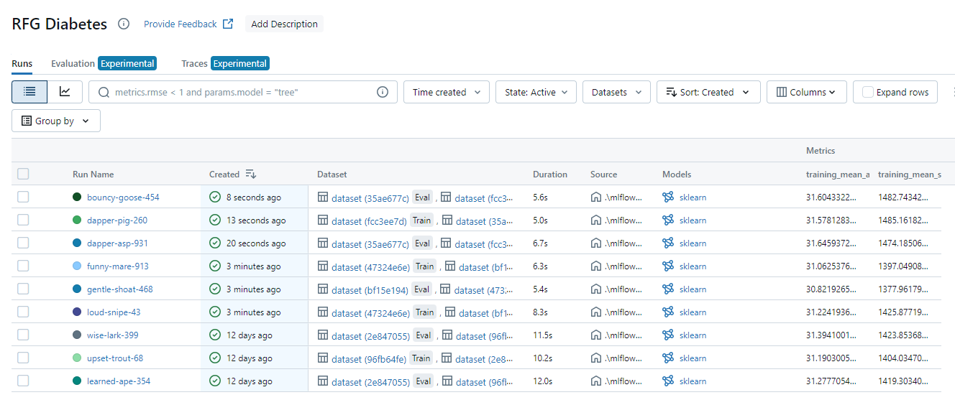
MLOps tool profile: MLflow
Overview
Type: Fast-growing tracking solution
History: Originally developed by startup databricks, donated to the Linux foundation. Commercial version is still provided by databricks.
License: Apache License 2.0 (free)
Link: https://mlflow.org/
ML
Frameworks
Notebooks
IDEs
Annotation
Tools
Code
Features
Models
Experiments
Pipelines
Features
Models
Develop
Versioning
Track
Serve
Pipelines
Train
Deploy
Monitor
Pre
Processing
Continuous
Training (CT)
Evaluation
Hyper
Parameter
Scalable
Infrastructure
CI/CD
Container
Dashboards
Re-Training
Trigger
Features
MLflow lets you train, reuse, and deploy models and package them. The four MLflow components are
MLflow Tracking: API and UI for logging parameters, code versions, metrics, and artifacts
MLflow Projects: standard format for packaging reusable data science code
MLflow Models: convention for packaging machine learning models in multiple flavours, and a variety of tools to help you deploy them
MLflow Registry: centralised model store, set of APIs, and UI
MLflow tracking UI
Notes:
MLFlow is a great open-source tool to address certain aspects of the MLOps pipeline.
Pictured is the tracking – used for visualising results of ML code.
Also have sections for packaging models, storing models in a registry and packaging code.

Slide 13

Questions

Slide 14


Your contacts
Elias Altrabsheh Manager - UK Healthcare Tel +44 20 7776-1000 Mobile +44 7799 543948 Elias.Altrabsheh@d-fine.com
James Sibbit Senior Consultant – UK Technoogy & AI Tel +44 20 7776-1000 Mobile +44 7825 613757 James.Sibbit@d-fine.com

