Slide 1
A method to apply temporal graph analysis on electronic patient record data to explore healthcare professional patient interaction intensity.
John Booth
Senior Research Data Engineer
Clinical Informatics Research Program
November 2024
RPYSOC 2024

Slide 2
Who am I?
I am John Booth:
Senior Research Data Engineer
Clinical Informatics Research Program (CIRP), Digital Research, Innovation and Virtual Environment unit (DRIVE), Great Ormond Street Hospital for Sick Children (GOSH).
PhD Candidate
Faculty of Population Health Sciences, UCL GOSH Institute of Child Health. Funded by GOSH CIRP.
john.booth@gosh,nhs.uk or john.booth.21@ucl.ac.uk
Notes:
I only started at GOSH 10 years ago, previously I had no clinical experience but at 58 I was looking for a career change and I completed a MSc in Health Informatics at Kingston University that enabled me to get a job in the NHS as a Research Data Manager.
2 years later I Joined the GOSH Data Research Environment, created 2 years before we had our EPR installed in April 2019.
My role was as lead data engineer to extract hospital data for research completed within the hospital, I soon got interested in what the data I was supplying was being used for, so I completed a second MSc this time in Data Science at Birkbeck college London in the evenings over 2 years.
Having worked in the DRE for 5 years I was looking to reduce my workload, so I moved to the clinical informatics research program within the DRE, CIRP funds PhD students to undertake more blue-sky research and just to keep my life interesting I enrolled on one of these PhDs myself. So, I work 2 days per week on data engineering for CIRP PHD students then the other 3 days per week I am completed my own PhD.
Exploring the role of graph analysis in the interrogation and visualisation of routinely collected Electronic Patient Record (EPR) data.

Slide 3
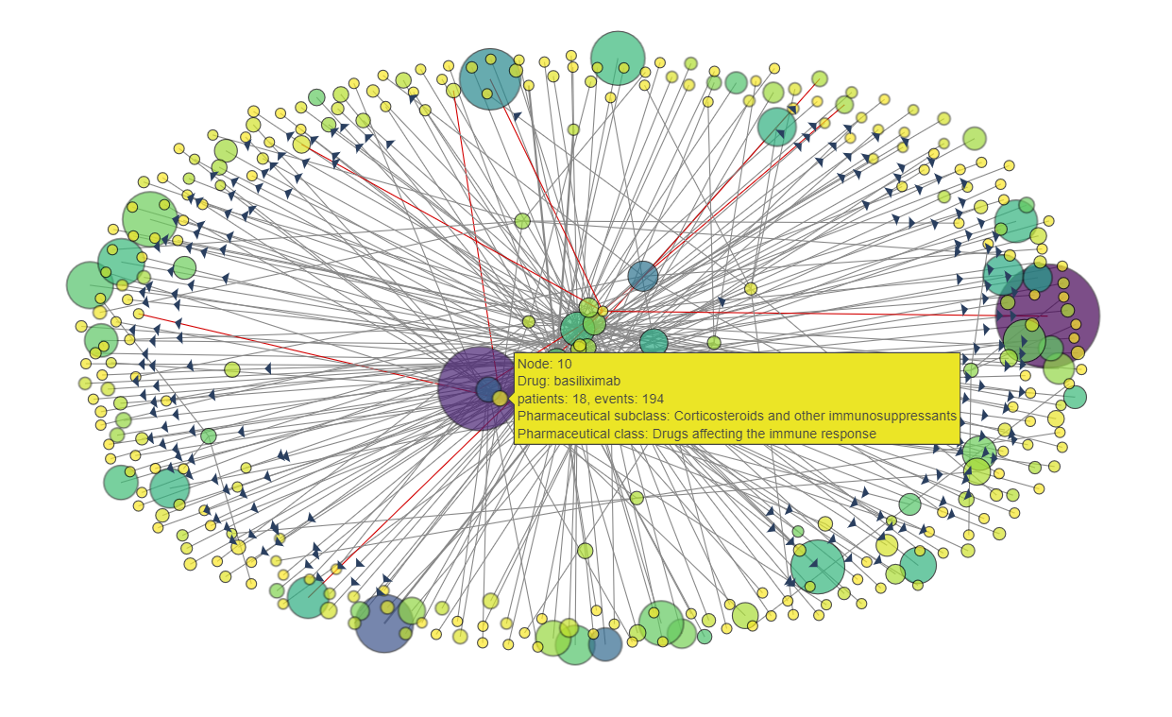
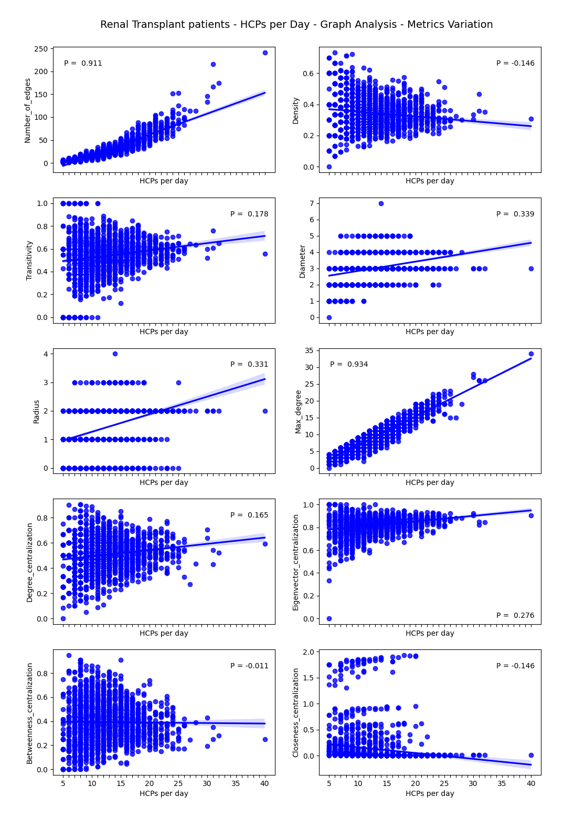

What am I going to talk about?
Graphs or networks but not charts.
Electronic Patient Record (EPR) System.
Notes:
No difference between the words graph or network within the context of my talk.
GOSH has had an EPR system for last 5 years. Installed in April 2019.
Records everything that happens to a patient within the confines of the hospital. NOT a HER which holds all healthcare information for a patient from multi various sources.
An EPR by necessity also records which health care professional (HCP) did what to which patient when. It is this data that I have looked to use within my PhD.

Slide 4
Introduction
Temporal graphs in this study are graphs for individual patients, for each day they are in hospital.
GOSH DRIVE has pre-defined data pipelines that produces standard tables (research data views; RDV) for any clinical cohort.
The example cohort was defined as admissions for patients who had undergone the same principal procedure Allotransplantation of kidney.
Notes:
The majority of the work completed using graph analysis with healthcare data has been patient cohort over a single period of time. Diagnoses has been popular but also care patterns.
Temporal graphs as defined by this project take a different position, graphing …..
Start with data extracted by the GOSG DRE.
RDV are two-dimensional datasets which cover most data requirements of the clinical research teams at GOSH and represent a functional union of data from several source EPR tables.
Currently there are 38 RDVs that range from demographics, hospital admissions, ward stays, OP activity to virology, microbiology and anti-cancer treatments. Each row has a de-identified patient identifier and a time stamp.

Slide 5
Data
The primary RDV used for this study was the healthcare professional (HCP) RDV.
All the recorded actions have a linked de-identified patient ID, HCP ID representing the HCP who carried out the action and a start and end timestamp.
Additional RDVs used to supplement the HCP RDV were Patient Demographics, Hospital Admissions, Ward Stays and Theatre List.
Notes:
What activities are covered:
event_source event_action
ClinicalNoteFact Authoring
DiagnosisEventFact Entered
DiagnosisEventFact Removed
FlowsheetValueFact Taken
LabTestFact Collected
MedicationAdministrationFact Administering
MedicationOrderFact OrderedBy
ProcedureEventFact Anesthesia
ProcedureEventFact Performing
ProcedureOrderFact OrderedBy
VisitFact Primary
VisitFact Second
Pro-active and re-active.

Slide 6
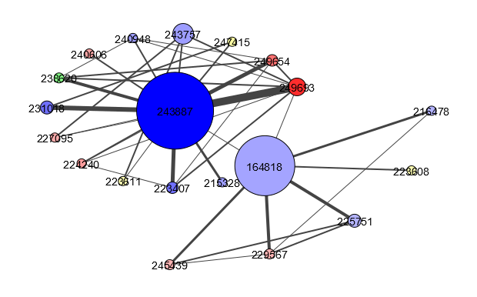
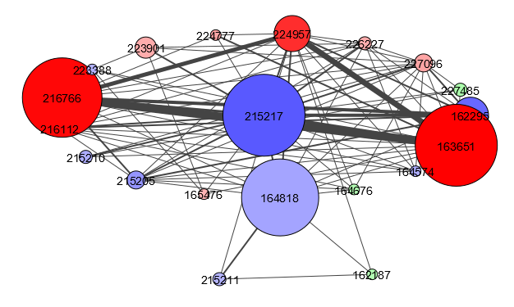
Why Graphs?
“Data has shape, shape has meaning, and meaning brings value” Gunnar Carlsson.
number of nodes | number of edges | density | transitivity | diameter | radius | largest clique size | number clusters | max degree | events | degree centralization | eigenvector centralization | betweenness centralization | closeness centralization
20 | 40 | 0.21053 | 0.43868 | 3 | 2 | 5 | 1 | 14 | 142 | 0.58480 | 0.88786 | 0.38335 | 0.00409
20 | 86 | 0.45263 | 0.70505 | 3 | 2 | 10 | 1 | 17 | 165 | 0.49123 | 0.86455 | 0.18324 | 0.00730
Both graphs represent a day of HCP and patient interactions with the same number of HCPs and a similar number of events. The graph meta data can be used to describe the difference in shape.
Notes:
This is where only having 15 minutes becomes a problem!
How to sum up graph analytics in one slide?
The key is that these two graphs describe a very similar amount of data. If only looking at numbers, this comparison would be very similar.
I will go into more detail about how the graphs are created on the next slide.
Colour – The professional group (Medical (Red), Nursing (Blue), Allied Health Professional (Green) and Other (Yellow))
The top row of numbers describes the left-hand graph.
A glossary is included at the end of the presentation that describes all the meta data items.

Slide 7
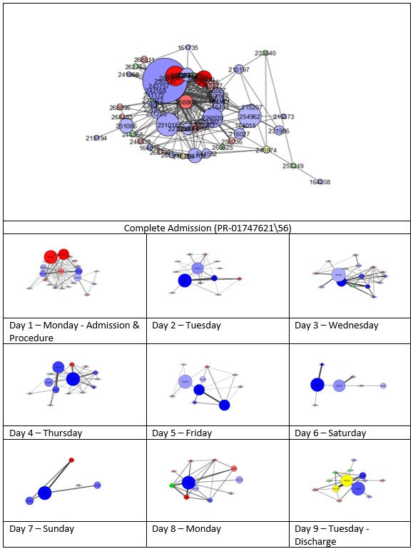
Creating Graphs
Nodes
All unique HCPs interacting with a patient, within a session.
Size – Number of events carried by the HCP
Colour – The professional group (Medical (Red), Nursing (Blue), Allied Health Professional (Green) and Other (Yellow)).
Edges
Represents at least one occurrence of two HCP that carried out an activity for the selected patient within a 60-minute period at any time during the day.
Weight – The number of interactions between the same two HCPs and the selected patient.
Notes:
The image on the slide shows a graph of the complete admission for a single patient at the top.
Then the daily temporal networks for the same patient admission.

Slide 8
Coding
Python 3.9
Packages
iGraph
Available for R in the tidy verse, using the common C library.
Speed. Required to generate a lot of graphs and extract their meta data.
Matplotlib
used by iGraph to create visualisations.
Pandas & Numpy
Notes:
Not networkX the most quoted graph analytics package for python.
Pros: written in python so can be extended/modified.
Cons: Slow.
NB pandas and writing xlsx files with embedded images very helpful as we will see.

Slide 9
Process
Loading RDV CSV files, including admission and session data.
Filtering by patient and session or session day.
Processing filtered data frame to generate unique list of nodes, store as dictionary, iterate through data frame and create list of edges.
Graph creation using node dictionary and edge list and record graph, node and edge metrics in dictionary.
Storing of results, all sessions and sessions days, in json file for each patient admission.
Output creation using metrics stored in json file (detailed HTML document with network plots created in two sizes of image and admission summary using Excel spreadsheets with multiple sheets linked to images created in the previous step).
Notes:
Stage 1 creates a structure to facilitate the creation of graphs at speed.
Stage 3 creates a structure that enable iGraph to create graphs at speed. Also, can be store in JSON file for recreation later.
Stage 6 splits out visualisation process from graph creation so you can have multiple visualisations from the same data i.e. graphs visualisations of different sizes.

Slide 10
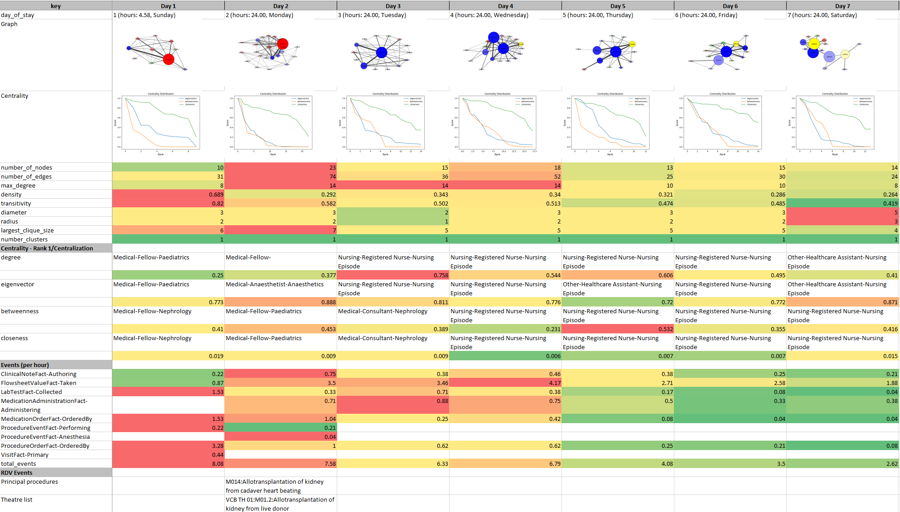
Result
Notes:
This image shows a single sheet which visualise a seven day period.
Heat maps work left to right highlighting different graph metrics.
Potentially each patient will have a spreadsheet with several sheets for multiple weeks in hospital.
Also, a week may be divided into ICU and non-ICU sessions on separate sheets.

Slide 11
Discussion
What can these graphs be used for?
Predicting staff and resource requirements in post procedure periods.
Identifying deviation from normal HCP-patient interactions for early prediction of potential complications and risk of increased length of stay.
Investigating any weekend effect within the hospital.
Notes:
Objective way of categorisation of days in hospital, split by ICU and non-ICU.
Categorize periods of stay by using the categorization of days as features of the period of stay.
Can produce temporal graphs for different aspects of EPR data. So, I have initially focussed on HCP patient interactions but could look at patient activity, (Medication admins, lab specimens and measurements) or documents being written about a patient.
Could produce temporal graphs for individual providers rather than patients, or even wards.

Slide 12
Acknowledgements
Many thanks to:
Prof Neil Sebire
Prof Spiros Denaxas
Dr Rebecca Pope
Dr Will Bryant
Paper:
Booth, J., Eriksson, M.H., Marks, S.D., Bryant, W.A., Denaxas, S., Pope, R. and Sebire, N.J., 2024. Method to apply temporal graph analysis on electronic patient record data to explore healthcare professional–patient interaction intensity: a cohort study. BMJ Health & Care Informatics, 31(1), p.e101072.

Slide 13
Glossary
Term | General Description | HCP patient interaction networks.
Nodes | A set of related objects. | Each node represents an individual HCP.
Edges | The links between the objects or nodes. | An edge represents the event of 2 HCPs interacting with the same patient within a 60-minute period.
Edge level metrics
Directed or undirected | Whether edges have a specific direction. | Undirected.
Weight | Each edge can be given a numeric measure or score that can be used for comparison of edges. | The weight of each edge is defined by the number of times 2 HCPs interact with the same patient within a 60-minute period during a day.
Node level metrics
Degree | The total number of edges that link a specific node to other nodes. Limited to the total number of nodes minus 1. | An HCP with a high degree means that the HCP was interacting with a patient alongside other HCPs.
Centrality | A score given to nodes based in some way on their position in a network.
Eigenvector centrality | A score based on the degree value of all nodes connected to a specific node. | The HCP with the highest eigenvector centrality would be described as the most influential HCP to a given patient.
Betweenness centrality | A score based on the number of times that a node appears on the shortest path between any 2 nodes. | The HCP with the highest betweenness centrality would be the person co-ordinating the care for that patient.
Closeness Centrality | A score based on the average length of the shortest paths to all other nodes. | The HCP with the highest betweenness centrality would be the best person to disseminate information to the network.
Network Metrics
Density | The density of a network is defined by the number of edges divided by the maximum number of possible edges. | The higher the density of a network the more tightly they are connected.
Transitivity | The ratio between the number of complete triplets and the maximum number possible of closed triplets. | Similar to density but indicating and even higher degree of interconnected care.
Diameter | The maximum shortest path between any 2 nodes. | The higher the density the more disconnected certain HCPs were from others in the daily network.
Radius | The minimum of all the longest paths between any 2 nodes. | A similar measure to diameter. A radius of zero means that certain HCPs are disconnected from others in the daily network.
Max degree | The maximum degree value of all nodes. | The closer the max degree is to the total number of HCPs then the more directly connected at least one HCP is to the other HCPs in the daily network.
Centralization | The centralization of any network is a measure of how central its most central node is in relation to how central all the other nodes are. Every centrality measure can have its own centralization measure. | A high eigenvector centralization indicates that there is a single influential HCP on a given day, whereas a low closeness centralization indicates the tightly connected nature the network.

