Slide 1


New genetic tests for cancer:
why R is a clinical scientist's best friend
Joe Shaw
Clinical Scientist
St Mary’s Hospital, Manchester
joe-m-shaw

Slide 2
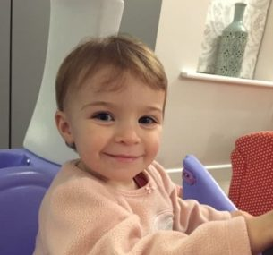
cancer sample
genetic testing
pipeline (bioinformaticians)
manual review (clinical scientists)
Alice
Patient with neuroblastoma
result
Task: make a new genetic test for cancer
https://www.childrenwithcancer.org.uk/stories/patient-story-alice-l/

Slide 3


Task: make a new genetic test for cancer

Slide 4
Assess (check it is good enough)
Document (show it is good enough)
Monitor (check it remains good enough)

Slide 5

joe-m-shaw/
pansolid_cnv_validation

Slide 6
I need to collate lots of data
Genetic results
Lab database
Other test results
Excel
SQL
HTML
dbplyr
odbc
readxl
rvest
ggplot2
dplyr

Slide 7
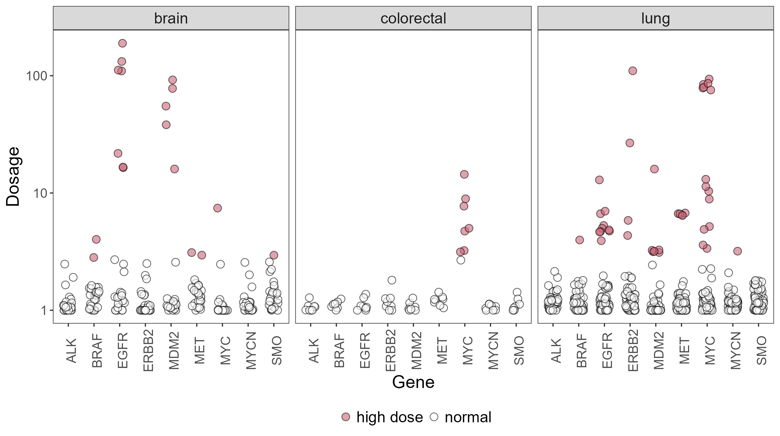
The new test detects gene changes across cancer types

Slide 8
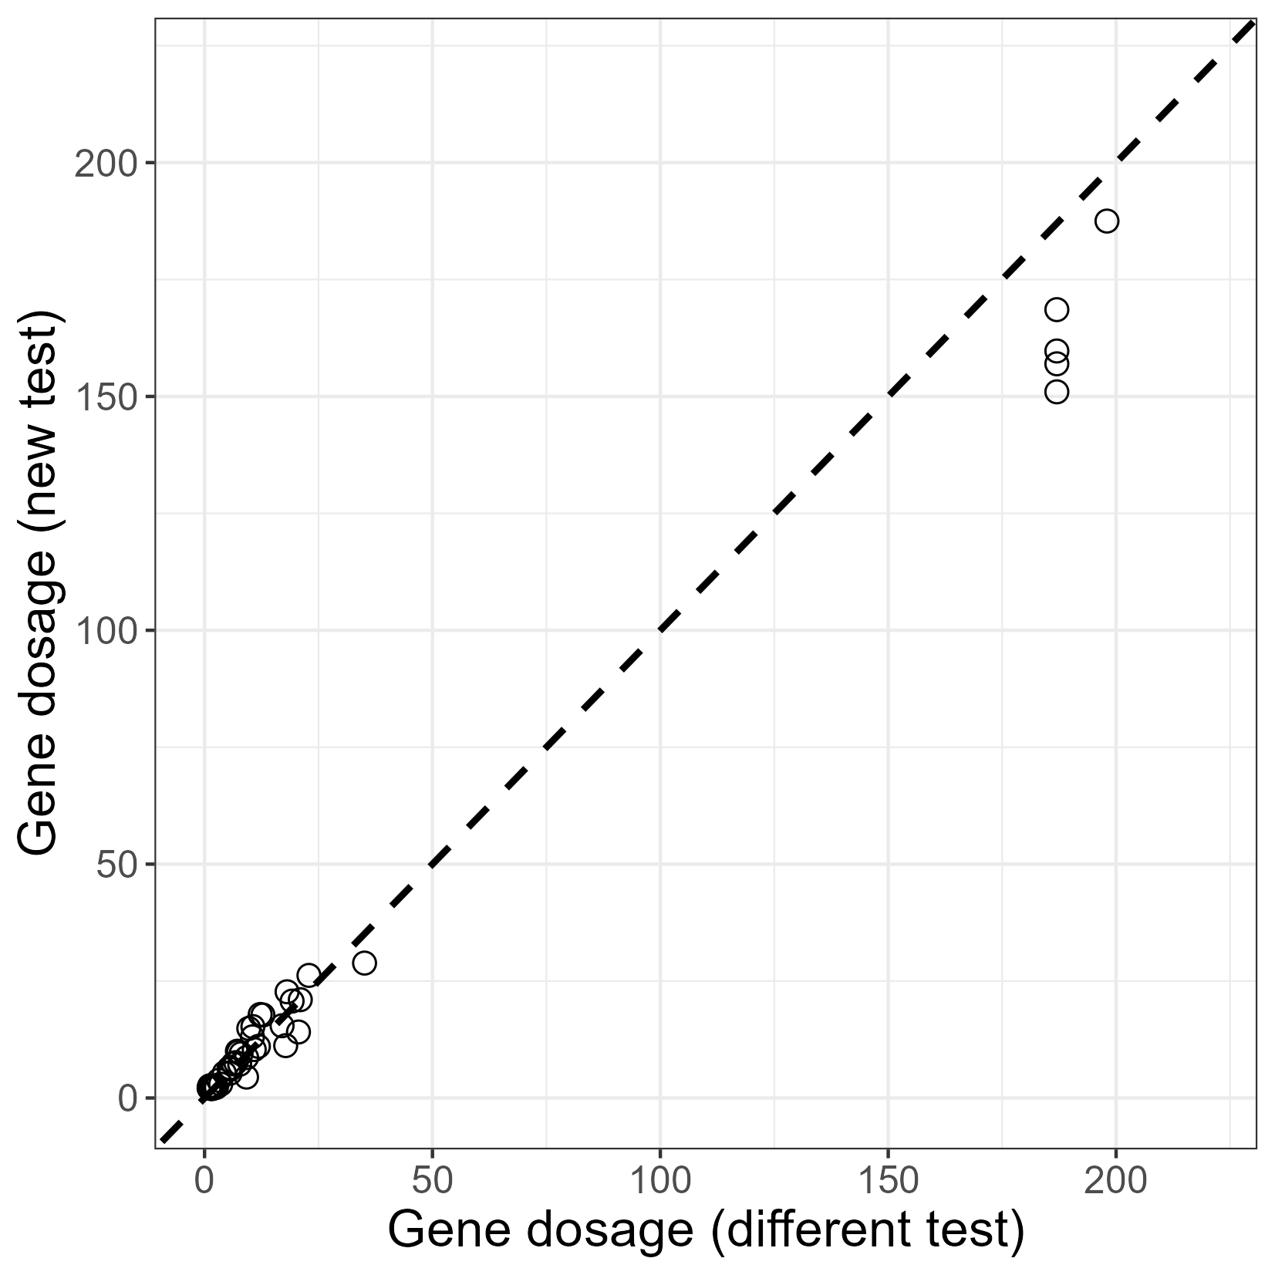
The new test has a good correlation with a different test

Slide 9


A clinical scientist should:
“- gather appropriate information
- analyse and critically evaluate the information collected”

Slide 10

Assess (check it is good enough)
Document (show it is good enough)
Monitor (check it remains good enough)

Slide 11
My lab has a
very specific document format

Slide 12
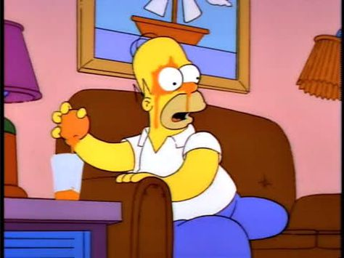
You mean there’s a better way?

Slide 13
Do you know Quarto?
Who’s Quarto?

Slide 14
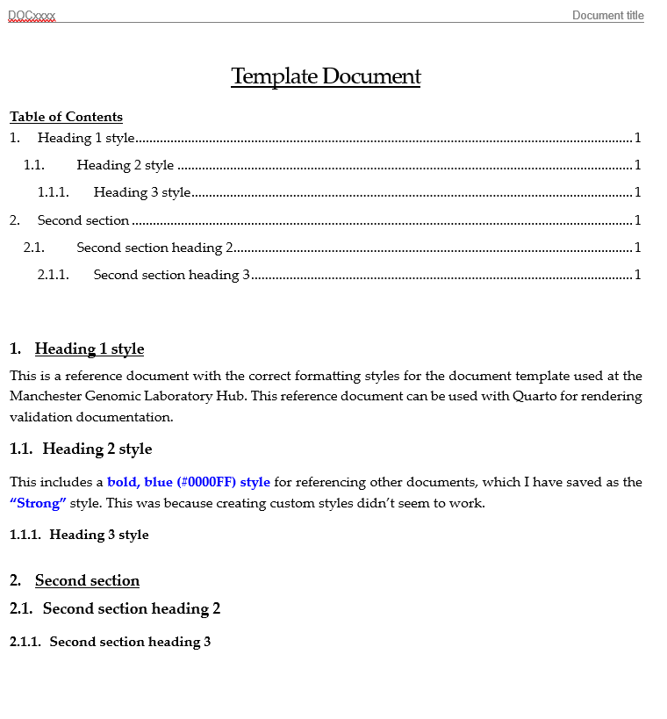
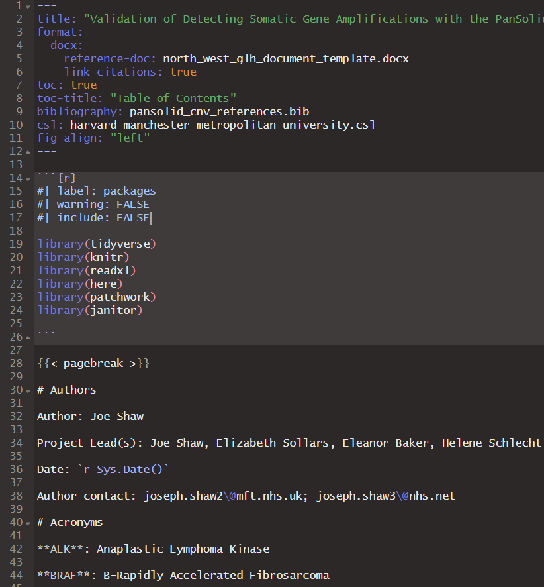
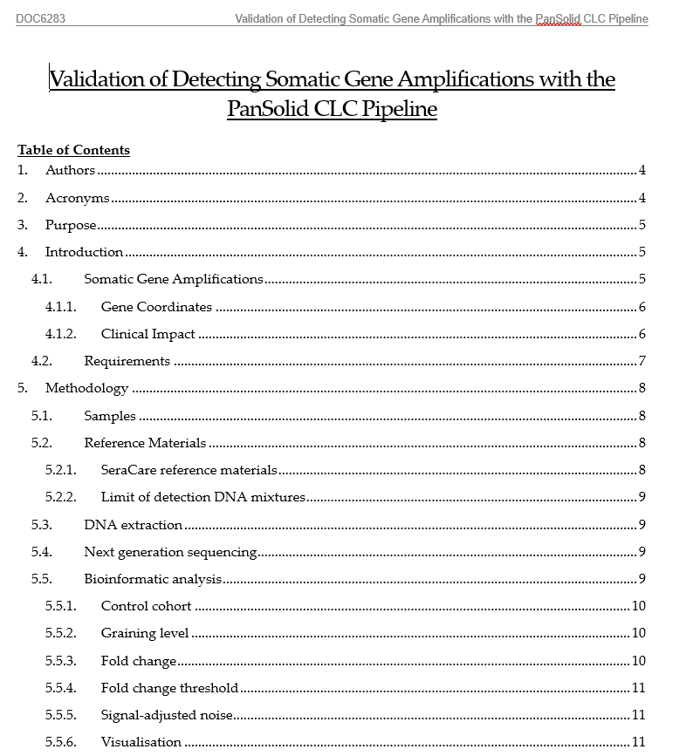
Template
(.docx)
Analysis
(.qmd)
Report
(.docx)
reference-doc:
template.docx
Meets requirements
Transparent

Slide 15

A clinical scientist should:
“Communicate the outcome of problem-solving and research and developmental activities”

Slide 16
Assess (check it is good enough)
Document (show it is good enough)
Monitor (check it remains good enough)

Slide 17
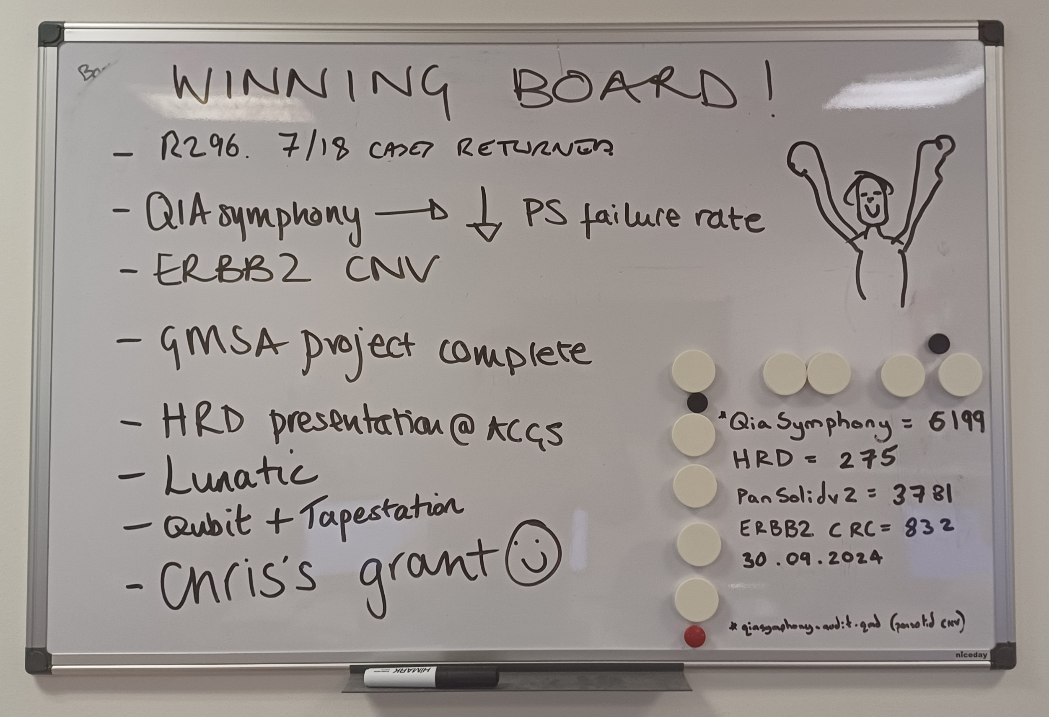
The “winning board”

Slide 18
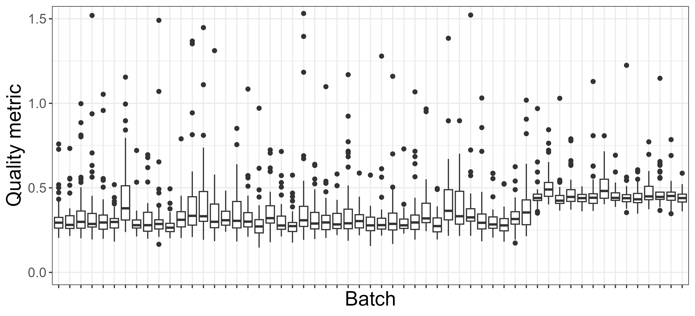
output$quality_plot <- renderPlot({ ggplot(data,
aes(x = batch, y = quality)) + geom_boxplot()})
Cause: a manufacturer error

Slide 19

A clinical scientist should:
“recognise the value of gathering and using data for quality assurance and improvement programmes”

Slide 20
Assess (check it is good enough)
Document (show it is good enough)
Monitor (check it remains good enough)

Slide 21
A clinical scientist should:
“identify the limits of their practice and when to seek advice”

Slide 22
Acknowledgements
Manchester Genetics
Elizabeth Sollars
Eleanor Baker
George Burghel
David Gokhale
Rebecca Hall
Cancer scientists and technicians
Thank you to the NHS-R community
Tom Smith
Luke Shaw

