Slide 1
Using Machine Learning and secondary care activity data for early diagnosis of cancer
Data Science and Strategic Analysis teams
NHS England
Notes:
Standard title slide

Slide 2
Situation and Complication
Situation
Late diagnosis of cancer is often associated with fewer treatment options, poorer outcomes for patients and increased mortality.
The NHS long term plan aims to increase the proportion of cancers diagnosed in early stages by 2028.
The disruption of services (e.g. screening) due to COVID-19 has made this goal even more challenging.
We are currently not able to identify all sub-populations at higher risk of a diagnosis for some cancer sites. These cancer sites often have non-specific symptoms and lower incidence, making interventions less viable.
Complication
New machine learning methods are available to identifying patients at risk and have been used in other countries (e.g. USA). NHS England has more recently strengthened its capabilities in data science and machine learning, and so can apply these methods to the NHS context.
More patient-level linked data is now available on patients’ previous interactions with the healthcare system, particularly in general practice.
Stakeholders
The NHSE Cancer Programme reporting to the National Clinical Director for Cancer is our key stakeholder. The Economic and Strategic Analysis (legacy NHS England – now Strategic Analysis) team proactively identified an opportunity in the area and liaised with the Cancer programme who at the time were seeking to commission this externally.
Project Team
Data Science: Divya Balasubramanian, Hadi Modarres, Scarlett Kynoch, Rupert Chaplin, Achut Manandhar (Advisory) Strategic Analysis: Tom Henstock, Dimitris Pipinis, Gursimran Thandi, Mary Amanuel, Rajun (SURNAME)
Notes:
Explain the situation – explain the collaboration of this work and the team working on this project.

Slide 3
Our objectives and areas of focus
What are the characteristics of cohorts of patients who are more likely to be diagnosed with cancer within months/years, with specific focus on patient’s previous interactions with the healthcare system and using novel machine learning techniques?
Priority cancers as given by stakeholders
Head and neck
Bladder
Lymphoma
Stomach
Pancreatic
Myeloma
Kidney
Ovarian
Oesophageal
Notes:
Highlighting the types of cancers and the overall objective.

Slide 4


Codebase Overview
National Data Platform
UDAL Platform
Palantir Foundry
Databricks & Azure DevOps
Correlation notebooks
Legend
Pseudonymised patient level data
Under-sampling experiments
Foundry dataset
Cancer target dataset
Merge and Write cancer dataset to data lake
notebook
Hyperparameter optimisation
Comorbidities dataset
Module
Geographic data
Baseline modelling notebooks
Run config
(which steps to run and parameters)
XG Boost high risk cohort pipeline notebook
Data validation
Outlier detection
Sampling
Train and test models
Optimise models
Risk prediction clustering
Notes:
Two codebases:
Data engineering workflow – sits in the National Data Platform – high level overview.
Analytical focused – sits in UDAL. – high level overview.

Slide 5
Data Engineering
Creating a Patient-level Dataset

Slide 6




Secondary Care Patient Level Dataset
Source datasets
Derived datasets
Modelling dataset
Data cleaning
Feature engineering
Creation of target variable
Merging of datasets and features
Master patient index
Demographic and socio-economic variables
Bridges to health segmentation dataset
SUS inpatient appointments
SUS outpatient appointments
Diagnoses (including cancer diagnosis)
Interactions with healthcare system
Modelling dataset
Emergency care dataset
Symptoms
Number of calls
111 calls
ONS mortality
Death and cause of death
Notes:
Bringing the datasets together. Give examples of Demographic and socio-economic variables etc. maybe worth mentioning how columns are one hot encoded for demographic variables. Explain how diagnoses were extracted out from SUS and ECDS using codes – ONS Mortality to help with exclusion i.e. those who passed away before the cut-off date as well as those who passed away for any other reason than cancer after the cut-off date.

Slide 7
Secondary Care Patient Level Dataset
Other Diseases of urinary system last 260 weeks
1
…
Blood in urine 111 calls last 104 weeks
1
…
Pain or Frequency of passing urine 111 calls last 52 weeks
1
…
Cancer Diagnosis in next 52 weeks
1
…
August 2021
Year 1
Year 2
Year 3
Year 4
Year 5
Year 6
Notes:
Giving an example of how these data features can paint a patient pathway across a period.

Slide 8
Data Analysis
Choosing and Training a Model

Slide 9
Model Pipeline Overview
Balance cancer and non-cancer cases
60% random split
Train (14.5M)
Under sampled training dataset
Train machine learning model
Model evaluation
Whole population dataset (24M)
Validation (4.8M)
20% random split
Hyperparameter optimisation
20% random split
Test (4.8M)
Model evaluated with un-seen test data
Notes:
Explain the whole population – exclusion criteria i.e. age 40 – 75. Then randomly split into Train, Validation, and Test.

Slide 10
Model Pipeline Overview
Balance cancer and non-cancer cases
60% random split
Train (14.5M)
Under sampled training dataset
Train machine learning model
Model evaluation
Whole population dataset (24M)
Validation (4.8M)
20% random split
Hyperparameter optimisation
20% random split
Test (4.8M)
Model evaluated with un-seen test data

Slide 11

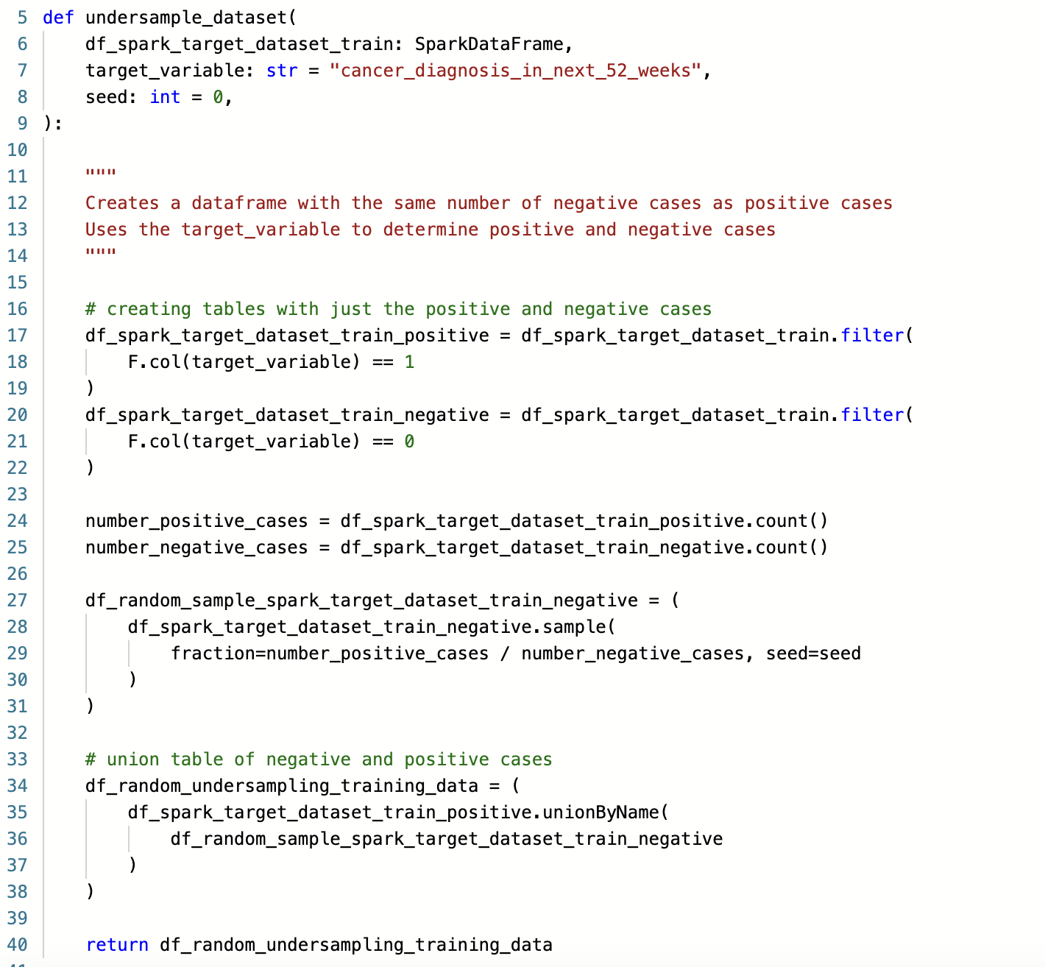

Under-sampling for a specific cancer type
Training Data (14.5M)
Individuals not diagnosed with bladder cancer
Random Sampling
Under-sampled Training Data
Notes:
14.5 million Training data – identify say 4,000 individuals suffer with Bladder cancer, we would then random sample 4,000 individuals from those that do not have bladder cancer to then create this under-sampled training dataset.

Slide 12
Model Pipeline Overview
Balance cancer and non-cancer cases
60% random split
Train (14.5M)
Under sampled training dataset
Train machine learning model
Model evaluation
Whole population dataset (24M)
Validation (4.8M)
20% random split
Hyperparameter optimisation
20% random split
Test (4.8M)
Model evaluated with un-seen test data

Slide 13

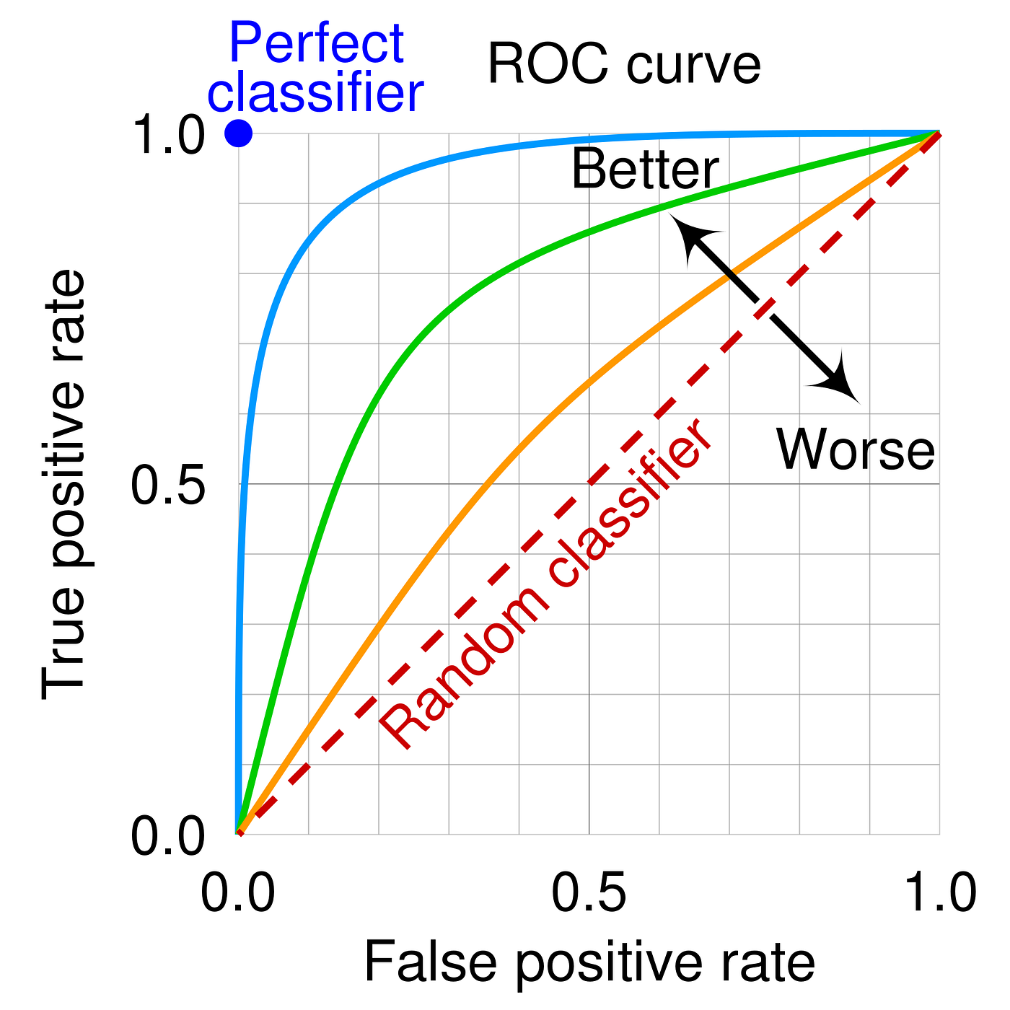

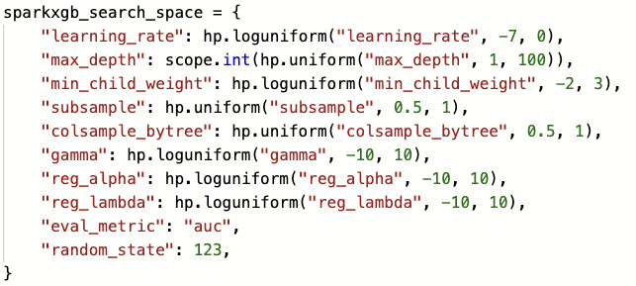
Hyper-optimisation
Under-sampled Train (~8,000)
AUC
Defined Hyperparameters
SparkXGBClassifier
Validation (4.8M)
Redefine Parameters for next iteration
https://hyperopt.github.io/hyperopt/
Notes:
Hyperoptimisation process – define a space of features you want to sample across (managed by hyperopt) – from these set of features a set of parameter values will be chosen –this is then used to train a model – in this pipeline we used a SparkXGBClassifier – XGBoost model – then we would apply the trained model onto our validation set and get out the area under the curve, this being the trade-off between the false positive and true positive rate. – how hyperopt works – and then on to define the next iteration of parameters – Mlflow is used to track each of these parameters – and the best parameter is the trained model that received the highest AUC.

Slide 14
Model Pipeline Overview
Balance cancer and non-cancer cases
60% random split
Train (14.5M)
Under sampled training dataset
Train machine learning model
Model evaluation
Whole population dataset (24M)
Validation (4.8M)
20% random split
Hyperparameter optimisation
20% random split
Test (4.8M)
Model evaluated with un-seen test data
Notes:
Model evaluation – best parameters from the hyperparameter tuning is used to train the model which is then tested on a set of data it has not seen before.

Slide 15








Model Evaluation
Cancer type | Training data size | AUC | Sensitivity (%) | Specificity (%)
Bladder | 7,194 | 82 | 77 | 73
Head and neck | 7,886 | 77 | 74 | 68
Lymphoma | 6,843 | 74 | 68 | 68
Pancreatic | 4,332 | 82 | 78 | 70
Stomach | 2,963 | 80 | 74 | 70
Myeloma | 3,044 | 78 | 72 | 69
Ovarian | 3,749 | 85 | 88 | 67
Kidney | 6,011 | 78 | 73 | 70
Oesophageal | 4,500 | 83 | 81 | 71
Area under the curve (AUC) – our models ranged between 0.74 – 0.85
Model performance is comparable to results reported in the literature (AUC 0.72 – 0.92) on using ML to predict cancer diagnosis
Notes:
Results for each set of cancer

Slide 16
Extracting out Insights

Slide 17
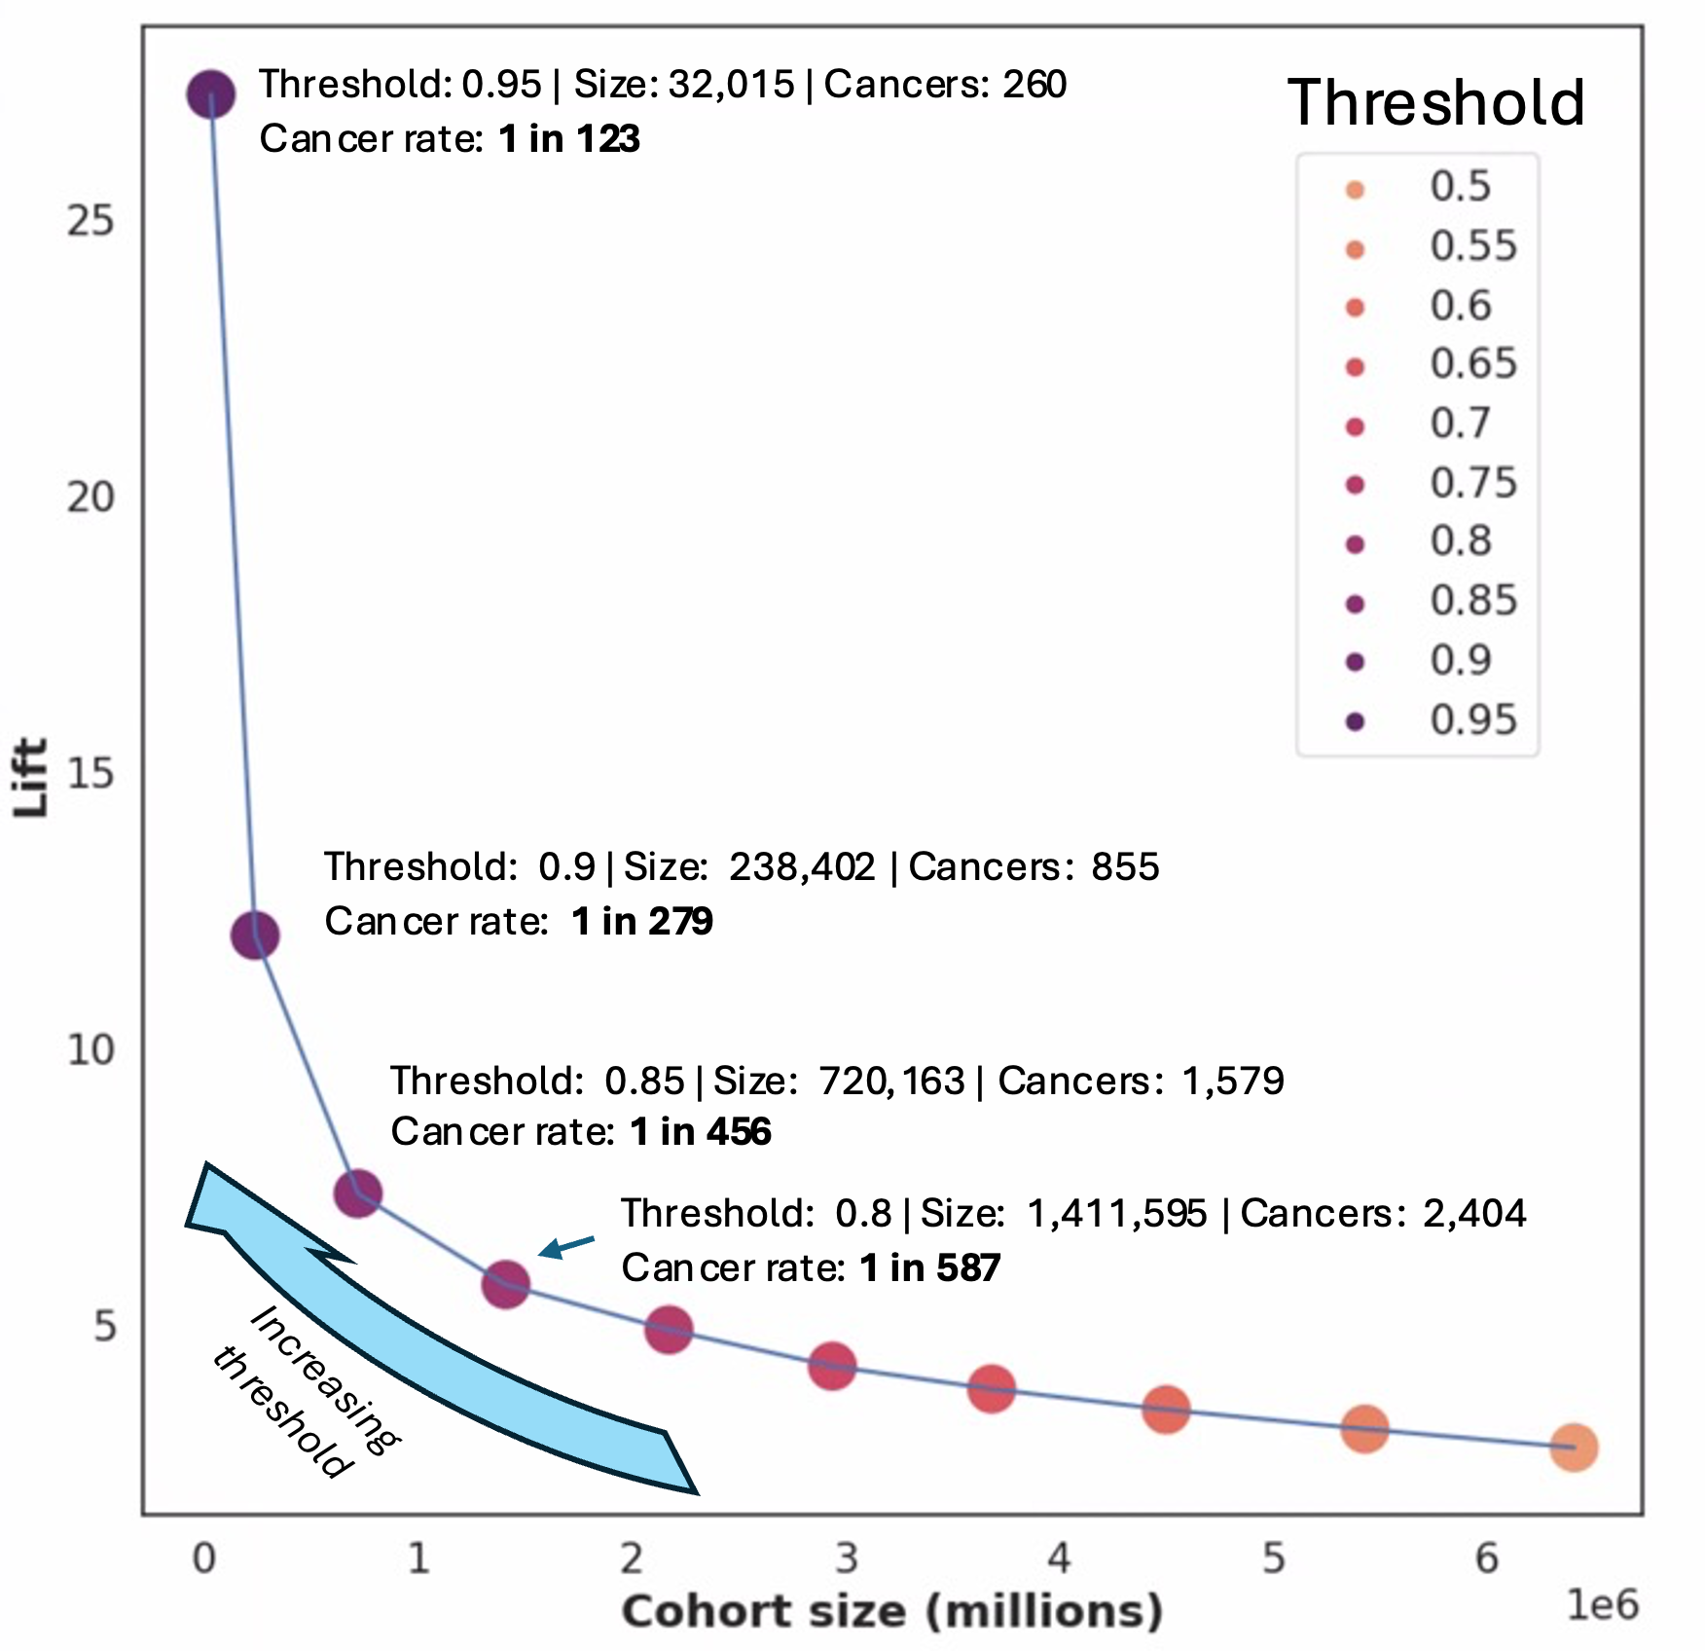
Lift Curve for High risks cohorts
Lift curve for Bladder cancer
We can extract out the risk score given to each patient from the trained model.
Feature_1
1
0
…
1
1
Feature_N
23
45
…
65
12
Risk Score
0.9
0.7
…
0.8
0.95
…
If we increase the risk threshold this produces a smaller cohort with a higher cancer incidence.
Cancer rate in the general population is 1 in 4,060. By increasing the threshold to 0.95, this produces an incidence of 1 in 123, which is ~33 times higher.
Lift: ratio of incidence in cohort to general population

Slide 18
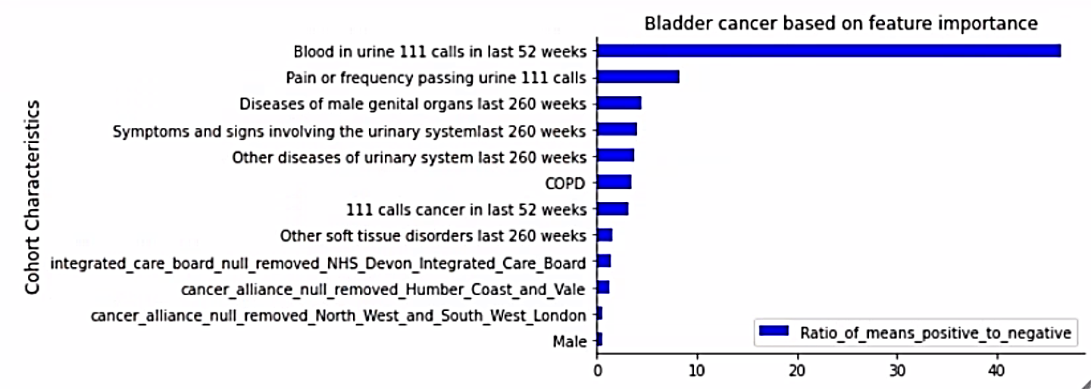
Feature Importance Extracted out of high-risk Cohort
A number of these characteristics are relevant to Bladder cancer as verified with NICE guidelines as well as clinicians.
Notes:
Gain is the relative contribution of the feature to the model outcome compared to other features in the model
The chart shows the top characteristics of the high-risk cohorts obtained from the model for Bladder cancer by using the model’s feature importance method.

Slide 19





Example case finding using informative features to identify higher risk groups
Whole population
24 cases per 100,000
Devon ICB
35 cases per 100,000
1.5x higher incidence
Male
49 cases per 100,000
2x higher incidence
111 call with cancer symptom
172 cases per 100,000
7x higher incidence
Previous diagnosis of diseases of urinary system
420 cases per 100,000
18x higher incidence
Higher risk region
Higher risk demographic
Risk symptom
Comorbidity
* In each step, all previous filters are included and added upon

Slide 20
Bias Analysis and Equality of Opportunity

Slide 21
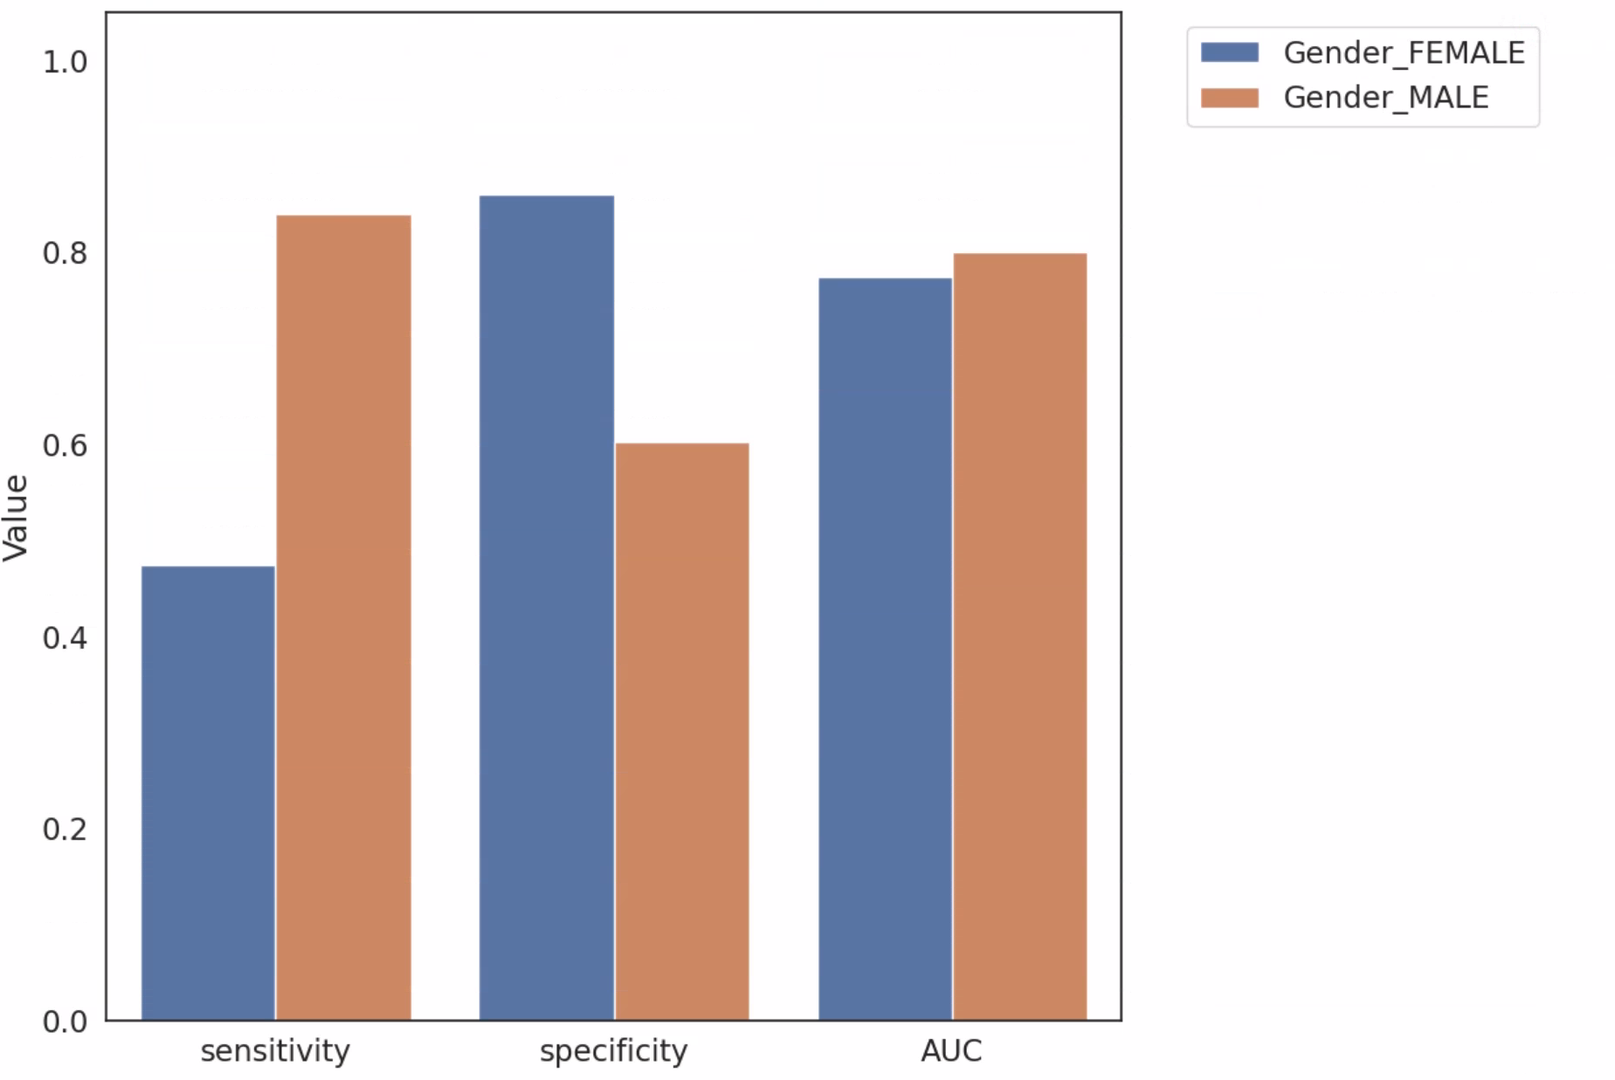
Inspecting the Model for Bias
We investigated how the model’s sensitivity, specificity, and AUC changed for different demographics.
Gender
Age (40-50, 50-60, 60-75)
Deprivation (IMD Decile level)
Ethnicity
Notes:
Sensitivity is the number of individuals that were correctly identified to have been diagnosed with cancer. Meaning females were nearly twice as likely to have a cancer diagnosed missed from the model. On the other hand, women were less likely to be misdiagnosed as having a high risk for developing cancer, meaning men were more likely to be falsely diagnosed as having cancer. This is likely due to cancer being 2/3rd more likely to occur in Men than women for bladder cancere.

Slide 22
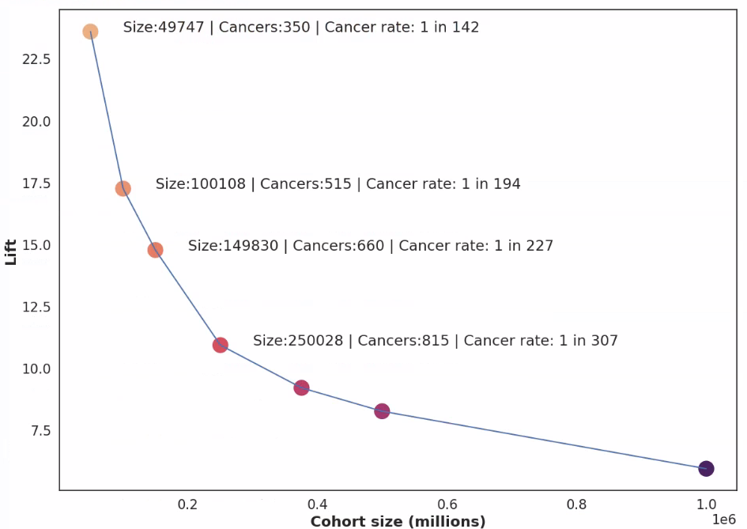
Equality of Opportunity Lift Curve
We create a categorical variable of gender, age, and ethnicity and then take the highest risk cohort for each category proportional to their representation in the cancer population.
Equality of Opportunity Lift curve for Bladder cancer
Demographic
Female, 60+, White
Male, 60+, Black or Black British
…
Female, <60, Asian or Asian British
Feature_N
23
45
…
65
Risk Score
0.9
0.7
…
0.8
…
This allows us to define top features for each group:
Female, 60+, White:
At least one 111 call reporting pain/frequency passing urine in the last year.
At least one call reporting blood in urine in last year.
Lift: ratio of incidence in cohort to general population

