Slide 1
Assignment No. 10
While Loops
30.08.2023
Md. Nurul Hoque
nhsakil1@gmail.com

Slide 2
Objective
Write a program that prompts the user to guess a secret number between 1 and 100. The program should provide feedback if the guessed number is too high or too low, and it should terminate when the number is guessed

Slide 3
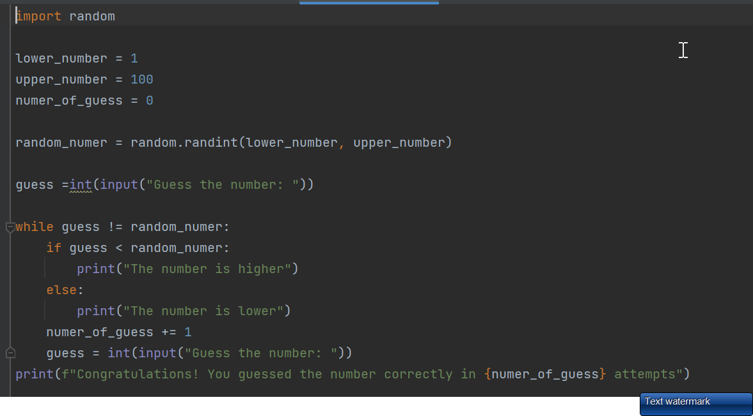
Code
Snapshot of your code

Slide 4
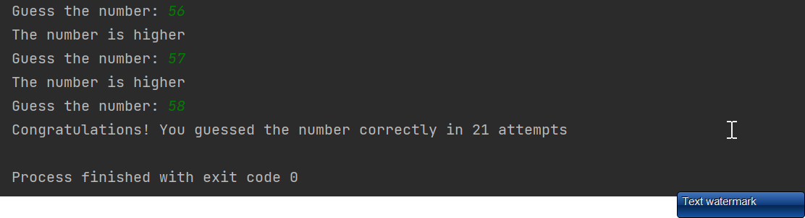
Output
Snapshot of your output

