Slide 1
Assignment No. 21
Inheritance
13.09.2023
Md. Nurul Hoque
nhsakil1@gmail.com

Slide 2
Objective
Write a program that uses Matplotlib library to plot a line graph showing the population growth of a country over a period of 10 years. Use appropriate labels, titles and axis ranges

Slide 3
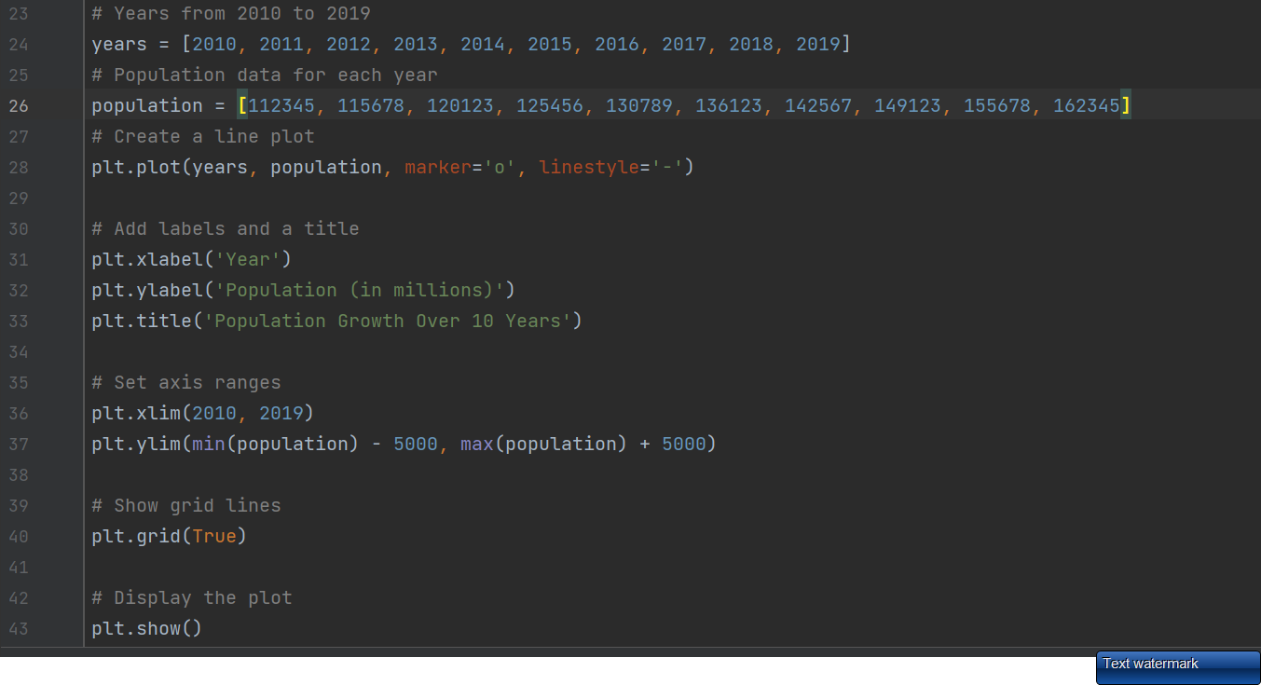
Code
Snapshot of your code

Slide 4
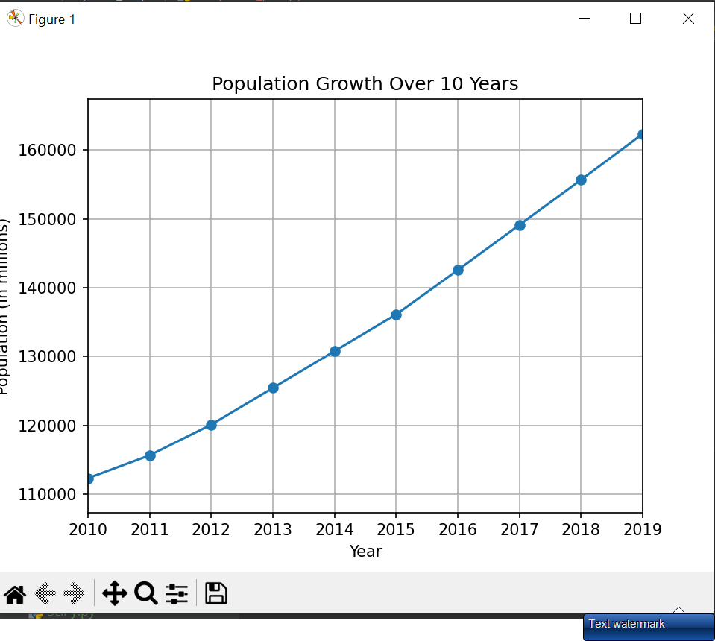
Output
Snapshot of your output

