Slide 1
Assignment No. 21
Inheritance
13.09.2023
Md. Nurul Hoque
nhsakil1@gmail.com

Slide 2
Objective
Write a module that contains a function to generate a random number between a given range. Import the module into another Python script and use the function to generate and print random numbers

Slide 3
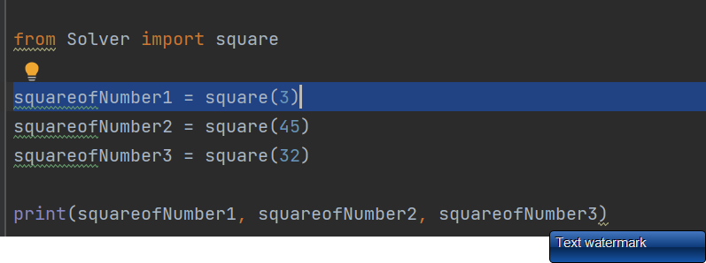
Code
Snapshot of your code

Slide 4
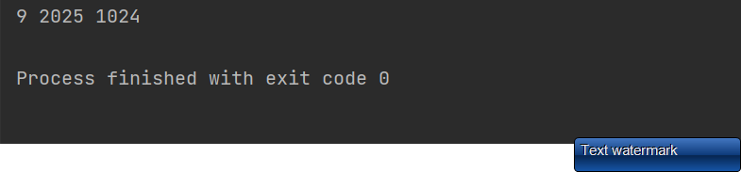
Output
Snapshot of your output

