Slide 1
Session Timeout Waring
How to install the NHSBSA Session Timeout Warning component into your prototype
UX Code Club

Slide 2
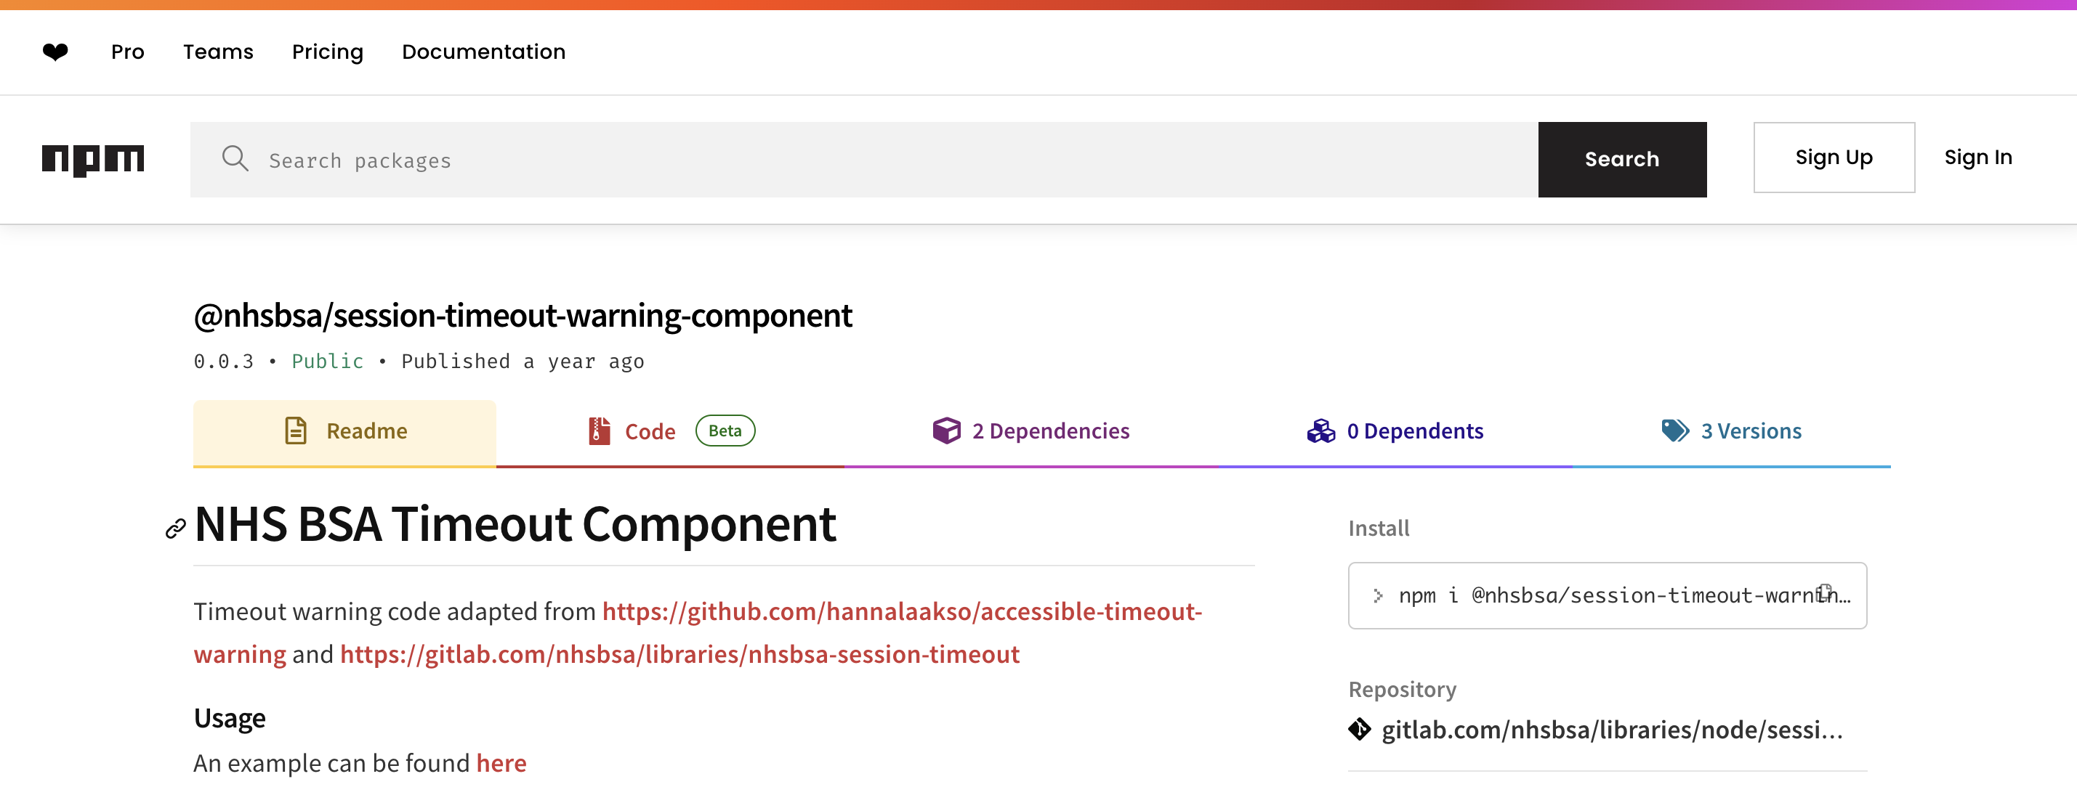
Installation
Find the NHSBSA Timeout Component on the npm website: https://www.npmjs.com/package/@nhsbsa/session-timeout-warning-component
Open your project in VS and open the terminal
Install the component using the npm installation command in the terminal:
npm i @nhsbsa/session-timeout-warning-component

Slide 3
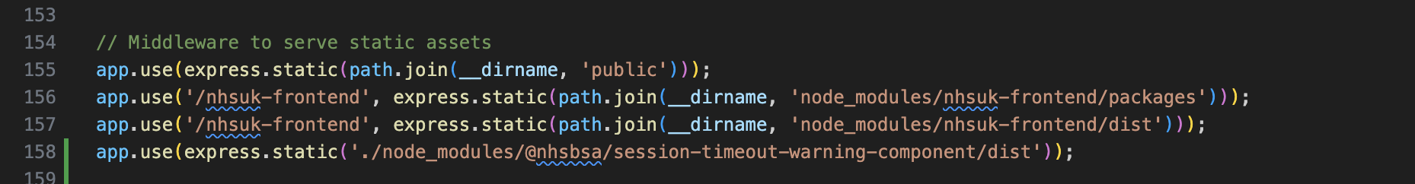
Component Setup – Step 1
Setting up the js
Look in the root of your prototype folder for app.js
Find the section with the comment title: // Middleware to serve static assets and add the code as per the screenshot below
app.use(express.static('./node_modules/@nhsbsa/session-timeout-warning-component/dist’))
This links the dist folder to your public folder so you can access the js file required for the component.

Slide 4
Component Setup – Step 2
Setting up the js
Add
<script src="/timeout.js" defer></script>
to the template.html file located in your docs/views folder this can be
added below the other js call which is already in there for
<script src="/nhsuk-frontend/nhsuk.min.js" defer></script>

Slide 5
Component Setup – Step 3
Setting up the styling
Look for the node_modules folder in the root and locate the new component:
@nhsbsa
> session-timeout-warning-component
> component
> session-timeout-warning
> _timeout.scss
copy this file into your project
app > assets > scss > components
Once you have the file in here you can import it into your main.scss file using
@import 'components/_timeout';

Slide 6
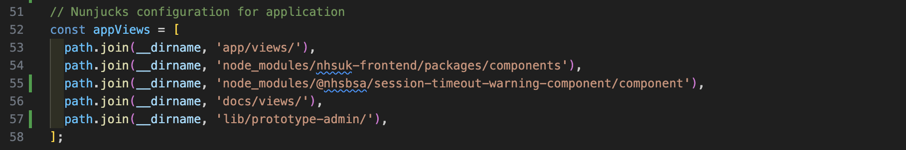
Component Setup – Step 4
Setting up the nunjuck
Look in the root of your prototype folder for app.js
Find the section with the comment title: // Nunjucks configuration for application and add the code as per the screenshot below
path.join(__dirname, 'node_modules/@nhsbsa/session-timeout-warning-component/component'),

Slide 7
Component Setup – Step 5
Including the session timeout using HTML
Insert the following HTML into either your template.html or your layout.html file depending how your project is setup
<dialog id="js-modal-dialog" data-url-redirect="session-timeout.html" data-session-timeout="60" data-session-timeout-warning="45" data-session-timeout-timer-text="You will be signed out in " data-session-timeout-timer-extra-text="This is to ensure you data is safe" class="modal-dialog dialog" role="dialog" aria-live="polite" aria-labelledby="dialog-title" aria-describedby="at-timer">
<div class="modal-dialog__inner">
<h1 id="dialog-title" class="heading-large"> Session Timeout </h1>
<div class="modal-dialog__inner__text">
<div id="timer" class="timer" aria-hidden="true" aria-relevant="additions"></div>
<div id="at-timer" class="at-timer nhsuk-u-visually-hidden" role="status"></div>
</div>
<div class="modal-dialog__inner__block">
<button class="nhsuk-button js-dialog-close">Continue Application</button>
</div>
</div>
</dialog>

Slide 8
Component Setup – Step 6
Including the session timeout using nunjucks
To use nunjucks you need to add the following line to the list of macros on in your template.html file
{%- from 'session-timeout-warning/macro.njk' import sessionTimeoutWarning %}
Insert the following code into either your template.html or your layout.html file depending how your project is setup
{{ sessionTimeoutWarning({
redirectOnSessionTimeout: true,
sessionTimeout: 30,
sessionTimeoutWarning: 15 - 5,
heading: "Your application will time out soon",
timerText: "We will sign you out in",
extraText: "This is to protect your data",
buttonText: "Continue Application",
urlRedirect: "/session-timeout.html"
}) }}

Slide 9
Alternate Layout – Step 7
Creating a second layout which doesn’t use the time out feature
A second layout is required for pages which do not use the session time out, for example you wouldn’t require the time out on the final confirmation page or the timed-out landing page.
{% extends 'layout-notimeout.html' %}
This page would be the same as layout.html without the nunjuck/html for the timeout dialog box.

Slide 10
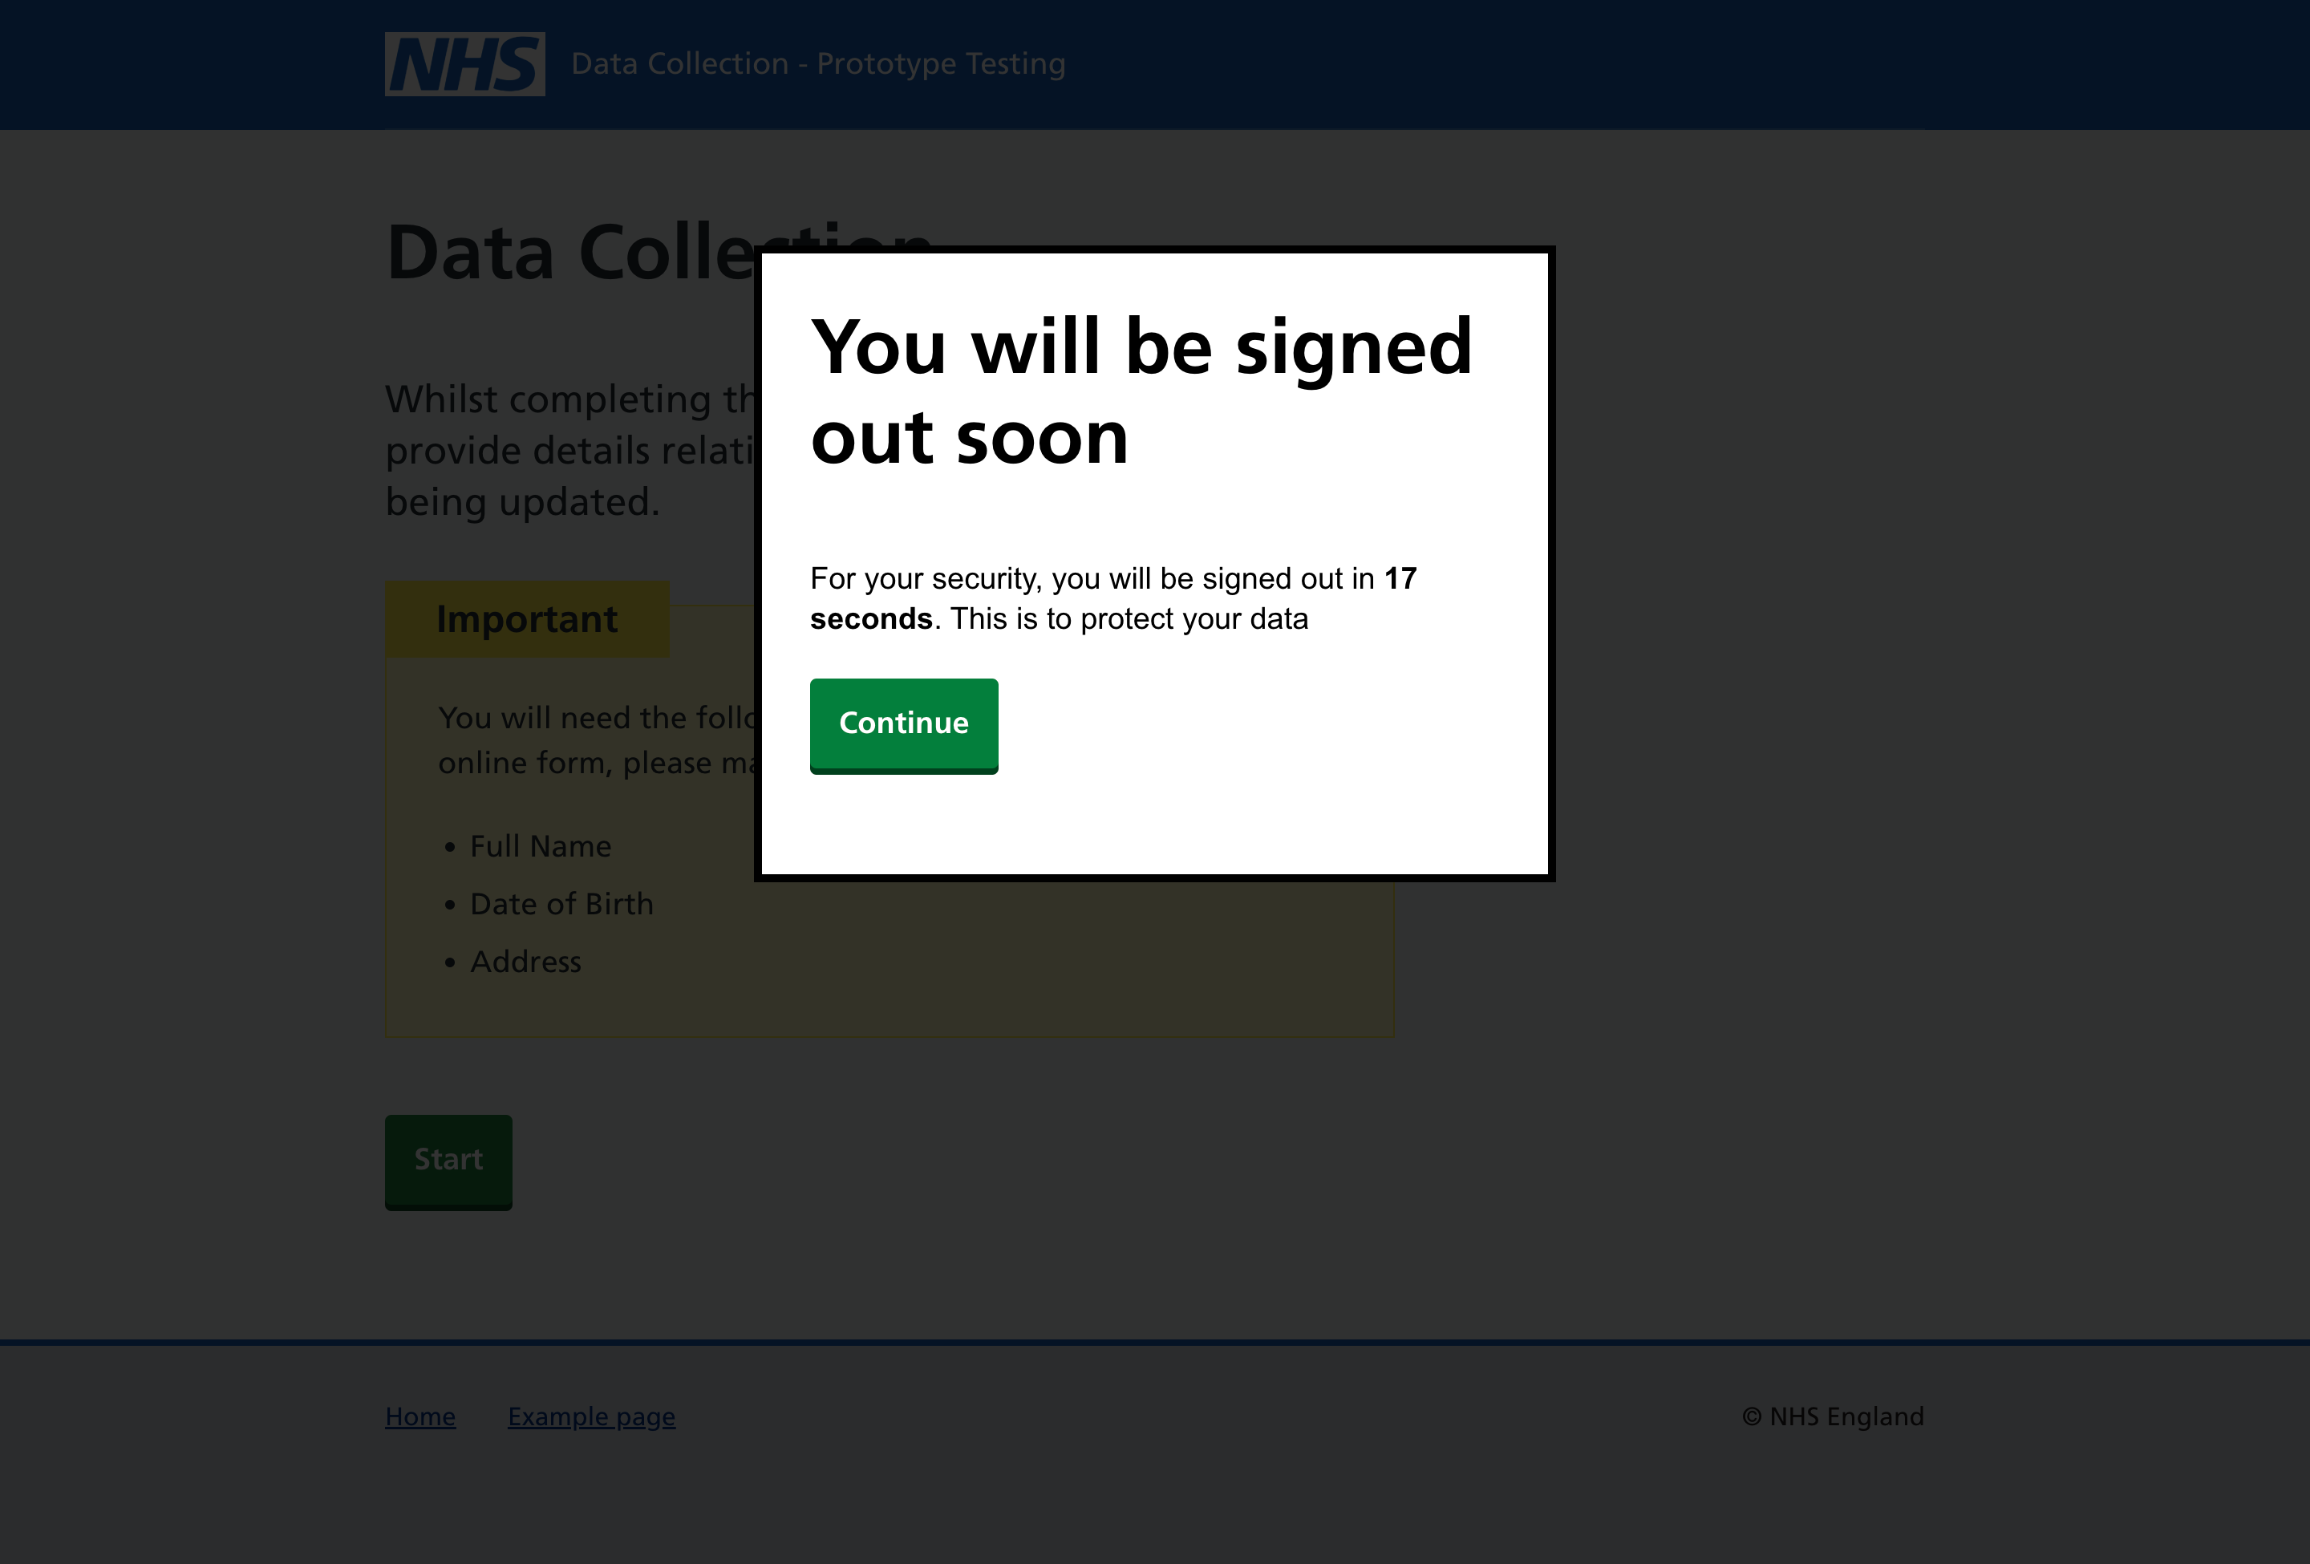
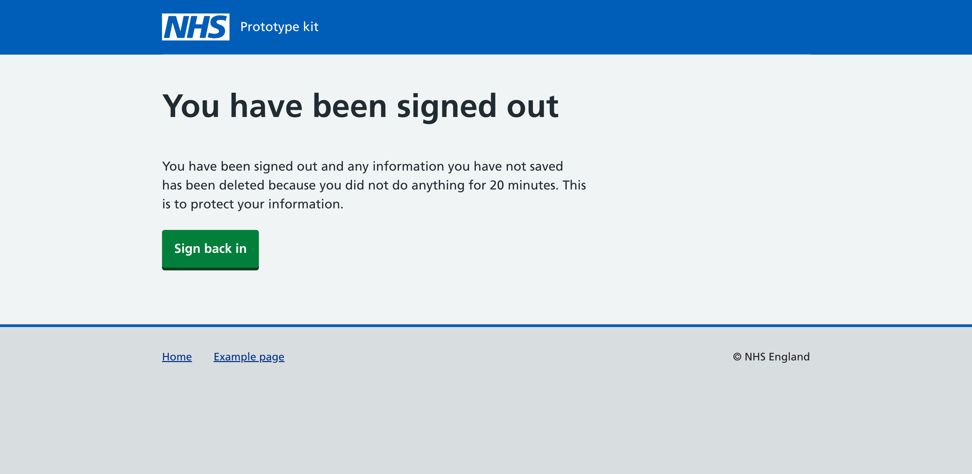
Conclusion
What will your timeout look like
Your timeout will look something like these example screenshots, you can change the text and the timer for the count down as required within the html or the nunjuck code.

Slide 11
Thanks for joining Code Club Any questions?
If you require further assistance drop me a message:
katie.twinn@nhsbsa.nhs.uk

