Slide 1
GP Connect - Structured Access Record
PCS Supplier WebEx, Tuesday 11th April 2017

Slide 2
WebEx Agenda
Item | Presenter
Welcome | Hazel Chappell
Introductions, purpose and agenda | Richard Challinor
Outline our use case development approach and priority use case | Nazia Kotia
Provide an overview of information models and FHIR Profiles | Pete Salisbury
Walk through API specifications / capability pack | Richard Pugmire
Discuss a overarching timeline and approach for delivery. | Richard Challinor / Hazel Chappell
Questions? | All
Next engagement event Close WebEx | Richard Challinor

Slide 3
GP Connect Use Cases
Progress to date
presented by Nazia Kotia

Slide 4
What has been done so far
Stakeholder Engagement
GPSoC bulletin
CCIO engagement with NHSE
INTEROPen community
CareConnect
Worked with Stakeholders to understand and identify their priority use cases
Draft use cases collated for the first 4 areas:
Medications
Allergies
Immunisations
Conditions

Slide 5
What are we currently working on
Collate the use cases from a variety of Stakeholders and develop these further
Further refinement of the use cases that we have to date
Internal validation from NHS Digital Clinicians & other internal stakeholders
Mapping the data items requested in the use cases against the information models

Slide 6
What work is coming up
Developing further Use Cases primarily focusing on Medications
Working collaboratively with Stakeholders on the Use Cases
To ensure that the outcomes that they are looking for are achieved
To solve any issues that arise through development
Collaborate with NHSE to confirm the scope and next priority areas
Clinical Scenarios | Drivers/Benefits | Why Structured and real-time | Elements on GP record needed
1. Visual Comparison of Medications | Drivers: Medication errors are the third most prevalent source of reported patient safety incidents in England Prescribing errors are the most important cause of medication errors Benefits: Reduction of safety issues on manual transcription Medication errors reduced as have up to date medication list Time taken to have to compare across tabs/systems | Cannot create a consolidated list from sets of information that are in different read-only views. Have up to date medication information | Medications

Slide 8
GP Clinical System provides the defined medication list to GP Connect.
This medication information will be the same as that provided in the SCR / SCR AI and will be subject to the same exclusion criteria:
Acute Medications (for the last 12 months)
Date Prescribed
Medication Item
Dosage Instructions (including days of administration where applicable)
Quantity
Reason for Medication
Current Repeat Medications
Date Last Issued
Medication Item
Dosage Instructions (including days of administration where applicable)
Quantity
Reason for Medication
Discontinued Repeat Medications (issued within the previous 6 months)
Date Last Issued
Medication Item
Dosage Instructions (including days of administration where applicable)
Quantity
Reason for Medication
Date Discontinued

Slide 9
Information Model mapping
Acute Medications for the last 12 months:
Data Item requested | RCP Mapping | Profile Mapping | Data Item Mapping | Description | M/R/O | Notes
Last Issued Date |  | MedicationStatement | lastIssueDate | The precribed date recorded on the prescription by the presciber. In most casese this is the date the prescription was issued but the prescriber can choose to set a different date. | Mandatory
Medication Item | Medication Name, Medication Form | MedicationStatement | medication/code/coding/code | The DM&D codes of the medication prescribed. Where no DM&D codes can be suppied (for example an historic medication without a DM&D mapping) a degraded DM&D code will be supplied. | Mandatory
 | Medication Name, Medication Form | MedicationStatement | medication/code/coding/display | A text description of the medication prescribed. Supplied to ensure a description of the medication is available when a DM&D code cannot be supplied. | Mandatory
Dosage Instructions | Dose | MedicationStatement | Dosage - text | A text description of the medication dosage. | Mandatory | GP Clinical Systems do not record dosage information as structured data. Therefore it is only possible to supply the data as a text string.
*Timing – the day of the week where applicable | Medication frequency | MedicationOrder | note | The patient instructions written by the prescribed and printed on the dispensed medication. For repeat description use the information from the latest issused prescriptions | Mandatory | GP Clinical System do not record timing information as structured data. Therefore it is only possible to supply the patient instructions as a text string.
Quantity |  | MedicationStatement | quantityDispensed | Total Quantity of medication prescribed | Required | Despite the data item name this is the prescribed quantity not the dispensed quantity.

Slide 10
GP Connect FHIR Profiles
Progress and Planning
presented by Pete Salisbury

Slide 11
What has been done so far
Worked with Data Standards, Clinicians and existing programmes (GP2GP, SCR, EPS, etc) to develop first draft of profiles
Also linked into Care Connect/Inter-open to co-ordinate and make sure we are consistent.
First drafts published on data.developer.nhs.uk for the first 4 areas
Medications
Allergies
Immunisations
Conditions
Received Feedback on individual calls with each of the GP Systems Suppliers on the published profiles
Notes:
Did some work to create a spreadsheet version of the profiles to make it simpler to understand and mapped to GP2GP fields where appropriate.
Completed last of the supplier calls last week. Feedback was generally good most suppliers happy. However we did get a reasonable amount of feedback,
obv we are very grateful for suppliers participation in the calls and for the collaborative approach everyone involved had taken. Appreciate your insight and expertise and it will improve the quality of the models before we hand over for development.

Slide 12
What are we currently working on
Collate the feedback from suppliers
Also internal feedback from Data Standards, TAs, Clinicians
Work with the terminology team to firm up value-sets
Compare to FHIR STU3 and assess impacts
Prepare some recommended changes and discussion points for Day Workshop on the 25 April
Agree changes with all stakeholders and publish new versions on data.developer.nhs.uk
Complete review and finalise Clinical Assurance Approach aligning to the wider Solution Assurance Approach
Notes:
As we collate the feedback we are doing so in conjunction with the wider team.
Also continue to seek feedback internally from other teams SCR, EPS
I believe we nearly have some resource in place from the terminology team...

Slide 13
What work is coming up
Developing further FHIR Resources
Work done on Observation, Procedure already
We’re working with NHSE to confirm the scope and next priority areas
Working collaboratively with suppliers on the Medication profiles
To support suppliers in populating the models
To solve any issues that arise through development
To support the clinical assurance process
Document how suppliers will populate the models starting with Medications
Notes:
Support - Write guidance notes around the models to further assist in population use.
Look at populating some worked examples of
Write a paper on degrading data and how it will work in GP Connect.

Slide 14
GP Connect FHIR Profiles
API Overview (S2/S3)
Rich Pugmire

Slide 15
The Secret Formula…
(FHIR Structures + Unified ValueSets) + (API definitions + API usage guidance)
= Semantic Interoperability Holy Grail
Where to put fields & data (Syntax)
What data? Coding? (Apple is an Apple)
How do you get at it? (search, list, sort, authorise, control)
Anything else to know? (Caveats, restrictions, filters, gotchas)

Slide 16
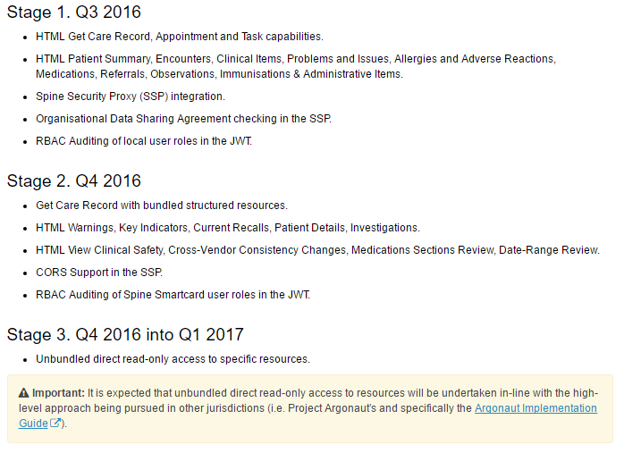
API Stages – The Maturity Model
Stage 2
Get Care Record with bundled structured resources.
Stage 3
Unbundled direct read-only access to specific resources.

Slide 17
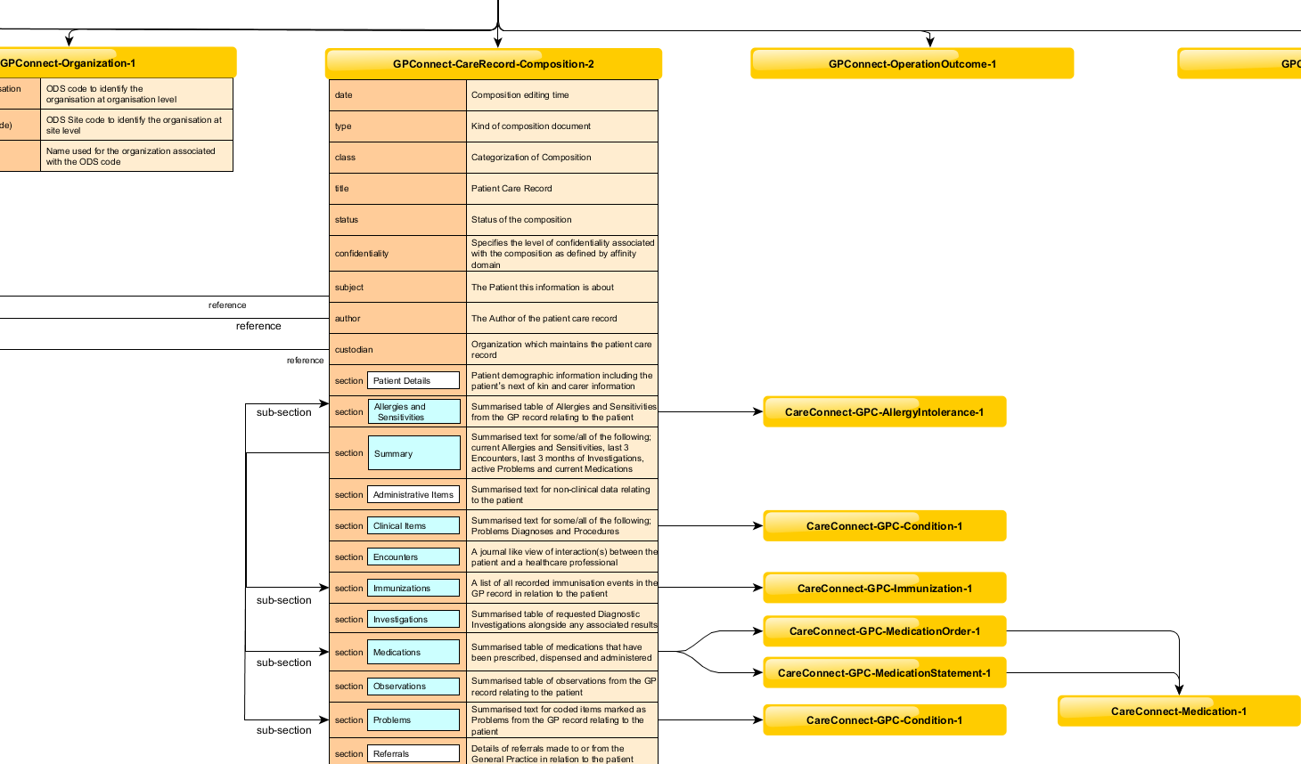
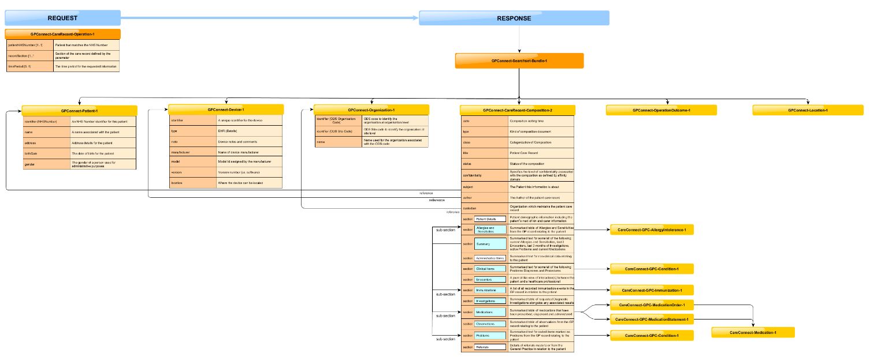
API Stage 2 – The Maturity Model
Stage 2 - Get Care Record with bundled structured resources.

Slide 18
API Stage 3 – The Maturity Model
Stage 3
Unbundled direct read-only access to specific resources:
GET https://[proxy_server]/https://[provider_server]/[fhir_base]/MedicationStatement?patient=[id]{&other search parameters}

Slide 19
Stage 2 API - Medications
Same as stage 1, ideally a non-breaking increment to $getcarerecord operation to include structured resources that go along with the data of the section.
For medications this is relevant to:
‘MED’ – Medications section
‘SUM’ – Summary section?
We’d also like to take this opportunity to include new Patient, Organisation, Practitioner and Location resources from CareConnect which have addressed some compatibility issues.

Slide 20
Stage 2 API – Medications Walk Through
XLS > Demonstrator > JSON output

Slide 21
Stage 3 API - Medications
Example:
https://nhsconnect.github.io/gpconnect/accessrecord_rest.html
GET https://[proxy_server]/https://[provider_server]/[fhir_base]/MedicationStatement?patient=[id]{&other search parameters}
GET /[fhir_base]/MedicationStatement?patient=3f4524f8-4996-4bb3-b02c-b82dcc282ce8&EffectiveDate=gt2016-04-11

Slide 22
Stage 3 API – Walk through
XLS > Demonstrator > JSON output

Slide 23
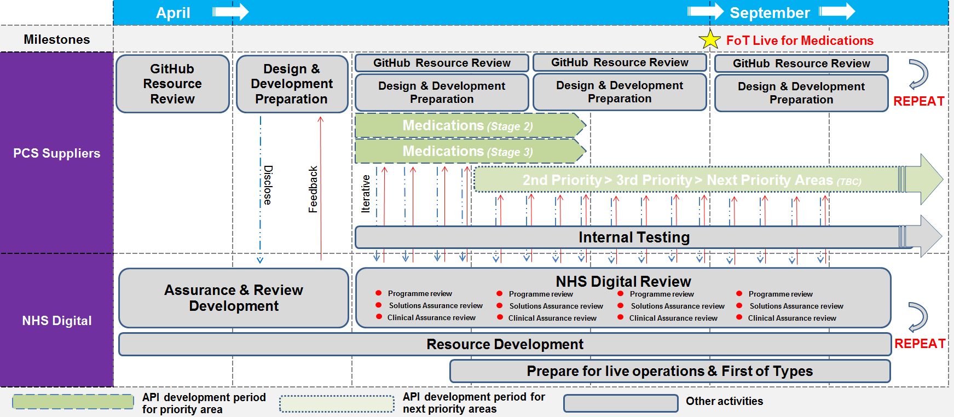
Delivery timeline and approach

Slide 24
Next engagement event
Tuesday 25th April 2017
The Met Hotel, Leeds (central)
Arrive 9.30am. Finish 4.30pm
Update on resource development, review approach to delivery, explore issues
- Has an understanding of how FHIR Profiles are populated
- Is a decision-maker for development of capabilities
- Has an understanding of APIs
- (optional) Is a clinician or has clinical experience

