Slide 1
Digitised Steps proficiencies
Introductory presentation
October 2023

Slide 2
Purpose of this document
This document has been created to provide an initial introduction and overview of our programme to digitise the Steps proficiencies
It can be read, presented or shared to raised awareness and improve knowledge
Within the PowerPoint notes we have included some further information to describe what each slide is showing
If you can’t see these notes (grey box below the slide) click ‘View’ in the top ribbon, and ‘Notes’ (listed under ‘Show’)

Slide 3






Who are we?
Content owner
Critical Care Networks National Nurse Leads ​(CC3N) - Steps proficiencies
Platform owner
NHS England Technology Enhanced Learning (NHS England TEL)
Implementation support
NHS Elect
Notes:
There are three organisations collaborating on this programme:
CC3N who own the Steps proficiencies content
NHS England who own the platform that the digital version is hosted on
NHS Elect who will support with implementation and delivery.

Slide 4



What have we digitised?
CC3N Steps proficiencies (Steps 1, 2 & 3)
Link to Step 1
Link to Step 2
Link to Step 3
700 proficiencies
For all qualified new CC nurses
Completed over 6–12 months
Used nationally
~140 (Step 2) & 120 (Step 3) proficiencies
For Registered Nurses on route to working in a Level 3 Critical Care area
Completed as part of Critical Care Course over 6–9 months
Used by majority of CC units in England (Wales & Scotland are starting to adopt)
Notes:
As you may know, the competency framework is divided into 3 steps, Steps 1, 2 & 3.
The Steps proficiencies documents were originally developed in paper format (PDF)
We have digitised the Steps 1, 2 & 3 proficiencies, which are for registered nurses working in critical care

Slide 5



Why are we digitising the Steps proficiencies?
There is the need and opportunity to:
Grow and transform our workforce using emerging technology
Improve the digital literacy of our staff
Use digital technology to improve patient care and release more time for care
Notes:
The Blended Learning report was the catalyst for this programme, supported by other key reports – it highlights the need and benefits of incorporating technology to allow more flexible learning for nurses and ultimately improved care for our patients.
And we felt it was important that this blended learning approach and experience doesn’t just stop once nurses are registered but continues as they advance and specialise through their careers.

Slide 6






Opportunities of digitisation
Quality assurance
Improved standardisation & control of use
Patient safety
Ability to update content more easily
Workforce planning
National visibility of staffs’ skills data
‘Digital first’ workforce
Opportunity to improve digital literacy
Staff mobility
More efficient transfer of staffs’ skills data
Resource requirements
Reduced wastage of staff time & paper
Visibility across competency frameworks
Opportunity to more easily see skills required for different roles, across care settings and professions
Notes:
Digitisation of the Steps proficiencies brings with it a lot of opportunities when compared to paper version:
Better standardisation of how proficiencies are signed off and who signs them off, to reduce variation in training and improve quality assurance
The ability to react quicker and edit proficiencies as needed, where there are changes in evidence, policy or population need like covid, for patient safety
Access to real-time to data on critical care nurses’ skills and location, for those working at a unit, hospital, Trust, Regional or even National level
Training and support for staff on how to use the digital platform, to help improve their overall digital literacy
Enabling staff to move more easily by making their skills data move with them, so there isn’t unnecessary time spent retraining and they’re able to hit the ground running
Reduced environmental impact of printing and wastage of staff time, as their able to get proficiencies signed-off more efficiently
And finally, whilst this is one set of proficiencies, the vision is that this platform would host a suite of competency frameworks in critical care and beyond. That nurses would have visibility of the skills required as they progress through their career in one place, and what really exciting is critical care nursing is leading the way here!

Slide 7


Programme approach
Establish need
Edit content & develop digital platform
Testing
Sep ’21 – July ‘22
National pilot
National pilot
Step 1
Step 2&3
Aug ’22 – Mar ’23
Oct ’23 – Mar ’24
Notes:
Once we had established that there was a need for this work back in September 2021, we worked closely with NHS England’s Technology Enhanced Learning team (NHS TEL) to make sure the platform had the necessary functionality, processes and governance required to host clinical competency frameworks.
In parallel we worked with CC3N and their Educator group CCNERF to review and edit any of the competency content required for it to be digitised, including updating any out-of-date guidance, documents or language used.
Between Feb-March 2022 we beta tested the platform with 17 Trusts and 2 higher education institutions across the country, to get feedback from a learner and supervisor perspective, which was then incorporated.
Following beta-testing, the digitised Step 1 proficiencies were piloted from mid-Aug 22 to March 2023. 54 NHS trusts participated from across the UK (including England, Scotland, Wales and Northern Ireland), spread across 3 cohorts (see further information on p. 8)
The digitised Step 2&3 proficiencies will now be piloted from October 2023 – March 2024

Slide 8
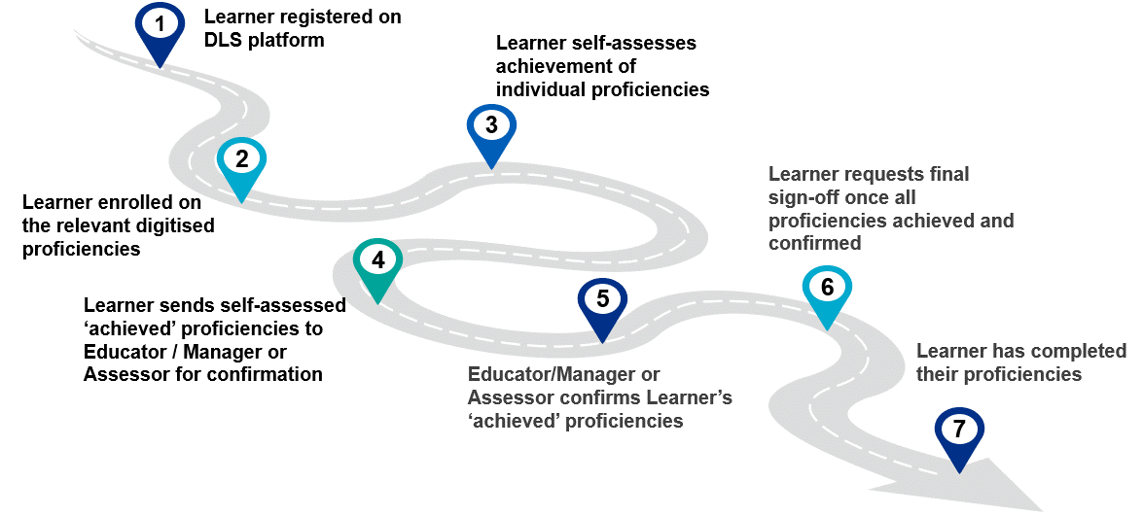
How the digitised versions differ
At a high level, the Learner will follow the below pathway for the completion of their digitised proficiencies
Stage 1 and 2 in the pathway are new for the digitised version (in comparison to what currently needs to happen for paper versions):
Notes:
We recommend you show the ‘What's new on the digitised proficiencies’ video in the training packages (https://vimeo.com/elect/step1-whatsnew), which provides further detail.

Slide 9
learningnetwork@nhselect.org.uk
Notes:
For any questions about this presentation, please contact us

