Slide 1
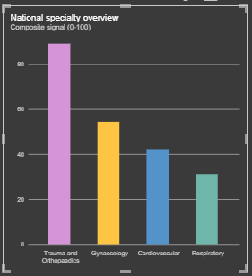
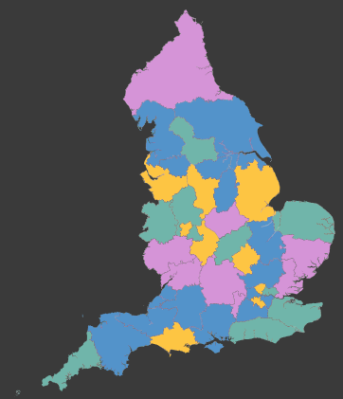

From a national specialty signal to regional variation
Early proof of concept testing whether routinely available NHS system data can provide an additional evidence layer for identifying potential areas of unmet need.
National specialty overview
Regional view: leading specialty signal by ICB
Interpret cautiously: This is a comparative screening output, not a definitive measure of unmet need. In some ICBs, the difference between the first and second specialty may be small – currently working on Power BI to add this in when hovering over an ICB.
Each ICB is coloured by the highest-scoring specialty among the four tested. The variation in colours shows that local pressure profiles may differ from the national ordering.
Four matched indicators (RTT, length of stay etc) were combined into a comparative specialty-level signal across 4 test specialties. In this initial test, Trauma & Orthopaedics showed the strongest national signal across the four specialties included.
Early proof of concept: These outputs provide comparative screening signals across four specialties and four matched indicators. Further methodological QA, clinical validation and expansion to other indicators/specialties would be required before informing decisions.

Slide 2
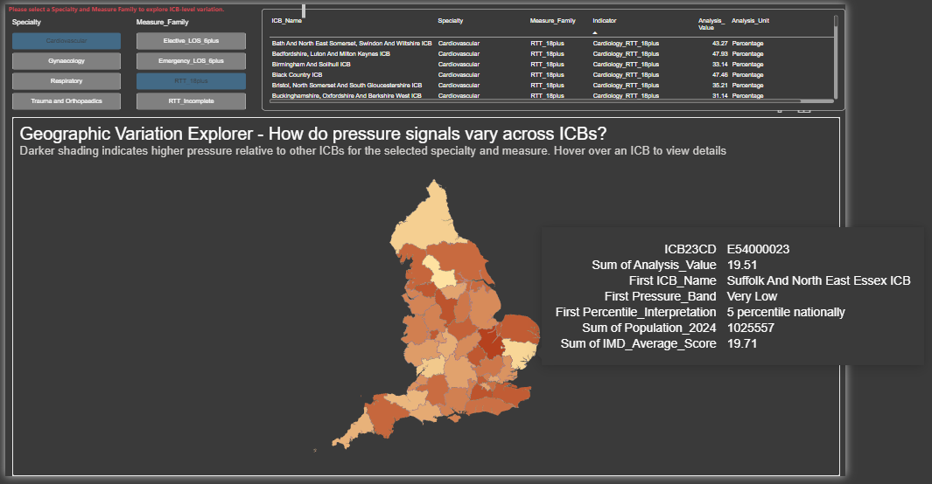
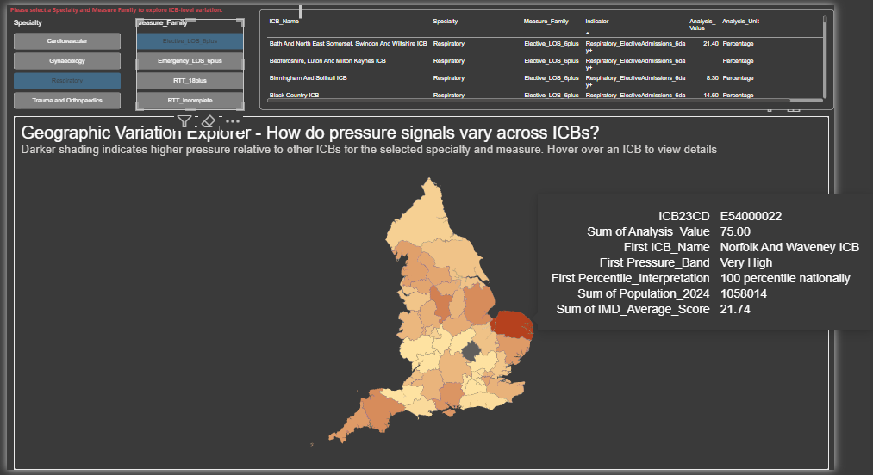
Exploring indicator-level geographic variation – 2 examples
The interactive dashboard allows users to move from the combined specialty signal to the individual indicators contributing to the analysis.
Example 1: Cardiovascular | RTT >18 weeks (Access Pressure)
What the user can explore:
Select a specialty and indicator.
Compare relative pressure across ICBs.
Hover over an ICB to view the underlying value, national percentile and contextual variables.
What the shading means: Darker shading indicates relatively higher pressure for the selected specialty and indicator compared with other ICBs.
Example 2: Respiratory | Elective LOS >6 days (Hospital Burden)
Interpret cautiously: The dashboard identifies relative variation but does not explain its causes or establish that a particular research or innovation intervention is appropriate.
Early proof of concept: These outputs provide comparative screening signals across four specialties and four matched indicators. Further methodological QA, clinical validation and expansion to other indicators/specialties would be required before informing decisions.

