Slide 1

Diabetes prevalence management and health
inequalities
Digital Analysis and Research Team (DART)
Data Science Internship
Author: Stephen Richer
Supervisor: Paul Carroll
Notes:
Good morning everyone, thanks for coming along.
So my names Stephen – I think I’ve had a chance to introduce myself to some of you by now but if not nice to meet you all.
So I’m just wrapping up my PhD in bioinformatics and I’ve now been part of this internship programme for just over a month now.
My project is in collaboration with the East Suffolk and North Essex Trust.
We have been provided with some primary and secondary care datasets relating to a cohort of the diabetic patients.
The project itself is fairly open ended in its scope but we ultimately want to develop methods to explore previously unknown sources of preventable health inequality.
So I’m just going to give a fairly quick over view of the project so far – I haven’t gone into too much detail and we’re still in the early stages so this certainly wont take the full meeting time.

Slide 2

What are Health Inequalities?
Health inequality generically refers to differences in the health of individuals or groups.
  Red-Green colour blindness is more common in men.
Health inequity are specific inequalities deemed to be unfair or unjust.
  Higher incidences of lung-cancer in areas of socio-economic deprivation may be associated with targeted tobacco advertising in lower income neighbourhoods.
‘Health equity means that everyone has a fair and just opportunity to be as healthy as possible. This requires removing obstacles to health such as poverty, discrimination and their consequences, including powerlessness and lack of access to good jobs with fair pay, quality education and housing, safe environments and health care’ ^{Braveman et al., 2017}
Notes:
So first of all, what are health inequalities?
It was actually quite hard to pin down an exact definition online – but this one seems to be the agreed definition in the research literature.
So broadly speaking, health inequality an objective term referring to any differences in the health of individuals or groups.
For example, red-green colour blindness is more common in men than women. This is an inequality – red-green colour blindness is linked to a recessive mutation on the X chromosome and men only have 1 copy of the X chromosome.
Health inequities, on the other hand, are specific inequalities deemed to be unfair or unjust. We wouldn’t normally argue that random genetic mutations are necessarily unjust. But many inequities do occur across different social groups and may relate to differences in health care accessibility, education and discrimination.
For example, there is a high incidence of lung-cancer in areas of socio-economic deprivation. This could be considered an unjust and preventable inequity driven by targeted of tobacco advertising to lower income neighbourhoods.
There’s no clear cut answer as to what makes an observed inequality unjust or unfair – ultimately these are political concepts.
Now, this project will not attempt to define which inequalities are just or unjust.
But we will be working to identify exactly what these health inequalities with a particular emphasis on patients with diabetes.
Ultimately identifying health inequalities and addressing them is key to improving equity and efficiency of health care services.

Slide 3
What is Diabetes?
Type 1
    Failure of pancreas in insulin production – sudden onset with no clear cause.
Type 2 (most common)
    Insulin resistance – failure of cells to respond to insulin.
Risk Factors
Being overweight
Sedentary lifestyle
Family history of diabetes
Age 45 or older
Certain Ethnic Groups
‘Diabetes is a metabolic disorder characterised by chronic hyperglycaemia (high blood sugar)’ (WHO, 1999)
Notes:
So we now know what we mean about health inequalities – and so I just want to quickly describe what diabetes is a disease.
Broadly speaking diabetes is a metabolic disorder characterised by high blood sugar.
This is generally a result of defects associated insulin secretion or insulin action,
There are three primary categories of diabetes.
Type 1 is caused by failure of the pancreas to secrete insulin and must be treated with insulin injections. The exact cause of type 1 diabetes is still unclear, there is known way to prevent it and it can occur suddenly at any age but onset is usually in childhood.
Type 2 diabetes is the most common, about 90% of diabetes cases. The body can still generally secrete insulin but the cells stop responding – this is known as insulin resistant.
Finally, gestational is generally similar to type 1 and can occur transiently in up to 10% of pregnancies.
There are numerous risk associated with diabetes – some of these of these are modifiable some of them aren’t.
In any case the prevalence of diabetes is increasing in the general population and even known it costs the NHS around £10 billion, or 10% of its total budget.
Most of this money goes towards treating complications of diabetes.
Many of these complications are associated with blood damage which can lead to kidney problems, eye problems and cardiovascular disease.
So early detection and effective management of diabetes is key to minimising the risk of complications and improving health outcomes.
And one component of this work will be investigating where inequalities in diagnosis or rates of complications might exist and could be addressed.

Slide 4
Project Outcomes
1) Inequality Analysis: National Level and at Ipswich Diabetes Centre
Exploring trends in Diabetes prevalence and inequality of service accessibility.
2) Estimate ‘Did Not Attend’ Probability (DNApredict)
Supervised binary classifier to estimate DNA risk.
3) Morbidity Network Analysis (MultiNet)
Python package to generate and analyse simple graphs from morbidity data.
Notes:
So, as I mentioned, there are two ongoing projects that I’d like to discuss today.
The first project is one I briefly introduced last time – here I’m working on a command line tool to generate simple graphs from multi-morbidity data.
And the second on-going project, more recently, is a supervised learning approach to assess the feasibility of estimating DNA probability using the Ipswich/Colchester outpatient data.
And hopefully at the next meeting I’ll be able to talk more the third project – where we hope to use supervised approaches to identify factors that influence poor health outcomes in diabetes.

Slide 5
1) Inequality Analysis:
National Level and at Ipswich Diabetes Center
Notes:
Good morning everyone, thanks for coming along.
So my names Stephen – I think I’ve had a chance to introduce myself to some of you by now but if not nice to meet you all.
So I’m just wrapping up my PhD in bioinformatics and I’ve now been part of this internship programme for just over a month now.
My project is in collaboration with the East Suffolk and North Essex Trust.
We have been provided with some primary and secondary care datasets relating to a cohort of the diabetic patients.
The project itself is fairly open ended in its scope but we ultimately want to develop methods to explore previously unknown sources of preventable health inequality.
So I’m just going to give a fairly quick over view of the project so far – I haven’t gone into too much detail and we’re still in the early stages so this certainly wont take the full meeting time.

Slide 6
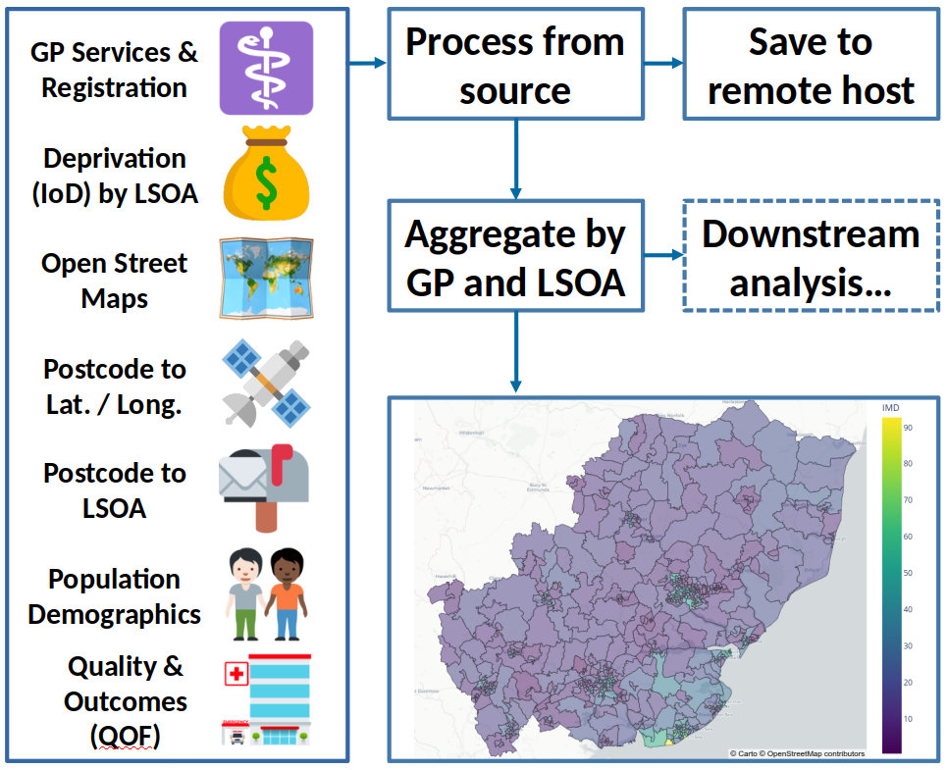
ESNEFT Tools
ESNEFT Tools implements a simple interface for accessing and manipulating a wide
variety of datasets relating to demographic and population inequalities.
Available at:
https://github.com/nhsx/p24-diabetes-inequal
Notes:
Good morning everyone, thanks for coming along.
So my names Stephen – I think I’ve had a chance to introduce myself to some of you by now but if not nice to meet you all.
So I’m just wrapping up my PhD in bioinformatics and I’ve now been part of this internship programme for just over a month now.
My project is in collaboration with the East Suffolk and North Essex Trust.
We have been provided with some primary and secondary care datasets relating to a cohort of the diabetic patients.
The project itself is fairly open ended in its scope but we ultimately want to develop methods to explore previously unknown sources of preventable health inequality.
So I’m just going to give a fairly quick over view of the project so far – I haven’t gone into too much detail and we’re still in the early stages so this certainly wont take the full meeting time.

Slide 7
Investigating sub-domains of deprivation associated with Disease Prevalence
The Index of Multiple Deprivation (IMD) is comprised of 7 sub-domains and each sub-domain is itself built from underlying indicators.
Analysing the underlying indicators can provide more meaningful insights into which specific factors of deprivation are associated with the feature of interest (e.g. diabetes prevalence)
Analysis method:
  ESNEFT Tools extracts GP-level disease prevalence data from the QoF and maps it to LSOA level.
  A partial Spearman correlation was performed between each disease prevalence and the deprivation score.
    Partial correlation can control from the confounding influence of the other deprivation domains and demographic factors (e.g. age).
Diabetes prevalence was most strongly associated with the Education sub-domain.
Within Education, Diabetes was most strongly associated with Adult Skills and specifically Adult Education.
Notes:
Good morning everyone, thanks for coming along.
So my names Stephen – I think I’ve had a chance to introduce myself to some of you by now but if not nice to meet you all.
So I’m just wrapping up my PhD in bioinformatics and I’ve now been part of this internship programme for just over a month now.
My project is in collaboration with the East Suffolk and North Essex Trust.
We have been provided with some primary and secondary care datasets relating to a cohort of the diabetic patients.
The project itself is fairly open ended in its scope but we ultimately want to develop methods to explore previously unknown sources of preventable health inequality.
So I’m just going to give a fairly quick over view of the project so far – I haven’t gone into too much detail and we’re still in the early stages so this certainly wont take the full meeting time.

Slide 8
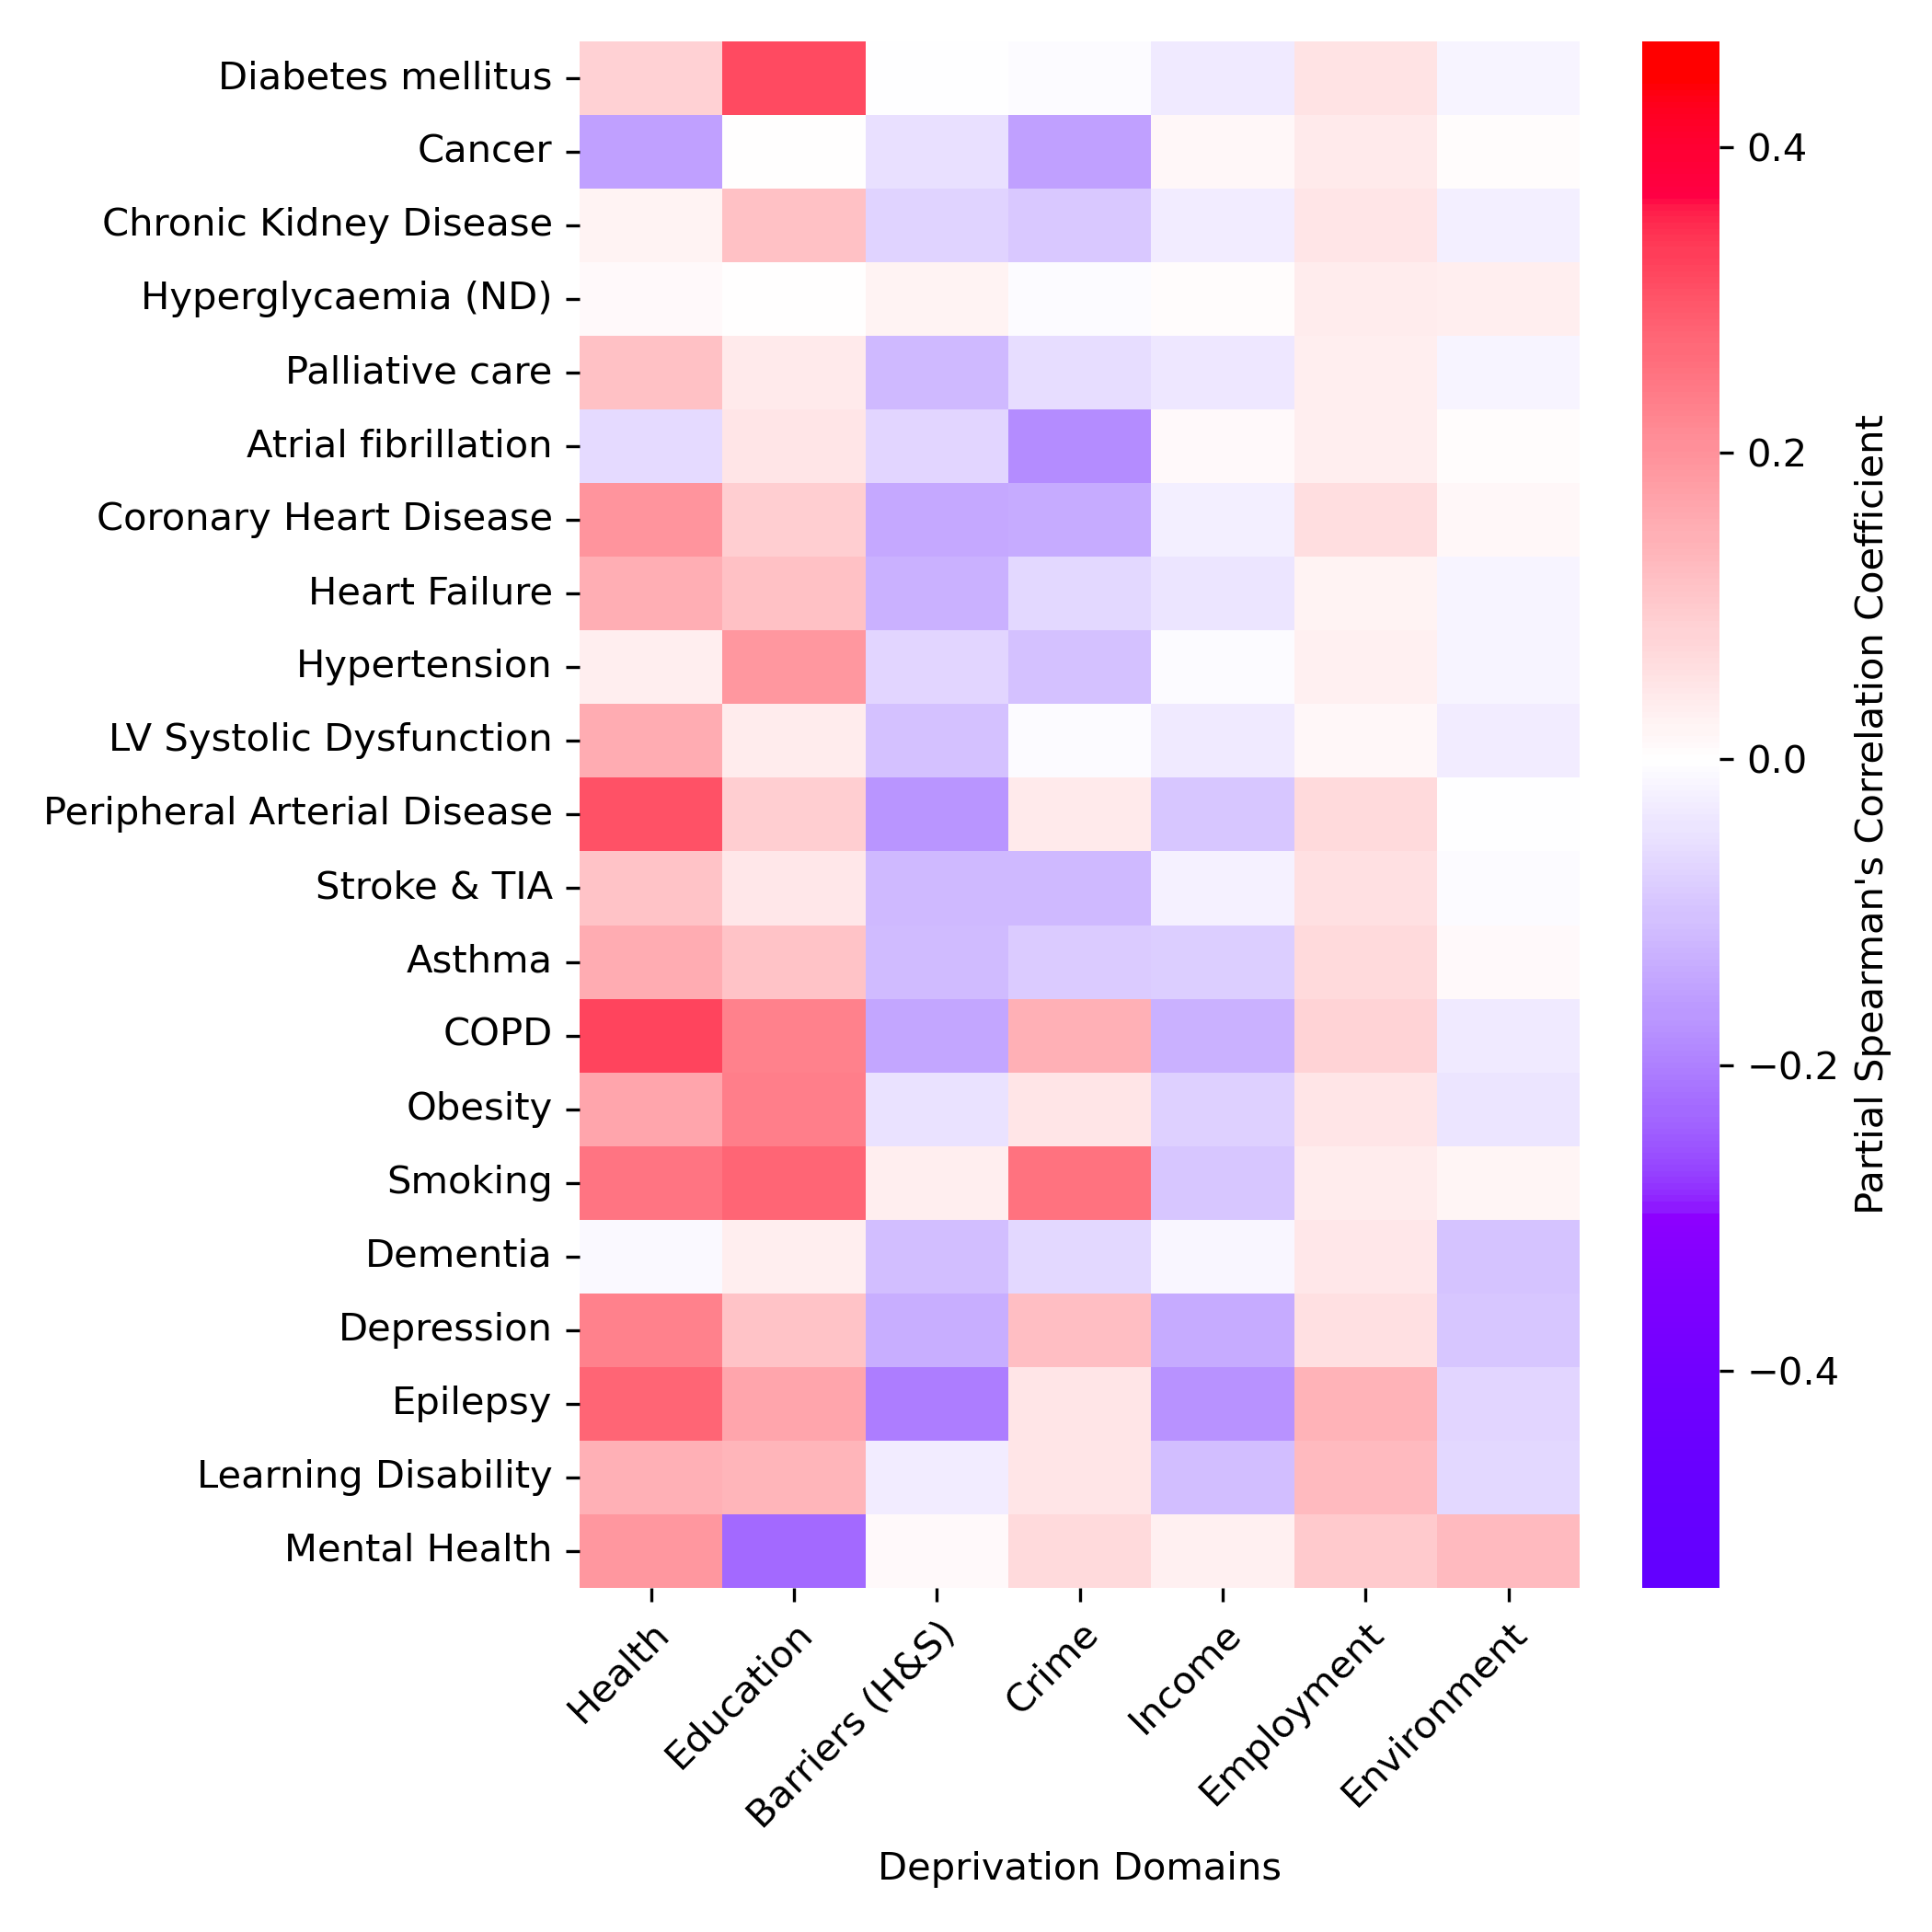
Figure shows heat map of partial correlation coefficient between disease prevalence and the 7 sub-domains of deprivation.
Health deprivation is most strongly associated with disease prevalence.
  This is expected as the sub-domain is defined by the health of the population.
Education deprivation is second most strongly associated.
  Diabetes, in particular, is highly associated with Education deprivation.
To investigate further, the analysis was repeated on the underlying indicators of Education deprivation: Adult Skills and Youth Skills.
Notes:
Good morning everyone, thanks for coming along.
So my names Stephen – I think I’ve had a chance to introduce myself to some of you by now but if not nice to meet you all.
So I’m just wrapping up my PhD in bioinformatics and I’ve now been part of this internship programme for just over a month now.
My project is in collaboration with the East Suffolk and North Essex Trust.
We have been provided with some primary and secondary care datasets relating to a cohort of the diabetic patients.
The project itself is fairly open ended in its scope but we ultimately want to develop methods to explore previously unknown sources of preventable health inequality.
So I’m just going to give a fairly quick over view of the project so far – I haven’t gone into too much detail and we’re still in the early stages so this certainly wont take the full meeting time.

Slide 9
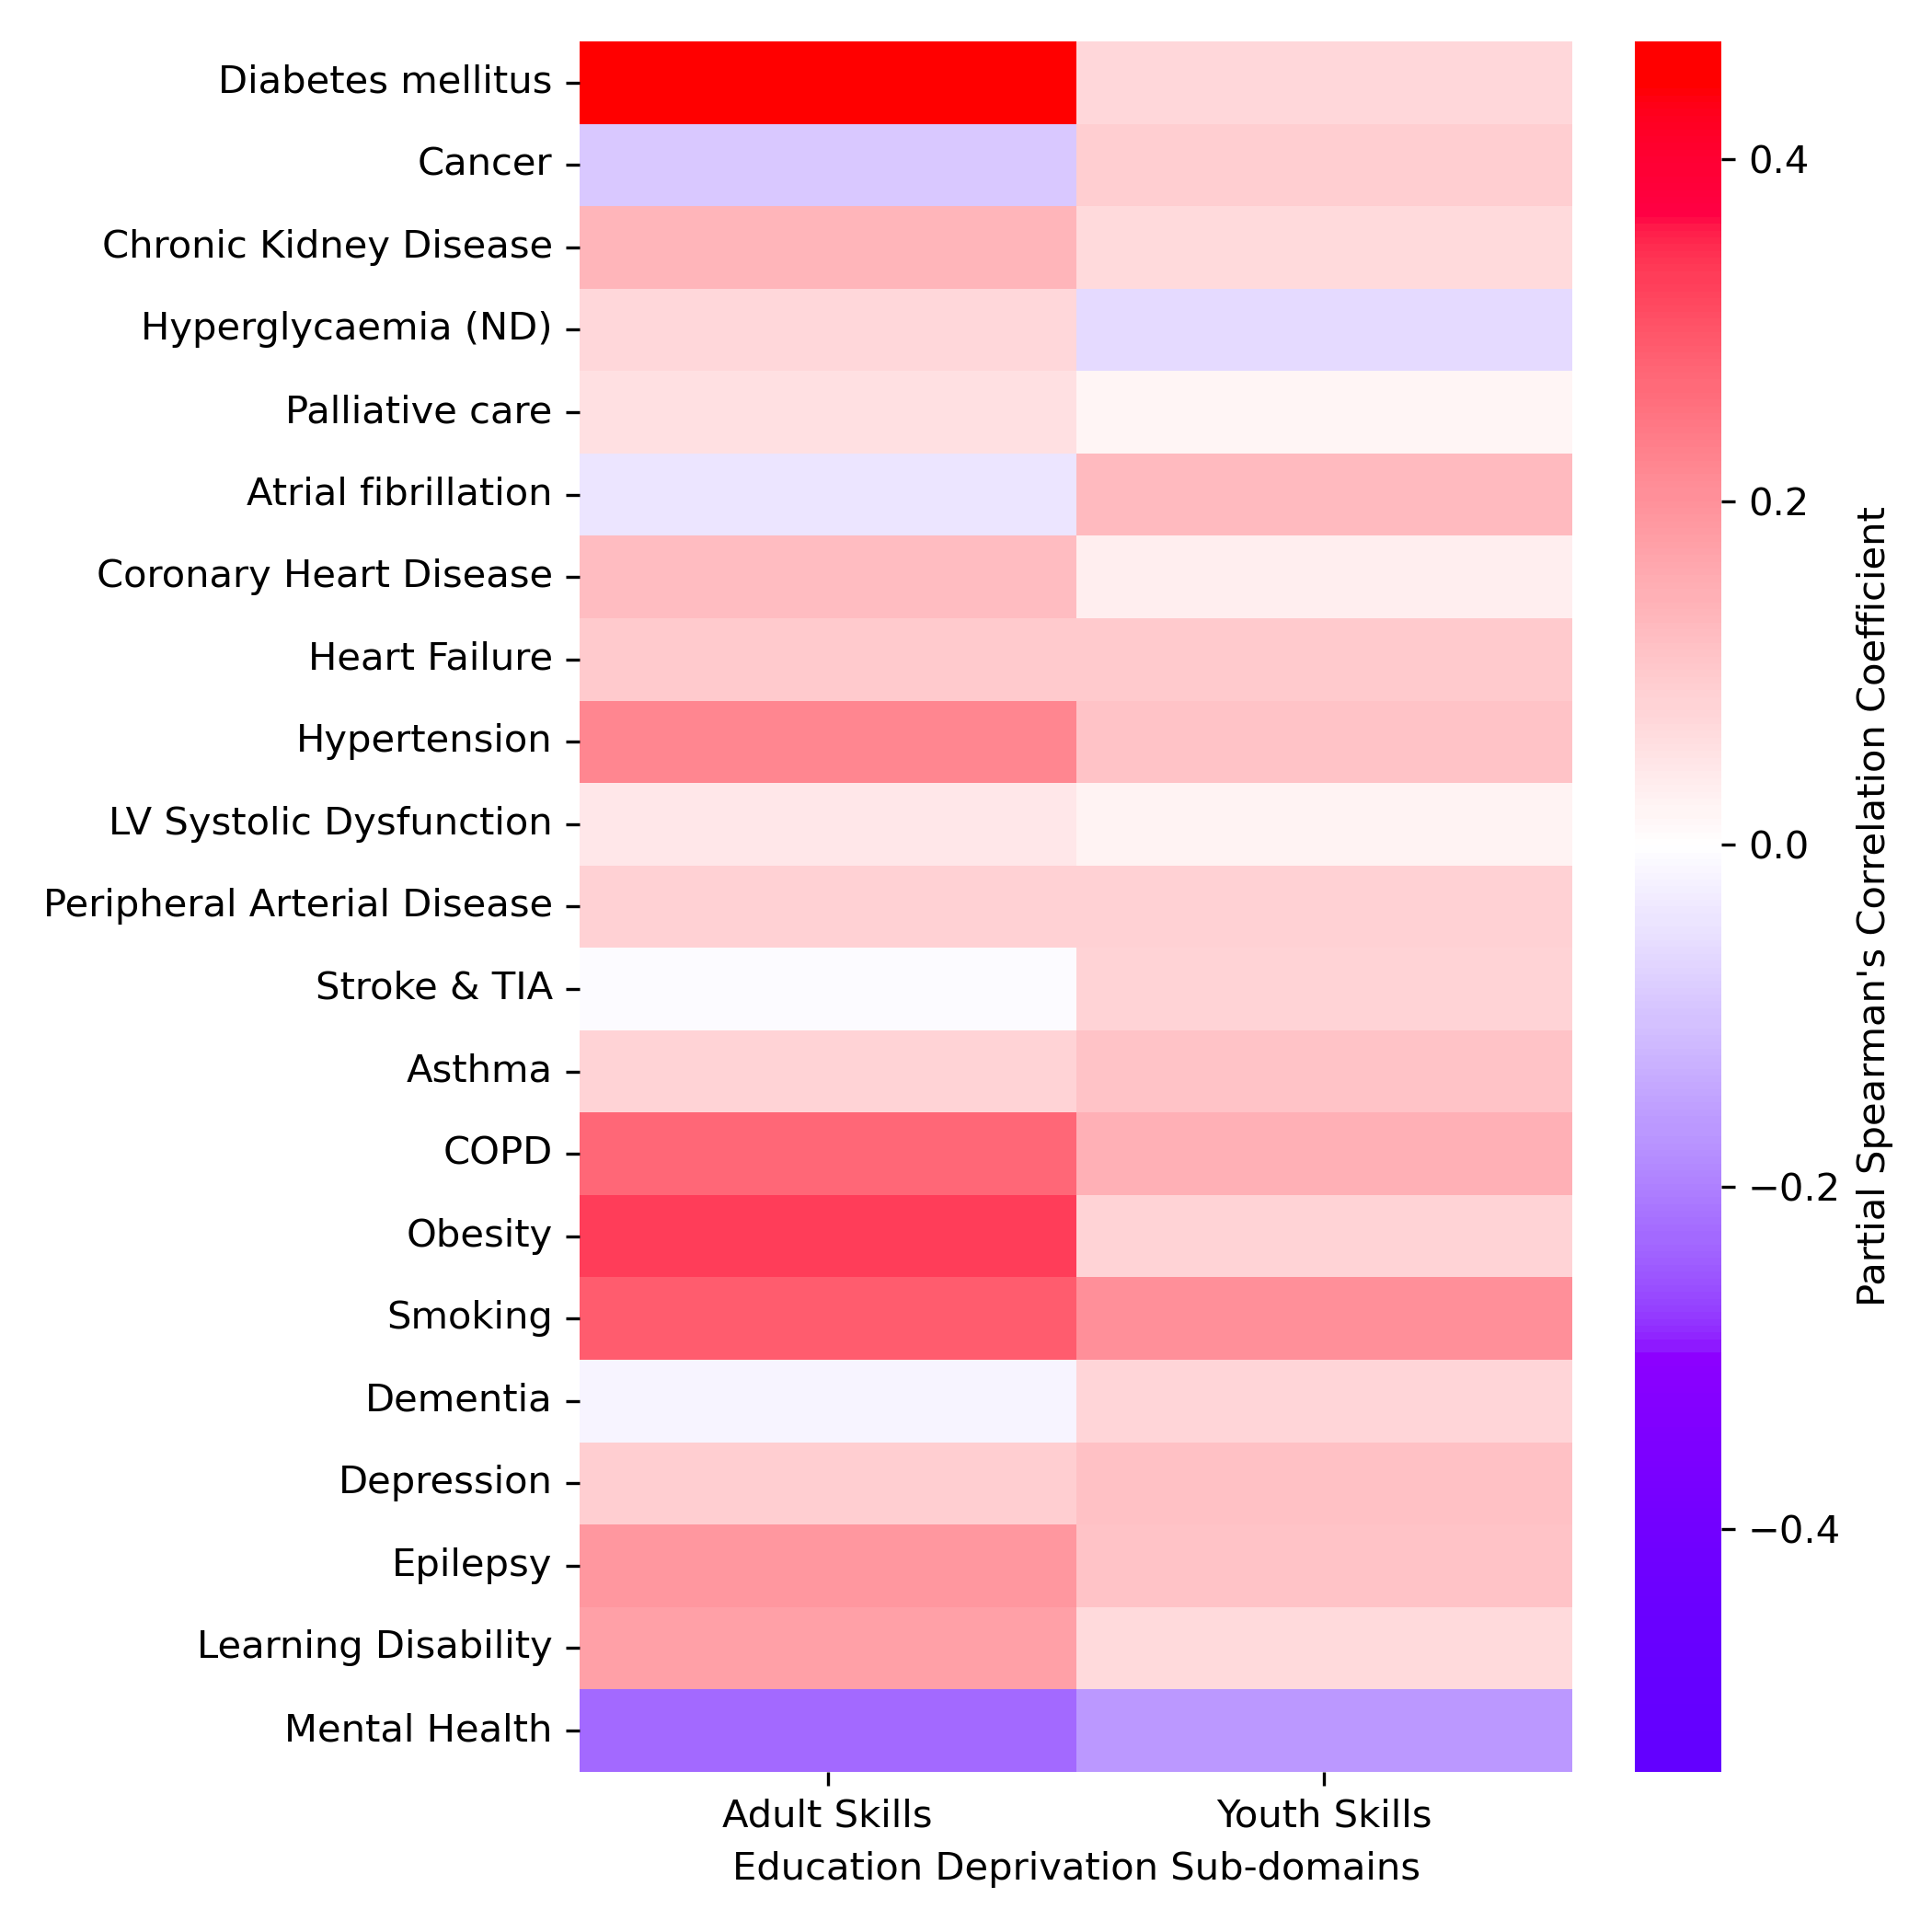
Adult Skills was identified as the predominant underlying indicator most strongly associated with Diabetes prevalence
Adult Skills itself is defined by two indicators:
  Adult Education: The proportion of the working age population with low or no qualifications.
  English Language Proficiency: The proportion of the working age population who cannot speak English or cannot speak it well.
As before, to investigate further, the analysis was repeated on these underlying indicators of Adult Skills deprivation.
Notes:
Good morning everyone, thanks for coming along.
So my names Stephen – I think I’ve had a chance to introduce myself to some of you by now but if not nice to meet you all.
So I’m just wrapping up my PhD in bioinformatics and I’ve now been part of this internship programme for just over a month now.
My project is in collaboration with the East Suffolk and North Essex Trust.
We have been provided with some primary and secondary care datasets relating to a cohort of the diabetic patients.
The project itself is fairly open ended in its scope but we ultimately want to develop methods to explore previously unknown sources of preventable health inequality.
So I’m just going to give a fairly quick over view of the project so far – I haven’t gone into too much detail and we’re still in the early stages so this certainly wont take the full meeting time.

Slide 10
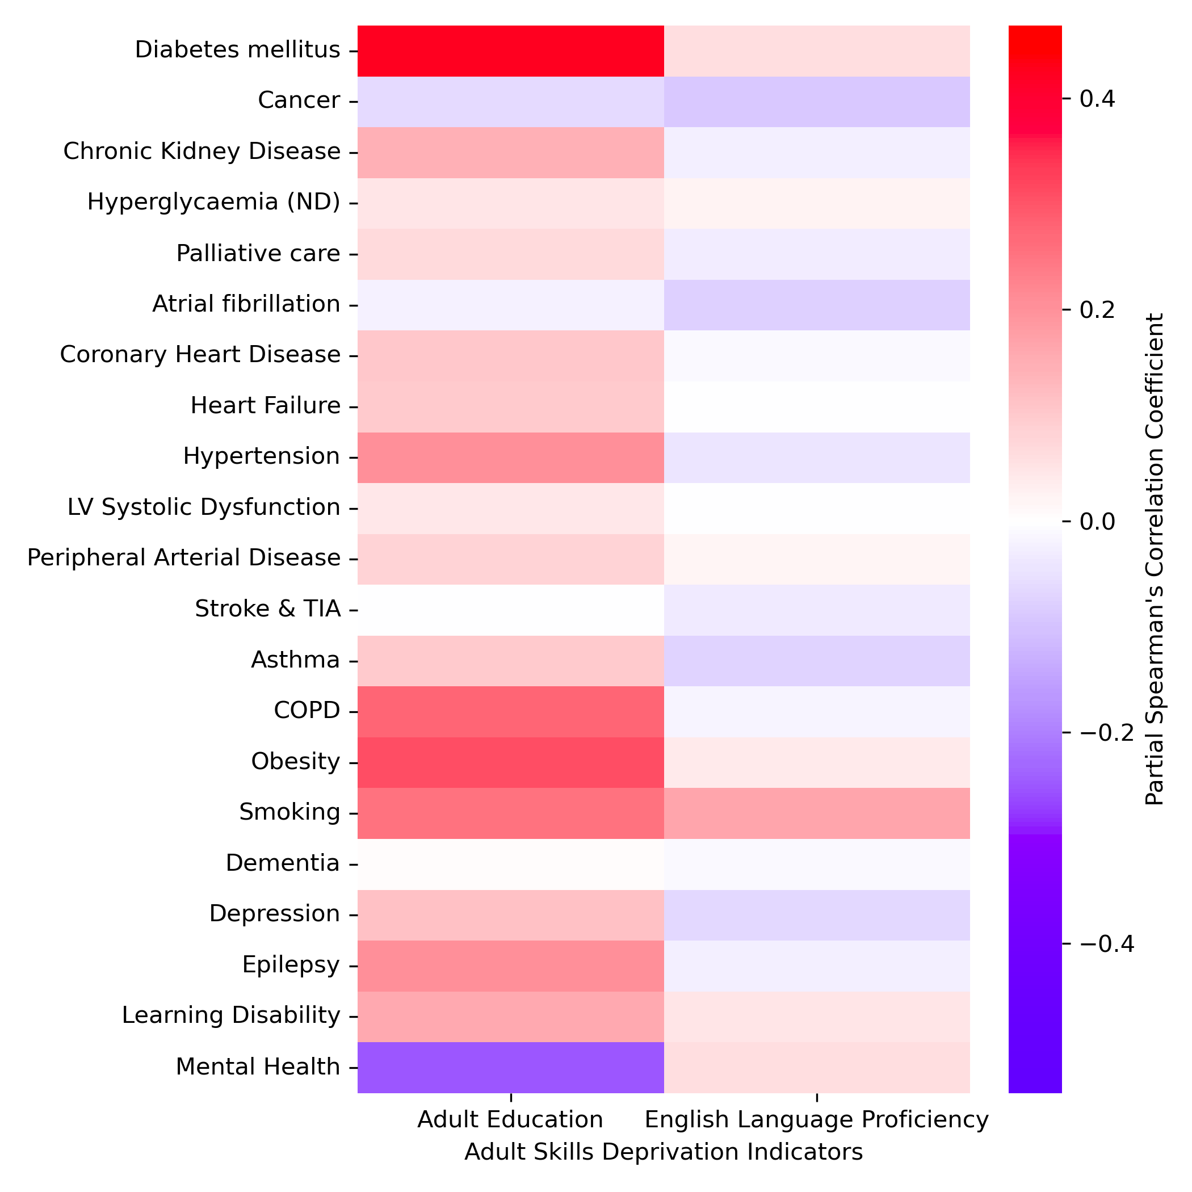
Adult Education was identified as the predominant underlying indicator most strongly associated with Diabetes prevalence
English Language Proficiency shows minimal association with disease prevalance.
Notes:
Good morning everyone, thanks for coming along.
So my names Stephen – I think I’ve had a chance to introduce myself to some of you by now but if not nice to meet you all.
So I’m just wrapping up my PhD in bioinformatics and I’ve now been part of this internship programme for just over a month now.
My project is in collaboration with the East Suffolk and North Essex Trust.
We have been provided with some primary and secondary care datasets relating to a cohort of the diabetic patients.
The project itself is fairly open ended in its scope but we ultimately want to develop methods to explore previously unknown sources of preventable health inequality.
So I’m just going to give a fairly quick over view of the project so far – I haven’t gone into too much detail and we’re still in the early stages so this certainly wont take the full meeting time.

Slide 11
Investigating associations with deprivation and service usage and accessibility at the Ipswich Diabetes Centre
268,912 anonymised records, corresponding to a full history of 8,521 patients, were obtained from the Ipswich Diabetes Centre from between approximately 2014 and 2022.
Patient demographic data were obtained by joining a separate ESNEFT outpatient dataset by anonymised patient identifier – 5,713 patients successfully associated.
Patient was assigned a deprivation score according to the LSOA associated with their postcode of residence.
The analysis sought to explore difference in service utilisation associated with deprivation scores.
  Analysis revealed that patients from deprivation LSOA’s had worse health metrics upon initial referral
  No other deprivation associated differences were detected following referral.
Findings suggest that referral of patients from deprived backgrounds may be delayed, perhaps due to delayed diagnosis or earlier disease onset.
Notes:
Good morning everyone, thanks for coming along.
So my names Stephen – I think I’ve had a chance to introduce myself to some of you by now but if not nice to meet you all.
So I’m just wrapping up my PhD in bioinformatics and I’ve now been part of this internship programme for just over a month now.
My project is in collaboration with the East Suffolk and North Essex Trust.
We have been provided with some primary and secondary care datasets relating to a cohort of the diabetic patients.
The project itself is fairly open ended in its scope but we ultimately want to develop methods to explore previously unknown sources of preventable health inequality.
So I’m just going to give a fairly quick over view of the project so far – I haven’t gone into too much detail and we’re still in the early stages so this certainly wont take the full meeting time.

Slide 12
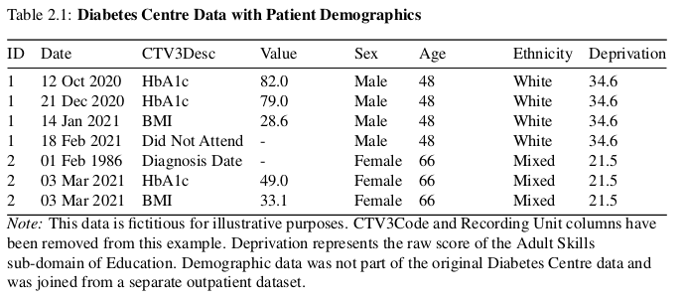
Example of Diabetes Centre Dataset
Notes:
Good morning everyone, thanks for coming along.
So my names Stephen – I think I’ve had a chance to introduce myself to some of you by now but if not nice to meet you all.
So I’m just wrapping up my PhD in bioinformatics and I’ve now been part of this internship programme for just over a month now.
My project is in collaboration with the East Suffolk and North Essex Trust.
We have been provided with some primary and secondary care datasets relating to a cohort of the diabetic patients.
The project itself is fairly open ended in its scope but we ultimately want to develop methods to explore previously unknown sources of preventable health inequality.
So I’m just going to give a fairly quick over view of the project so far – I haven’t gone into too much detail and we’re still in the early stages so this certainly wont take the full meeting time.

Slide 13
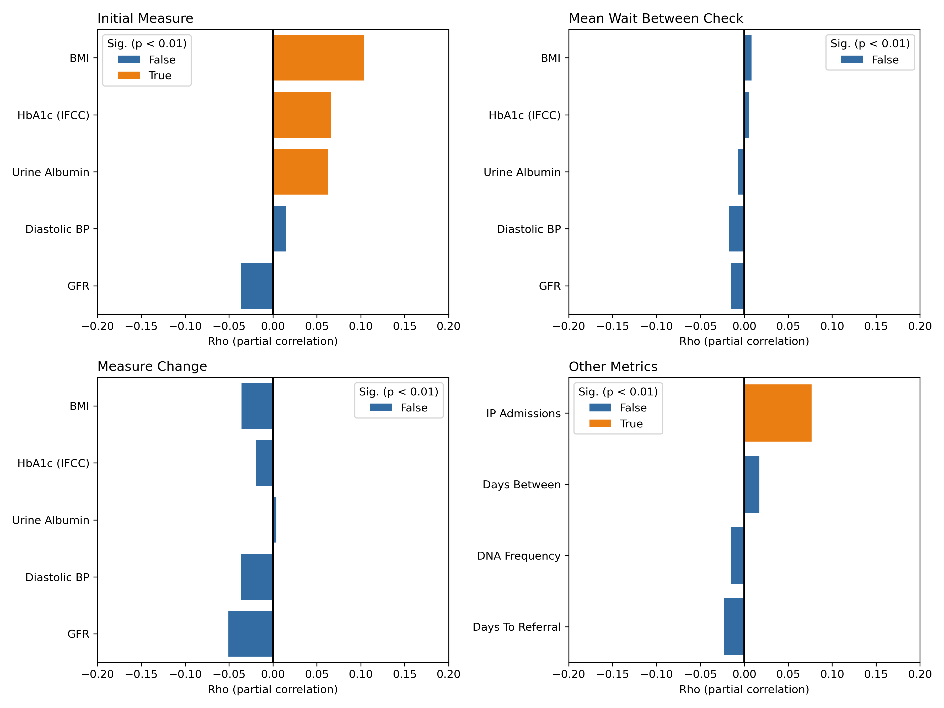
Partial correlation analysis revealed a positive correlation with deprivation and initial health metrics of BMI, HbA1C and Urine Microalbumin.
These metrics were all higher (worse) in patients from deprived LSOAs.
Patients from deprived LSOAs were also more likely to have a more IP admissions.
Next steps would be to identify the referral routes of patient sub-groups. Are patients from deprived backgrounds more likely to be referred following IP admission?
Notes:
Good morning everyone, thanks for coming along.
So my names Stephen – I think I’ve had a chance to introduce myself to some of you by now but if not nice to meet you all.
So I’m just wrapping up my PhD in bioinformatics and I’ve now been part of this internship programme for just over a month now.
My project is in collaboration with the East Suffolk and North Essex Trust.
We have been provided with some primary and secondary care datasets relating to a cohort of the diabetic patients.
The project itself is fairly open ended in its scope but we ultimately want to develop methods to explore previously unknown sources of preventable health inequality.
So I’m just going to give a fairly quick over view of the project so far – I haven’t gone into too much detail and we’re still in the early stages so this certainly wont take the full meeting time.

Slide 14
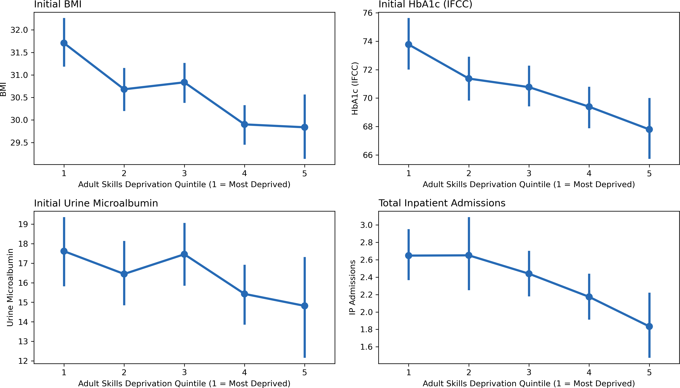
Notes:
Good morning everyone, thanks for coming along.
So my names Stephen – I think I’ve had a chance to introduce myself to some of you by now but if not nice to meet you all.
So I’m just wrapping up my PhD in bioinformatics and I’ve now been part of this internship programme for just over a month now.
My project is in collaboration with the East Suffolk and North Essex Trust.
We have been provided with some primary and secondary care datasets relating to a cohort of the diabetic patients.
The project itself is fairly open ended in its scope but we ultimately want to develop methods to explore previously unknown sources of preventable health inequality.
So I’m just going to give a fairly quick over view of the project so far – I haven’t gone into too much detail and we’re still in the early stages so this certainly wont take the full meeting time.

Slide 15
Caveats of Deprivation Analysis
Deprivation indexes represent aggregate summaries of a specific area – they cannot be used to infer patient deprivation.
  Deprived patients may live in affluent areas, affluent patients may live in deprived areas.
  Cannot distinguish between factors associated with the local area or the individual.
  Future work would need direct measure of patient deprivation (e.g. education level).
The Diabetes Centre dataset is an incomplete record of a patient’s interaction with healthcare services for the diabetes treatment.
  Interactions with GPs are not be recorded.
  No clear pattern of patient interaction with the Diabetes Centre.
    Why are there large gaps between appointments?
      Could be due to lack of patient engagement.
      Alternatively, patient may not need the service due to positive progress.
Notes:
Good morning everyone, thanks for coming along.
So my names Stephen – I think I’ve had a chance to introduce myself to some of you by now but if not nice to meet you all.
So I’m just wrapping up my PhD in bioinformatics and I’ve now been part of this internship programme for just over a month now.
My project is in collaboration with the East Suffolk and North Essex Trust.
We have been provided with some primary and secondary care datasets relating to a cohort of the diabetic patients.
The project itself is fairly open ended in its scope but we ultimately want to develop methods to explore previously unknown sources of preventable health inequality.
So I’m just going to give a fairly quick over view of the project so far – I haven’t gone into too much detail and we’re still in the early stages so this certainly wont take the full meeting time.

Slide 16
Future Work
Future work needs to identify the underlying reasons why patients from deprived LSOAs have worse metrics on referral?
Patient’s may be developing diabetes earlier, or more rapidly, so it is not immediately picked up in primary care.
Patient’s may be under-utilising primary care.
    Can we compare patient pathways leading up to referral?
    Are patients being referred from different routes (e.g. primary vs secondary).
Deprivation may be associated with area, rather than individual.
    e.g. perhaps GP practises in deprived LSOAs are less resourced.
A more complete record of the patient interactions for diabetes treatment is required.
  Individual patient deprivation measures (e.g. education level)
  Metadata describing why patients were referred and the referral source.
Notes:
Good morning everyone, thanks for coming along.
So my names Stephen – I think I’ve had a chance to introduce myself to some of you by now but if not nice to meet you all.
So I’m just wrapping up my PhD in bioinformatics and I’ve now been part of this internship programme for just over a month now.
My project is in collaboration with the East Suffolk and North Essex Trust.
We have been provided with some primary and secondary care datasets relating to a cohort of the diabetic patients.
The project itself is fairly open ended in its scope but we ultimately want to develop methods to explore previously unknown sources of preventable health inequality.
So I’m just going to give a fairly quick over view of the project so far – I haven’t gone into too much detail and we’re still in the early stages so this certainly wont take the full meeting time.

Slide 17
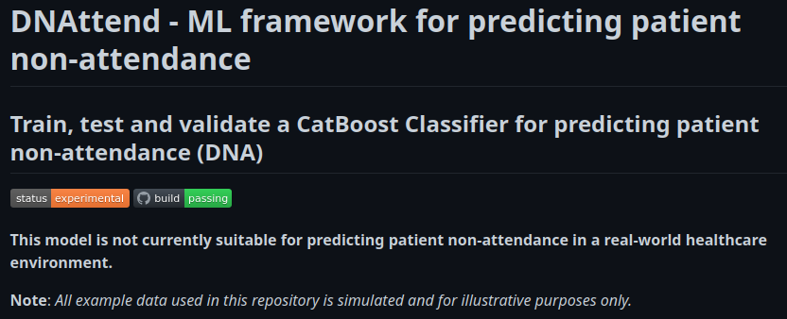
2) DNAttend
AutoML framework for predicting patient non-attendance.
Full Documentation Available At:
https://github.com/nhsx/dna-risk-predict
Notes:
Good morning everyone, thanks for coming along.
So my names Stephen – I think I’ve had a chance to introduce myself to some of you by now but if not nice to meet you all.
So I’m just wrapping up my PhD in bioinformatics and I’ve now been part of this internship programme for just over a month now.
My project is in collaboration with the East Suffolk and North Essex Trust.
We have been provided with some primary and secondary care datasets relating to a cohort of the diabetic patients.
The project itself is fairly open ended in its scope but we ultimately want to develop methods to explore previously unknown sources of preventable health inequality.
So I’m just going to give a fairly quick over view of the project so far – I haven’t gone into too much detail and we’re still in the early stages so this certainly wont take the full meeting time.

Slide 18
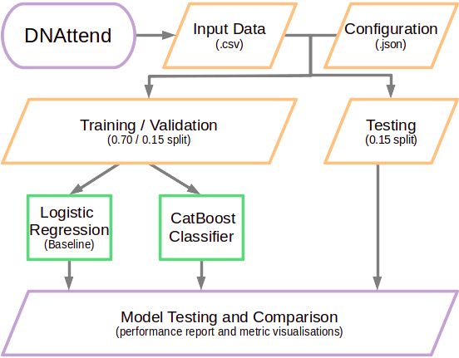
DNAttend: Simplified Workflow
Notes:
Good morning everyone, thanks for coming along.
So my names Stephen – I think I’ve had a chance to introduce myself to some of you by now but if not nice to meet you all.
So I’m just wrapping up my PhD in bioinformatics and I’ve now been part of this internship programme for just over a month now.
My project is in collaboration with the East Suffolk and North Essex Trust.
We have been provided with some primary and secondary care datasets relating to a cohort of the diabetic patients.
The project itself is fairly open ended in its scope but we ultimately want to develop methods to explore previously unknown sources of preventable health inequality.
So I’m just going to give a fairly quick over view of the project so far – I haven’t gone into too much detail and we’re still in the early stages so this certainly wont take the full meeting time.

Slide 19
DNAttend: Key Features
Patient non-attendance is a significant burden to the NHS with approximately 5% of all primary healthcare appointments listed as Did Not Attend (DNA).
In addition to putting patients at risk, DNAs reduce clinical capacity and are estimated to cost the NHS as much as £216 million annually.
DNAttend is a supervised machine learning framework for identifying hidden patterns that determine an individual’s DNA risk.
Command-line utility for training and evaluating binary classification models for predicting patient non-attendance.
  Enables non-expert users to quickly build and evaluate robust models.
DNAttend builds two models:
  Logistic regression (simple baseline model)
  CatBoost (gradient-boosted decision tree)
    Hyper-parameters are automatically tuned via random search.
A full example workflow, with simulated data, is available at the GitHub repository.
Notes:
Good morning everyone, thanks for coming along.
So my names Stephen – I think I’ve had a chance to introduce myself to some of you by now but if not nice to meet you all.
So I’m just wrapping up my PhD in bioinformatics and I’ve now been part of this internship programme for just over a month now.
My project is in collaboration with the East Suffolk and North Essex Trust.
We have been provided with some primary and secondary care datasets relating to a cohort of the diabetic patients.
The project itself is fairly open ended in its scope but we ultimately want to develop methods to explore previously unknown sources of preventable health inequality.
So I’m just going to give a fairly quick over view of the project so far – I haven’t gone into too much detail and we’re still in the early stages so this certainly wont take the full meeting time.

Slide 20
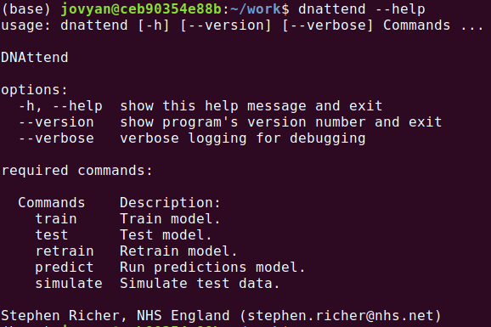
DNAttend: Command Line Interface
Notes:
Good morning everyone, thanks for coming along.
So my names Stephen – I think I’ve had a chance to introduce myself to some of you by now but if not nice to meet you all.
So I’m just wrapping up my PhD in bioinformatics and I’ve now been part of this internship programme for just over a month now.
My project is in collaboration with the East Suffolk and North Essex Trust.
We have been provided with some primary and secondary care datasets relating to a cohort of the diabetic patients.
The project itself is fairly open ended in its scope but we ultimately want to develop methods to explore previously unknown sources of preventable health inequality.
So I’m just going to give a fairly quick over view of the project so far – I haven’t gone into too much detail and we’re still in the early stages so this certainly wont take the full meeting time.

Slide 21
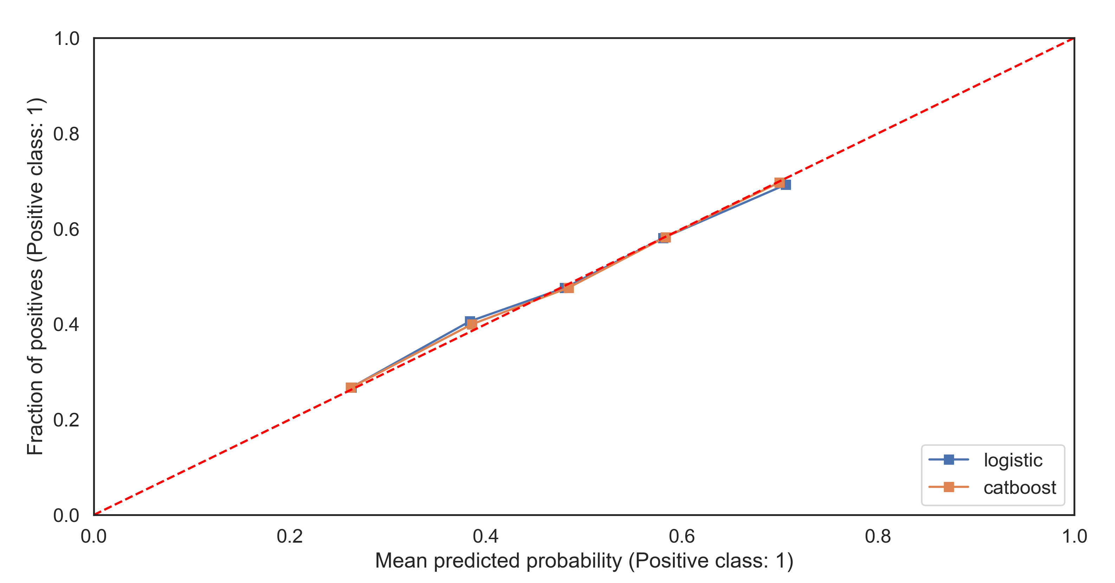
Example Output: Calibrated Probabilities
Notes:
Good morning everyone, thanks for coming along.
So my names Stephen – I think I’ve had a chance to introduce myself to some of you by now but if not nice to meet you all.
So I’m just wrapping up my PhD in bioinformatics and I’ve now been part of this internship programme for just over a month now.
My project is in collaboration with the East Suffolk and North Essex Trust.
We have been provided with some primary and secondary care datasets relating to a cohort of the diabetic patients.
The project itself is fairly open ended in its scope but we ultimately want to develop methods to explore previously unknown sources of preventable health inequality.
So I’m just going to give a fairly quick over view of the project so far – I haven’t gone into too much detail and we’re still in the early stages so this certainly wont take the full meeting time.

Slide 22
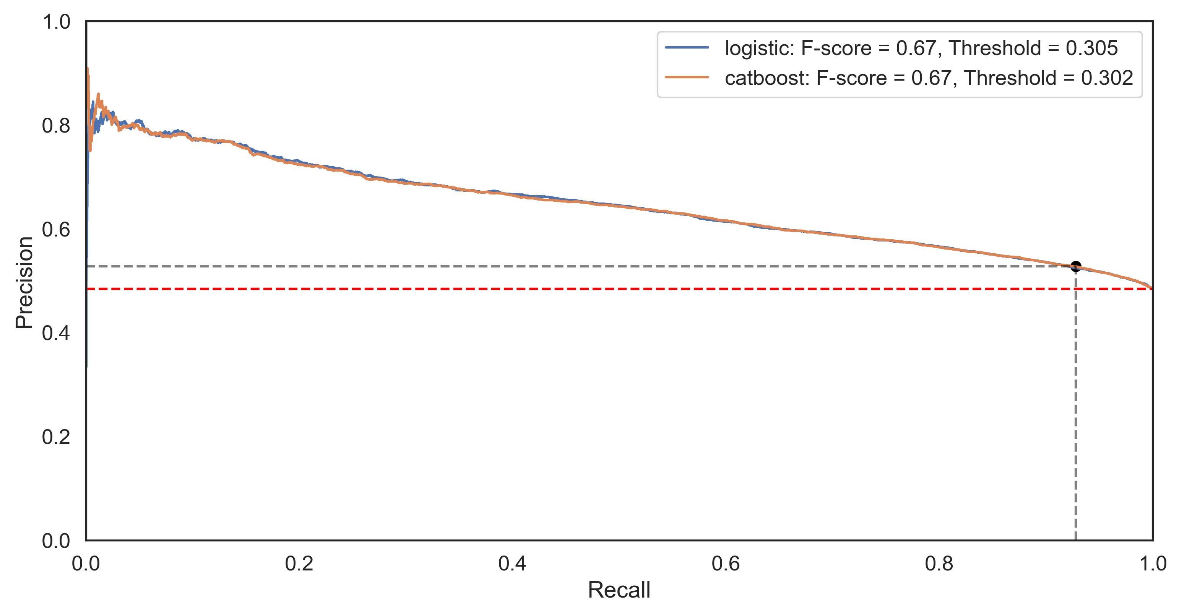
Example Output: Precision-Recall Curve
Notes:
Good morning everyone, thanks for coming along.
So my names Stephen – I think I’ve had a chance to introduce myself to some of you by now but if not nice to meet you all.
So I’m just wrapping up my PhD in bioinformatics and I’ve now been part of this internship programme for just over a month now.
My project is in collaboration with the East Suffolk and North Essex Trust.
We have been provided with some primary and secondary care datasets relating to a cohort of the diabetic patients.
The project itself is fairly open ended in its scope but we ultimately want to develop methods to explore previously unknown sources of preventable health inequality.
So I’m just going to give a fairly quick over view of the project so far – I haven’t gone into too much detail and we’re still in the early stages so this certainly wont take the full meeting time.

Slide 23
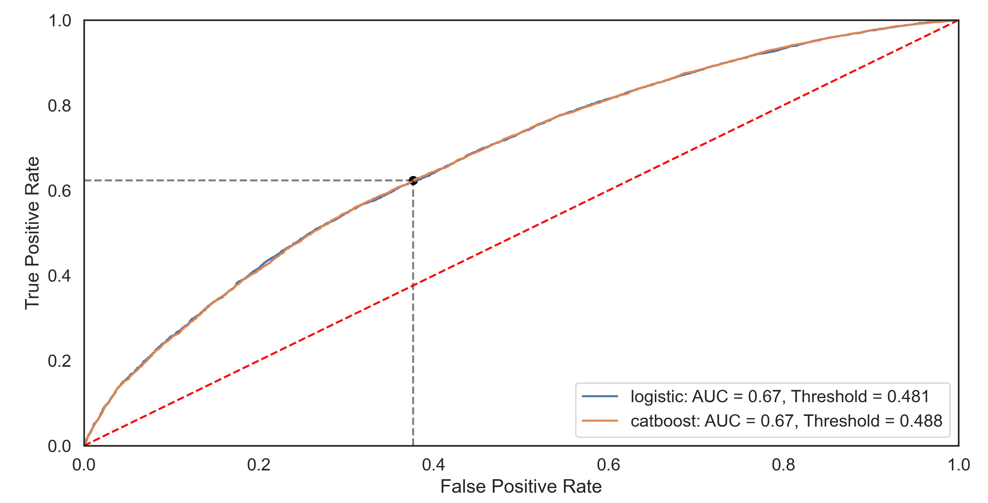
Example Output: ROC Curve
Notes:
Good morning everyone, thanks for coming along.
So my names Stephen – I think I’ve had a chance to introduce myself to some of you by now but if not nice to meet you all.
So I’m just wrapping up my PhD in bioinformatics and I’ve now been part of this internship programme for just over a month now.
My project is in collaboration with the East Suffolk and North Essex Trust.
We have been provided with some primary and secondary care datasets relating to a cohort of the diabetic patients.
The project itself is fairly open ended in its scope but we ultimately want to develop methods to explore previously unknown sources of preventable health inequality.
So I’m just going to give a fairly quick over view of the project so far – I haven’t gone into too much detail and we’re still in the early stages so this certainly wont take the full meeting time.

Slide 24
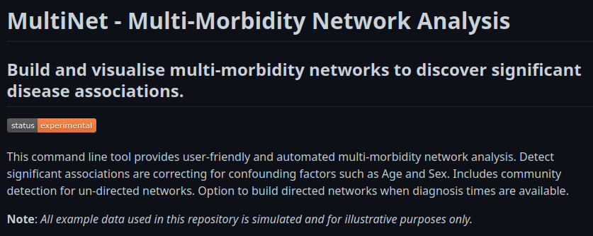
3) MultiNet
Build and visualise multi-morbidity networks to discover significant disease associations.
Full Documentation Available At:
https://github.com/nhsx/morbidity_network_analysis
Notes:
Good morning everyone, thanks for coming along.
So my names Stephen – I think I’ve had a chance to introduce myself to some of you by now but if not nice to meet you all.
So I’m just wrapping up my PhD in bioinformatics and I’ve now been part of this internship programme for just over a month now.
My project is in collaboration with the East Suffolk and North Essex Trust.
We have been provided with some primary and secondary care datasets relating to a cohort of the diabetic patients.
The project itself is fairly open ended in its scope but we ultimately want to develop methods to explore previously unknown sources of preventable health inequality.
So I’m just going to give a fairly quick over view of the project so far – I haven’t gone into too much detail and we’re still in the early stages so this certainly wont take the full meeting time.

Slide 25
MultiNet: Key Features
Multi-morbidity represents the co-occurrence of two of more chronic medical conditions.
A substantial proportion of patients have multi-morbidities and the associated costs of treating such patients are often significantly higher.
Multi-morbidities can be studied using network analysis to identify significant disease associations and pathways.
  The methodology for simple network analysis is established [Aguado et al., 2020].
  However, the approaches remain inaccessible to non-exert users – simple interfaces for performing these analyses are not widely available.
MultiNet is a user-friendly command-line utility for generating multi-morbidity networks and discovering significant associations between pairs of diseases.
A full example workflow, with simulated data, is available at the GitHub repository.
Notes:
Good morning everyone, thanks for coming along.
So my names Stephen – I think I’ve had a chance to introduce myself to some of you by now but if not nice to meet you all.
So I’m just wrapping up my PhD in bioinformatics and I’ve now been part of this internship programme for just over a month now.
My project is in collaboration with the East Suffolk and North Essex Trust.
We have been provided with some primary and secondary care datasets relating to a cohort of the diabetic patients.
The project itself is fairly open ended in its scope but we ultimately want to develop methods to explore previously unknown sources of preventable health inequality.
So I’m just going to give a fairly quick over view of the project so far – I haven’t gone into too much detail and we’re still in the early stages so this certainly wont take the full meeting time.

Slide 26
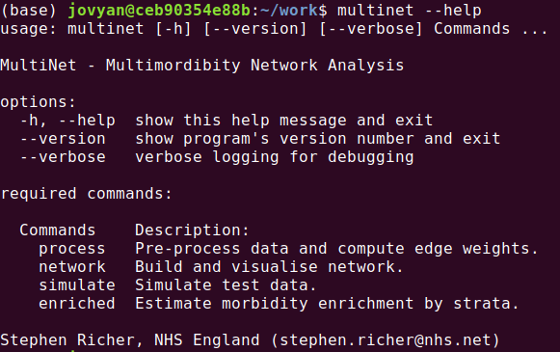
MultiNet: Command Line Interface
Notes:
Good morning everyone, thanks for coming along.
So my names Stephen – I think I’ve had a chance to introduce myself to some of you by now but if not nice to meet you all.
So I’m just wrapping up my PhD in bioinformatics and I’ve now been part of this internship programme for just over a month now.
My project is in collaboration with the East Suffolk and North Essex Trust.
We have been provided with some primary and secondary care datasets relating to a cohort of the diabetic patients.
The project itself is fairly open ended in its scope but we ultimately want to develop methods to explore previously unknown sources of preventable health inequality.
So I’m just going to give a fairly quick over view of the project so far – I haven’t gone into too much detail and we’re still in the early stages so this certainly wont take the full meeting time.

Slide 27
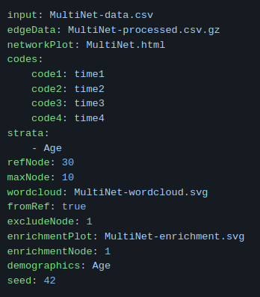
MultiNet: Example Configuration
MultiNet is configured via a single YAML file that describes input data and paramers.
The command `multinet simulate` generates a full example dataset with configuration file.
  The dataset describes directional relationships between numeric factors (e.g. 12 -> (2, 3, 4, 6)).
  The simulated data allows users to explore functionality and serve as a the template for real-world clinical data.
Notes:
Good morning everyone, thanks for coming along.
So my names Stephen – I think I’ve had a chance to introduce myself to some of you by now but if not nice to meet you all.
So I’m just wrapping up my PhD in bioinformatics and I’ve now been part of this internship programme for just over a month now.
My project is in collaboration with the East Suffolk and North Essex Trust.
We have been provided with some primary and secondary care datasets relating to a cohort of the diabetic patients.
The project itself is fairly open ended in its scope but we ultimately want to develop methods to explore previously unknown sources of preventable health inequality.
So I’m just going to give a fairly quick over view of the project so far – I haven’t gone into too much detail and we’re still in the early stages so this certainly wont take the full meeting time.

Slide 28
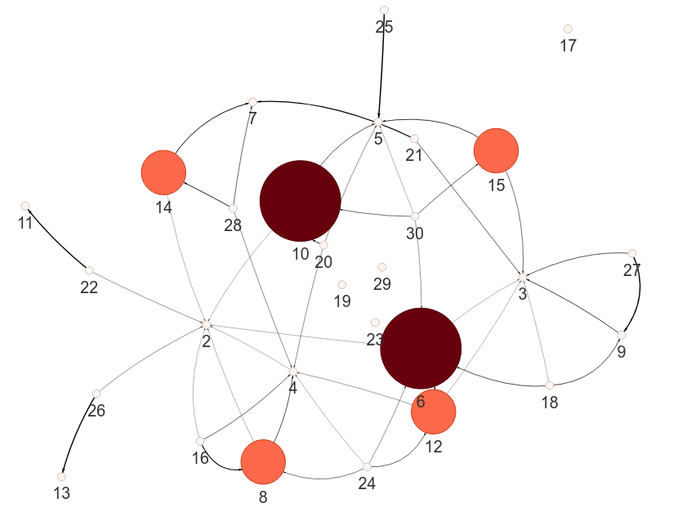
Example: Full Network Visualisation
Small networks may be suitable for visualisation in their entirety.
Edge thickness is proportional to the strength of association between two nodes.
Node size and colour is proportional to betweenness centrality.
Notes:
Good morning everyone, thanks for coming along.
So my names Stephen – I think I’ve had a chance to introduce myself to some of you by now but if not nice to meet you all.
So I’m just wrapping up my PhD in bioinformatics and I’ve now been part of this internship programme for just over a month now.
My project is in collaboration with the East Suffolk and North Essex Trust.
We have been provided with some primary and secondary care datasets relating to a cohort of the diabetic patients.
The project itself is fairly open ended in its scope but we ultimately want to develop methods to explore previously unknown sources of preventable health inequality.
So I’m just going to give a fairly quick over view of the project so far – I haven’t gone into too much detail and we’re still in the early stages so this certainly wont take the full meeting time.

Slide 29
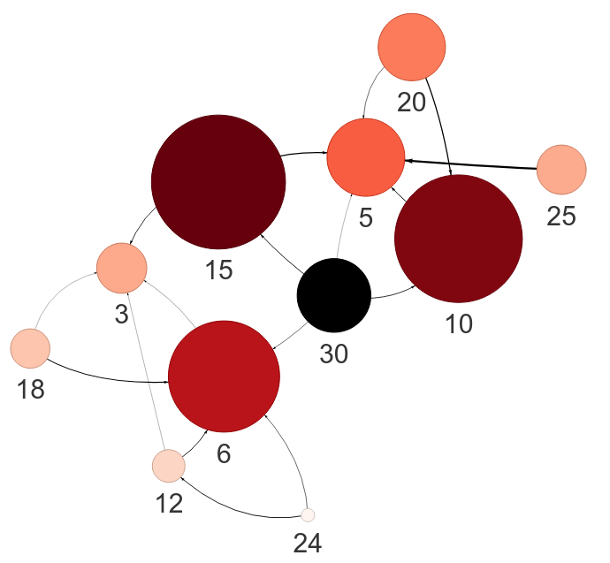
Example: Visualisation from Reference
A reference node(s) is usually for focussing on sub-graphs of larger networks.
Edge thickness is proportional to the strength of association between two nodes.
Node size and colour is scaled to the distance from the reference node(s).
Notes:
Good morning everyone, thanks for coming along.
So my names Stephen – I think I’ve had a chance to introduce myself to some of you by now but if not nice to meet you all.
So I’m just wrapping up my PhD in bioinformatics and I’ve now been part of this internship programme for just over a month now.
My project is in collaboration with the East Suffolk and North Essex Trust.
We have been provided with some primary and secondary care datasets relating to a cohort of the diabetic patients.
The project itself is fairly open ended in its scope but we ultimately want to develop methods to explore previously unknown sources of preventable health inequality.
So I’m just going to give a fairly quick over view of the project so far – I haven’t gone into too much detail and we’re still in the early stages so this certainly wont take the full meeting time.

Slide 30
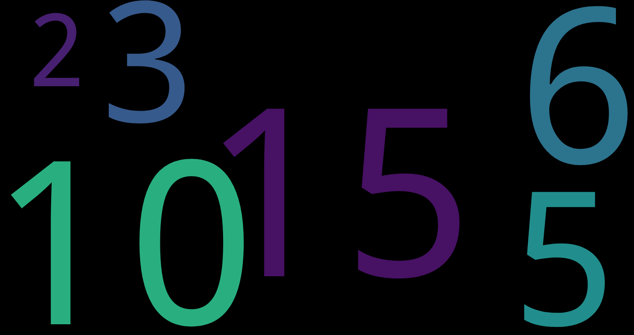
Example: WordCloud from/to Reference
A WordCloud is alternate approach to visualising node association from reference.
For directional graphs, the WordCloud is configured either from the reference node or to the reference node.
  from:
    e.g. 30 -> (15, 10, 6, 5, 3, 2)
  to:
    e.g. (120, 90, 60) -> 30
Word size is scaled to the distance from the reference node(s).
Notes:
Good morning everyone, thanks for coming along.
So my names Stephen – I think I’ve had a chance to introduce myself to some of you by now but if not nice to meet you all.
So I’m just wrapping up my PhD in bioinformatics and I’ve now been part of this internship programme for just over a month now.
My project is in collaboration with the East Suffolk and North Essex Trust.
We have been provided with some primary and secondary care datasets relating to a cohort of the diabetic patients.
The project itself is fairly open ended in its scope but we ultimately want to develop methods to explore previously unknown sources of preventable health inequality.
So I’m just going to give a fairly quick over view of the project so far – I haven’t gone into too much detail and we’re still in the early stages so this certainly wont take the full meeting time.

