Slide 1

User types
1
2
3
People who validate + upload data
People who analyse + share data
People who share +
act on the analysis
Hospital trusts
NHS England, Cancer Alliances, CCGs, ICSs
Cancer Alliances, CCGs and ICSs
I need to make sure data is uploaded correctly and on time so my trust doesn’t get penalised
I need granular data that I can manipulate so I can spot problems and answer questions about waiting times
I need detailed analysis so I can understand the cause of long wait times and work with trusts to improve their service

Slide 2

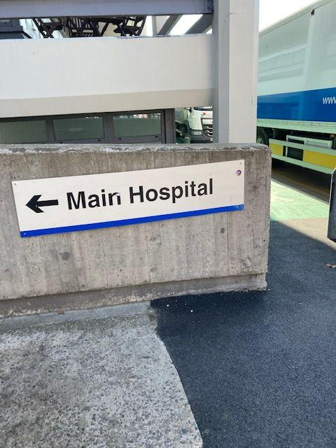
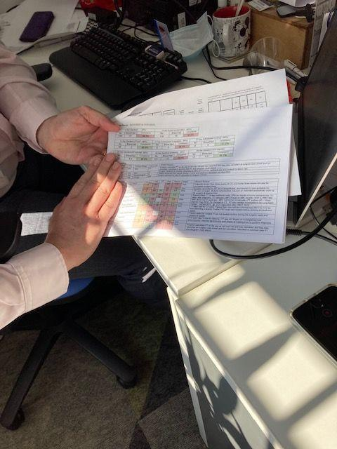

User type: People who validate and upload data in hospital trusts
Job titles: Cancer manager, business manager, cancer pathway analyst, data manager, service coordinator, advanced information analyst, cancer performance manager
Skills: Data analysis, Attention to detail, People skills: communicating and influencing
Goals
Accurately record how trust is performing against standards
Inform colleagues about performance and pass information to clinicians
Align local and national data so it matches
Make sure everything is complete and accurate
Activities
Attends meetings to keep track of patients
Communicates with colleagues about discrepancies
Contacts other trusts to make sure standard Breaches are assigned correctly when a patient moves between trusts
Produces charts of performance for senior staff and to motivate clinicians
Motivations
Has had to learn a lot; takes pride in what they do due to its complexity
Pressured to meet national reporting deadlines (and legal requirements)
Interaction with service
Logs in a few times a month
Validating and gathering data for whole month - this is most of their role (users report 20-60%)

Slide 3

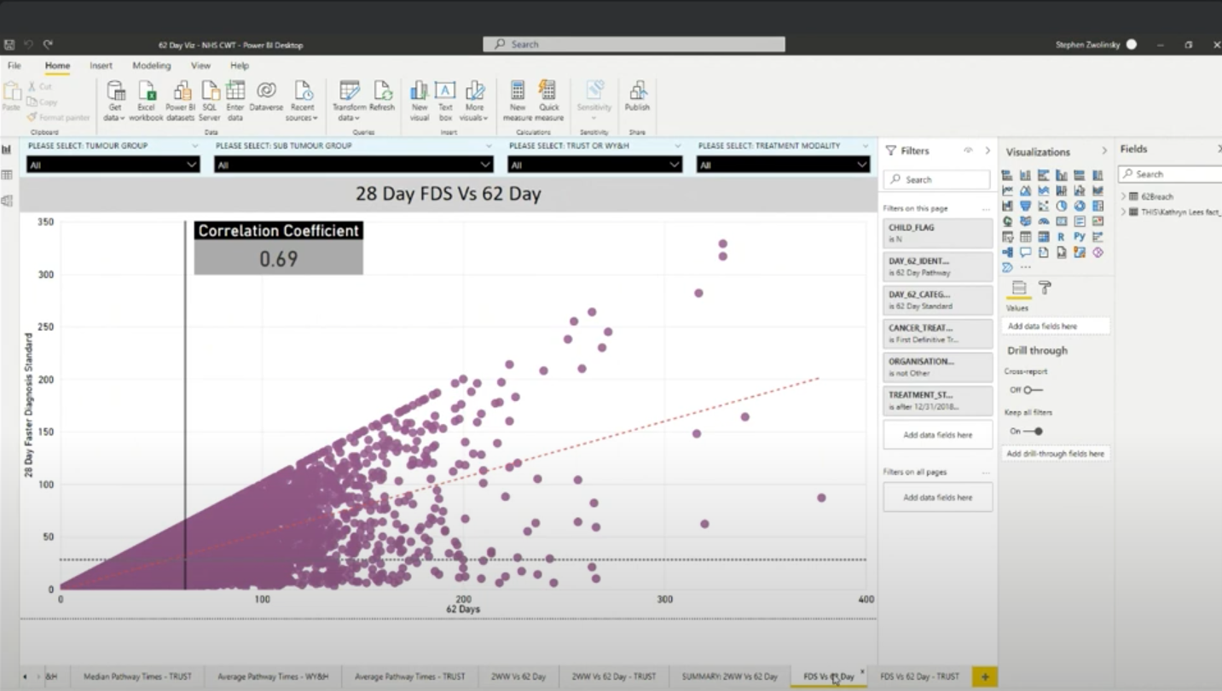
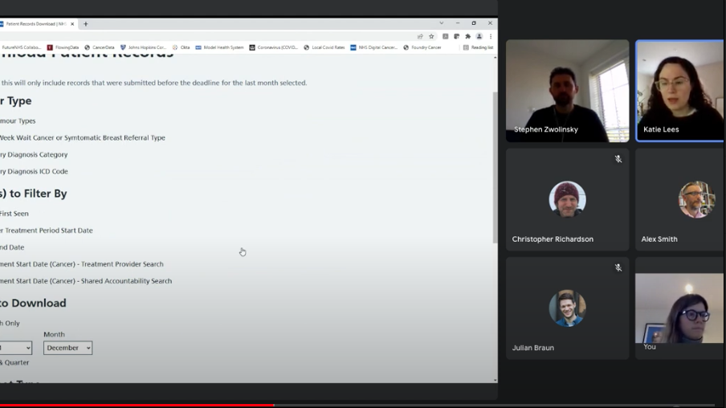
User type: People who analyse and report on data in Cancer Alliances, CCGs and ICSs
Job titles: Programme analyst, development lead, reporting analyst, data analyst, business intelligence, performance analyst
Skills: Data analysis, Attention to detail, Technical knowledge, eg some understanding of coding.
Goals
Accurately analyse data for multiple trusts so that problems in waiting times can be spotted
Analyse and slice the data in a way that exposes the potential causes of long wait times, for example: 'is demand actually high or is there another reason?'
Visualise data so that others can see where the problems are
Activities
Manipulating data from a CSV extract using tools such as Excel and PowerBI
Producing charts, data packs, dashboard and presentations, usually for other people to use.
Speaking to peers in their region to learn new ways of analysing data and to understand data logic.
Motivations
Intrinsic: detail oriented, enjoys playing with data and spotting anomalies and trends.
Extrinsic: It is their org's purpose to monitor and improve waiting times (amongst other metrics)
Extrinsic: Senior leader (sometimes their manager) is asking for analysis and reports
Interaction with service
Logs in once a month to download a data extract

Slide 4
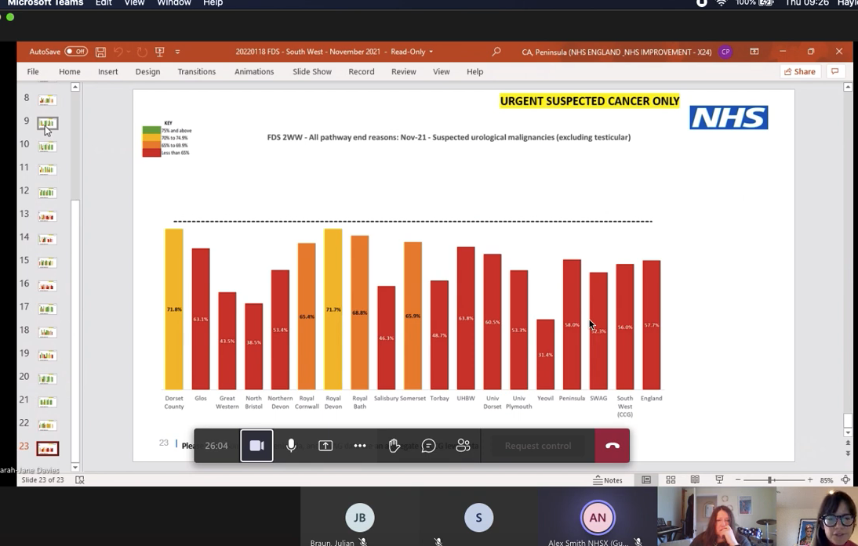


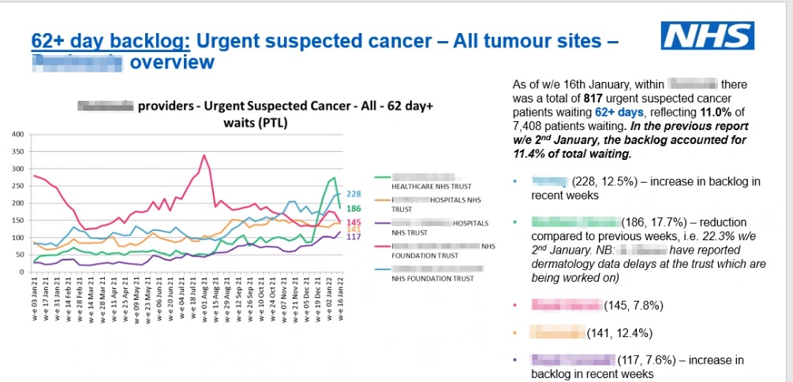
User type: People who act on analysis in Integrated Care Systems/Clinical Commissioning Groups and Cancer Alliances
Job titles: Director of cancer improvement, cancer commissioning manager, cancer lead, improvement delivery lead, programme lead, director of cancer performance, head of service improvement
Skills: Strategic and long-term problem solving; Building relationships; Communication skills: can discuss problems with all staff from frontline to directors
Goals
Find solutions to address problems with long cancer waiting times that have been highlighted by analysis.
Working to help their area is perform better against regional and national benchmarks.
Activities
Go back to analysts for clarification.
Attending lots of meetings with trusts, with people of different levels of seniority.
Using reports produced by analysts to discuss with senior leaders ways to improve performance on pathways.
Motivations
Responsible for the strategy rather than patient level issues
It is their org's purpose to monitor and improve waiting times (amongst other metrics)
Interaction with service
Doesn't log-in to CWT platform. Relies on analyst to
extract data and analyse.
Uses analysis of CWT data all the time to make decisions.

