Slide 1
Multiview coding video coding
H.264/AVC

Slide 2
Terminology
Coded picture: a field or a frame is encoded.
Coded frame has a frame number.
Picture order count: define the decoding order of fields.
Reference frames: previously coded frames; is organised into one or tow list (list 0, list 1)

Slide 3
Terminology
Macroblock: 16x16 luma, 8x8 Cb, 8x8 Cr samples
Are arranged in slides (a slice is a set of macroblocks in raster scan order)
I macroblock: intra prediction from current slice
P macroblock: inter prediction from reference frames.
B macroblock

Slide 4
H.264 codec
Encoder includes 2 paths:
Forward path
Reconstruction path
Decoder

Slide 5
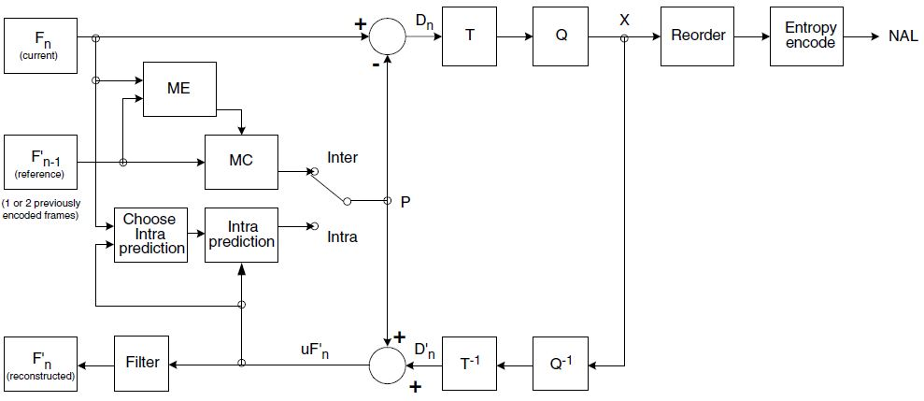
H.264 codec - Encoder

Slide 6
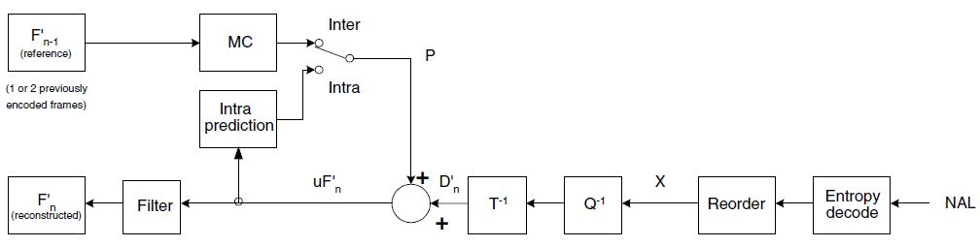
H.264 codec - Decoder

Slide 7
H264 structure
Profiles and level
Video format
Coded data format
Reference pictures
Slices
Macroblocks

Slide 8
Profile and Level
H264 defines a set of three profiles:
Base line profile
Main profile
Extended profile
Performance limit for codec is a set of Levels: sample processing rate, picture size, coded bitrate and memory requirements.

Slide 9
Video format
H.264 supports coding and decoding of 4:2:0 progressive or interlaced video.

Slide 10
Coded data format
The output of the encoding process is VCL data (a sequence of bits representing the coded video data) which are mapped to NAL units prior to transmission or storage.
Each NAL unit contains a Raw Byte Sequence Payload (RBSP), a set of data corresponding to coded video data or header information

Slide 11
Reference pictures
Inter coded macroblocks and macroblock partitions in P slices (see below) are predicted from pictures in a single list, list 0. Inter coded macroblocks and macroblock partitions in a B slice (see below) may be predicted from two lists, list 0 and list 1.

Slide 12
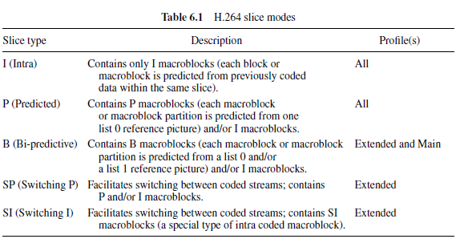
Slices

Slide 13
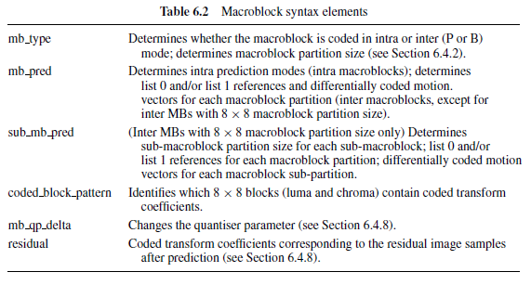
Macroblock

Slide 14
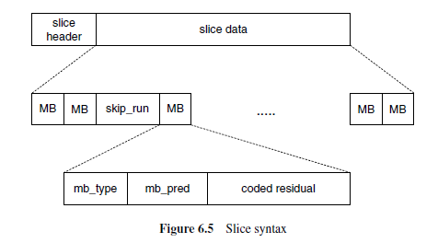
Macroblock

Slide 15
Base line profile
The Baseline Profile supports coded sequences containing I- and P-slices.
After prediction, the residual data for each MB is transformed using a 4×4 integer transform (based on the DCT) and quantised.
Transform coefficients are entropy coded using a context-adaptive variable length coding scheme (CAVLC) and all other syntax elements are coded using fixed-length or Exponential-Golomb Variable Length Codes.

Slide 16
Reference Picture Management
Pictures that have previously been encoded are stored in a reference buffer.
List of previously coded pictures, reference picture list 0, for use in motion-compensated prediction of inter macroblocks in P slices.

Slide 17
Slices
I slice contains only intra-coded macroblocks (predicted from previously coded samples in the same slice).
P slice can contain inter coded macroblocks (predicted from samples in previously coded pictures).
The decoder calculates a vector for the skipped macroblock and reconstructs the macroblock using motion-compensated prediction from the first reference picture in list 0.

Slide 18
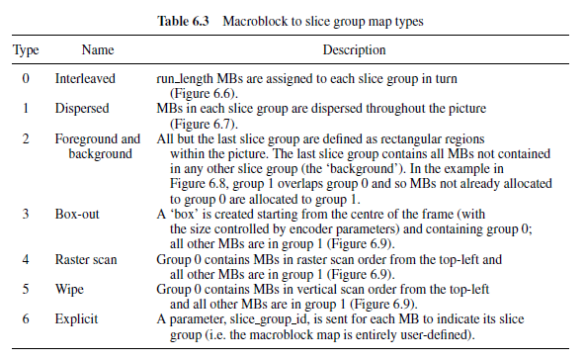
Slices

Slide 19
Macroblock prediction
Prediction is subtracted from the current macroblock or block and the result of the subtraction (residual) is compressed and transmitted to the decoder, together with information required for the decoder to repeat the prediction process (motion vector(s), prediction mode, etc.).

Slide 20
Inter prediction
Inter prediction creates a prediction model from one or more previously encoded video frames or fields using block-based motion compensation.

Slide 21
Inter prediction
Method of partitioning macroblocks into motion compensated sub-blocks of varying size is known as tree structured motion compensation.
A large partition size is appropriate for homogeneous areas of the frame and a small partition size may be beneficial for detailed areas.

Slide 22
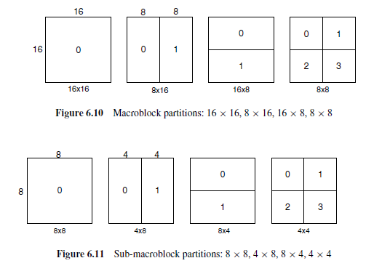
Inter prediction

Slide 23
Inter prediction
Each partition or sub-macroblock partition in an inter-coded macroblock is predicted from an area of the same size in a reference picture.
The luma and chroma samples at sub-sample positions do not exist in the reference picture and so it is necessary to create them using interpolation from nearby coded samples.

Slide 24
Inter prediction
For luma:
Half-pel samples use a six tap Finite Impulse Response (FIR) filter with weights:
(1/32,−5/32, 5/8, 5/8,−5/32, 1/32).
Quarter-pel samples are linearly interpolated between these adjacent samples.

Slide 25
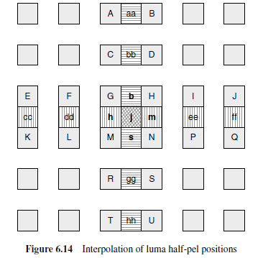
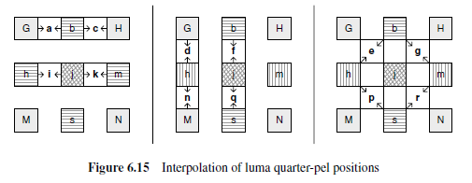
Inter prediction

Slide 26
Inter prediction

Slide 27
Inter prediction
For Chroma:
Each sub-sample position a is a linear combination of the neighbouring integer sample positions A, B, C and D:
a = round([(8 − dx ) · (8 − dy)A + dx · (8 − dy)B + (8 − dx ) · dyC + dx · dyD]/64).

Slide 28
Inter prediction
For Chroma:
Each sub-sample position a is a linear combination of the neighbouring integer sample positions A, B, C and D:
a = round([(8 − dx ) · (8 − dy)A + dx · (8 − dy)B + (8 − dx ) · dyC + dx · dyD]/64).

Slide 29
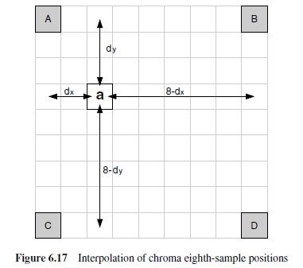
Inter prediction

Slide 30
Inter prediction
Motion vector prediction:
For transmitted partitions excluding 16 × 8 and 8 × 16 partition sizes, MVp is the medianof the motion vectors for partitions A, B and C.
For 16 × 8 partitions, MVp for the upper 16 × 8 partition is predicted from B and MVp for the lower 16 × 8 partition is predicted from A.
For 8 × 16 partitions, MVp for the left 8 × 16 partition is predicted from A and MVp for the right 8 × 16 partition is predicted from C.
For skipped macroblocks, a 16 × 16 vector MVp is generated as in case (1) above.

Slide 31
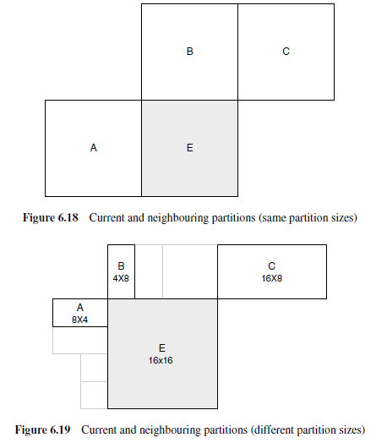
Inter prediction

Slide 32
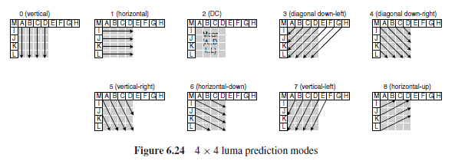
Intra prediction

Slide 33
Deblocking filter
A filter is applied to each decoded macroblock to reduce blocking distortion.
The deblocking filter is applied after the inverse transform in the encoder, before reconstructing.
The filter smooths block edges, improving the appearance of decoded frames.
The filtered image can improve compression performance.

Slide 34
Transform and Quantisation
H.264 uses three transforms depending on the type of residual data that is to be coded: a Hadamard transform for the 4×4 array of lumaDCcoefficients in intra macroblocks predicted in 16×16 mode, a Hadamard transform for the 2 × 2 array of chroma DC coefficients (in any macroblock) and a DCT-based transform for all other 4 × 4 blocks in the residual data.

Slide 35
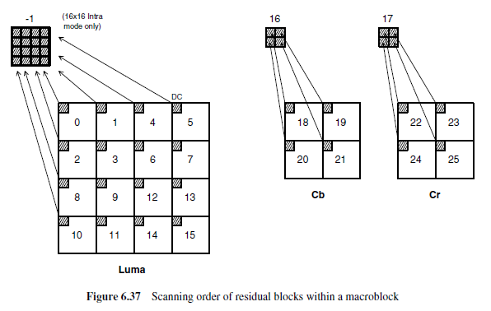
Transform and Quantisation

Slide 36
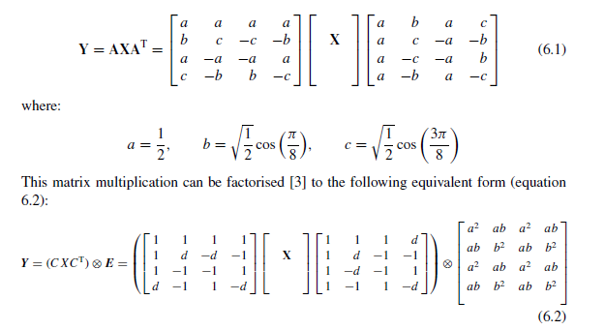
Transform and Quantisation

Slide 37
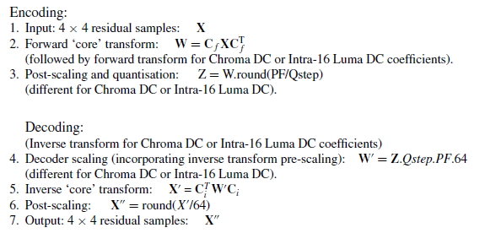
Transform and Quantisation

Slide 38
Reordering
Each 4×4 block of quantised transform coefficients is mapped to a 16-element array in a zig-zag order.
In 16 × 16 Intra mode, the DC coefficients (top-left) of each 4 × 4 luminance block are scanned first and these DC coefficients form a 4 × 4 array that is scanned in zig-zag order.

Slide 39
Reordering
The 2 × 2 DC coefficients of each chroma component are first scanned in rasterorder.
The 15 AC coefficients in each chroma 4 × 4 block are scanned starting from the 2nd position.

Slide 40
Entropy coding
Elements are coded using either variable-length codes (VLCs) or context-adaptive arithmetic coding (CABAC) depending on the entropy encoding mode.
In mode is set to 0, residual block data is coded using a context-adaptive variable length coding (CAVLC) scheme and other variable-length coded units are coded using Exp-Golomb codes.

Slide 41
Entropy coding
Elements are coded using either variable-length codes (VLCs) or context-adaptive arithmetic coding (CABAC) depending on the entropy encoding mode.
In mode is set to 0, residual block data is coded using a context-adaptive variable length coding (CAVLC) scheme and other variable-length coded units are coded using Exp-Golomb codes.

Slide 42
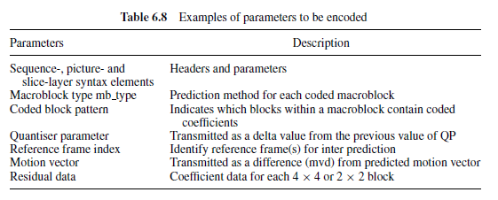
Exp-Golomb Entropy Coding

Slide 43
Exp-Golomb Entropy Coding
[M zeros][1][INFO]
INFO is anM-bit field carrying information
each codeword can be constructed by the encoder based on its index code_num:
M = floor(log2[code_num + 1])
INFO = code_num + 1 − 2M

Slide 44
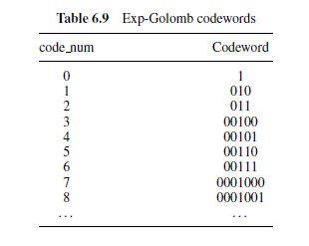
Exp-Golomb Entropy Coding

Slide 45
Context-Based Adaptive Variable Length Coding (CAVLC)
After prediction, transformation and quantisation, blocks are typically sparse (containing mostly zeros). CAVLC uses run-level coding to represent strings of zeros compactly.
The highest nonzero coefficients after the zig-zag scan are often sequences of ±1 and CAVLC signals the number of high-frequency ±1 coefficients (‘Trailing Ones’) in a compact way.

Slide 46
Context-Based Adaptive Variable Length Coding (CAVLC)
The number of coefficients is encoded using a look-up table and the choice of look-up table depends on the number of nonzero coefficients in neighbouring blocks.
The level (magnitude) of nonzero coefficients tends to be larger at the start of the reordered array (near the DC coefficient) and smaller towards the higher frequencies.

Slide 47
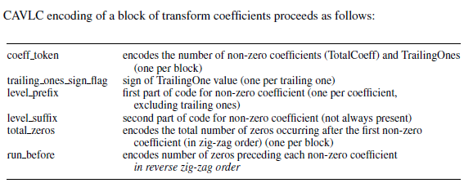
Context-Based Adaptive Variable Length Coding (CAVLC)

Slide 48
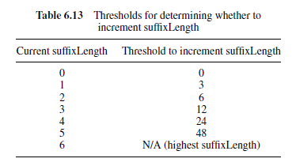
Context-Based Adaptive Variable Length Coding (CAVLC)

Slide 49
Main Profile
Suitable application for the Main Profile include (but are not limited to) broadcast media applications such as digital television and stored digital video
is almost a superset of the Baseline Profile

Slide 50
Main Profile
Privides:
B Slice (bi-predicted slices for greater coding efficiency),
weighted prediction (providing increased flexibility in creating a motion-compensated prediction block)
support for interlaced video (coding of fields as well as frames)
CABAC (an alternative entropy coding method based on Arithmetic Coding).

Slide 51
B Slice
Each macroblock partition in an inter coded macroblock may be predicted from one or two reference pictures, before or after the current picture in temporal order.
Reference pictures: are organised to 2 list
List 0: contains short term picture.
List 1: contains long term picture.

Slide 52
Reference pictures
List 0: The closest past picture is assigned index 0, followed by any other past pictures, followed by any future pictures.
List 1: The closest future picture is assigned index 0, followed by any other future picture, followed by any past.

Slide 53
B slice – Prediction option
Direct mode.
MC prediction from list 0.
MC prediction from list 1.
MC bi-prediction from list 0 and 1.

Slide 54
Bi-prediction
Two MC reference areas are obtained from a list 0 and a list 1 picture respectively (two motion vectors are required) and each sample of the prediction block is calculated as an average of the list 0 and list 1 prediction samples.

Slide 55
Direct prediction
the decoder calculates list 0 and list 1 vectors based on previously-coded vectors and uses these to carry out bi-predictive motion compensation of the decoded residual samples.

Slide 56
Weighted prediction
prediction sample from list 0 or list 1 is scaled by a weighting factor w0 or w1 prior to motion-compensated prediction.
3 types:
1. P slice macroblock, ‘explicit’ weighted prediction;
2. B slice macroblock, ‘explicit’ weighted prediction;
3. B slice macroblock, ‘implicit’ weighted prediction.
Notes:
Explicit: weighted factors are detemined by encoder and transmitted in the slice header.
Implicit: factors are calculated based on the relative temporal position of the list 0 and list 1 reference pictures.

Slide 57
Interlaced video
the type of picture (frame or field) is signalled in the header of each slice.
macroblock-adaptive frame/field (MB-AFF) coding mode, the choice of field or frame coding may be specified at the macroblock level.

Slide 58
Context-based Adaptive Binary Arithmetic Coding (CABAC)
Flag entropy_coding_mode is set to 1.
CABAC:
selecting probability models for each syntax element according to the element’s context
adapting probability estimates based on local statistics
using arithmetic coding rather than variable-length coding.

Slide 59
Context-based Adaptive Binary Arithmetic Coding (CABAC)
Binarise the value → Choose a context model for each bin → Encode each bin →Update the context models.

Slide 60
TRANSPORT OF H.264
A coded H.264 video sequence consists of a series of NAL units.
Each containing an RBSP, Coded slices (including Data Partitioned slices and IDR slices) and the End of Sequence RBSP are defined as VCL NAL units.

Slide 61
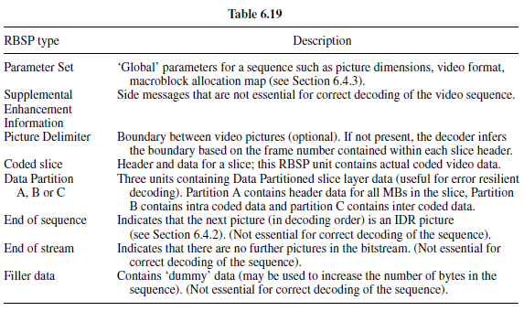
TRANSPORT OF H.264

