Slide 1
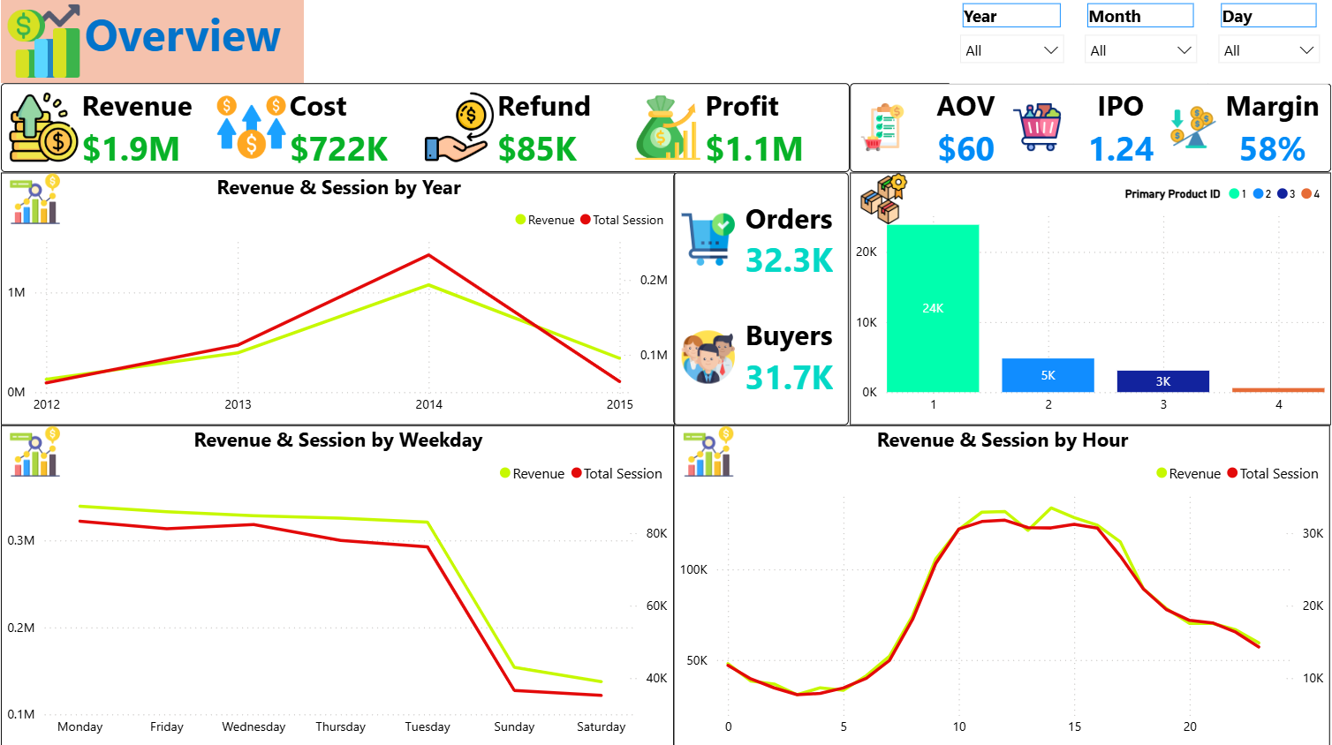
Ecommerce
Ecommerce - BI
I. Overview Dashboard
- KPI charts:
+ Revenue: price_usd
+ Cost: Cogs_usd
+ Refund: Refund_amount_usd
+ Profit = revenue – cogs
+ AOV: average order value
+ IPO: Item per order
+ Margin: profit / revenue
+ Orders: total orders
+ Buyers: total buyers

Slide 2
Ecommerce
Ecommerce - BI
I. Overview Dashboard
*Filter apply only to this page
- Revenue & Session over time (Y,Q,M,D)
- Revenue & Session by Day of week
- Revenue & Session by Hour
- Order by Primary Product ID

Slide 3
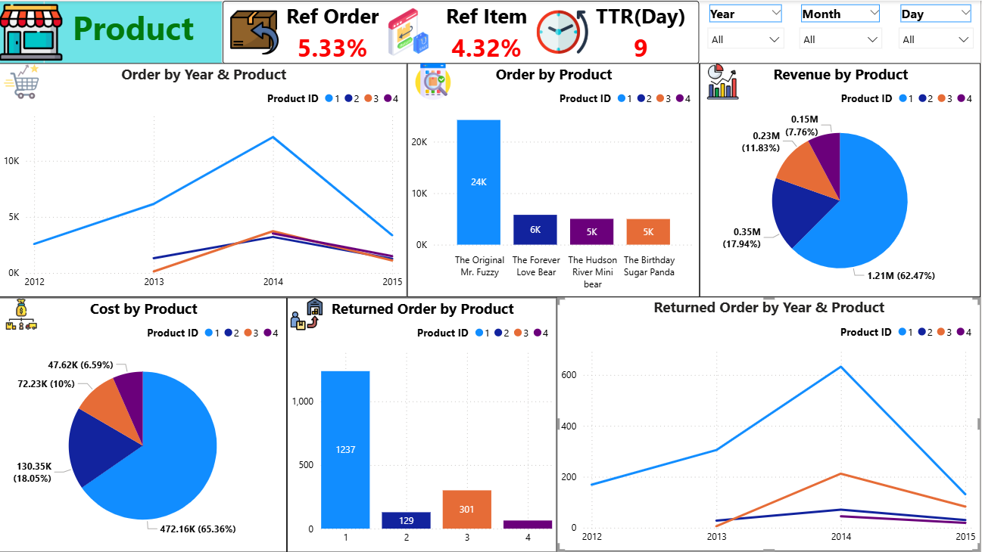
Ecommerce
Ecommerce - BI
II. Product Dashboard
*Filter apply only to this page
- KPI chart:
+ Ref Order: Refund order rate
+ Ref Item: Refund item rate
+ TTR(Day): Time to Return highlights
a high-risk post-purchase window.

Slide 4
Ecommerce
Ecommerce - BI
II. Product Dashboard
- Order Trend by Time & Product ID
(Y,Q,M,D)
- Order by Product ID & Name (bar chart)
- Revenue by Product ID & Name
- Cost by Product ID & Name
- Returned Order by Product ID & Name
(Tooltips: Refund)
- Returned Order Trend by Time &
Product ID

Slide 5
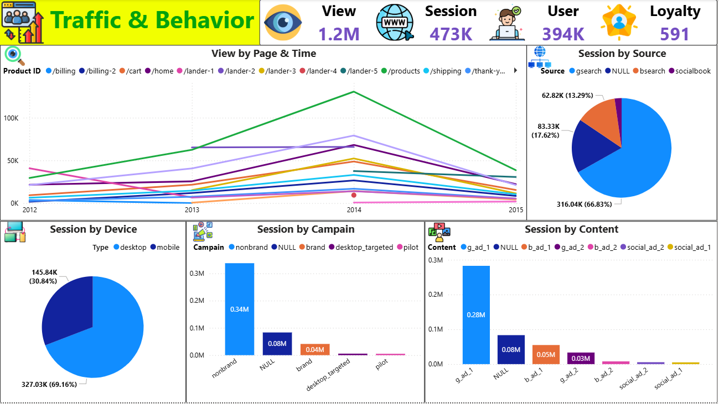
Ecommerce
Ecommerce - BI
II. Traffic & Behavior Dashboard
- KPI chart:
+ View: Total page views
+ Session: Total sessions
+ User: Total users access this website
+ Loyalty: Total repeat customers

Slide 6
Ecommerce
Ecommerce - BI
II. Traffic & Behavior Dashboard
- View Trend by Page & Time
(Y,Q,M,D)
- Session by Source
- Session by Device Type
- Session by Campaign
- Session by Content

