Slide 1
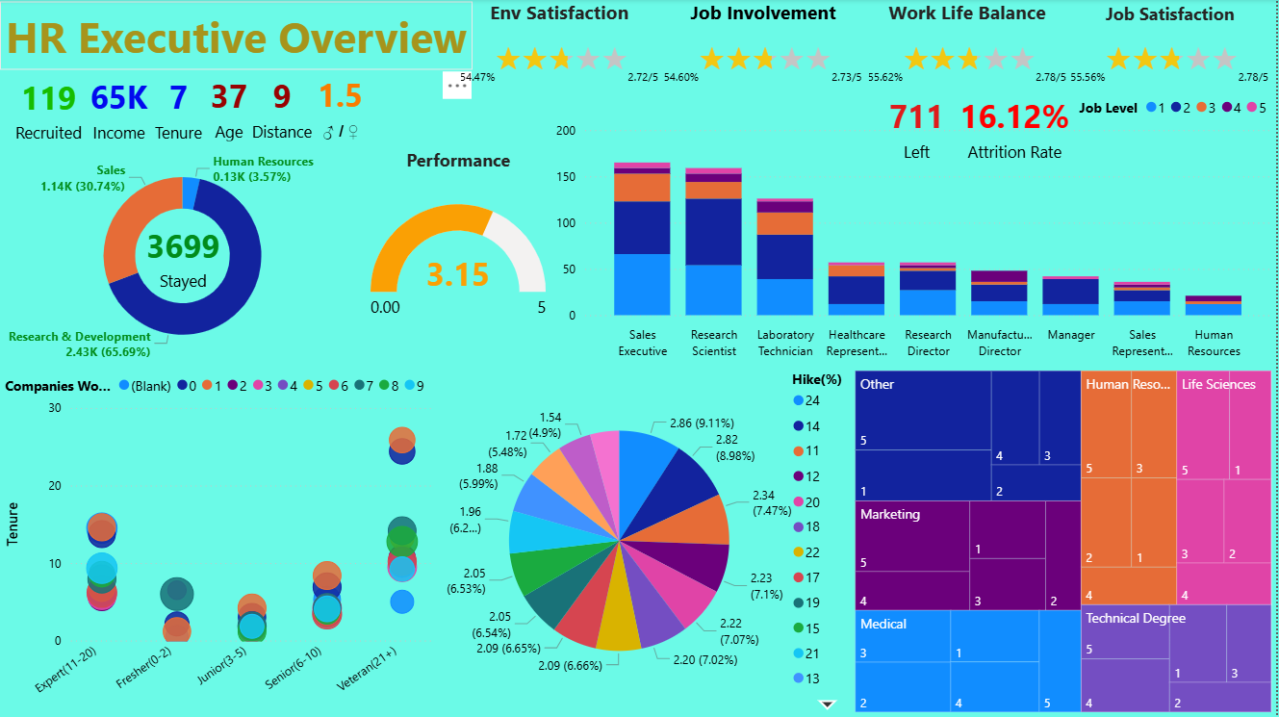
HR Department - BI
I. Overview Dashboard
- It is divided into 3 areas:
- Area 1:
+ Total recruited employees
+ Average Monthly Income
+ Average Tenure
+ Average age
+ Average Distance from home
+ Ratio: Male/Female
+ Distribution by Department(stayed)
+ Performance Rating

Slide 2
HR Department - BI
I. Overview Dashboard
- Area 2:
+ Stacked bar by Role, Level (left)
+ Environment Satisfaction (0-5)
+ Job Involvement (0-5)
+ Work Life Balance (0-5)
+ Job Satisfaction (0-5)
+ Total left employees
+ Attrition rate (left/stayed + left)

Slide 3
HR Department - BI
I. Overview Dashboard
- Area 3:
+ Scatter plot: Relationship between
employee tenure & experience,
colored by number of companies worked
& sized by monthly income.
+ Pie chart: Distribution of last promotion
by salary hike, with years under current
manager shown in tooltip.
+ Tree map: Stock option distribution by
education field & level.

Slide 4
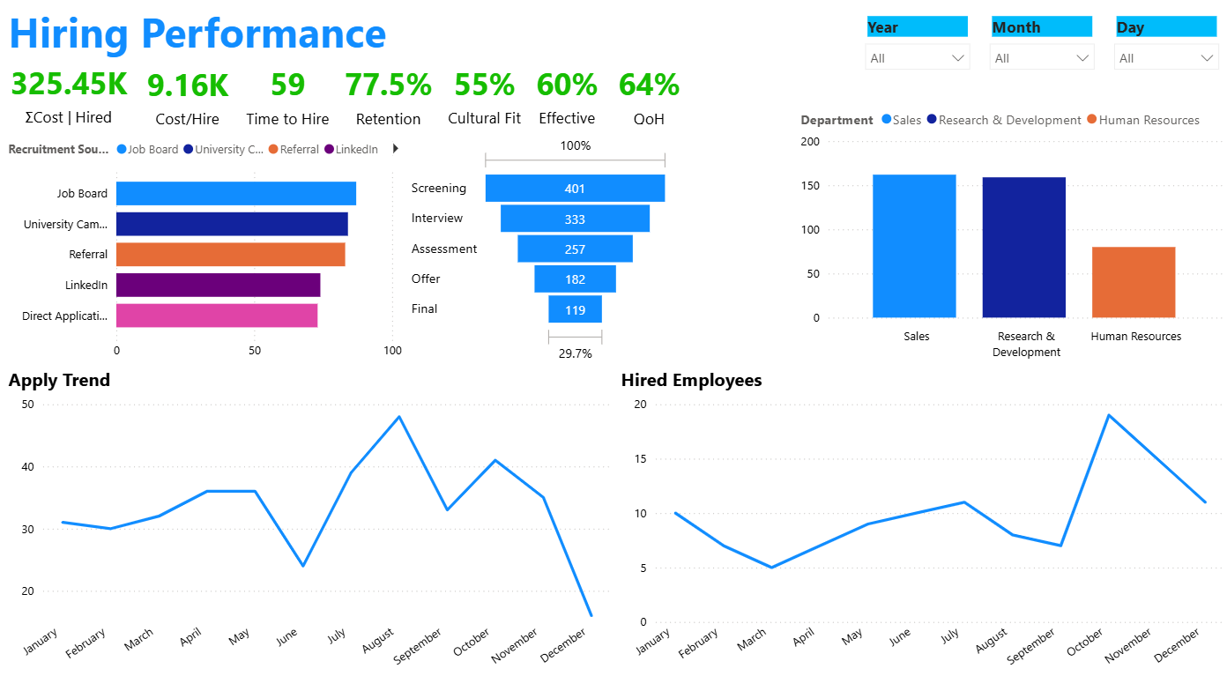
HR Department - BI
II. Recruitment Dashboard
- Total payroll
- Cost per hire - average
- Time to hire (day) – average
- Retention – total hired employees
(Stayed/ left + stayed)
- Cultural fit – Avg(JobSat + EnvSat + WLB)
- Effective – Avg( Perf + Involve)
- Quality of hires: 0.3 retention +
0.3 cultural + 0.4 effective

Slide 5
HR Department - BI
II. Recruitment Dashboard
- Global dashboard filter
- Employee Hires by Channel
- Hiring Funnel – (conversion rate)
- Employee Hires by Department
- Apply trend: year, quarter, month, day
- Hired trend: year, quarter, month, day

Slide 6
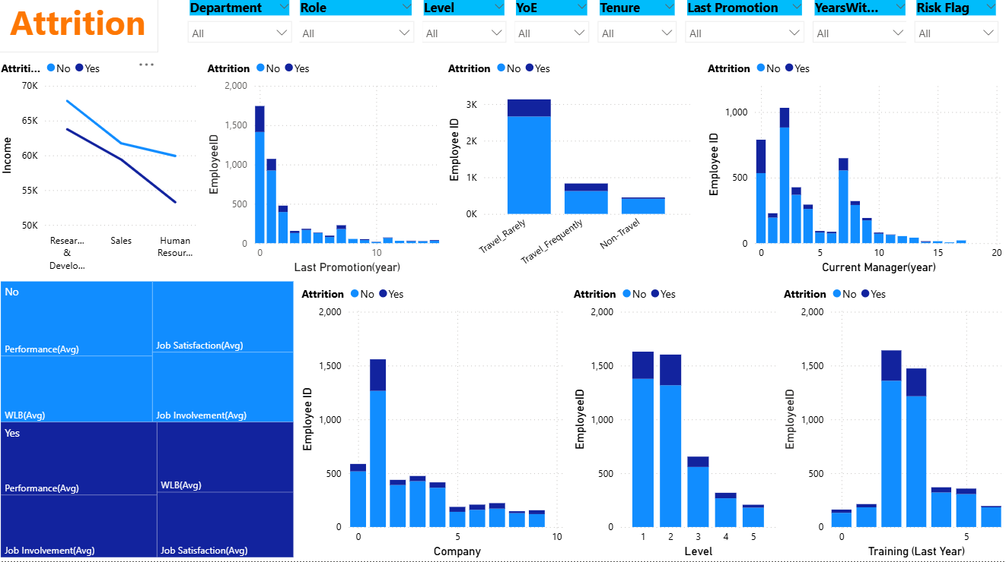
HR Department - BI
III. Attrition Dashboard
- Global dashboard filter
- Income by Department (Attrition split)
- Attrition by Last Promotion (Years)
- Attrition by Business Travel
- Attrition by Current Manager (Years)
- Engagement & Satisfaction (Attrition split)
- Attrition by Company
- Attrition by Job Level
- Attrition by Training (Last Year)

Slide 7
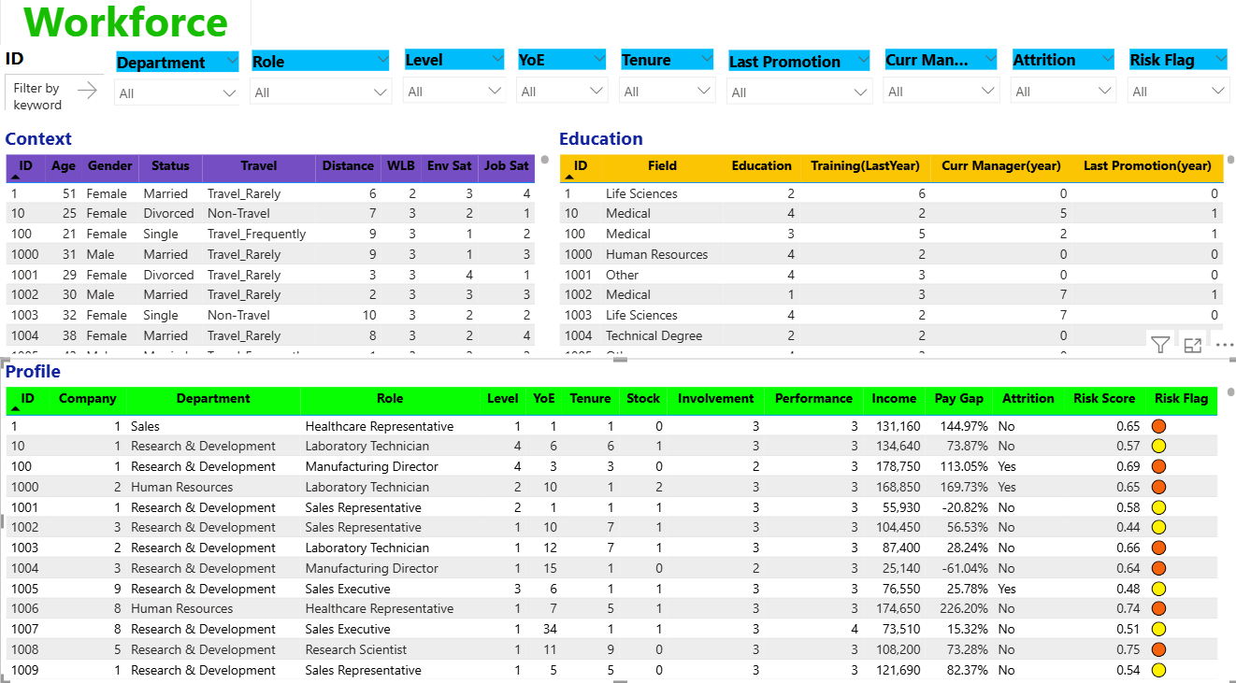
HR Department - BI
IV. Workfore Detail
- Global dashboard filter
- Context: related to employee context
- Education: related to employee
development
- Profile: Consolidated employee profile

Slide 8
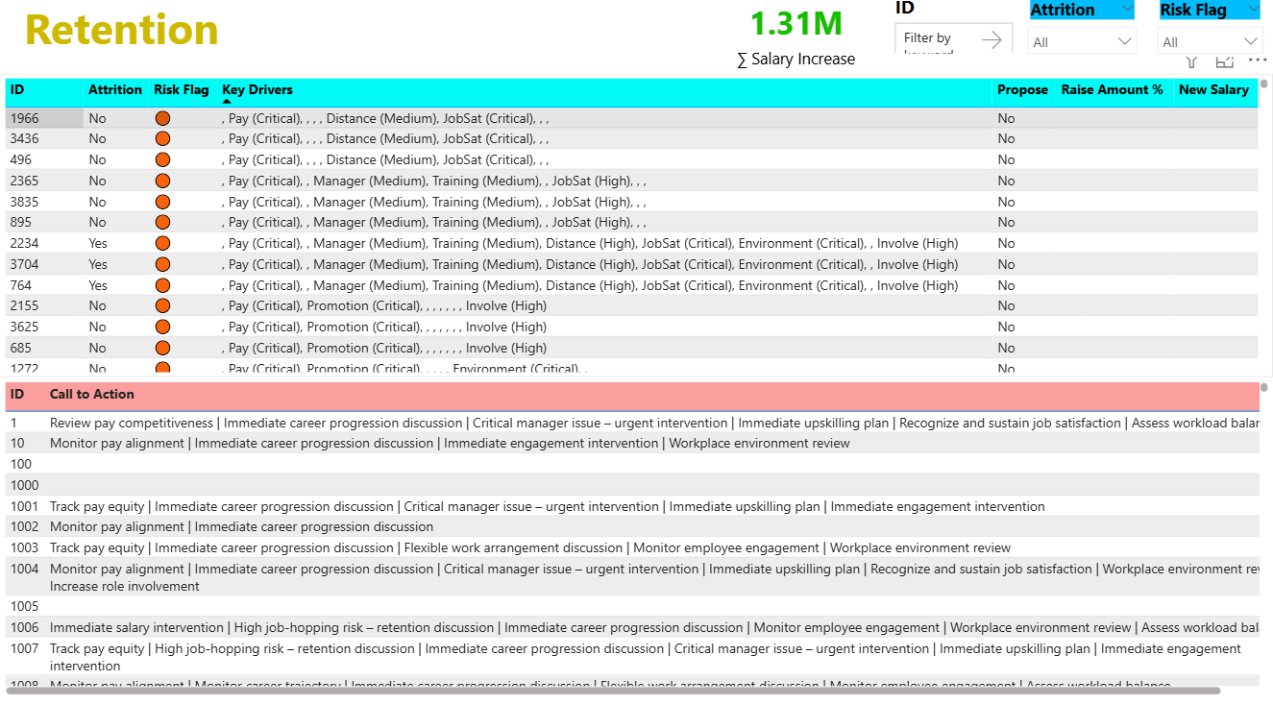
HR Department - BI
V. Retention
- Global dashboard filter
- KPI: Total Proposed Salary Increase
- Retention Risk Details: Key Drivers &
projected compensation impact.
- CTA: Recommended Retention Actions

