Slide 1
Japan Restaurant
1. Ask
1. How is the overall business performance changing over time, and what are the key fluctuations in revenue ?
2. Which products or product groups contribute the most to revenue, and which underperforming items should be considered for optimization or removal ?
3. What customer behavior patterns can be observed by time (hour/day) and by group size, and how do these patterns impact the Average Order Value (AOV) ?
4. How are the different sales channels (dine-in, delivery app, take-away, etc.) performing, and which channel provides the highest value to the restaurant ?
5. Are the current promotional programs truly effective in increasing revenue or AOV, or are they reducing profit margins ?
6. Are there opportunities to build combos or upsell recommendations based on frequently purchased item pairs (cross-selling) ?
7. Based on performance and growth, how can the current menu be categorized (BCG matrix) to support decisions on which items to invest in, maintain, optimize, or eliminate ?

Slide 2
Japan Restaurant
2. Prepare
Data source: The dataset was provided as part of a recruitment assessment for a Data Analyst position.
The dataset contains 46 columns & 1665 rows.
Each row corresponds to a product.
The dataset includes typical columns:
+ Text(Món mới, Hoá đơn)
+ Number(Số hoá đơn, Giá, Thành tiền)
+ Datetime (Ngày, Giờ)

Slide 3
Japan Restaurant
3. Process
Tools: Excel + Looker Studio
Clean data through Excel:
  + Create the filter in order to identify the incorrect values.
  + Check for missing values & remove duplicate
  + Trim values
  + Check & standardize datatype.
  + Check & handle datetime (Ngày, Giờ)
  + Extract the week from “Ngày” column.

Slide 4
Japan Restaurant
4. Analyze
- Overall Revenue Performance:
+ Key metrics: Total Revenue (gross sales) and Net Revenue (= gross sales - discounts - promotions).
+ Analyze daily and weekly revenue trends to determine whether the business is growing or declining over time.
- Product Performance & Menu Optimization:
+ Evaluate dish performance by listing the top 10 best-selling items by revenue and by quantity, and identify the bottom 10 underperforming items.
+ Review revenue contribution by menu categories (main dishes, appetizers, drinks, etc.).
+ Perform cross-selling analysis to find dish pairs frequently ordered together and recommend potential combo offerings.
+ Apply a BCG matrix to categorize menu items into Stars, Cash Cows, Question Marks, and Dogs to guide menu strategy.

Slide 5
Japan Restaurant
4. Analyze
- Customer Behavior Insights:
+ Conduct peak time analysis by examining revenue and order volume by hour of day and by day of week to identify high-demand periods.
+ Calculate Average Order Value (AOV) overall, and compare AOV between weekdays and weekends as well as across sales channels (dine-in, delivery apps, takeaway).
+ Analyze how group size affects spending behavior and item selection.
- Sales Channels & Promotion Effectiveness:
+ Assess channel performance by measuring revenue share and AOV for each channel (dine-in, delivery apps, takeaway) to identify the most profitable channels.
+ Evaluate promotion effectiveness by tracking usage frequency of each promotion code or campaign and comparing AOV for orders with promotions versus orders without to determine the impact of discounts on customer spending.

Slide 6
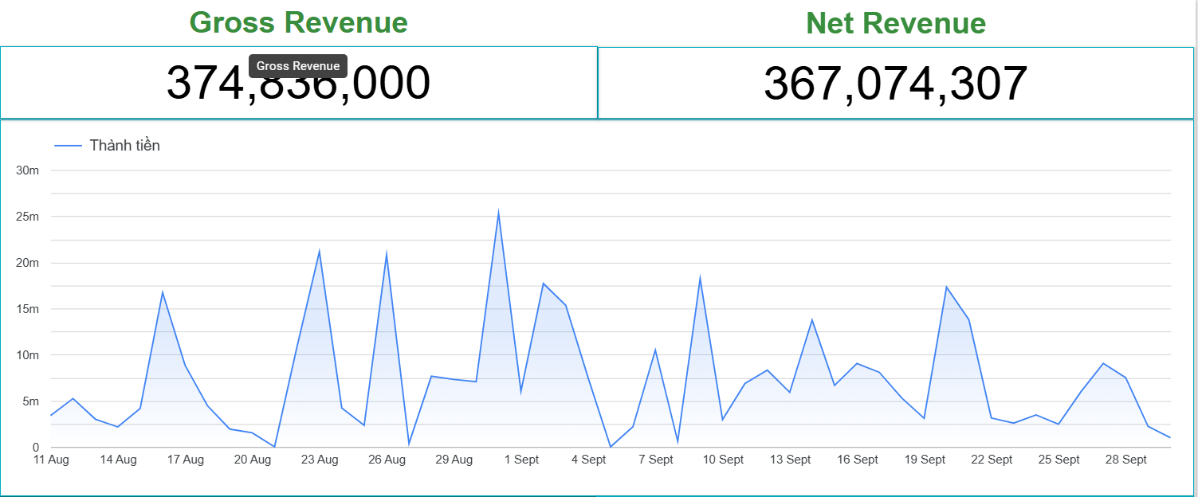
Japan Restaurant
5. Share
➔ This revenue level is considered below average for a typical Japanese restaurant (200m/month). Revenue fluctuates considerably without forming a consistent trend or seasonality.

Slide 7
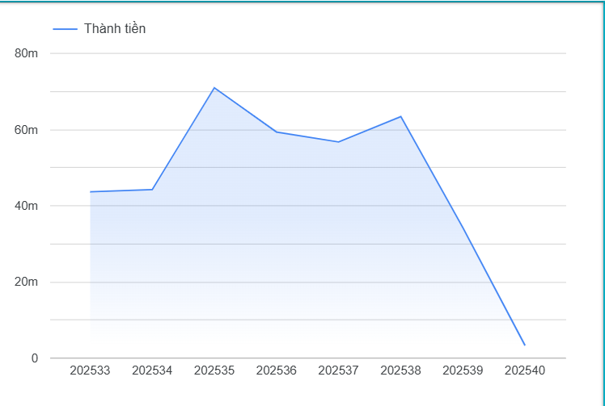
Japan Restaurant
5. Share
- 202533 = 2025 week 33
- The highest profit was recorded in Week 35,
which corresponds to the end of August. This
suggests that customer traffic tends to increase
toward the end of the month, potentially leading
to higher restaurant spending during this period.

Slide 8
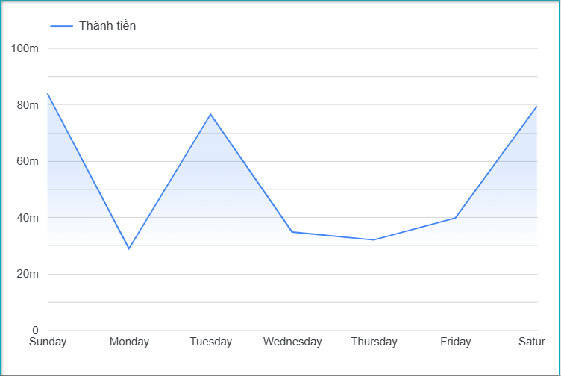
Japan Restaurant
5. Share
- Revenue increases significantly on weekends
and Tuesday, while the remaining days
maintain a normal and stable level.

Slide 9
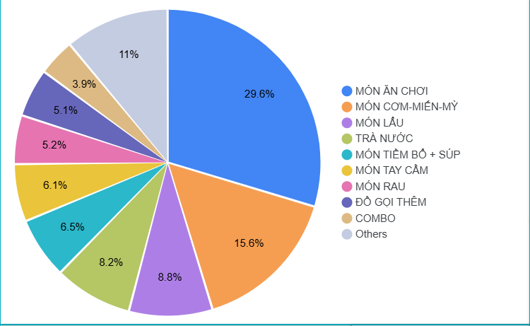
Japan Restaurant
5. Share
- “MÓN ĂN CHƠI” account for the largest
share of revenue at 30%. Following that,
“MÓN CƠM-MIẾN-MỲ”, “MÓN LẨU” &
“TRÀ NƯỚC” also contribute significantly to
overall revenue.

Slide 10
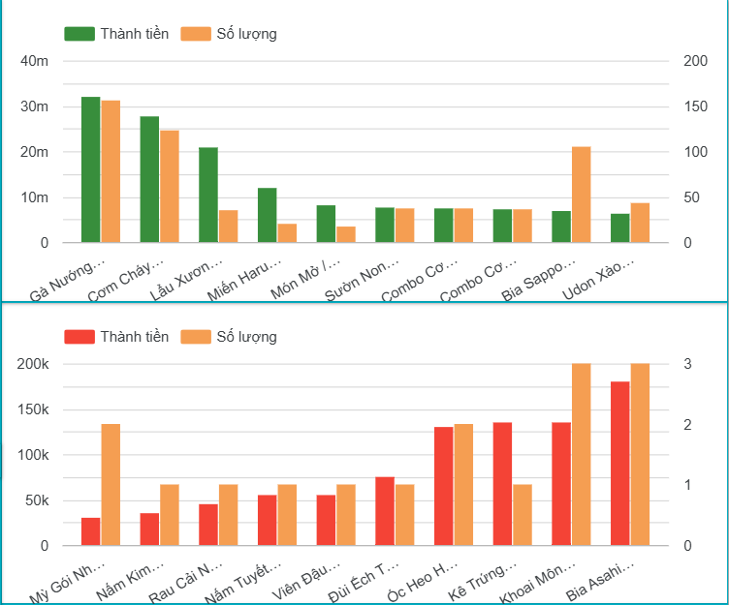
Japan Restaurant
5. Share
- 3 Best-selling items:
+ Gà nướng Teriyaki nửa con
+ Cơm cháy Nhật Bản
+ Lẩu xương hầm Tonkotsu
- 5 underperforming items:
+ Mỳ gói Nhật thêm
+ Nấm kim châm Enoki
+ Rau cải ngọt luộc
+ Nấm tuyết Shirokikurage
+ Viên đậu hũ phô mai

Slide 11
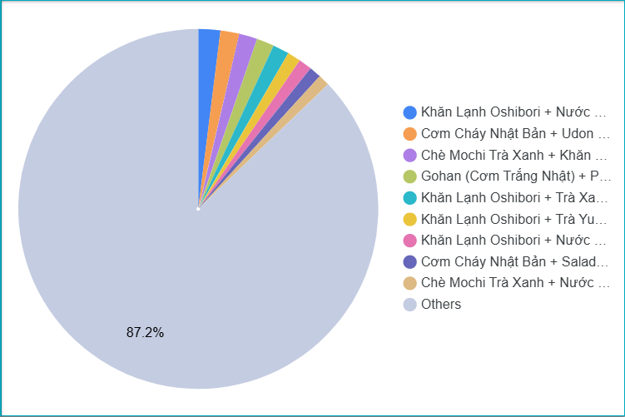
Japan Restaurant
5. Share
- Cross-selling: potential combo
1st: Khăn lạnh Oshibori + nước khoáng Fuji.
2nd: Cơm cháy Nhật + Udon xào bò sốt kem
Nấm.
3rd: Chè Mochi trà xanh + Khăn lạnh Oshibori.
4th: Gohan(cơm trắng Nhật) + phụ thu món
chờ.
5th: Khăn lạnh Oshibori + Trà xanh lài
Genmaicha.
6th: Khăn lạnh Oshibori + Trà yuzu me đá.
7th: Khăn lạnh Oshibori + Nước chanh yuzu
muối.

Slide 12
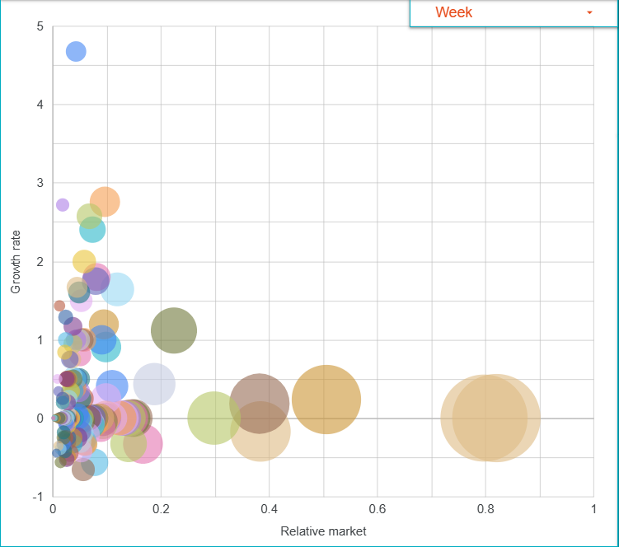
Japan Restaurant
5. Share
- BCG matrix:
+ Stars: No items were identified.
+ Cast Cows: Combo cơm gà Teriyaki + canh
Miso(nhỏ), combo cơm gà hấp + canh miso(nhỏ),
Gà nướng Teriyaki (nửa con).
+ Question marks: Trà lúa mạch Mugicha, tôm
sú chiên tỏi Ebi Chili, Bò teppanyaki, Sườn heo
nướng sốt Miso,...
+ Dogs: bia Asashi super dry, sườn heo hầm
Miso, Salad rau càng cua thịt bò Tataki, Sò điệp
Nhật áp chảo măng tây,…

Slide 13
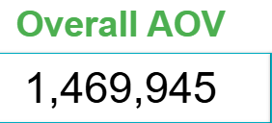
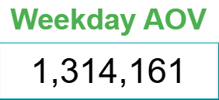
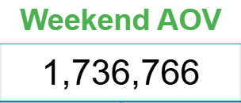
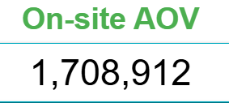
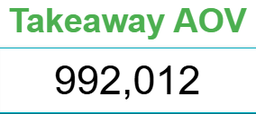
Japan Restaurant
5. Share
- Weekends show the highest AOV, indicating customers spend more
during those days.
- Onsite orders maintain a high AOV, suggesting diners tend to spend
more when eating at the restaurant.
- Takeaway has the lowest AOV, which is typical for smaller, quick orders.
- Weekdays show a moderate and stable AOV.

Slide 14
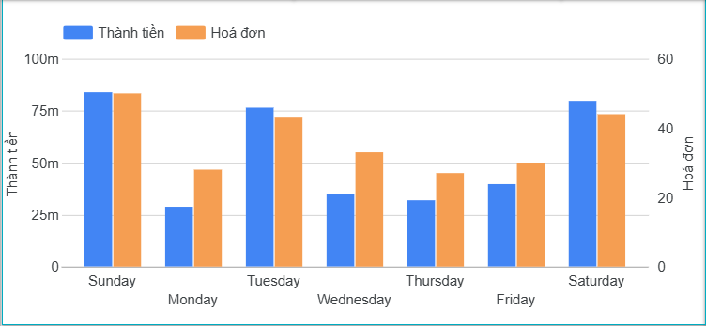
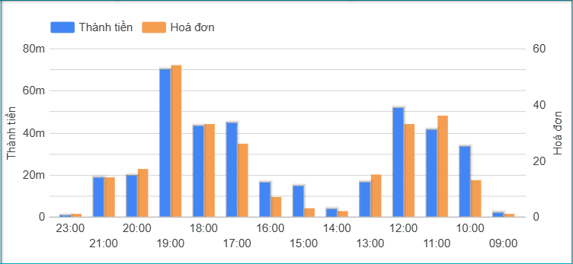
Japan Restaurant
5. Share
- Customer traffic peaks on weekends and
Tuesday.
- Customer traffic is highest during the
evening (17:00–19:00) and midday
(11:00–12:00).

Slide 15
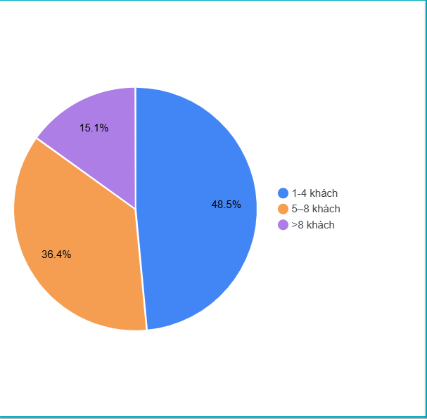
Japan Restaurant
5. Share
- The AOV mainly comes from groups of
1–4 customers, accounting for 48.5%.
- This is followed by groups of 5–8 customers at
36.4%.

Slide 16
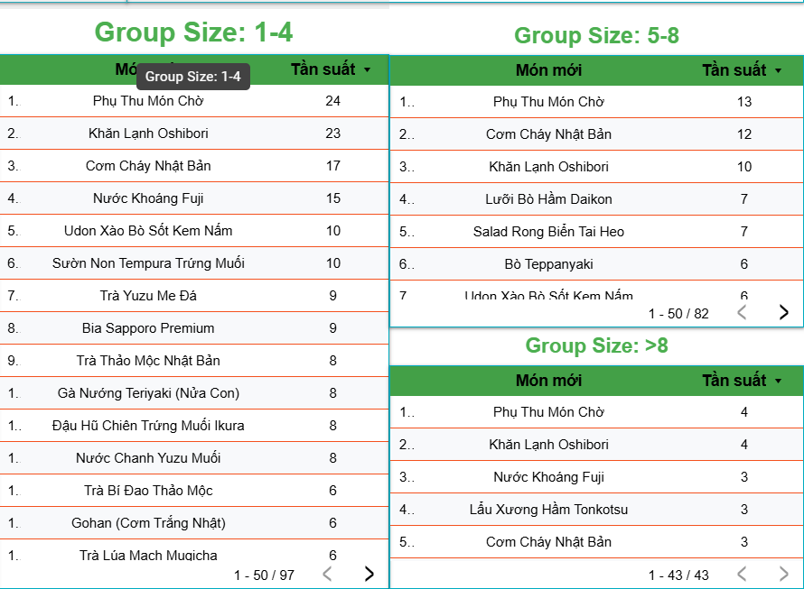
Japan Restaurant
5. Share
- Overall, the popular dishes across the 3
groups are quite similar. However, larger
groups tend to order additional items such as:
+ Lưỡi bò hầm Daikon
+ Salad rong biển tai heo
+ Lẩu xương hầm Tonkotsu

Slide 17
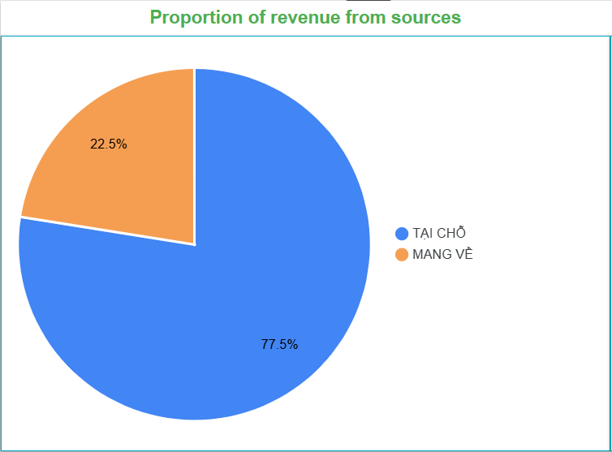
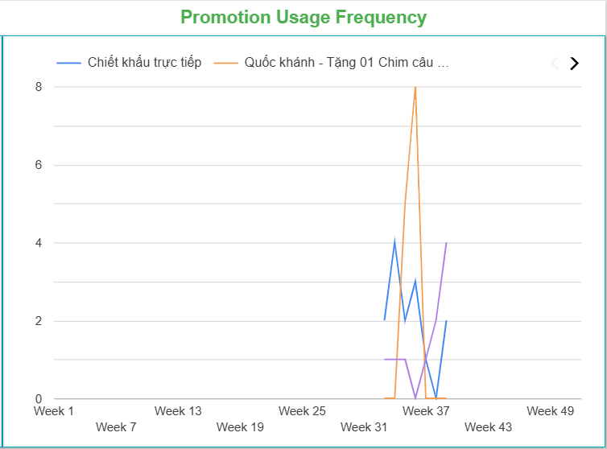
Japan Restaurant
5. Share
- Most of the revenue comes from dine-in service(77.5%).
- The number, frequency, and duration of promotional
strategies are still too low and limited, so their
effectiveness cannot be clearly or reliably evaluated yet.

Slide 18
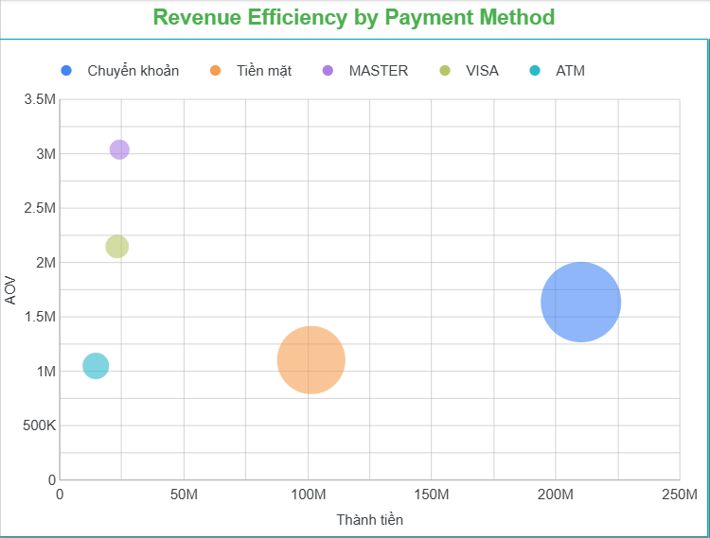
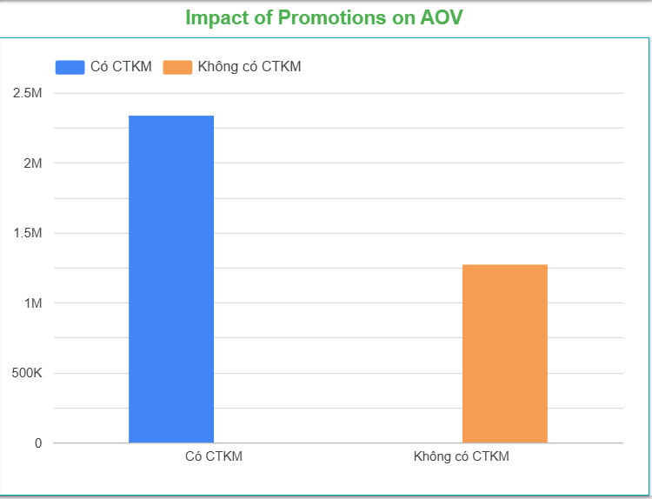
Japan Restaurant
5. Share
- Customers who prefer paying via bank transfer
contribute the largest share of revenue and show a
relatively strong AOV. Notably, customer groups using
international payment cards exhibit exceptionally high
AOV levels.
- The AOV shows a clear and significant increase
whenever promotions are implemented.

Slide 19
Japan Restaurant
6. Act
- Optimize Traffic: Since weekends & Tuesday have the highest customer volume:
+ Prioritize staffing during peak periods.
+ Push high-value combo upselling.
+ Cross-sell signature drinks.
- Increase Onsite Revenue: Focus on enhancing the onsite dining experience, as it is the primary revenue source. Improve peak-hour performance by:
+ Introducing set menus for groups of 1–4, 5–8 & >8.
+ Prioritizing shareable dishes, combos, and top-selling items.
- Boost AOV for Larger Customer Groups:
+ Launch Family / Group Combo packages
+ Encourage upselling: snacks/appetizers, signature drinks, toppings, and extras.
+ Place banners or table tents to promote group-focused offers.

Slide 20
Japan Restaurant
6. Act
- Promotion Strategy: Increase the frequency and duration of promotional experiments. Implement 3 types of test promotions:
+ Time-based deals: Lunch Deal (11:00–13:00), Dinner Booster (17:00–20:00).
+ Category-based promo: Discount on snacks/appetizers & drink to drive traffic.
+ Payment-based promo: 5–10% discount for international cards or bank transfer.
- Increase Takeaway Revenue: Takeaway performance is currently weak — improve it by:
+ Offering takeaway combos at 10% lower pricing.
+ Improving packaging consistency and presentation.
+ Creating a “Happy Tuesday” takeaway promotion.

Slide 21
Japan Restaurant
6. Act
- Focus on International Card Users: This segment shows very high AOV, Strategies:
+ Provide exclusive discounts for Visa/Mastercard users.
+ Collaborate with banks for co-branded promotions.
- Menu Strategy:
+ Maintain top-performing menu items
+ Develop more shareable dishes for larger groups.
+ Strengthen marketing for the Snack/Appetizer & drink category.

Slide 22
Japan Restaurant
6. Act
- Overall Strategic Recommendations:
+ Identify potential customer segments & nearby communities around the store.
+ Develop menu offerings & service experiences that align with seasonal weather conditions.
+ Strengthen targeted marketing campaigns for each audience group.
+ Launch promotions & discounts aligned with annual events & emerging social media trends among younger customers.
+ Establish a quality-control process to evaluate the value & usability of ingredients.
+ Develop a recycling & sustainability model.
+ Create food & beverage items that are entertaining, visually appealing, and shareable to enhance word-of-mouth impact.
+ Conduct margin analysis for each product to gain accurate insights into profitability.
+ Remove items with low sales volume & low usage frequency.
+ Flexibly apply these strategies to optimize inventory management and minimize waste.

