Slide 1
Employee Churn Analysis
1. Overview
- Goals: + Analyze the data collected by the HR department (read in report_DA file).
+ Build a model that predicts whether or not an employee will leave the company.
- Stage: Construct
+ Determine which models are most appropriate
+ Construct the model
+ Confirm model assumptions
+ Evaluate model results to determine how well the model fits the data
- Model:
+ Logistic regression
+ Decision tree
+ Random forest
+ XGBoost

Slide 2
Employee Churn Analysis
2. Transform data
- There is a chance that there is some data leakage occurring.
- The average_monthly_hours column is a source of some data leakage.
- If employees have already decided upon quitting, or have already been identified by management as people to be fired, they may be working fewer hours.
- As clarified in the report_DA file, people who work more than 166.67 hours per month will be overworked, otherwise it will be normal.
Transform average_monthly_hours column to workload_status column. Value >175 = overworked & value <175 = normal.
- Encoding the categorical features: workload_status, department, salary.

Slide 3
Employee Churn Analysis
3. Logistic Regression
Assumptions:
✅ Pass: Outcome variable is categorical – (0 = stayed, 1 = left)
✅ Pass: Observations are independent of each other
(Each record in the dataset represents a unique employee, and there are no repeated measurements or time-series dependencies)
✅ Pass: No severe multicollinearity among X variables (Assessed using a correlation matrix)
✅ Pass: No extreme outliers – (data cleaned)
❌Violate: Linear relationship between each X variable and the logit of the outcome variable
(The results showed that most key predictors — including number_project, average_monthly_hours, last_evaluation, time_spend_company, and satisfaction_level — have statistically significant p-values (p < 0.05), indicating violations of the linearity assumption. Logistic Regression is sensitive to this requirement, and violation of linearity may reduce its predictive accuracy relative to nonlinear models. The violation of the linearity assumption was acknowledged as a limitation, and more flexible algorithms (Decision Tree, Random Forest, XGBoost) were introduced to capture these nonlinear relationships.)
✅ Pass: Sufficiently large sample size (1882 left/ 19 features)

Slide 4
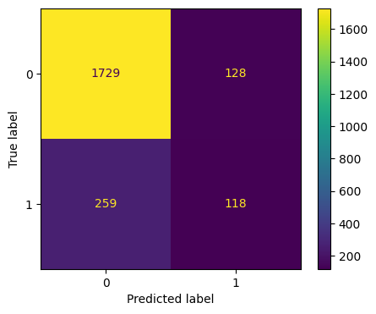
Employee Churn Analysis
3. Logistic Regression
- Split the data (test_size=0.2)
- True Positive: Left & predicted left.
- False Positive: Stayed but predicted left.
- True Negative: Stayed & predicted stayed.
- False Negative: Left but predicted stayed.
➔There is an approximately 83%-17% split.
The data is not perfectly balanced, but it is
not too imbalanced.

Slide 5
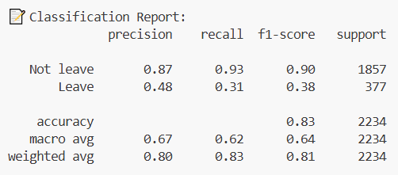
Employee Churn Analysis
3. Logistic Regression
- Precision: 0.8, Recall:0.83,
f1-score: 0.81 (all weighted averages),
Accuracy: 0.83
It’s important to predict who leave, so
the scores are significantly lower.

Slide 6
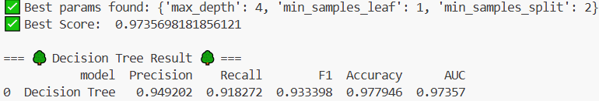
Employee Churn Analysis
4. Decision Tree
- Split the data (test_size=0.2)
- Param = max_depth: [4, 6, 8, None], min_samples_split: [2, 4, 6], min_samples_leaf: [1, 2, 4]
- Cross-validation = 5
- Refit = roc_auc
✅ All of these scores are strong indicators of good model performance.
⚠ Decision trees can be vulnerable to overfitting.
⭐ Random forests avoid overfitting by incorporating multiple trees to make predictions.

Slide 7
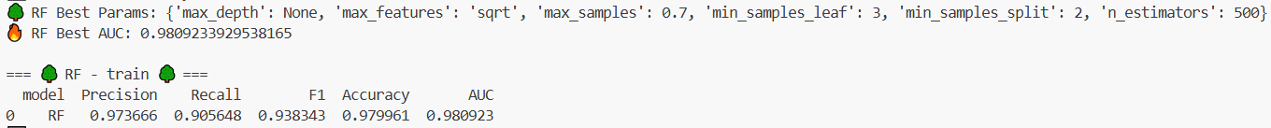
Employee Churn Analysis
5. Random Forest
- Split the data (test_size=0.2)
Param = max_depth: [3, 5, None], max_features: ['sqrt', 'log2’], max_samples: [0.7, 1.0],
min_samples_split: [2, 3, 4], min_samples_leaf: [1, 2, 3], n_estimators: [300, 500]
- Cross-validation = 5
Refit = roc_auc
🎯 The Random Forest demonstrates strong overall performance on both the training and test sets.

Slide 8
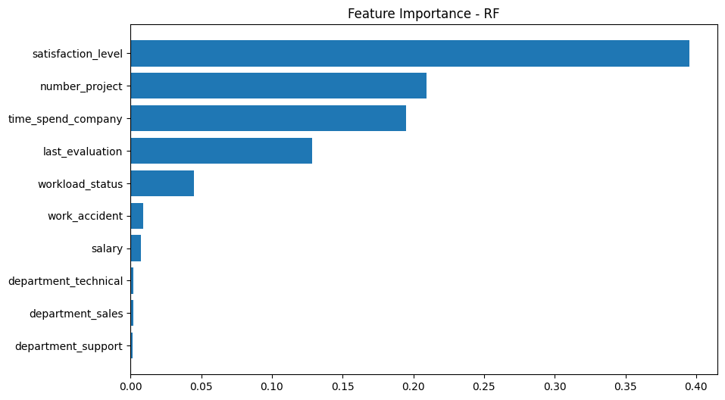
Employee Churn Analysis
5. Random Forest
- The model’s behavior shows that
Satisfaction_level, workload,
tenure are the primary drivers of
attrition prediction.
- This insight can guide HR strategies
toward improving satisfaction and
managing workload distribution to
reduce turnover.
➔⚠ When scaling HR analytics to larger employee datasets or running frequent retraining jobs, RF’s runtime cost becomes a bottleneck.

Slide 9
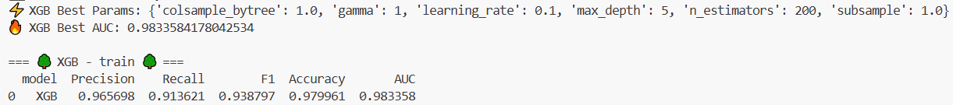
Employee Churn Analysis
6. XGBoost
- Split the data (test_size=0.2)
- Param = n_estimators: [200, 300], learning_rate: [0.01, 0.1], max_depth: [3, 5], subsample: [0.7, 1.0], colsample_bytree: [0.7, 1.0], gamma: [0, 1]
- Cross-validation = 5
- Evaluate metric= logloss
- Refit = roc_auc
➔ XGBoost offers superior predictive capability compared to Random Forest, particularly in terms of AUC, F1 & Recall.

Slide 10
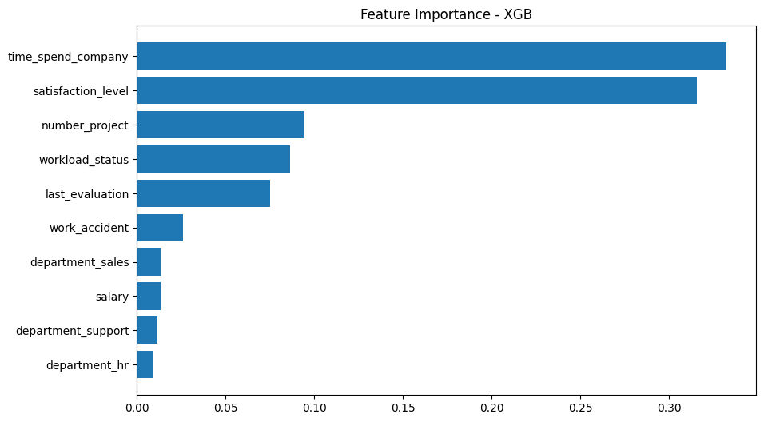
Employee Churn Analysis
6. XGBoost
- XGBoost emphasizes a combination
of tenure, satisfaction & workload
health as the primary determinants of
employee turnover.
- These insights guide HR toward
focusing on:
+ Career development for long-tenure
employees
+ Satisfaction improvement initiatives
+ Workload balancing to prevent burnout

Slide 11
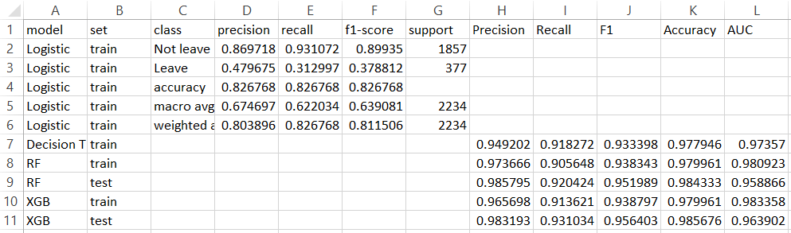
Employee Churn Analysis
6. XGBoost
➔ 🏆 XGBoost is the most effective and reliable model for predicting employee turnover, offering the strongest predictive power and best balance between accuracy, recall, and computational efficiency.

