Slide 1
BIKE-SHARE
1. Ask
1. What do customers like when using our services ?
2. What are the difficulties in operating our service system ?
3. How do annual members and casual riders use Cyclistic bikes differently ?
4. Why would casual riders buy Cyclistic annual memberships ?
5. How can Cyclistic use digital media to influence casual riders to become members ?

Slide 2
BIKE-SHARE
2. Prepare
Data source: https://divvy-tripdata.s3.amazonaws.com/index.html
The data consist of 12 “.csv” file, each representing a month of trips.
Each file contains 13 columns with consistent structure.
Each row corresponds to a single bike trip.
The dataset include:
+ Unique identifiers(ride_id)
+ Catergorical variables(rideable_type, member_casual, start_station_name, end_station_name, start_station_id, end_station_id)
+ Datetime variables(started_at, ended_at)
+ Geographic coordinates(start_lat, start_lng, end_lat, end_lng)
- All 12 monthly files have a consistent schema.

Slide 3
BIKE-SHARE
2. Prepare
ROCCC criteria:
+ Reliable: the data is provided by Motivate International Inc.
+ Original: this is first-party data collected directly from the Divvy bike system.
+ Comprehensive: The dataset includes detailed trip-level data.
+ Current: The data includes recent trip history ( 2024/07 - 2025/06)
+ Cited: The dataset is publicly available under a specific license and clearly states its source.
The data does not contain any personally identifiable information(PII) and no sensitive or private data is stored.
The data is freely accessible to everyone via Google Data Analytics Professional on Coursera.
Note: it lacks demographic information such as age, gender, or location, which limits deeper customer segmentation beyond membership type.

Slide 4
BIKE-SHARE
3. Process
Tools: Kaggle + DBeaver + MySQL(XAMPP) + Tableau
Data integrity: make a copy of the dataset before data is merged on Kaggle, https://www.kaggle.com/code/nhthienda/cyclistic-tripdata .
Clean data on DBeaver – use MySQL:
+ Import data & create database with 13 columns and corresponding data types by writing code.
+ Check for null values using the built-in column filter feature in Dbeaver (ride_id, rideable_type, started_at, ended_at, member_casual).
+ Check for duplicate values in ride_id column.
+ Check & remove if the trip end time occurred before the start time.
+ Chech & remove if the trip duration less than 1 minute or more than 24 hours.
+ Classify the values in the rideable_type & member_casual columns.
+ Check white space in rideable_type, start_station_name, start_station_id, end_station_name, end_station_id and mem_casual columns.

Slide 5
BIKE-SHARE
3. Process
+ Remove white space in start_station_name, start_station_id, end_station_name, end_station_id columns.
+ Filter rows where exactly all 4 columns are empty (start_station_name, start_station_id, end_station_name, end_station_id) .
+ Filter rows where exactly 1 out of 4 columns is non-empty (start_station_name, start_station_id, end_station_name, end_station_id).
+ Create new column for trip duration (ride_length),
+ Create new column for day of week (day_of_week).
+ Clean id colunns: convert from Double to Varchar format (id: 1253.0 → ‘1253’).
+ Check & remove the null value in lat, long columns.
+ Create table with valid station (start or end column is non-empty).

Slide 6
BIKE-SHARE
4. Analyze
Calculate the average of trip duration.
Determine the percentage distribution of each vehicle type.
Rank the top 5 most and least popular stations.
Identify the percentage distribution of user groups.
Find the day of week mode.
- Find the month mode.
Find the hour mode.
Identify spatial-density through map.
Provide the overview about usage level of distribution.

Slide 7
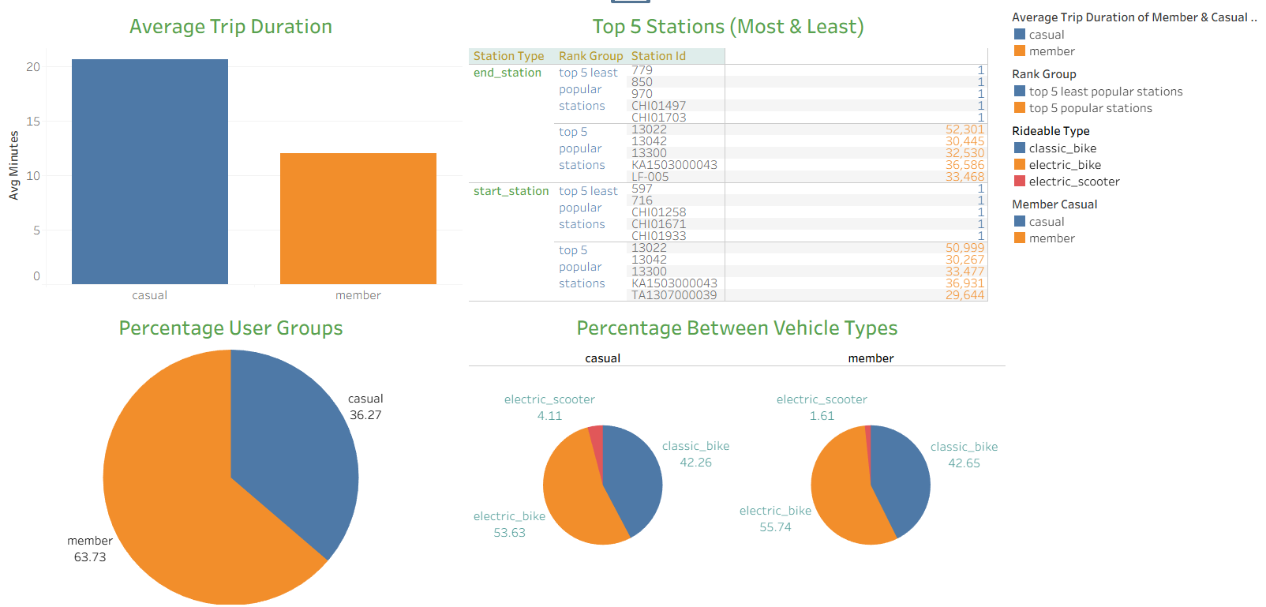
BIKE-SHARE
5. Share
- Ride usage dashboard:

Slide 8
BIKE-SHARE
5. Share
Ride Usage Dashboard:
The trip duration between casual and member customers is 20 minutes and 12 minutes respectively,
The percentage distribution of casual customers is almost 2 times higher than that of member customers.
The distribution of vehicle types is quite similar. Only the electric scooter of the casual group is 2 times higher than that of the member group (1.61%).
Top 5 most stations with up to 50 thounsand uses. Additionally, it is worth noting that there are many stations that only have one use.

Slide 9
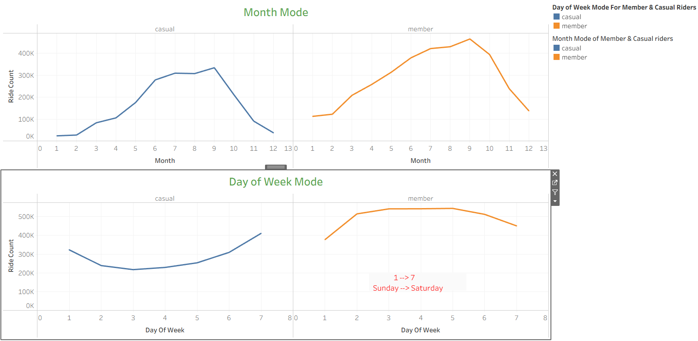
BIKE-SHARE
5. Share
User behavior dashboard 1:

Slide 10
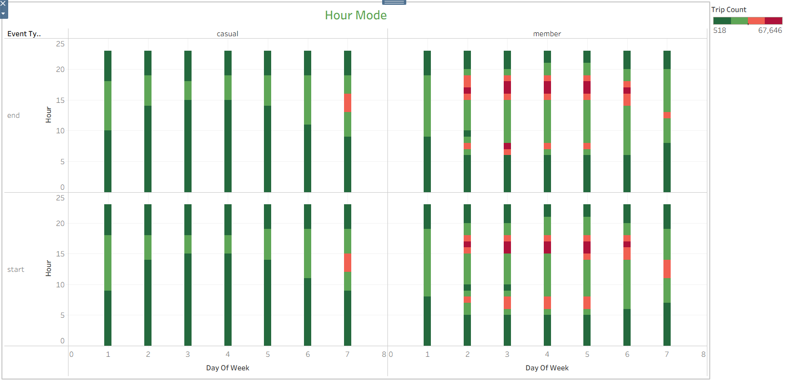
BIKE-SHARE
5. Share
User behavior dashboard 2:

Slide 11
BIKE-SHARE
5. Share
User Behavior Dashboard 1:
In monthly mode, the two charts are quite similar.
In day of week mode, the charts are opposite. While the casual group only uses it a lot on weekends, and gradually decreases on weekdays, the member group is completely opposite and in general the number of uses are higher.
User Behavior Dashboard 2:
Casual group:
Rush hour frame is from 1pm to 4pm on Saturday (about 35k number of uses).
Popular time frame is from 10am to 7pm on Saturday and this frame gradually narrows during the weekdays, the narrowest being around Tuesday and Wednesday from 4pm to 6pm.
Member group:
Peak hours are 7–8 AM and 3–7 PM, except during lunchtime on Saturdays.
On Wednesdays, the most popular time frame is 6am to 9pm, which narrows on both sides on other days.

Slide 12
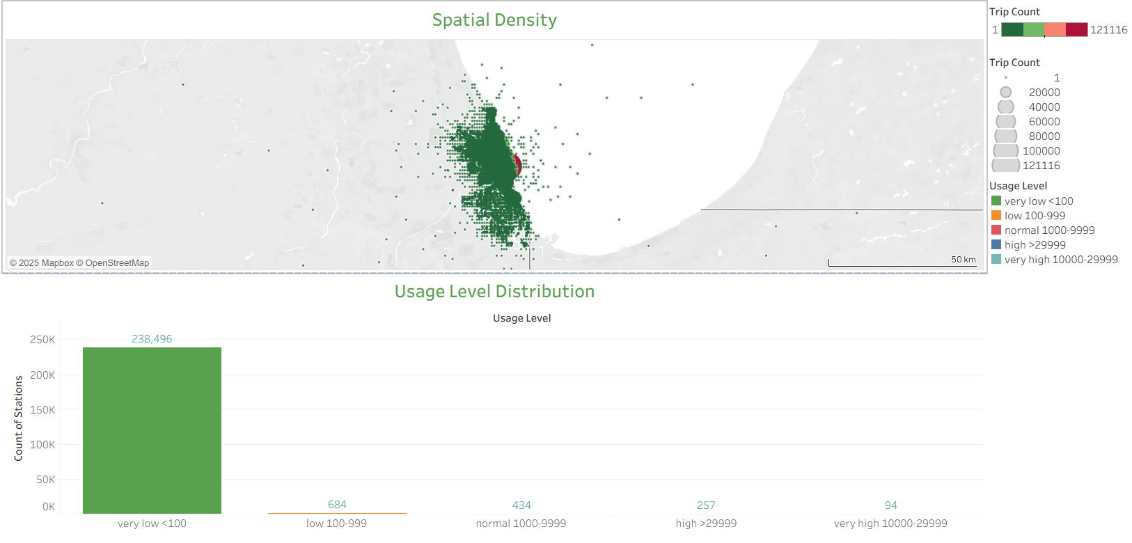
BIKE-SHARE
5. Share
Density & Distribution:

Slide 13
BIKE-SHARE
5. Share
Density & Distribution:
Spatial Density Map:
Density gradually increases as closer to the Michigan lake, generally concentrating in Chicago.
Usage Level Distribution:
From normal level onwards there are less than 500 stations.
Surprisingly, the lowest usage level includes almost 240,000 stations."

Slide 14
BIKE-SHARE
5. Share
Answer the questions:
1. What do customers like when using our services ?
- Customers love Lake Michigan and its scenery.
2. What are the difficulties in operating our service system ?
- There are many stations that have only 1 use per year. And more than 240k stations have less than 100 uses per year. There are even many cases where the vehicles are under Lake Michigan and the ocean.
3. How do annual members and casual riders use Cyclistic bikes differently ?
- The answer is clearly described in the previous slide (user behavior).
- In addition, the trip duration of the casual group is longer because they often ride on weekends as a sport and the frequency of their rides is less so they have a need to ride more. Maybe they are married or busy with work during the week.
- For the group of member customers, they may be students or young working people, so they often use services outside of office hours.

Slide 15
BIKE-SHARE
5. Share
Answer the questions:
4. Why would casual riders buy Cyclistic annual memberships ?
- Users seem to like lake Michigan.
- They have a need for exercise & want to optimize the costs.
- They want to get the best service & more benefits.
- They need to use Cyclistic vehicle to get to work, school or other locations.
5. How can Cyclistic use digital media to influence casual riders to become members ?
- First, use the insights from question 4 to develop advertising strategies that appeal to user psychology.
- Besides, Cyclistic can create promotional, incentive or reward programs for member for members to motivate the casual group to become members.
- Additionally, Cyclistic can create connection programs, community programs for only members.

Slide 16
BIKE-SHARE
6. Act
- Conclusion:
Expanding the market around lake Michigan.
Identify the stations that have only been used once in the past year, and also the stations that have not been used at all. Then cut down and combine many less popular stations to save costs, especially the stations that are too far from Lake Michigan.
In addition, it is necessary to coordinate vehicles reasonably at stations near the lake to avoid supply not meeting demand during rush hour.
Focus on improving service quality to attract member customers and compete with rivals.
Create membership packages for customers who ride more on weekends, or less on weekdays to optimize value and create customer habits.

