Slide 1
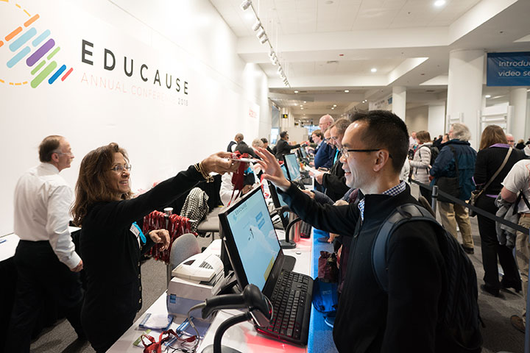
Exhibition 101

Slide 2




TheVista Exhibition
Organizer
Vender
VISITORS
Exhibitors

Slide 3
TheVista Exhibition
Organizer
Vender
VISITORS
Exhibitors

Slide 4




Smart Event
Need it

Slide 5
TheVista Exhibition
Exhibitors
Organizer
Exhibitors List
VIPS
Speakers
VISITORS

Slide 6
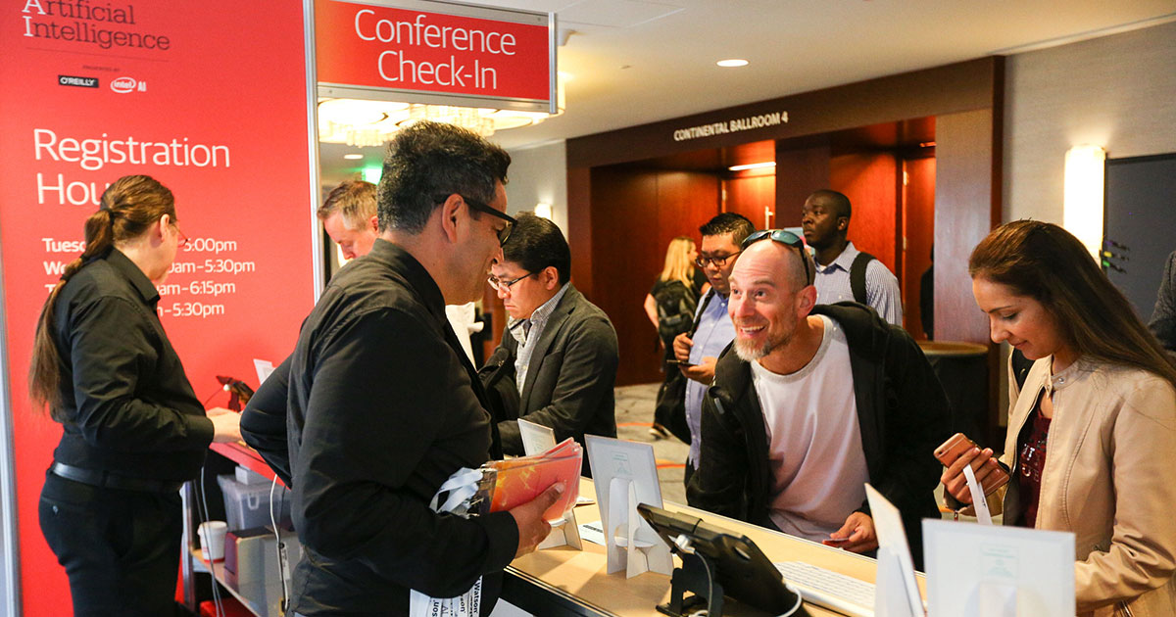
Before Exhibition Start
In Lab Next Week

Slide 7
TheVista Exhibition
Need Pre-reg
Organizer
Vender
Register
Report
Register
VISITORS

Slide 8

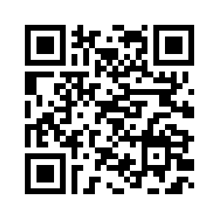
TheVista Exhibition
Walk-in
Local-server
VISITORS
Register
Pre-reg
Self-reg
Online-reg

Slide 9


TheVista Exhibition
Print & Go
A5
VISITORS
Register
Pre-reg
Self-reg
VIPS
Invitation card
Speakers
NAME
Online-reg

Slide 10
TheVista Exhibition
Sales Team
CPHI
MS. Nongnaphat Jeerakitlert
MS. Thansaya Patcharathanatcha
MRS. Nureen Chantarawirod
MRS. Naruechon Boonpaiboon

Slide 11
TheVista Exhibition
Event Team
CPHI
MS. Suchawadee Lavanamal
MR.Aliridor Wichiennoi

