Slide 1

The History of CARE Nigeria
From a global movement born in 1945 to a country office
serving millions across Nigeria
Extracted from carenigeria.org | October 2026
care

Slide 2
What This Presentation Covers
A journey through CARE's story — globally and in Nigeria
01
Who We Are & Our Values
Mission, vision, focus and guiding principles
02
Global Origins
Born in 1945 from the CARE Package®
03
History of CARE in Nigeria
From cross-border work to a country office in 2017
04
Growth & Expansion
From 2 states to 14 states across Nigeria
05
Where CARE Works in Nigeria
The national presence map
06
What We Do & Our Impact
Focus areas, results and numbers
07
The Global CARE Journey
Eight decades of humanitarian action
08
Governance & In This Section
Advisory Committee, Community of CARE and more
CARE

Slide 3
Who We Are
CARE is a global leader within a worldwide movement dedicated to ending poverty — known everywhere for its unshakeable commitment to the dignity of people. CARE works around the globe to save lives, defeat poverty, and achieve social justice.
OUR MISSION
CARE works around the globe to save lives, defeat poverty, and achieve social justice.
OUR FOCUS
We put women and girls in the center because we cannot overcome poverty until all people have equal rights and opportunities.
OUR VISION
A world of hope, inclusion and social justice where poverty has been overcome.
CARE Nigeria is one of the many country offices of CARE. CARE is an acronym for Cooperative for Assistance and Relief Everywhere, and is a leading humanitarian organization fighting global poverty — founded in 1945 with the creation of the CARE Package®.
Source: carenigeria.org/mission-and-vision
CARE

Slide 4
Our Values
Five enduring principles that guide everything CARE does
Transformation
Integrity
Diversity
Excellence
Equality
Urgent action, innovation, and the necessity of transformation — within the world and our own organization.
Accountable to the people and partners we humbly serve, transparently sharing our results, stories, and lessons.
Embracing differences, including a variety of voices, and joining together to solve complex problems.
Challenging ourselves to the highest level of learning and performance, tapping the best of the human spirit.
The equal value of every human being; respecting and honoring each individual — change happens through people.
We believe in the equal value of every human being — and we know that change happens through people.
CARE

Slide 5
Global Origins: Born in 1945
In 1945, CARE — then the Cooperative for American Remittances to Europe — took possession of 2.8 million “10-in-1” military food rations known as the CARE Package®. That same year, CARE delivered its first CARE Packages to Le Havre, France, and by the end of the year had operations in 10 European nations.
1945 — the year CARE and the famous CARE Package® were born, out of World War II relief efforts. The package soon expanded to soap, textiles, toys, seed programs and self-help agricultural projects.
WHAT THE NAME MEANS
Founded as the Cooperative for American Remittances to Europe. As the mission grew worldwide, in 1992 the name became Cooperative for Assistance and Relief Everywhere — and the “E” became “Everywhere.”
CARE TODAY (2024)
CARE works in over 118 countries, reaching more than 53 million people through 1,450 projects — with CARE Nigeria among its country offices.
Over 78 years
of fighting global poverty — now in 109 countries, reaching 167 million people worldwide.
CARE

Slide 6
History of CARE in Nigeria
The story of CARE started in Nigeria long before the establishment of a Country Office. In 2001/2002, the Regional Office for West Africa started implementing cross-border programming in Nigeria.
27 APRIL 2017 — OFFICIAL REGISTRATION
As a result of the protracted humanitarian crisis in the northeast, CARE was officially registered in Nigeria with the Corporate Affairs Commission (CAC), and signed a Memorandum of Understanding (MOU) with the Government of Nigeria.
FIRST PROGRAMS
Program implementation focused specifically on Borno and Yobe States, with Reproductive Health and Food Security Projects — driven by the humanitarian crisis in the northeast.
FIRST DONORS
Our first donors were CARE USA, CARE Canada, and the World Food Programme (WFP). Our focus areas are selected for relevancy and responsiveness.
BEYOND EMERGENCY RESPONSE
CARE supports longer-term efforts that strengthen resilience, improve social service systems, and influence federal and state policies.
Since 2017, we have reached over 3.1 million people with lifesaving humanitarian assistance in Food and Nutrition, WASH, Protection, Violence Against Women and Girls, and Sexual and Reproductive Health and Rights.
CARE

Slide 7
History of CARE in Nigeria — Growth & Impact
From Borno and Yobe, the first two states where CARE started its implementation in Nigeria, we extended our presence to Kebbi, Nasarawa, Jigawa, Bauchi, Adamawa, Kogi, Niger, and, most recently, to Oyo, Lagos, Kano, Enugu, Sokoto, and Katsina as of 2024.
CARE works in Nigeria, contributing to
saving lives, fighting poverty, and promoting social justice.
ASSISTANCE DELIVERED IN:
3.1M people reached
directly with lifesaving humanitarian assistance since 2017
▪ Food and Nutrition
▪ Water, Sanitation, and Hygiene (WASH)
▪ Protection
▪ Violence Against Women and Girls
▪ Sexual and Reproductive Health and Rights
Source: carenigeria.org/history
CARE

Slide 8
CARE Comes to Nigeria: The Timeline
The story of CARE in Nigeria began long before the country office existed
2001 / 2002
Cross-Border Beginnings
The CARE Regional Office for West Africa started implementing cross-border programming in Nigeria.
2017
First Programs
Borno and Yobe States — Reproductive Health and Food Security projects. First donors: CARE USA, CARE Canada, WFP.
1
2
3
4
27 April 2017
Official Registration
CARE was registered with the Corporate Affairs Commission (CAC) and signed an MOU with the Government of Nigeria.
2024
National Reach
Presence extended to 14 states — from the northeast to Oyo, Lagos, Kano, Enugu, Sokoto and Katsina.
CARE began work in Nigeria in 2017 in response to the protracted humanitarian crisis in the northeast of the country.
CARE

Slide 9
Expansion Across Nigeria
From two states in 2017 to fourteen states in 2024
WHERE IT STARTED (2017)
NEXT PHASE OF GROWTH
MOST RECENT — AS OF 2024
▪
Borno State
▪
Kebbi
▪
Oyo
▪
Yobe State
▪
Nasarawa
▪
Lagos
▪
Jigawa
▪
Kano
▪
Bauchi
▪
Enugu
▪
Adamawa
▪
Sokoto
▪
Kogi
▪
Katsina
▪
Niger
14 states and counting.
In 2024, CARE works in over 118 countries and reaches more than 53 million people through 1,450 projects. In Nigeria, since 2017, CARE has reached more than 3,126,834 people across 14 states.
CARE supports longer-term efforts that strengthen resilience, improve social service systems, and influence federal and state policies.
CARE

Slide 10
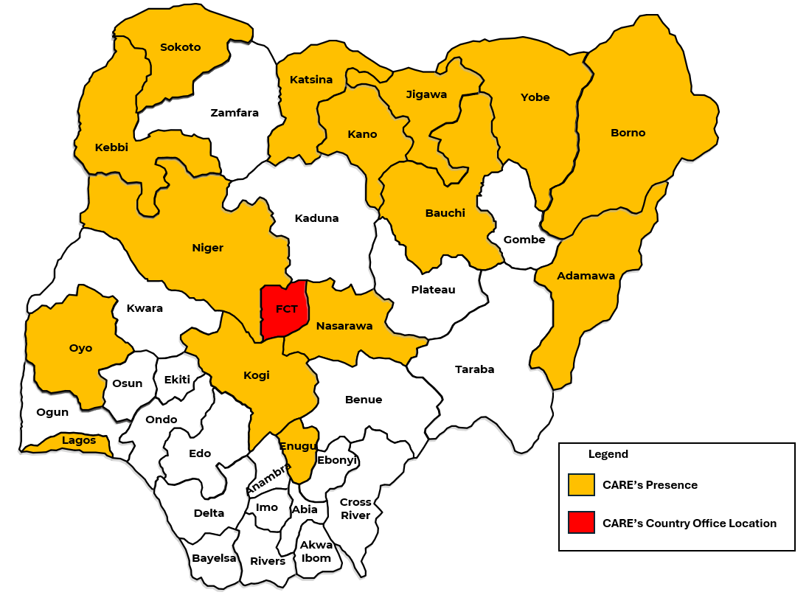
Where CARE Works in Nigeria
CARE's presence across Nigeria — 14 states and the Country Office in the FCT
IN NIGERIA, SINCE 2017
CARE has reached more than 3,126,834 people across 14 states.
GLOBALLY, IN 2024
CARE works in over 118 countries and reaches more than 53 million people through 1,450 projects.
LEGEND
🟨 Yellow — CARE's Presence
🟥 Red (FCT) — CARE's Country Office
Map: CARE Nigeria's Presence — carenigeria.org/history
CARE

Slide 11
What CARE Nigeria Does
In line with CARE's localization agenda, CARE Nigeria is working with local women-led organizations to build capacities. Our work in Nigeria focuses on:
Humanitarian Preparedness & Response
Food Systems & Livelihoods
Justice for Women and Girls
Right to Health & Nutrition
Saving lives and supporting communities affected by conflict, displacement and crisis.
Strengthening food security and household livelihoods so families can recover and thrive.
Advancing gender equality, preventing violence against women and girls, supporting survivors.
Reproductive health, rights, and nutrition programs that keep families healthy.
Since 2017, these priorities have reached over 3.1 million people with lifesaving assistance. CARE Nigeria piloted the Community of CARE and launched a national Advisory Committee to strengthen the quality, scale and impact of its programs.
CARE

Slide 12
Our Impact
CARE works in Nigeria, contributing to saving lives, fighting poverty, and promoting social justice.
14 STATES
3.1M
PEOPLE REACHED
DIRECTLY
in Nigeria since 2017
67
PROJECTS
implemented across Nigeria
▪ 3,126,834 people reached since 2017
▪ Saving lives • fighting poverty • social justice
▪ Strengthening resilience and social service systems
▪ Influencing federal and state policies
Globally, CARE works in over 118 countries, reaching more than 53 million people through 1,450 projects — and has worked to alleviate poverty for over 64 million people since its 60th anniversary in 2016.
CARE

Slide 13
Governance & Community
Strengthening quality, scale and impact in service to communities
THE ADVISORY COMMITTEE
CARE Nigeria launched our Advisory Committee — a pool of national experts and supporters with the key mandate to advise CARE Nigeria and its partners on matters that will strengthen and enhance the quality, scale, and impact of our development and humanitarian programs, in service to communities and families that are disproportionately impacted by extreme poverty and social injustice.
COMMUNITY OF CARE
We are piloting the Community of CARE, where its members shall contribute and share their expert knowledge and understanding of the Nigerian development and humanitarian sectors, policy environment, and funding landscape.
Localization in action
In line with CARE's localization agenda, CARE Nigeria is working with local women-led organizations to build capacities — ensuring Nigerian leadership drives the fight against poverty and social injustice.
CARE

Slide 14
The Global CARE Journey (1945 – 1975)
1945 – 1955
1956 – 1965
1966 – 1975
The Beginning: War and Recovery
New Frontiers
Leading Global Development
CARE delivered its first CARE Packages to Le Havre, France, and by the end of the year had operations in 10 European nations. The CARE Package expanded to soap, textiles, toys, seed programs, and self-help agricultural projects. In 1950, CARE joined famine relief in Yugoslavia, Pakistan, and India, and began Korean War relief.
With Europe recovering, CARE became increasingly involved in Asia and Latin America. In 1952, CARE opened its first mission in Mexico — and the “E” in CARE became “Everywhere.” CARE reached Africa (Liberia and Sierra Leone) and delivered the 50 millionth CARE Package in Colombia in 1963.
CARE transitioned to a development organization — family planning in Egypt, education programs, and war relief in Vietnam and Nigeria-Biafra. In 1967, CARE Europe formed, and the 100 millionth CARE Package was sold.
CARE

Slide 15
The Global CARE Journey (1976 – 2005)
1976 – 1985
1986 – 1995
1996 – 2005
New Programs: Local Leadership
The Birth of a New CARE
The New Millennium
CARE trained national staff to take over local operations. CARE International was established in 1982. Women's development programs expanded internationally. In 1983, CARE expanded rapidly in Africa, and in 1985 responded as the worst famine in a century gripped the continent.
In 1992, CARE moved its headquarters from New York to Atlanta and changed its name to “Cooperative for Assistance and Relief Everywhere.” In 1993, CARE committed to focusing on women and girls as key agents of change. In 1995, CARE celebrated its first 50 years.
Empowerment, equity, sustainability and advocacy: CARE tackled poverty's root causes and strengthened civil society through terrorism, war and the HIV/AIDS pandemic. By 2005: basic and girls' education, emergency response, HIV/AIDS, water and sanitation.
CARE

Slide 16
The Global CARE Journey (2006 – Present)
2006 – 2015
Women and Girls at the Center
CARE placed women and girls at the center while working alongside men and boys — Pathways to Empowerment and signature programs in maternal health, education, leadership and economic opportunity. CARE became a leading responder to food crises and droughts across the globe.
2016 – Present
Scaling the Future
CARE, an international NGO, has been working to alleviate poverty in over 64 million people since its 60th anniversary in 2016. New tools track impact globally, aligning with the Sustainable Development Goals. This is the era in which CARE Nigeria was born and grew.
CARE's understanding of poverty has grown over decades of experience — helping us to address poverty's root causes. Today, CARE and partners work in 109 countries, reaching 167 million people around the world through poverty-fighting development and humanitarian aid programs.
CARE Nigeria: born from this global journey — cross-border programming in 2001 to 14 states in 2024.
CARE

Slide 17
In This Section
Explore more about CARE Nigeria at carenigeria.org
History
Partners
The full story of CARE in Nigeria and CARE's global journey across eight decades.
The donors and partners who make CARE Nigeria's work possible — including CARE USA, CARE Canada and WFP.
🔗 carenigeria.org/history
🔗 carenigeria.org/partners
Team
Vision
Meet the team leading CARE Nigeria's development and humanitarian programs.
CARE's mission, vision, focus and values — a world of hope, inclusion and social justice.
🔗 carenigeria.org/team
🔗 carenigeria.org/mission-and-vision
CARE

Slide 18
“A world of hope, inclusion,
and social justice.”
Where poverty has been overcome and all people live with dignity and security.
Sources: carenigeria.org — Mission & Vision and History
care

