Slide 1

MÔ HÌNH QUẢN LÝ BÃI XE
Group :
Phạm Văn Trọng Nhân
Nguyễn Lê Như Quỳnh
Phạm Hồng Sáng
Trương Khánh Tường

Slide 2
Table of Content
I. Introduce problem (Giới thiệu bài toán)
Description (Mô tả bài toán)
Management Objectives (Mục tiêu quản lý)
II. Describe Enity (Mô tả thực thể)
Entity-attribute identification (Xác định thực thể - thuộc tính)
Entity-contact modeling (Lập mô hình thực thể- liên hệ)
III. Related Schema - Related Model (Lược đồ quan hệ - Mô hình quan hệ)
Convert the ER model to a relational schema (Chuyển mô hình ER sang lược đồ quan hệ)
Standardize the schema (Chuẩn hóa lược dồ)
Relational model (Mô hình quan hệ)

Slide 3
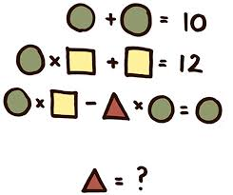
Description (Mô tả bài toán)

Slide 4

Management Objectives (Mục tiêu quản lý)
Managing employees' working days and hours.
Manage the registration time, expiry date, code of vehicle card, license plate and customer code
Manage personal information, codes, positions and salaries of employees.
Manage the access time history of each card
Manage ID, name, date of birth and gender of customers in the database
Manage the license plate, color,vehicle model and its owner in the database.

Slide 5
Entity-attribute identification (Xác định thực thể - thuộc tính)
OperationRoom: TimesIn, TimesOut, Employess ID.
Card: CardID, TimesRegisttration, TimesExpired, license plates, CusID.
Employees: ID, Gender, PhoneNumber,Position , Salary, Fullname, Address,Level.
Customers: CusID, Gender, Fullname, Birthday
Vehicle: mode, Color, OwnerID,ID
History: TimesIn, TimesOut, CardID.

Slide 6
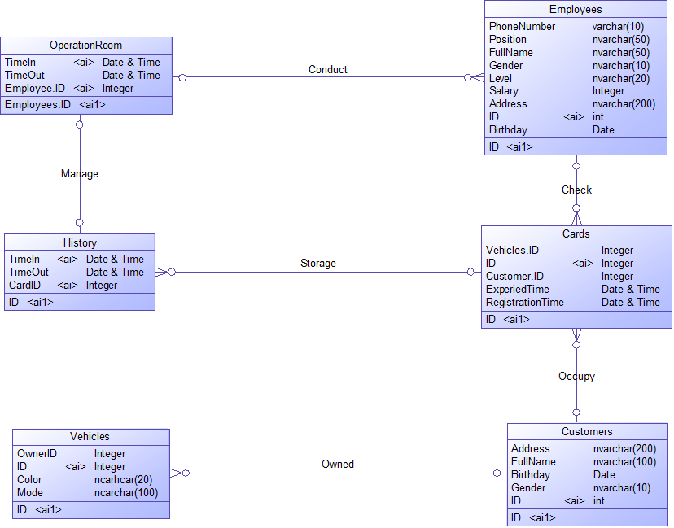
Entity-contact modeling (Lập mô hình thực thể- liên hệ)

Slide 7
Convert the ER model to a relational schema (Chuyển mô hình ER sang lược đồ quan hệ)
Relational schema | Key | Foreign Key | Function dependencies
OperationRoom | Startime, EmployeeID | EmployeeID | Startime, EmployeeID->EndTime EndTime, EmployeeID->Startime
Employees | EmployeeID | X | EmployeeID-> FullName, Address, Level, Position, Gender, Brthday, Salary
Card | CardID | CustomerID, VehicleID | CardID-> CustomerID, VehicleID, RegistrantionTime, ExpiredTime, LicensePlates, PhoneNumber VehicleID->CardID
Customer | CustomerID | X | CustomerID-> Fullname, Birthday, Gender
Vehicle | VehicleID | CustomerID | VehicleID-> CustomerID, Mode, Color
History | CardID, TimeIn | CardID | CardID, TimeIn-> TimeOut CardID, TimeOut-> TimeIn

Slide 8
Standardize the schema (Chuẩn hóa lược đồ)
Function Dependency | Main courses | Relational schema | 3NF
Startime, EmployeeID->EndTime EndTime, EmployeeID->Startime | StartTime, EmployeesID | OperationRoom: StartTime, EndTime, EmployeesID.
CardID-> CustomerID, VehicleID, RegistrantionTime, ExpiredTime, PhoneNumber. VehicleID->CardID | CardID | Card: CardID, CustomerID, VehicleID, RegisttrationTimes, ExpiredTimes.
EmployeeID-> FullName, Address, Level, Position, Gender, Brthday, Salary | EmployeesID | Employees: EmployeesID, FullName, Address, PhoneNumber, Level, Position, Gender, Birthday, Salary
CustomerID-> Fullname, Birthday, Gender | CustomersID | Customers: CustomersID, Gender, Address, Fullname, Birthday
VehicleID-> CustomerID, Mode, Color | VehicleID | Vehicle: VehicleID, CustomerID, Mode, Color.
CardID, TimeIn-> TimeOut CardID, TimeOut-> TimeIn | TimesIn, CardID | History: TimesIn, TimesOut, CardID.

Slide 9
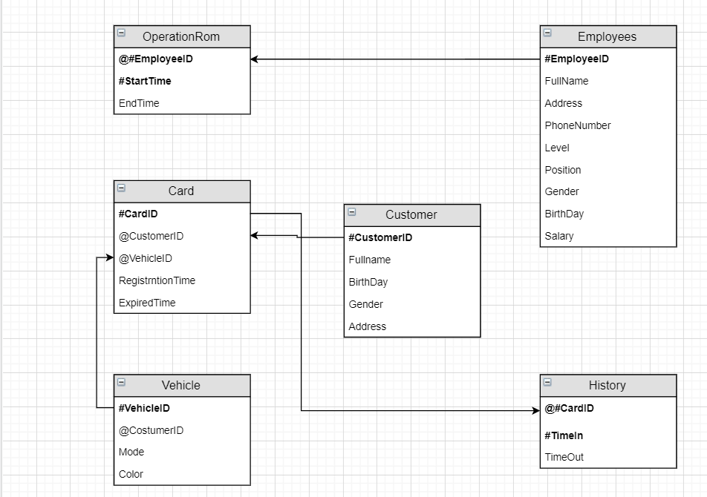
Relational model (Mô hình quan hệ)

Slide 10
Table identifier (Định danh bảng)

