Slide 1
Voice Based Age and Gender Detection using Long Short - Term Memory
Student Research Competition in FPT University
Year 2024
Nguyen Minh Nhut, Nguyen Thanh Trung, Nguyen Huu Tan,
Luong Dang Doanh, and Duc Ngoc Minh Dang
FPT University, Ho Chi Minh Campus, Vietnam

Slide 2
Introduction
In recent times, there have been notable advancements in the field of voice-based recognition systems, specifically in the areas of distinguishing gender and age.
This project explores using Long Short-Term Memory (LSTM) networks to predict age and gender from voice recordings.
Student Research Competition in FPT University

Slide 3
Long Short-Term Memory (LSTM)
Long Short – Term Memory (LSTM) is a type of Recurrent Neural Network (RNN) that can process and analyze sequential data.
They use a memory cell and gates to control the flow of information, allowing them to selectively retain or discard information as needed and thus avoid the vanishing gradient problem that plagues traditional RNNs.
LSTMs are widely used in various applications such as natural language processing, speech recognition, and time series forecasting.
Recurrent Neural Network
Long Short – Term Memory

Slide 4
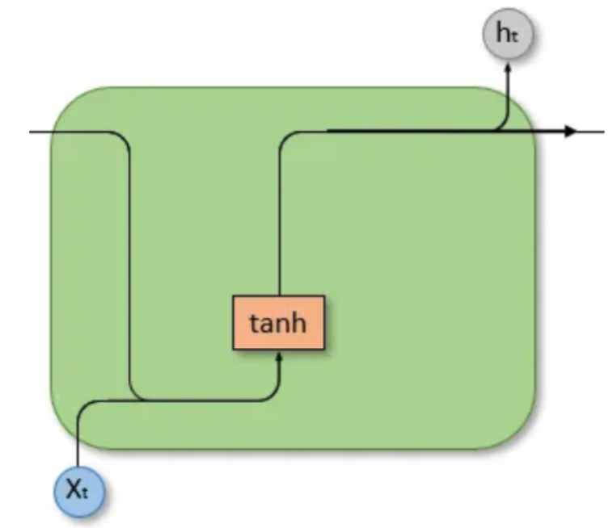
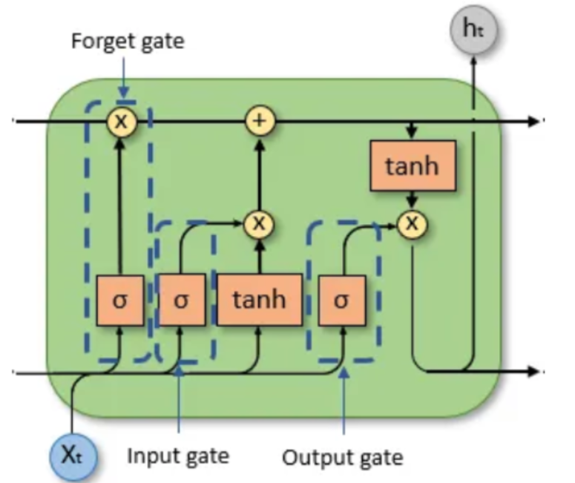
Long Short-Term Memory (LSTM)
Age classification model
Age Output
Extract Feature
Input Data
Recurrent Neural Network
Long Short – Term Memory
Gender Output
Gender classification model

Slide 5
Architecture of Voice-based Age and Gender Recognition
01
04
02
Age classification model
Age Output
05
Input Data
Extract Feature
03
Gender classification model
Gender Output
06

Slide 6
Feature Extraction
01
04
Shifted delta coefficients
Mel-Frequency Cepstral Coefficients
02
Delta Mel-Frequency Cepstral Coefficients
05
Pitch estimate
03
Delta Delta
Mel-Frequency Cepstral Coefficients
06
Magnitude estimate

Slide 7
Age Dataset
Group 1
53% | 20 - 29
16% | No information
10% | 40 - 49
8% | 30 - 39
7% | 0 - 19
4% | 50 -59
1% | 60 -69
Group 2
Group 3
Group 4
Group 5
Group 6
Group 7

Slide 8
Gender Dataset
Group 1
44% | Male
38% | Female
18% | No information
Group 2
Group 3

Slide 9
Proposed Gender Classification Model
Long Short- Term Memory layer
Fully connected layer
LSTM (256 nodes)
FCN (128 nodes)
Dropout layer (0.3)
Activation = ReLU
Dropout layer (0.3)
Batch Normalization

Slide 10
Proposed Gender Classification Model
Input Feature
LSTM (256 nodes)
Normalisation
Dropout layer (0.3)
LSTM (256 nodes)
Dropout layer (0.3)
FCN (128 nodes)
FCN (64 nodes)
Activation = ReLU
Activation = ReLU
Dropout layer (0.3)
Dropout layer (0.3)
Batch Normalization
Batch Normalization
FCN (2 nodes)
Activation = Softmax
Output

Slide 11
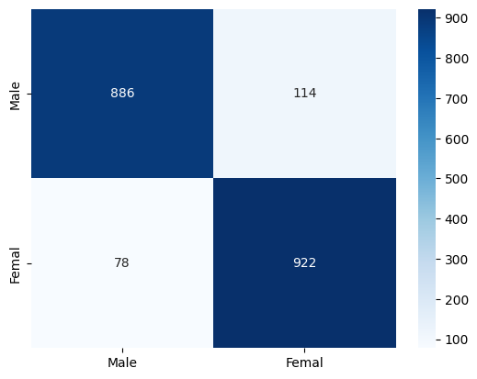
Experience Result of Gender Model
Confusion Matrix of
Gender Classification Prediction

Slide 12
Experience Result of Gender Model
 | Precision | Recall | F1 - scored | Support
Male | 0.91909 | 0.88600 | 0.90224 | 1000
Female | 0.88996 | 0.92200 | 0.90570 | 1000
Accuracy |  |  | 0.90400 | 2000
Macro average | 0.90452 | 0.90400 | 0.90397 | 2000
Weighted average | 0.90452 | 0.90400 | 0.90397 | 2000
The overall accuracy of Gender Classification Prediction

Slide 13
Proposed Age Classification Model
Long Short- Term Memory layer
Fully connected layer
LSTM (256 nodes)
FCN (128 nodes)
Dropout layer (0.3)
Activation = ReLU
Dropout layer (0.3)
Batch Normalization

Slide 14
Proposed Age Classification Model
FCN (128 nodes)
FCN (2 nodes)
Activation = ReLU
Activation = Softmax
Input Feature
Dropout layer (0.3)
Normalisation
Output
Batch Normalization
LSTM (256 nodes)
FCN (64 nodes)
Dropout layer (0.3)
Activation = ReLU
LSTM (256 nodes)
Dropout layer (0.3)
Dropout layer (0.3)
Batch Normalization
FCN (256 nodes)
FCN (128 nodes)
Activation = ReLU
Activation = ReLU
Dropout layer (0.3)
Dropout layer (0.3)
Batch Normalization
Batch Normalization

Slide 15
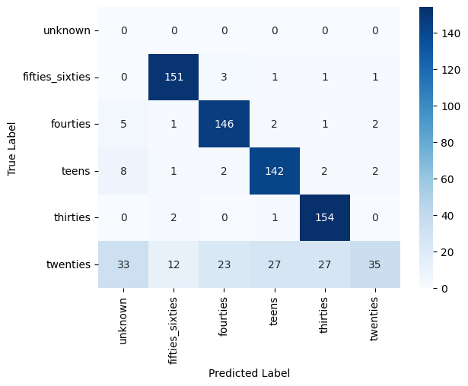
Experience Result of Age Model
Confusion Matrix of
Age Classification Prediction

Slide 16
Experience Result of Age Model
 | Precision | Recall | F1 - scored | Support
Fifties – Sixties | 0.90417 | 0.96178 | 0.93210 | 157
Forties | 0.83908 | 0.92994 | 0.88218 | 157
Teens | 0.82081 | 0.90446 | 0.86061 | 157
Thirsties | 0.83243 | 0.98089 | 0.90058 | 157
Twienties | 0.87500 | 0.22293 | 0.35533 | 157
Accuracy |  |  | 0.80000 | 785
Macro average | 0.71192 | 0.66667 | 0.65513 | 785
Weighted average | 0.85430 | 0.80000 | 0.78616 | 785
The overall accuracy of Age Classification Prediction

Slide 17
The future application and importance of the project
Security
Entertainment
Service
Age restrictions on accessing applications.
AI voice acting.
Voice imitation application.
Automatically route calls.
Product suggestions for users.

Slide 18
Conclusion
The Voice Recognition System shows promise in gender and age identification tasks, with notable success in age prediction despite struggles with accents. Further enhancements could overcome these limitations, making it valuable for diverse applications relying on voice-based age prediction.
Student Research Competition in FPT University

Slide 19
Voice Based Age and Gender Detection using Long Short - Term Memory
Student Research Competition in FPT University
Year 2024
Thank you for listening
Nguyen Minh Nhut, Nguyen Thanh Trung, Nguyen Huu Tan,
Luong Dang Doanh, and Duc Ngoc Minh Dang
FPT University, Ho Chi Minh Campus, Vietnam

